Slide 1
CREATIVE AND PERFORMING ARTS
Year 9 and 10
Menai High School

Slide 2
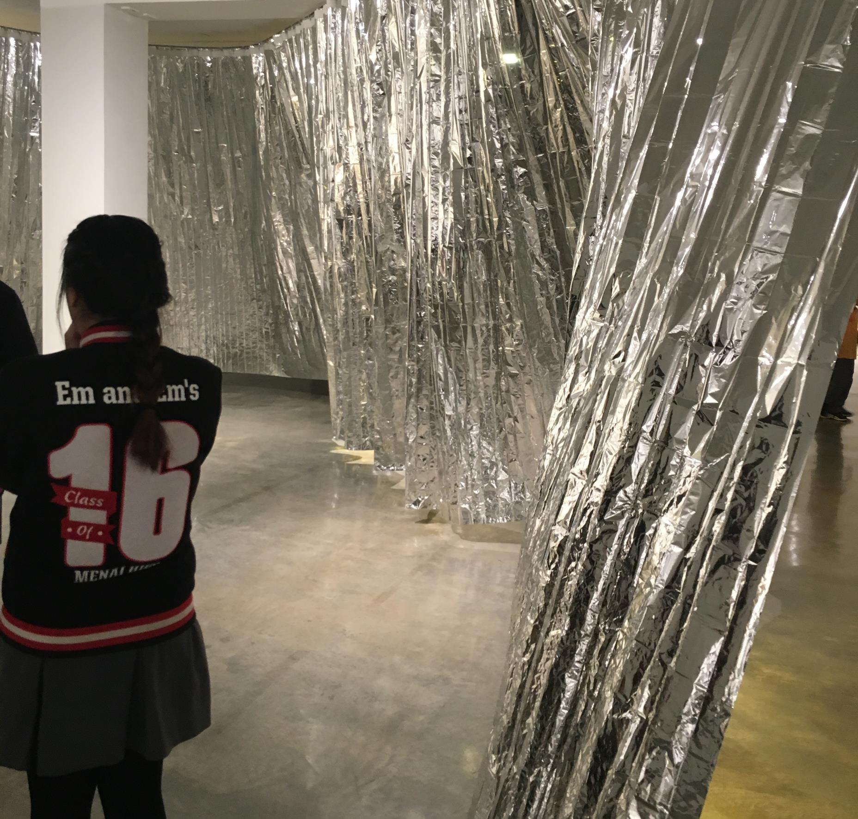
Year 9-10 electives offer an opportunity challenge yourself to;
try something new
develop new skills
explore new learning experiences
pursue your passions

Slide 3
DO THE SUBJECTS YOU LIKE AND ARE GOOD AT
DON’T DO A SUBJECT BECAUSE YOUR FRIENDS ARE DOING IT or
SOMEONE ELSE SAYS YOU SHOULD DO IT

Slide 4
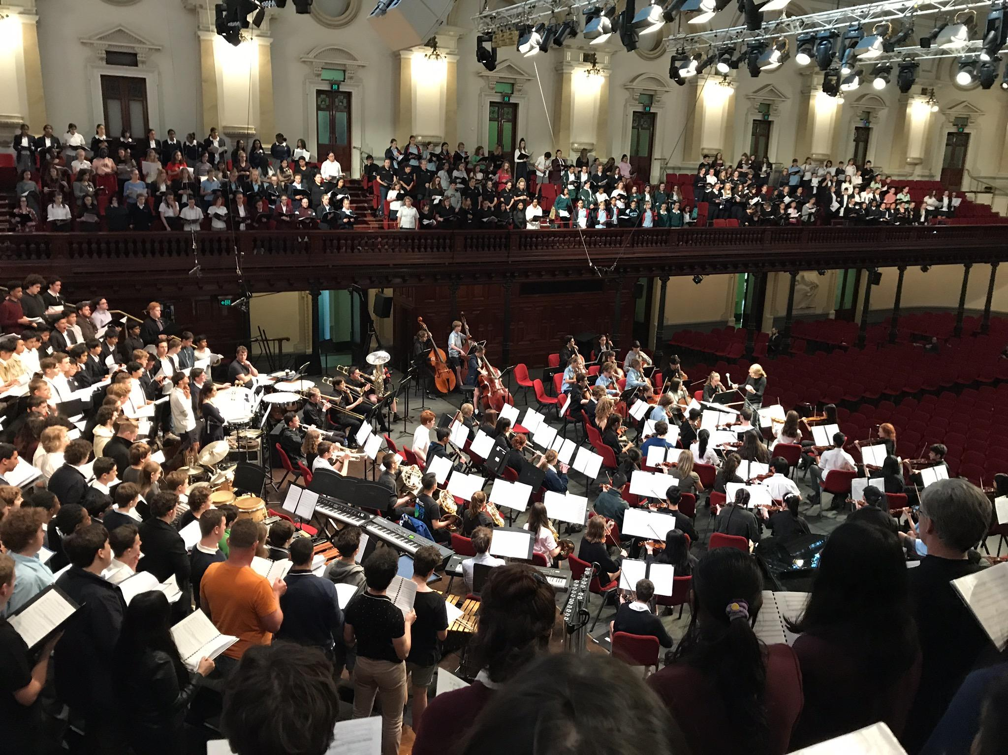
Dance
Drama
Music
Visual Arts
Visual Design
Photography, Video & Digital Media

Slide 5
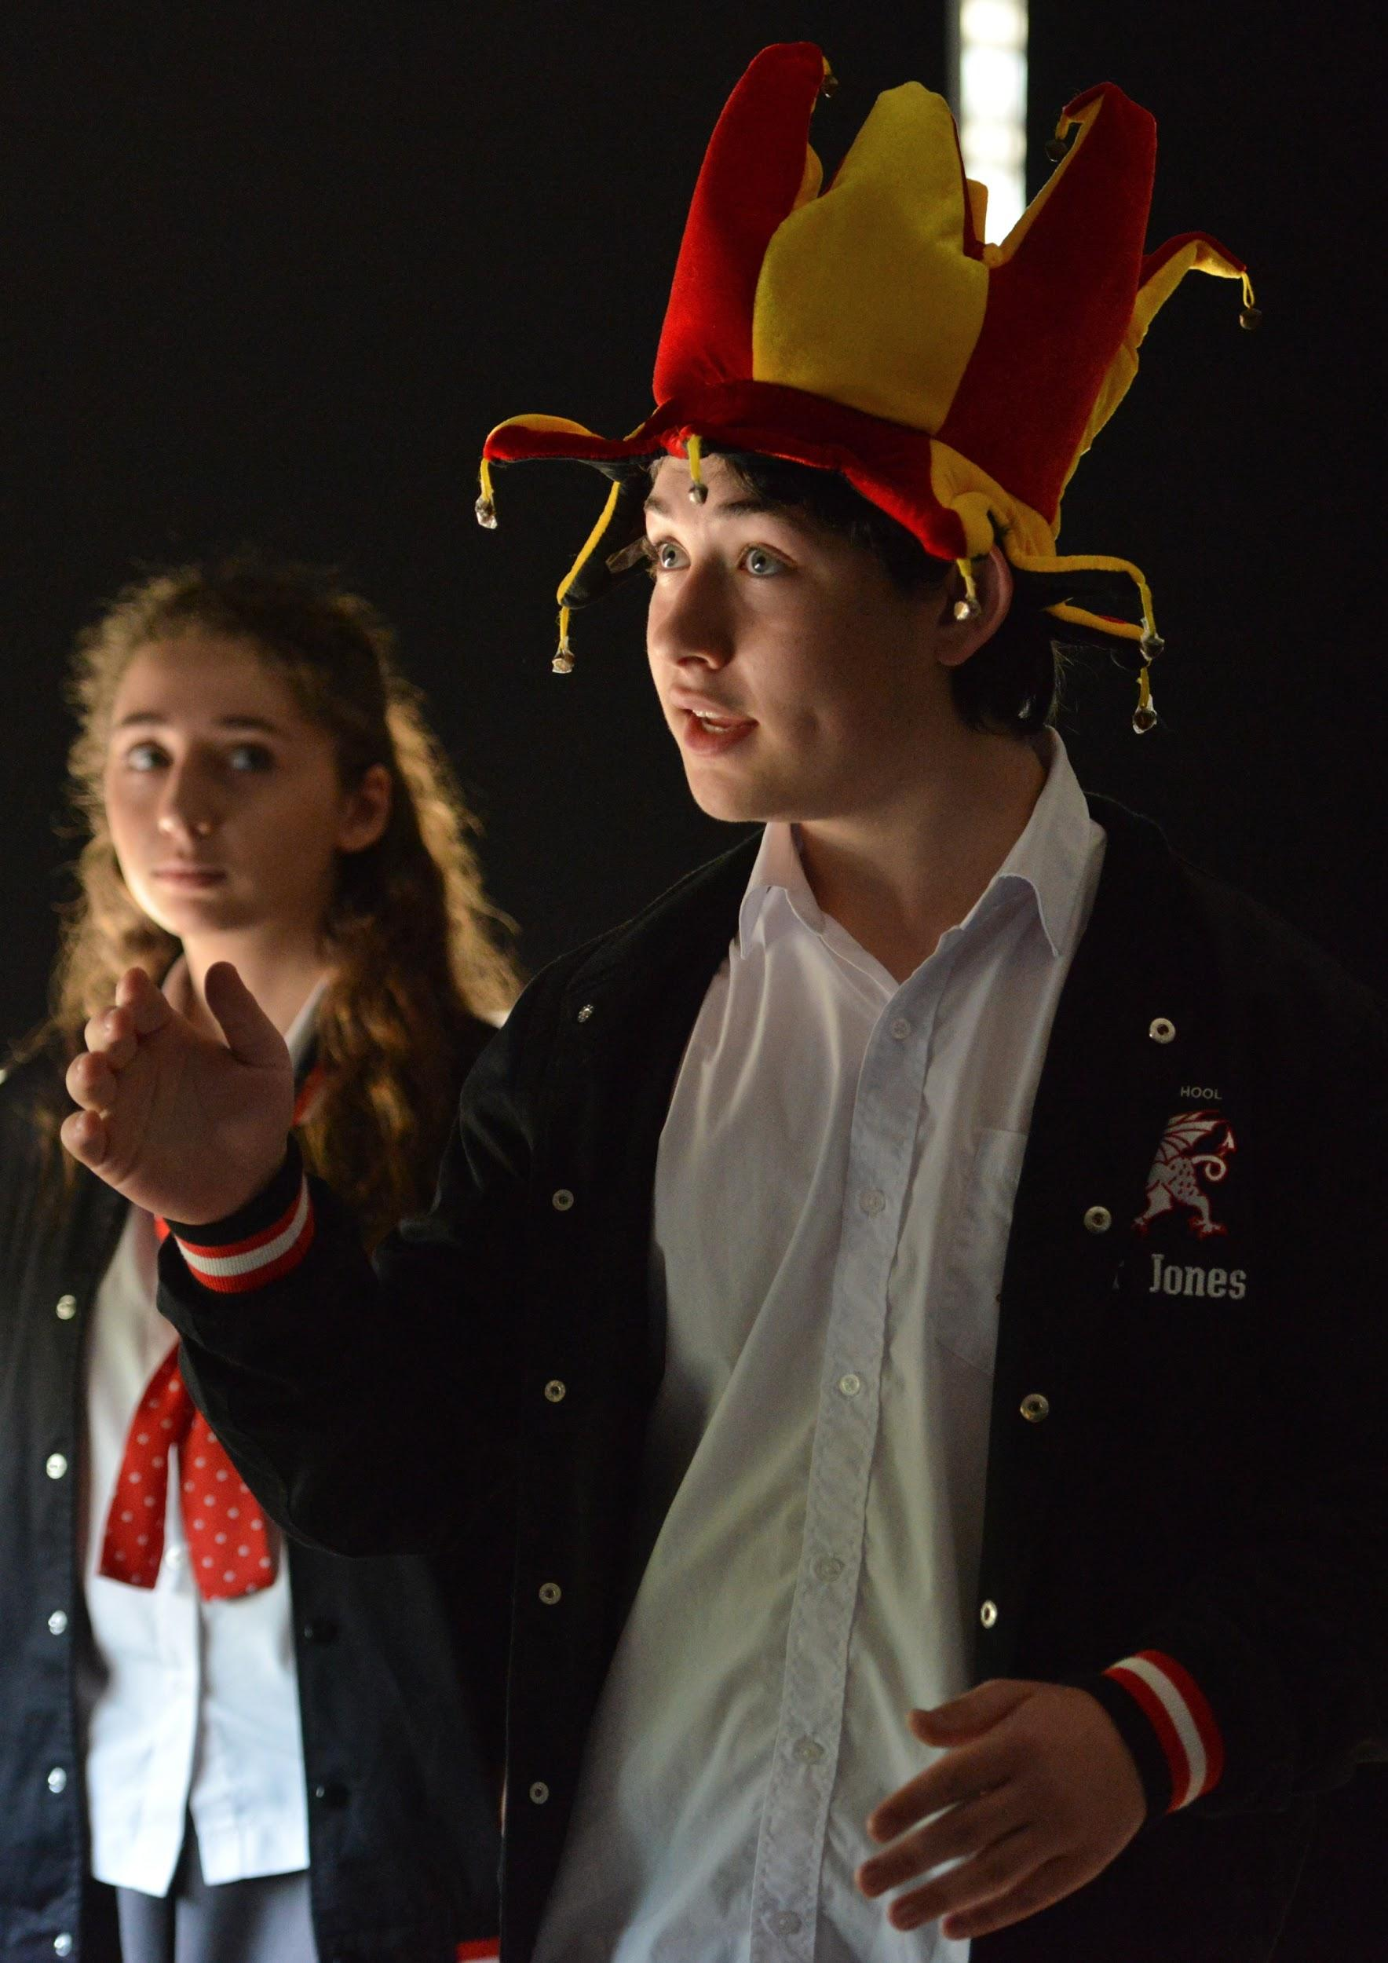
MYTHS
Not Academic
Not Vocational
Highly Specialised
Requires Natural Talent

Slide 6
Academic
Learning through the arts reinforces critical academic skills in reading, language and maths, and provides students with the skills to creatively solve problems.

Slide 7
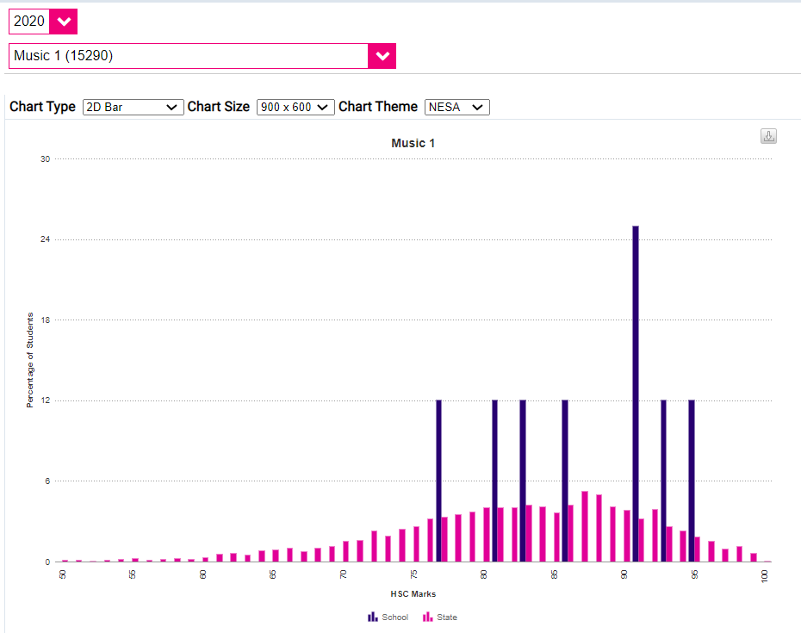
MUSIC
HSC Results
Menai is BLUE
The rest of the state is PINK

Slide 8
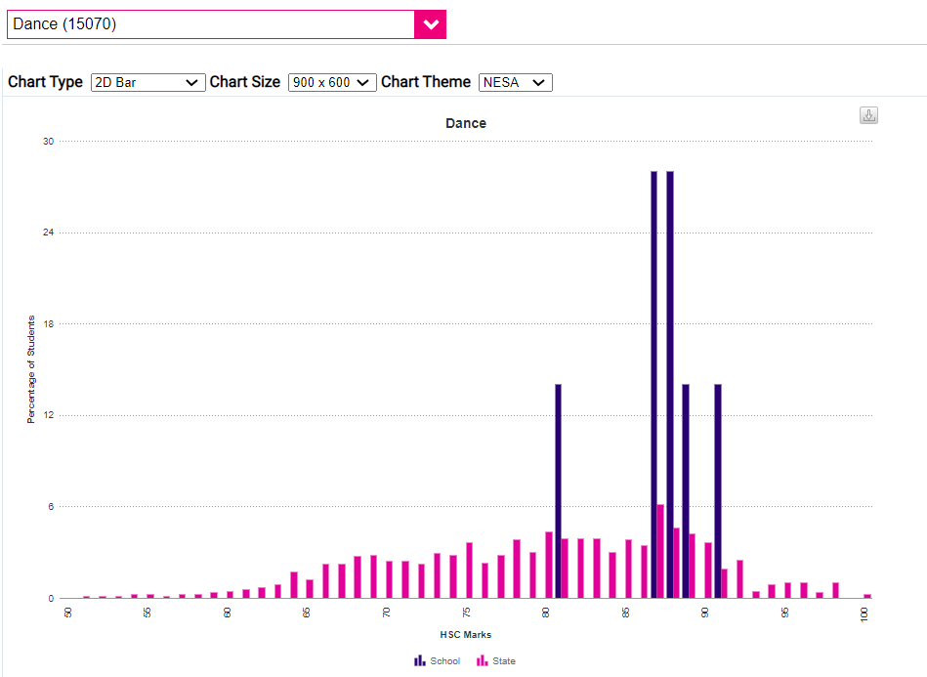
DANCE
HSC Results
Menai is BLUE
The rest of the state is PINK

Slide 9
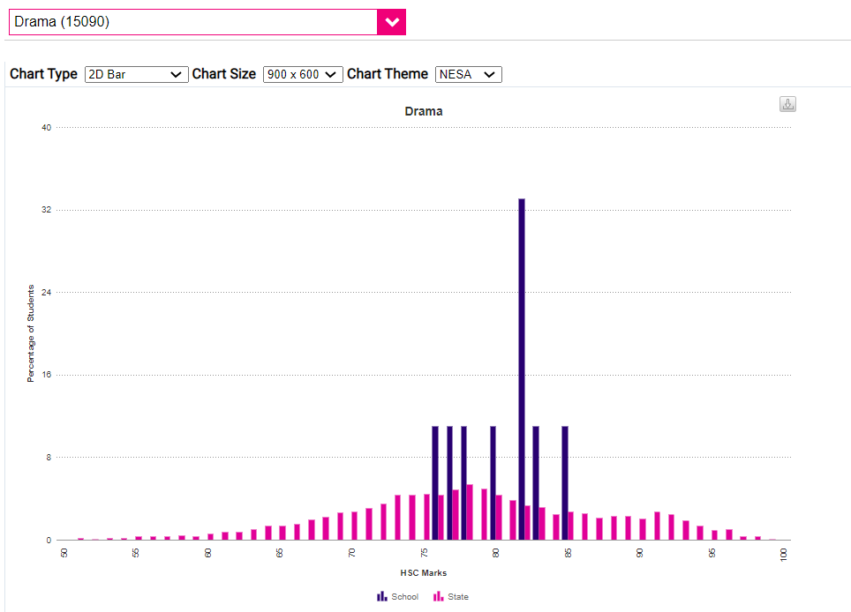
DRAMA
HSC Results
Menai is BLUE
The rest of the state is PINK

Slide 10
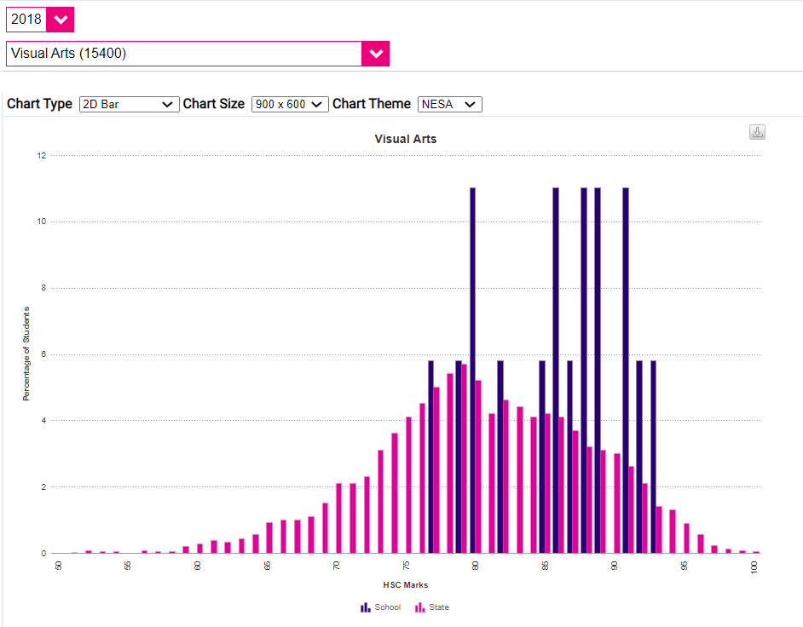
VISUAL ARTS
HSC Results
Menai is BLUE
The rest of the state is PINK

Slide 11
Vocational
it’s not a “hobby” - it’s and INDUSTRY

Slide 12
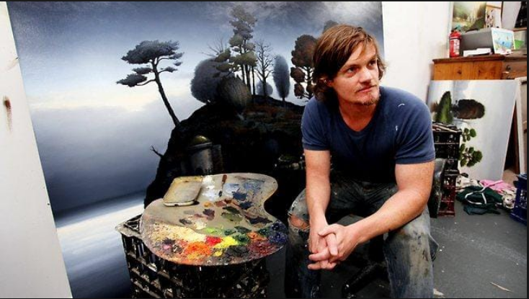
Alexander Mackenzie - Contemporary Australian Artist

Slide 13
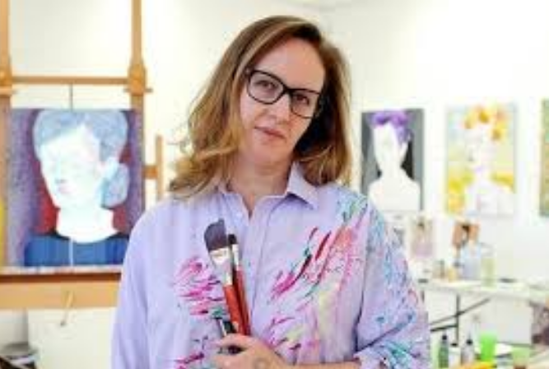
Del Kathryn Barton - Contemporary Australian Artist

Slide 14
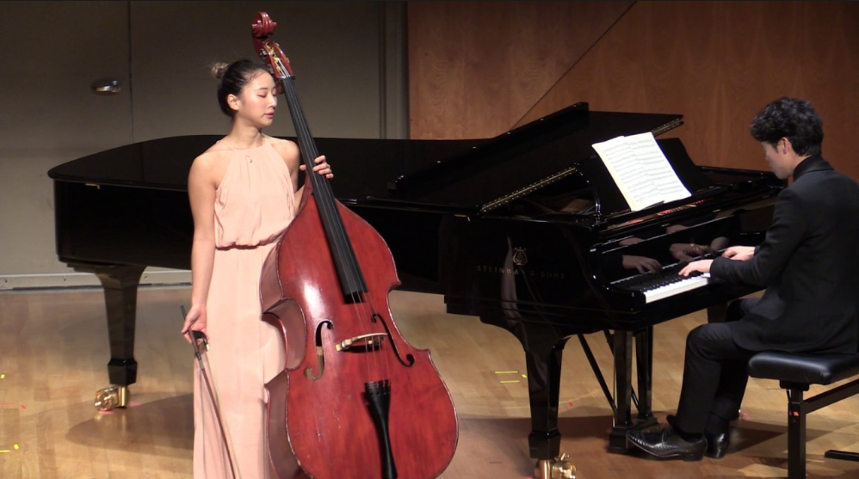
Mikyung Sung - Professional Musician

Slide 15
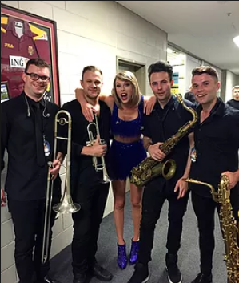
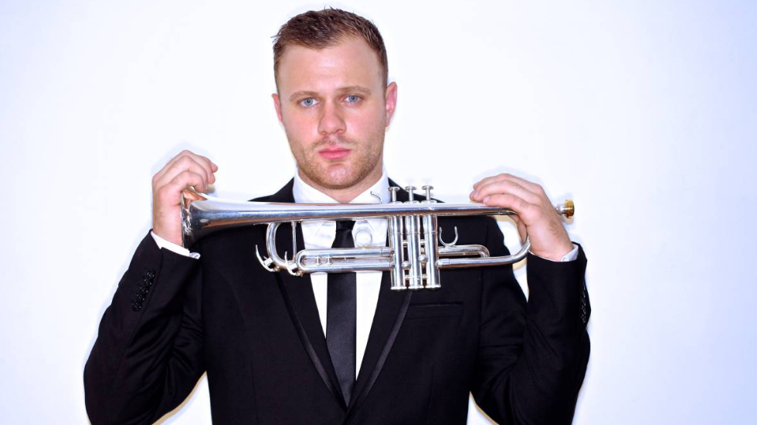
Dane Laboyrie - Professional Musician

Slide 16
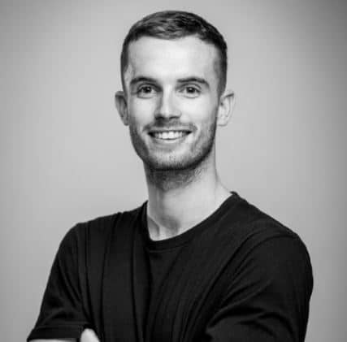
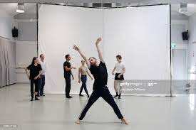
Dean Elliot - Professional Dancer - Sydney Dance Company

Slide 17
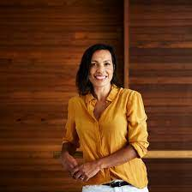
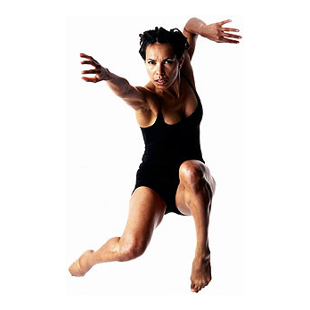
Francis Rings - Dancer / Choreographer - Bangara Dance Company

Slide 19
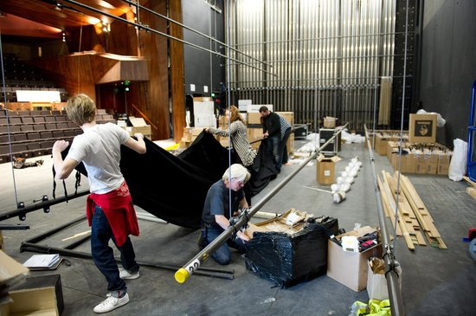

Slide 20
We teach you special skills
You will discover and develop your talent

Slide 21
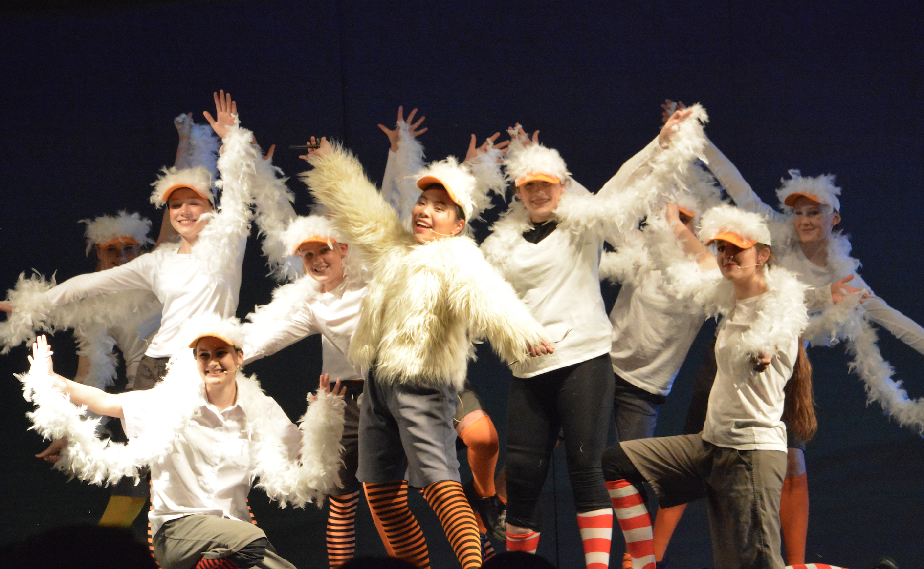
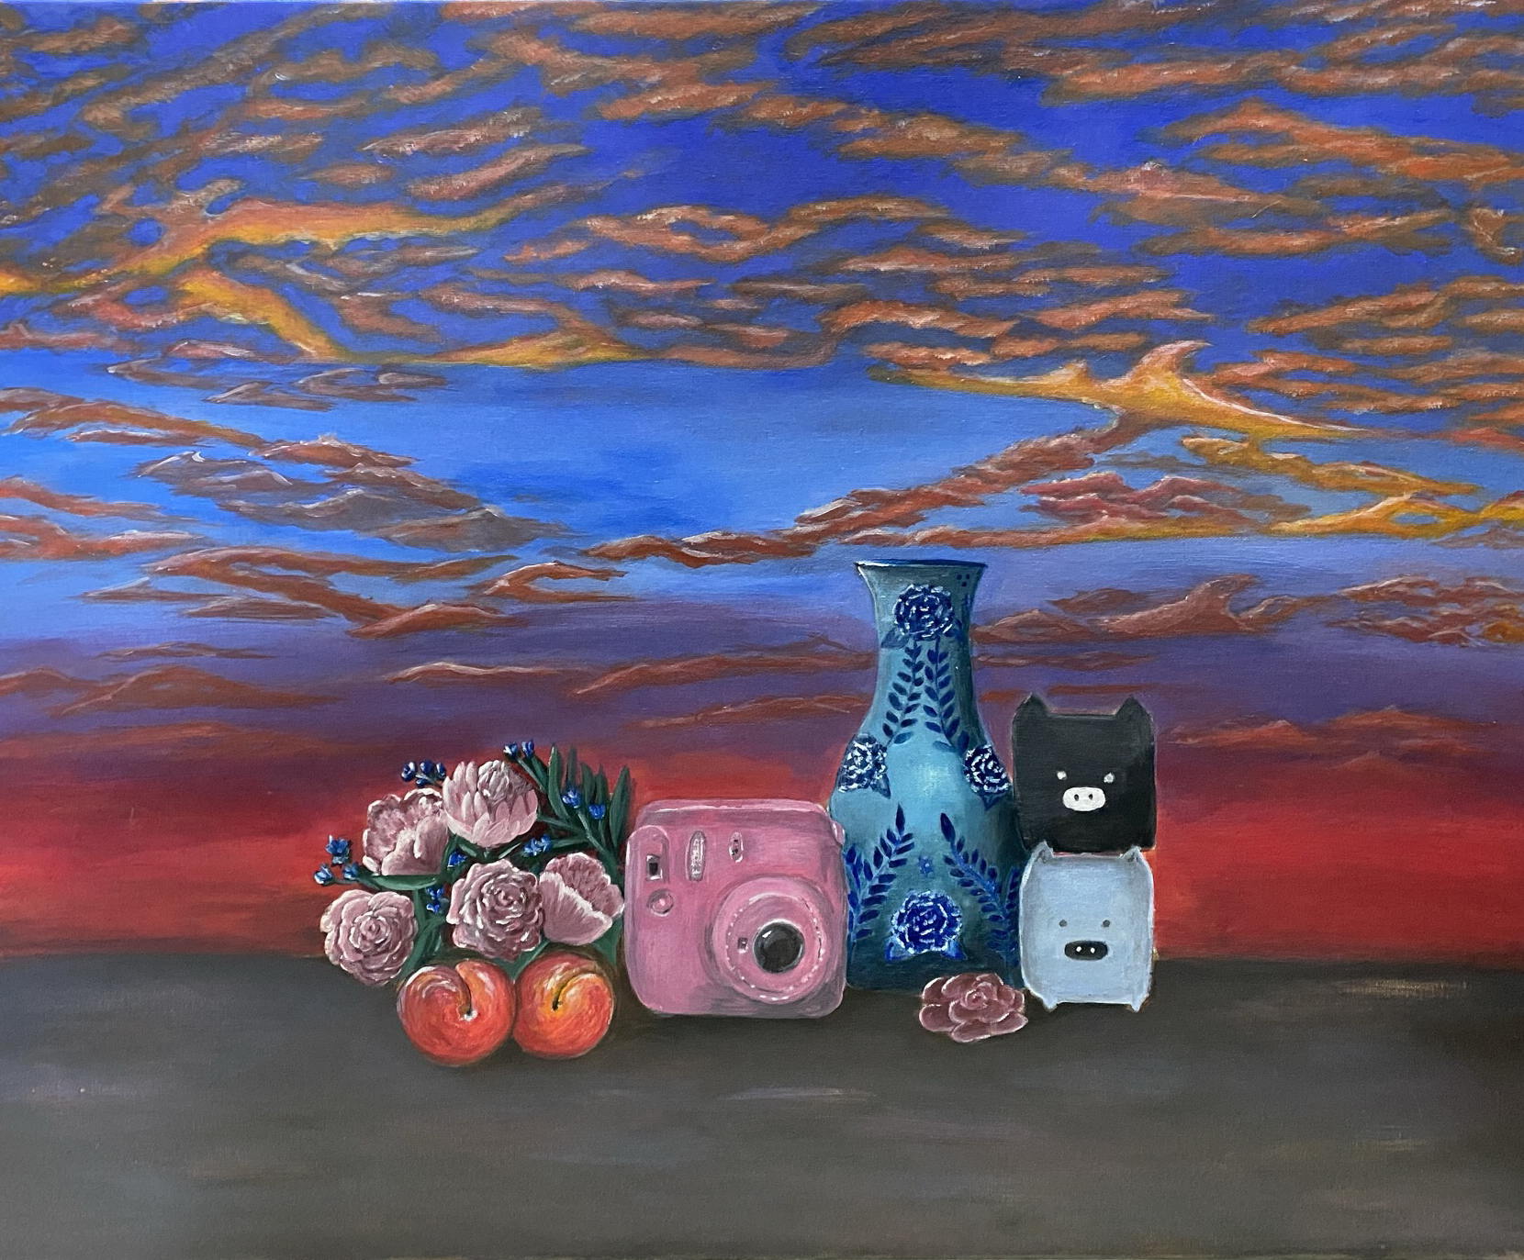
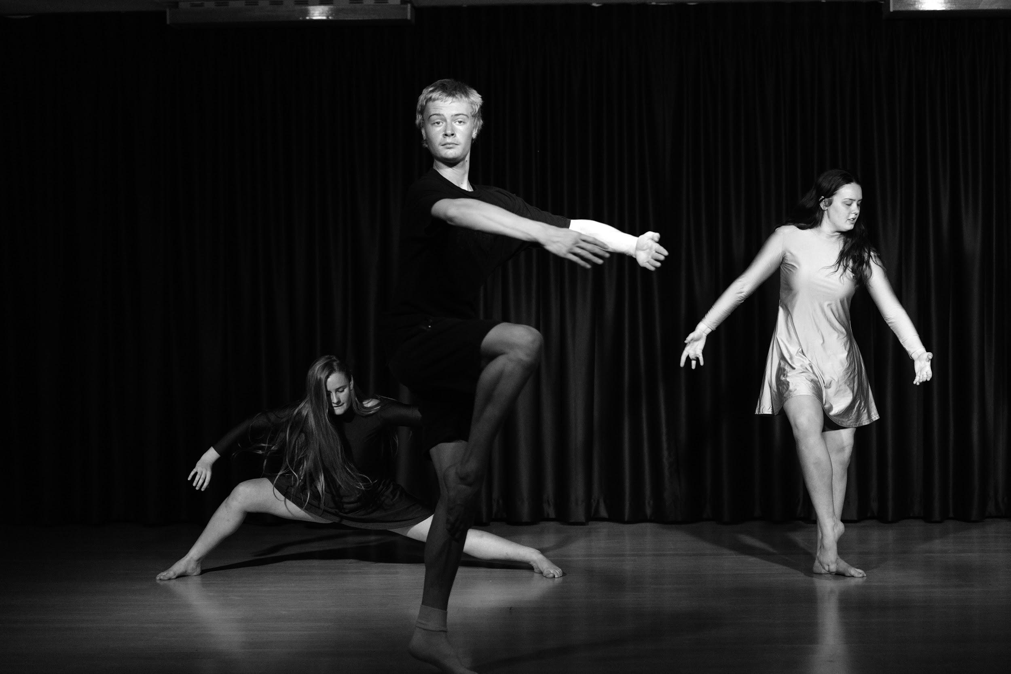
“Tell me and I forget…
teach me and I may remember….
involve me and I’ll learn”
Benjamin Franklin

Slide 22
Creativity and Problem Solving
Initiative and Enterprise
Self-learning and Project Based Learning
Communication
Collaboration
Planning and Organising
Time Management
Technology
Cross-Cultural Understanding

Slide 23
“It’s in Apple’s DNA that technology alone is not enough. It’s technology married with liberal arts, married with the humanities, that yields the results that make our hearts sing.”
Steve Jobs – founder of Apple

Slide 24
Questions??
Speak to your Dance, Drama, Music or Visual Arts Teacher via;
Email
Google Classroom
Sentral Portal messaging
Parents can email the school – attention to your teacher’s name
menai-h.school@det.nsw.edu.au
Mr Middleton, Head Teacher Creative and Performing Arts
neil.middleton@det.nsw.edu.au

