Slide 1
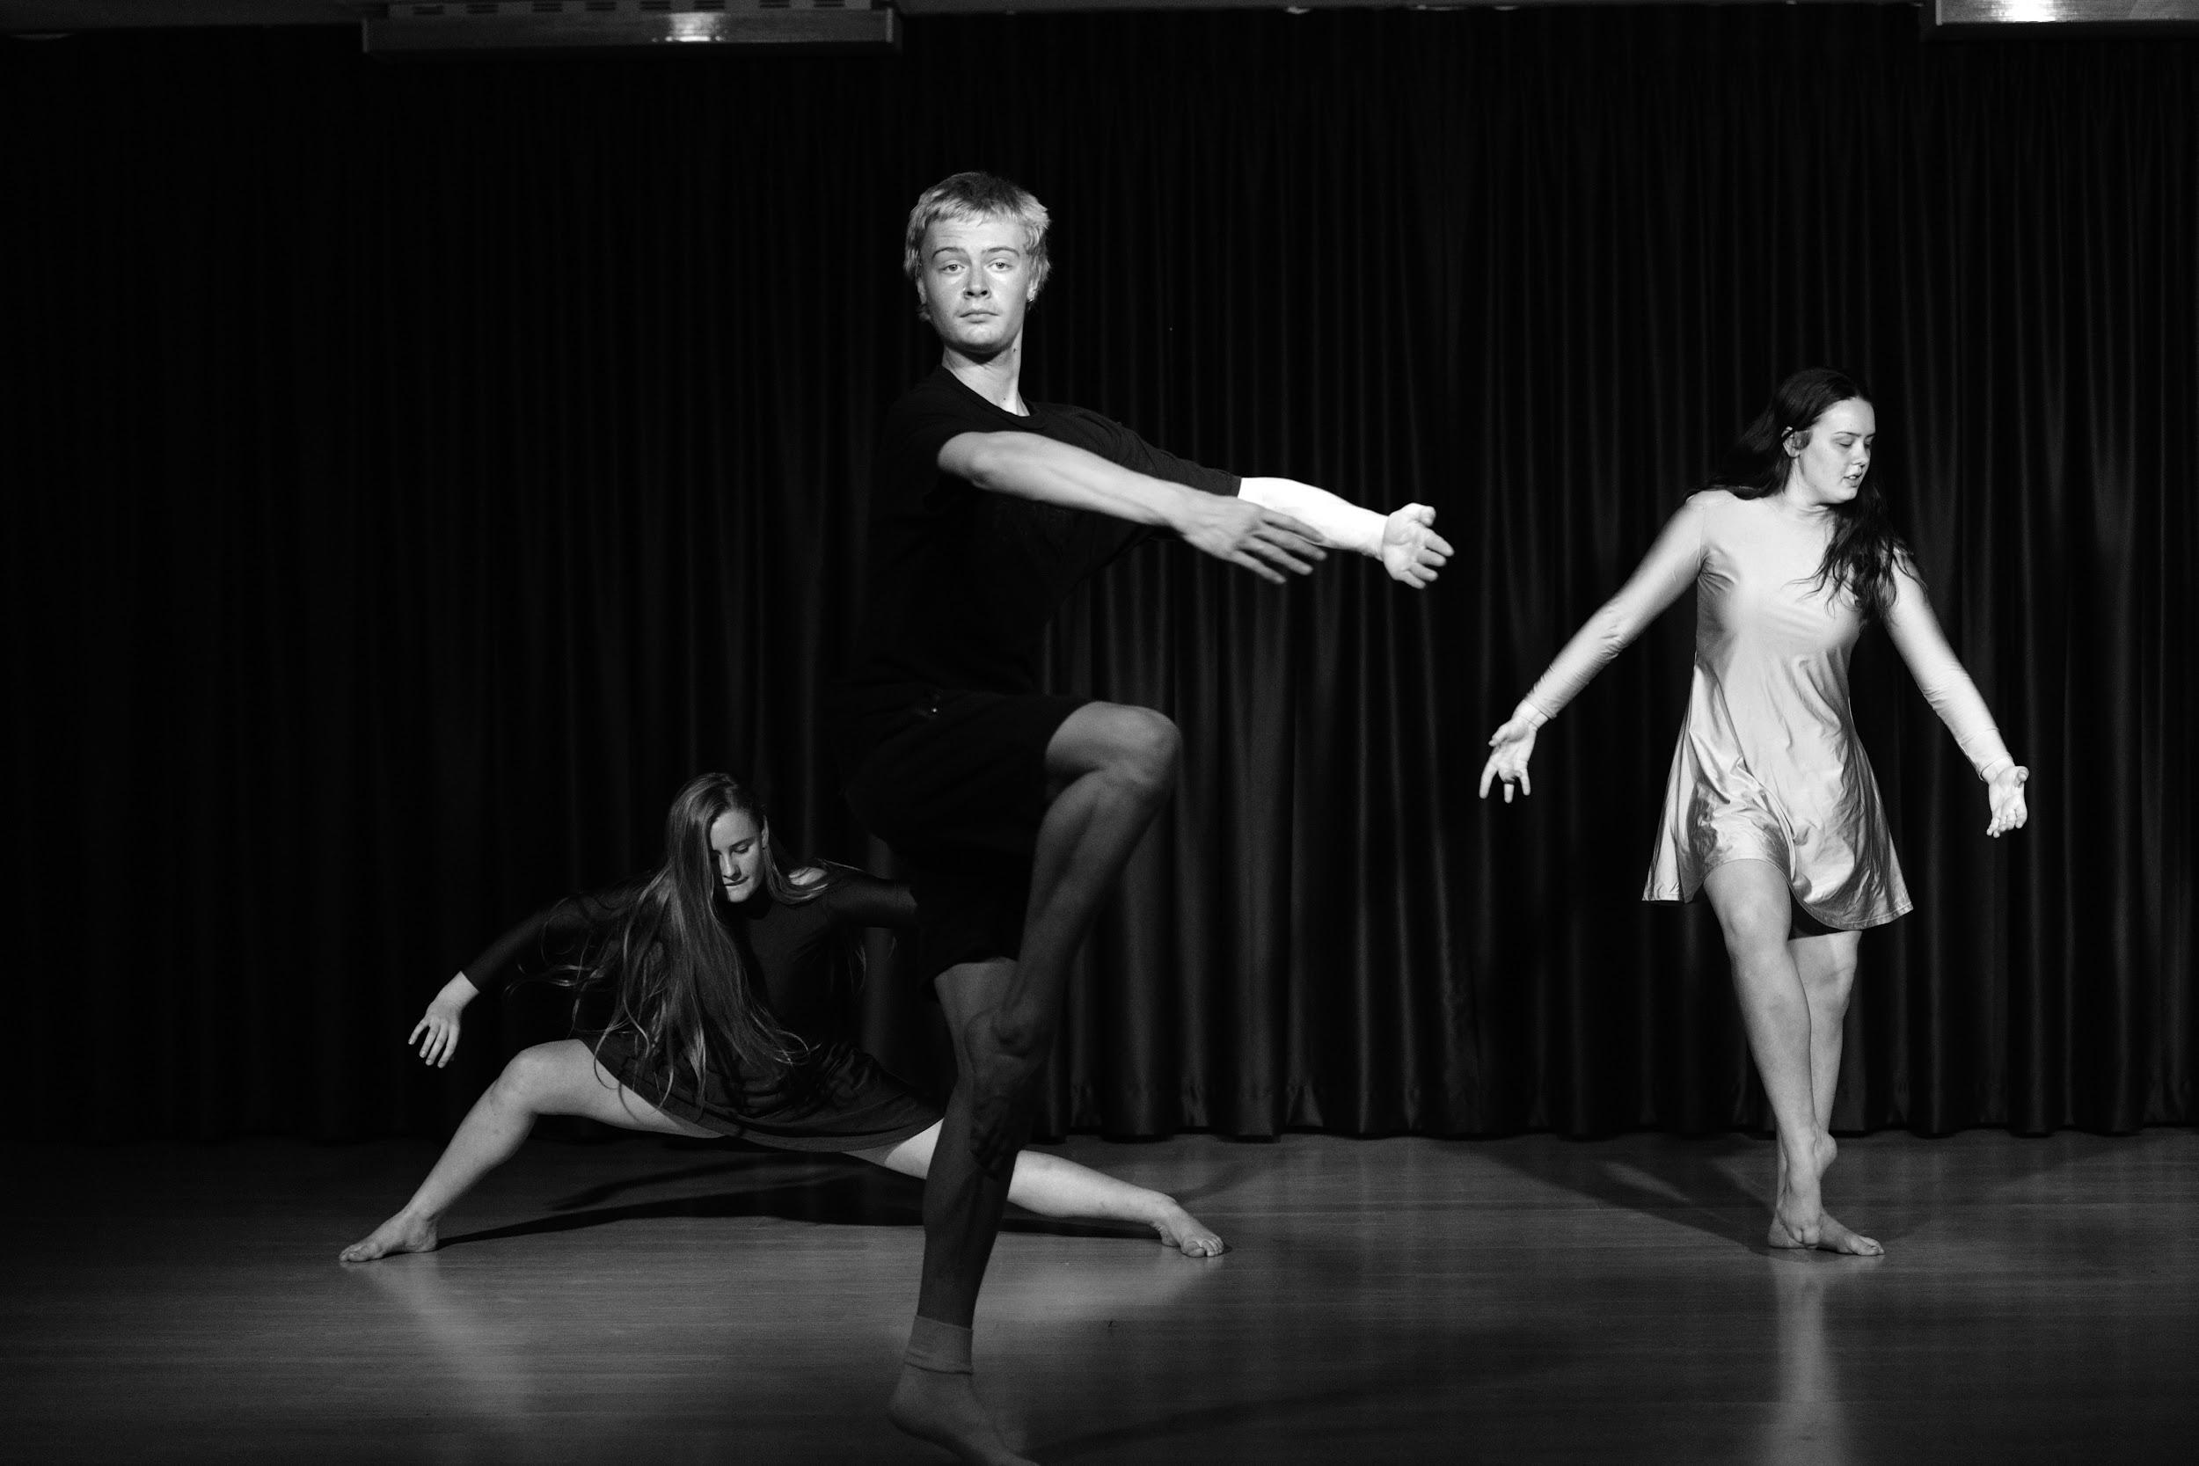
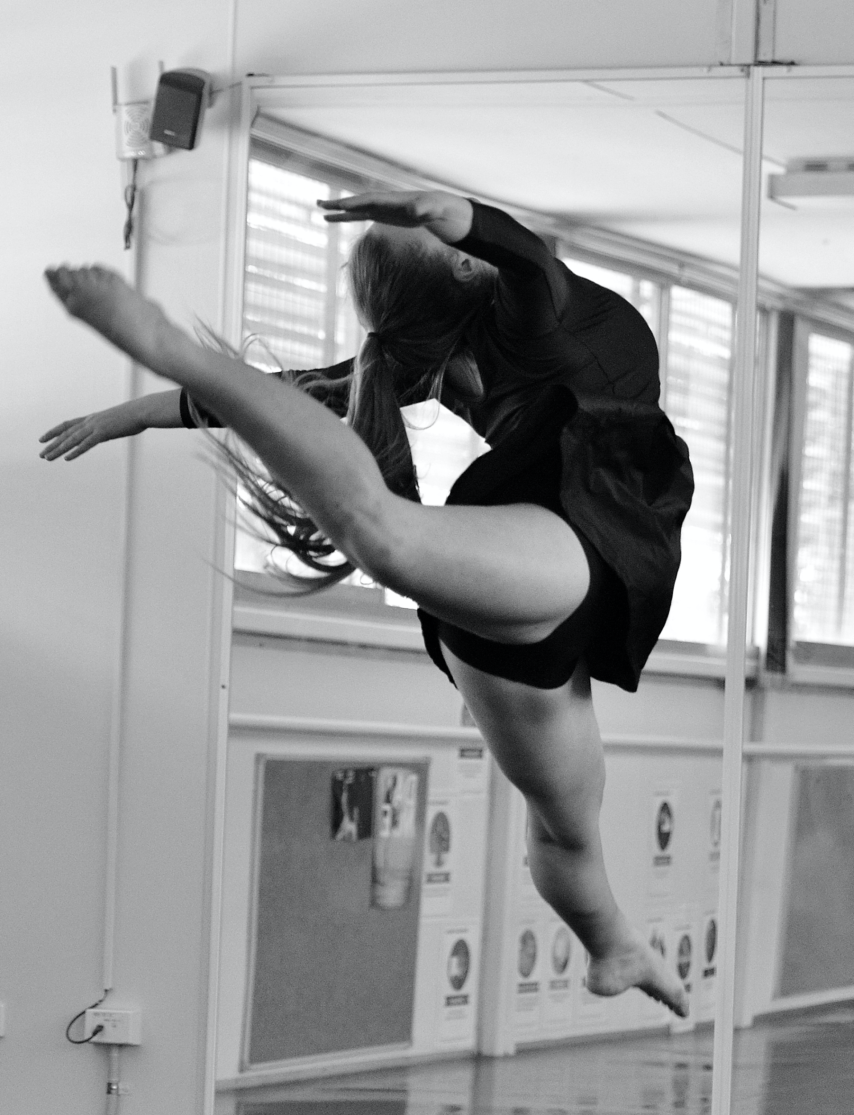
DANCE
Years 9 &10 - Stage 5

Slide 2
Dance – Year 9 - 200 hours (over the two years)
80% PRACTICAL
20% THEORY

Slide 3
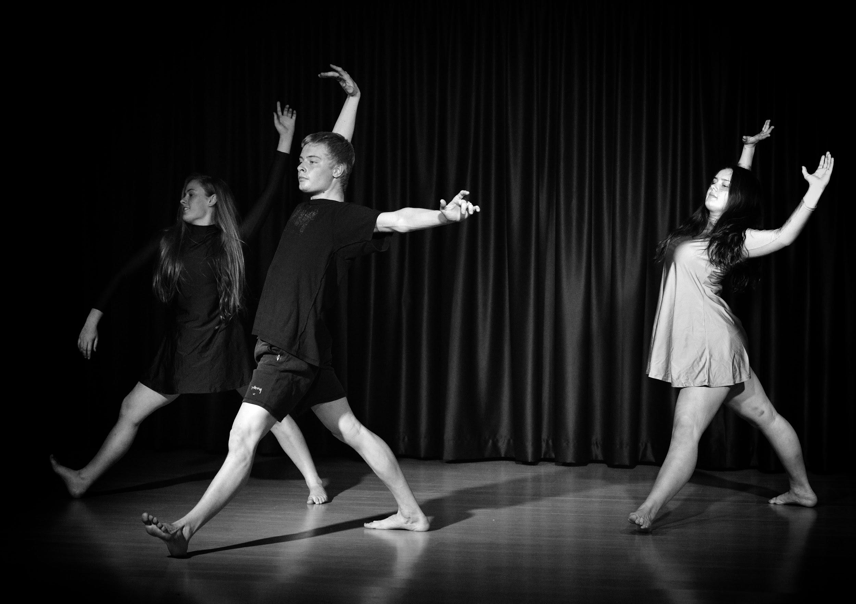
DANCE
Previous Dance training is not essential.
Menai High has many Dance ensembles and companies that you can be involved in to increase your technique and performance quality over Years 9 and 10.

Slide 4
The Course:
Topics covered include:
Development of Dance technique and performance quality to communicate ideas.
Safe Dance Practice, anatomy and fundamental physiology of the human body.
Dance composition as a means to creating and structuring movement to communicate an idea.
Appreciating Dance as a means to analysis and describe its use in a historical and cultural context.
Indigenous Dance and culture and its basis for Dance in Australia.

Slide 5
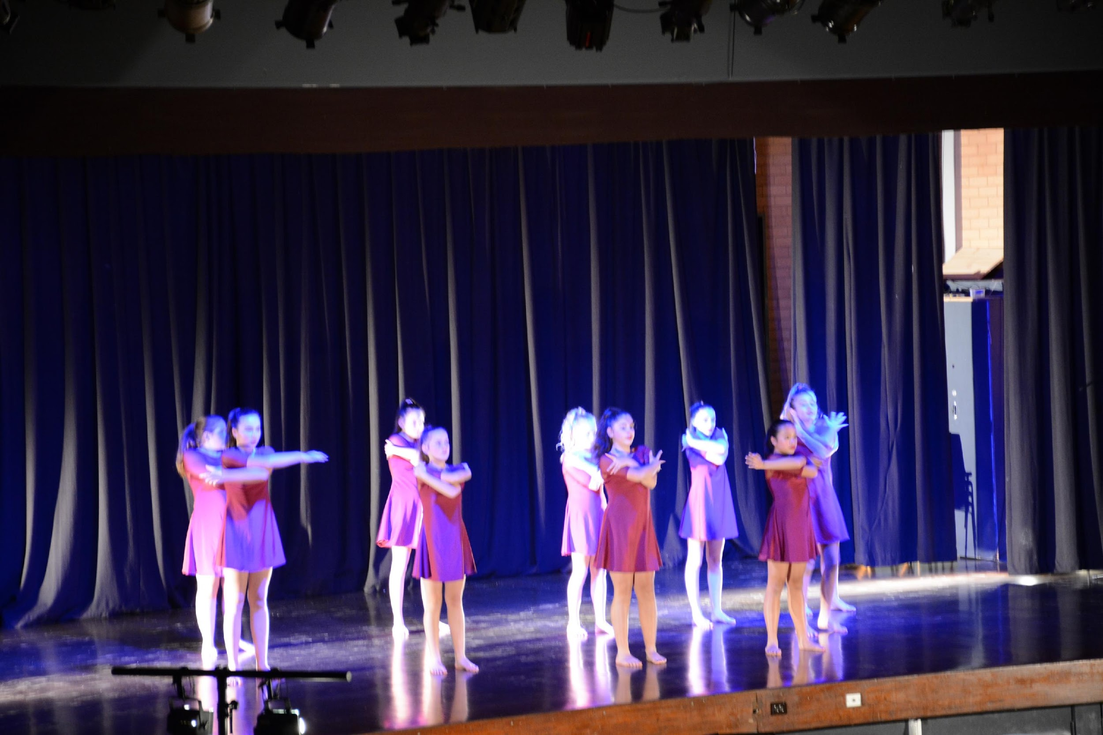
Some Dance Styles covered throughout the course:
Dance Technique - NSW syllabus
Contemporary
Lyrical
Ballet
Musical Theatre
Jazz
Indigenous Dance

Slide 6
