Slide 1
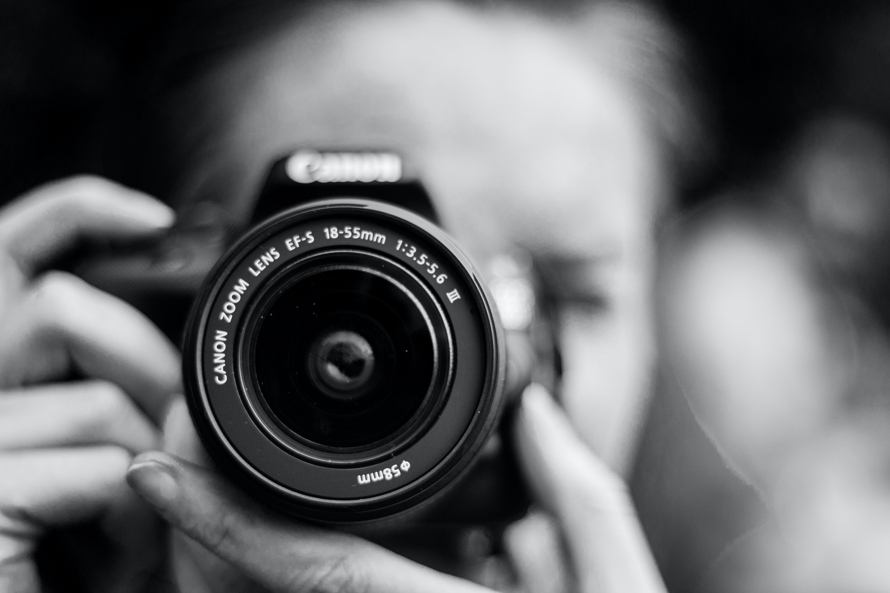
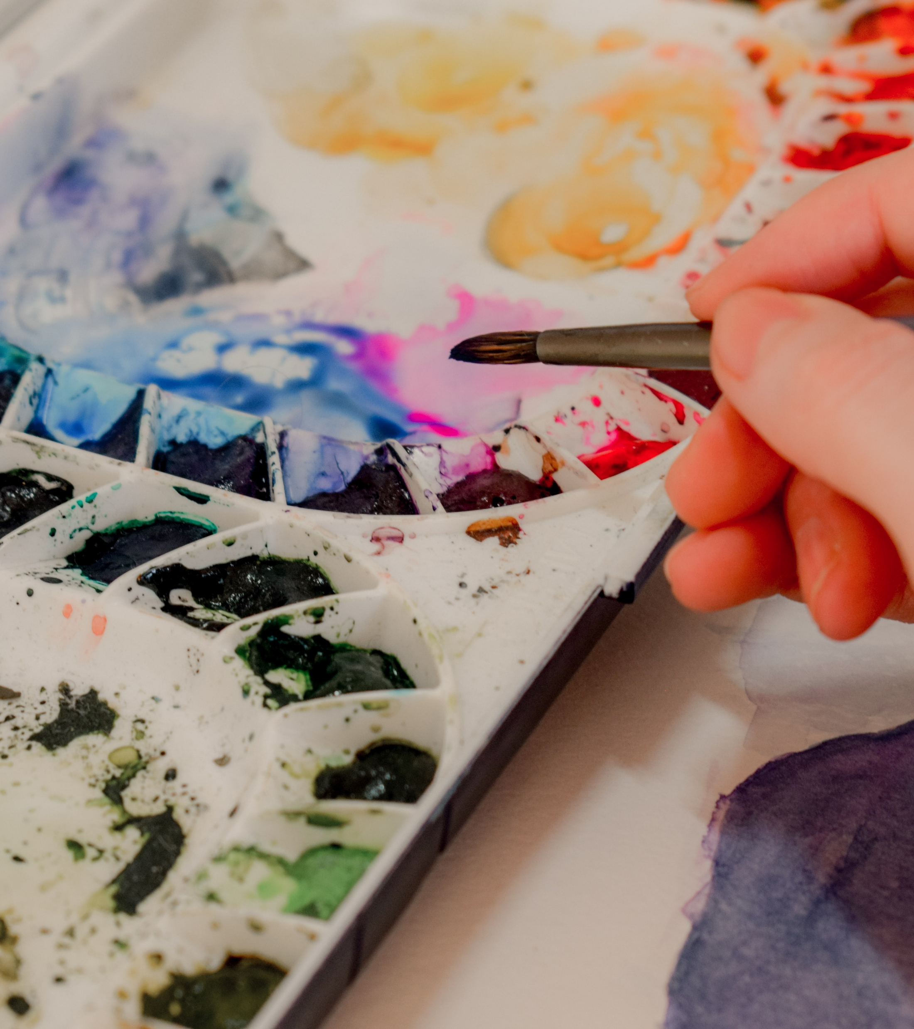

Slide 2
VISUAL ARTS
VISUAL DESIGN
PHOTOGRAPHY, VIDEO and DIGITAL MEDIA
CERAMICS

Slide 3
ALL SUBJECTS ARE WEIGHTED
60% PRACTICAL
40% THEORY

Slide 4
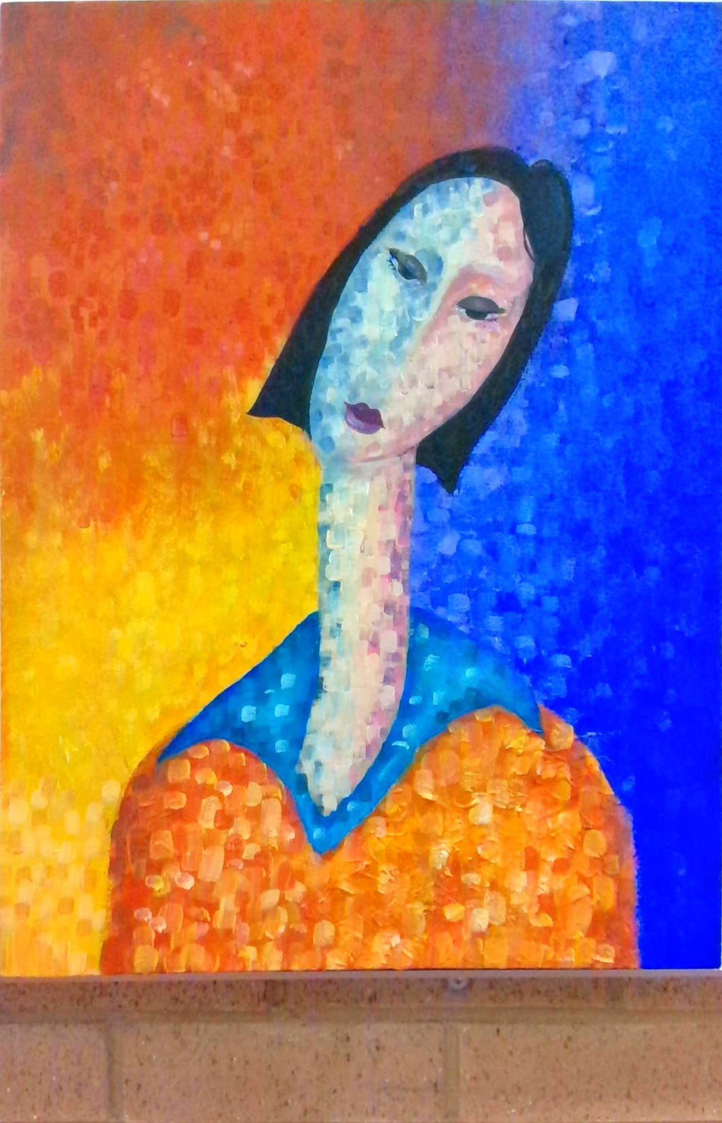
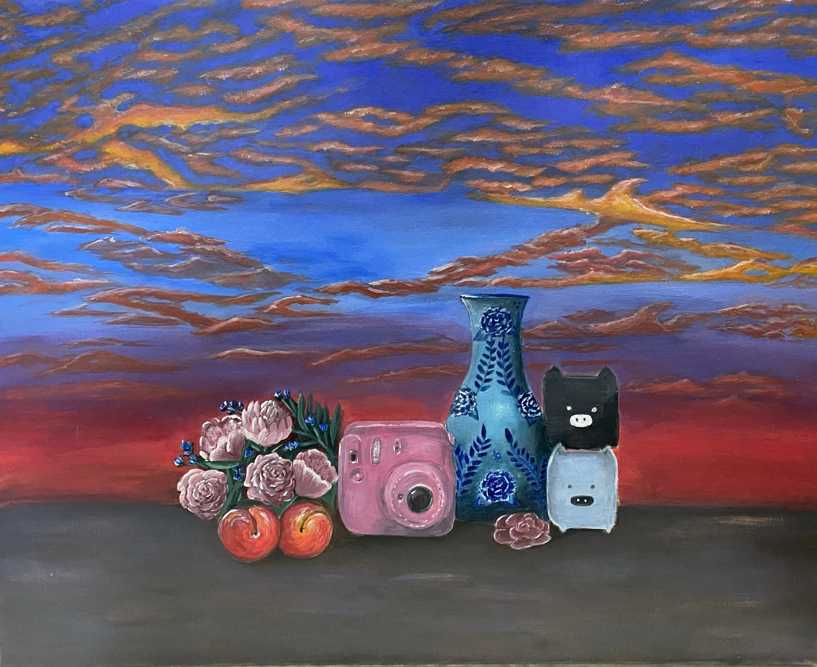
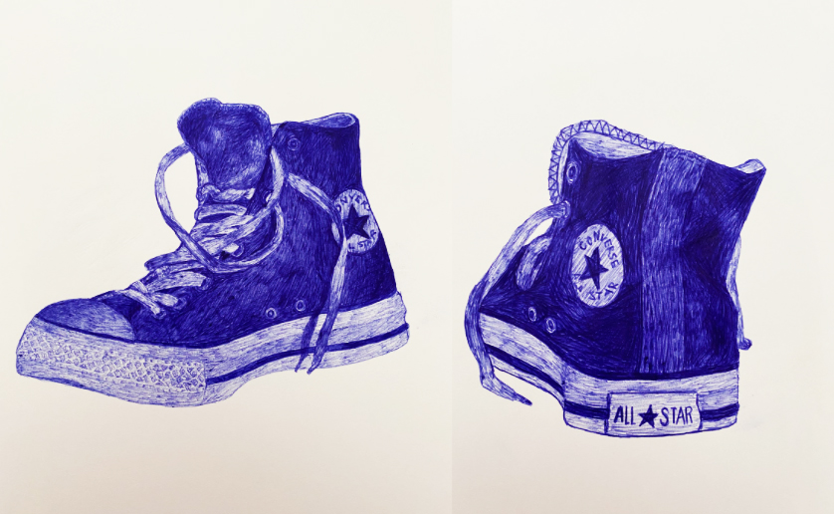
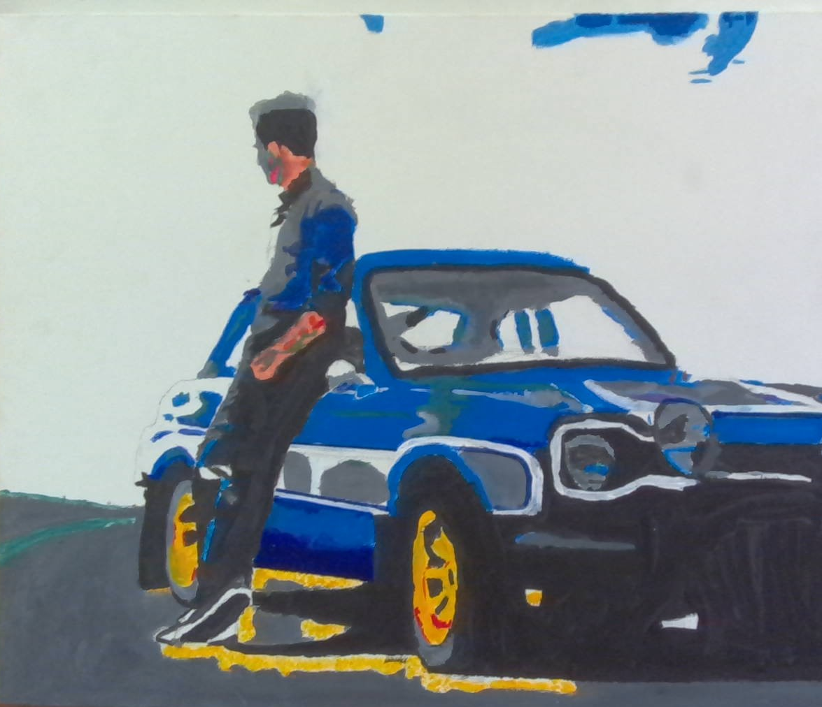
VISUAL ARTS

Slide 5
SOME OF THE DIFFERENT MEDIA YOU WILL WORK IN
Illustration
Painting
Photo-media
Sculpture
Printmaking

Slide 6
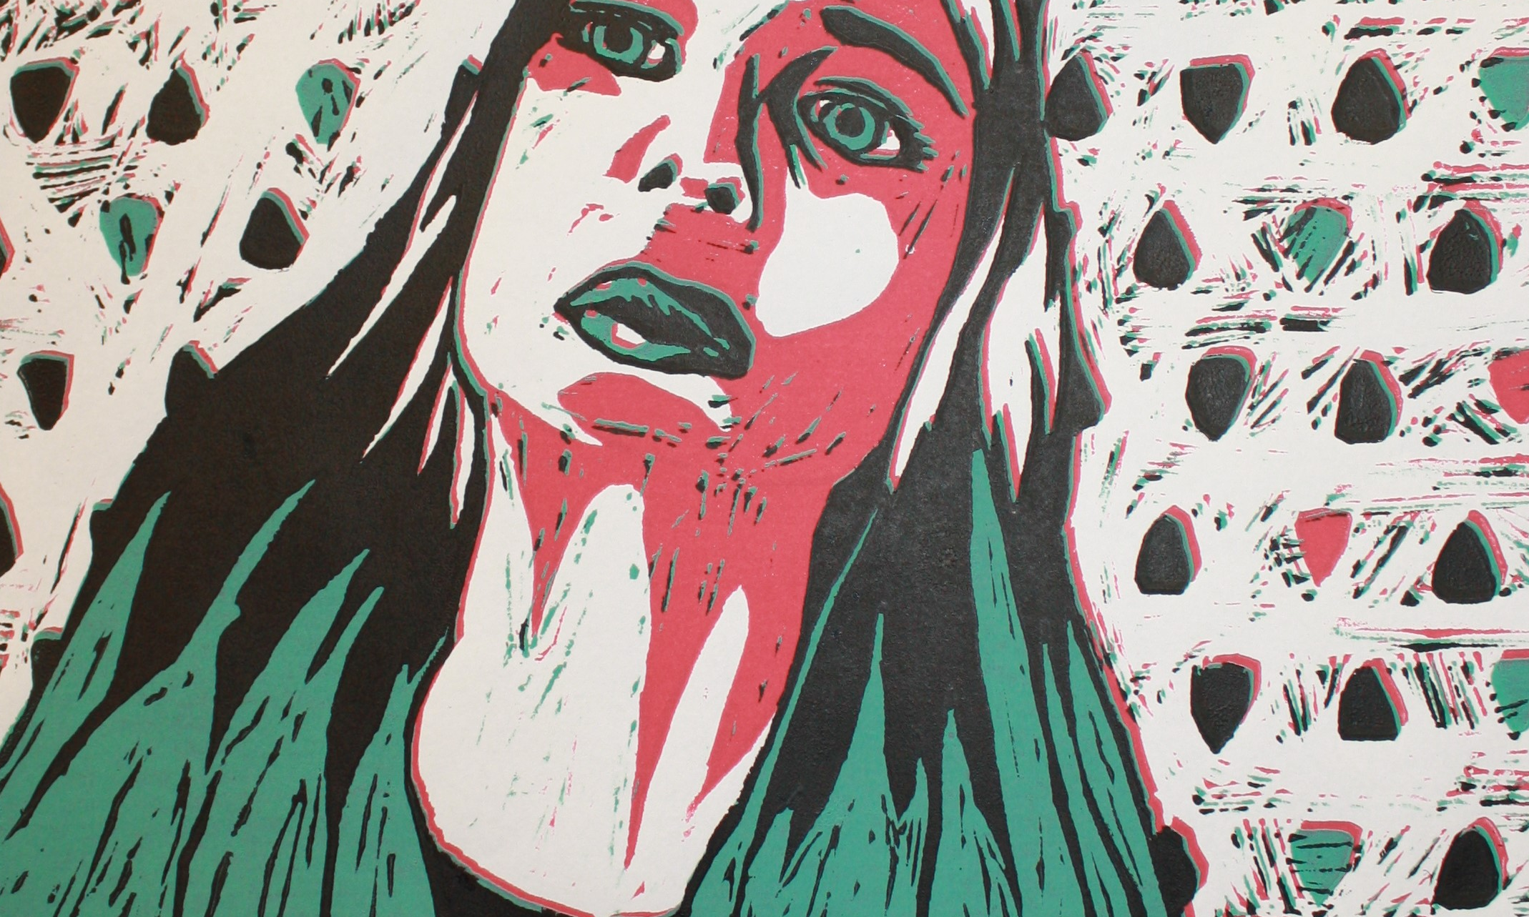
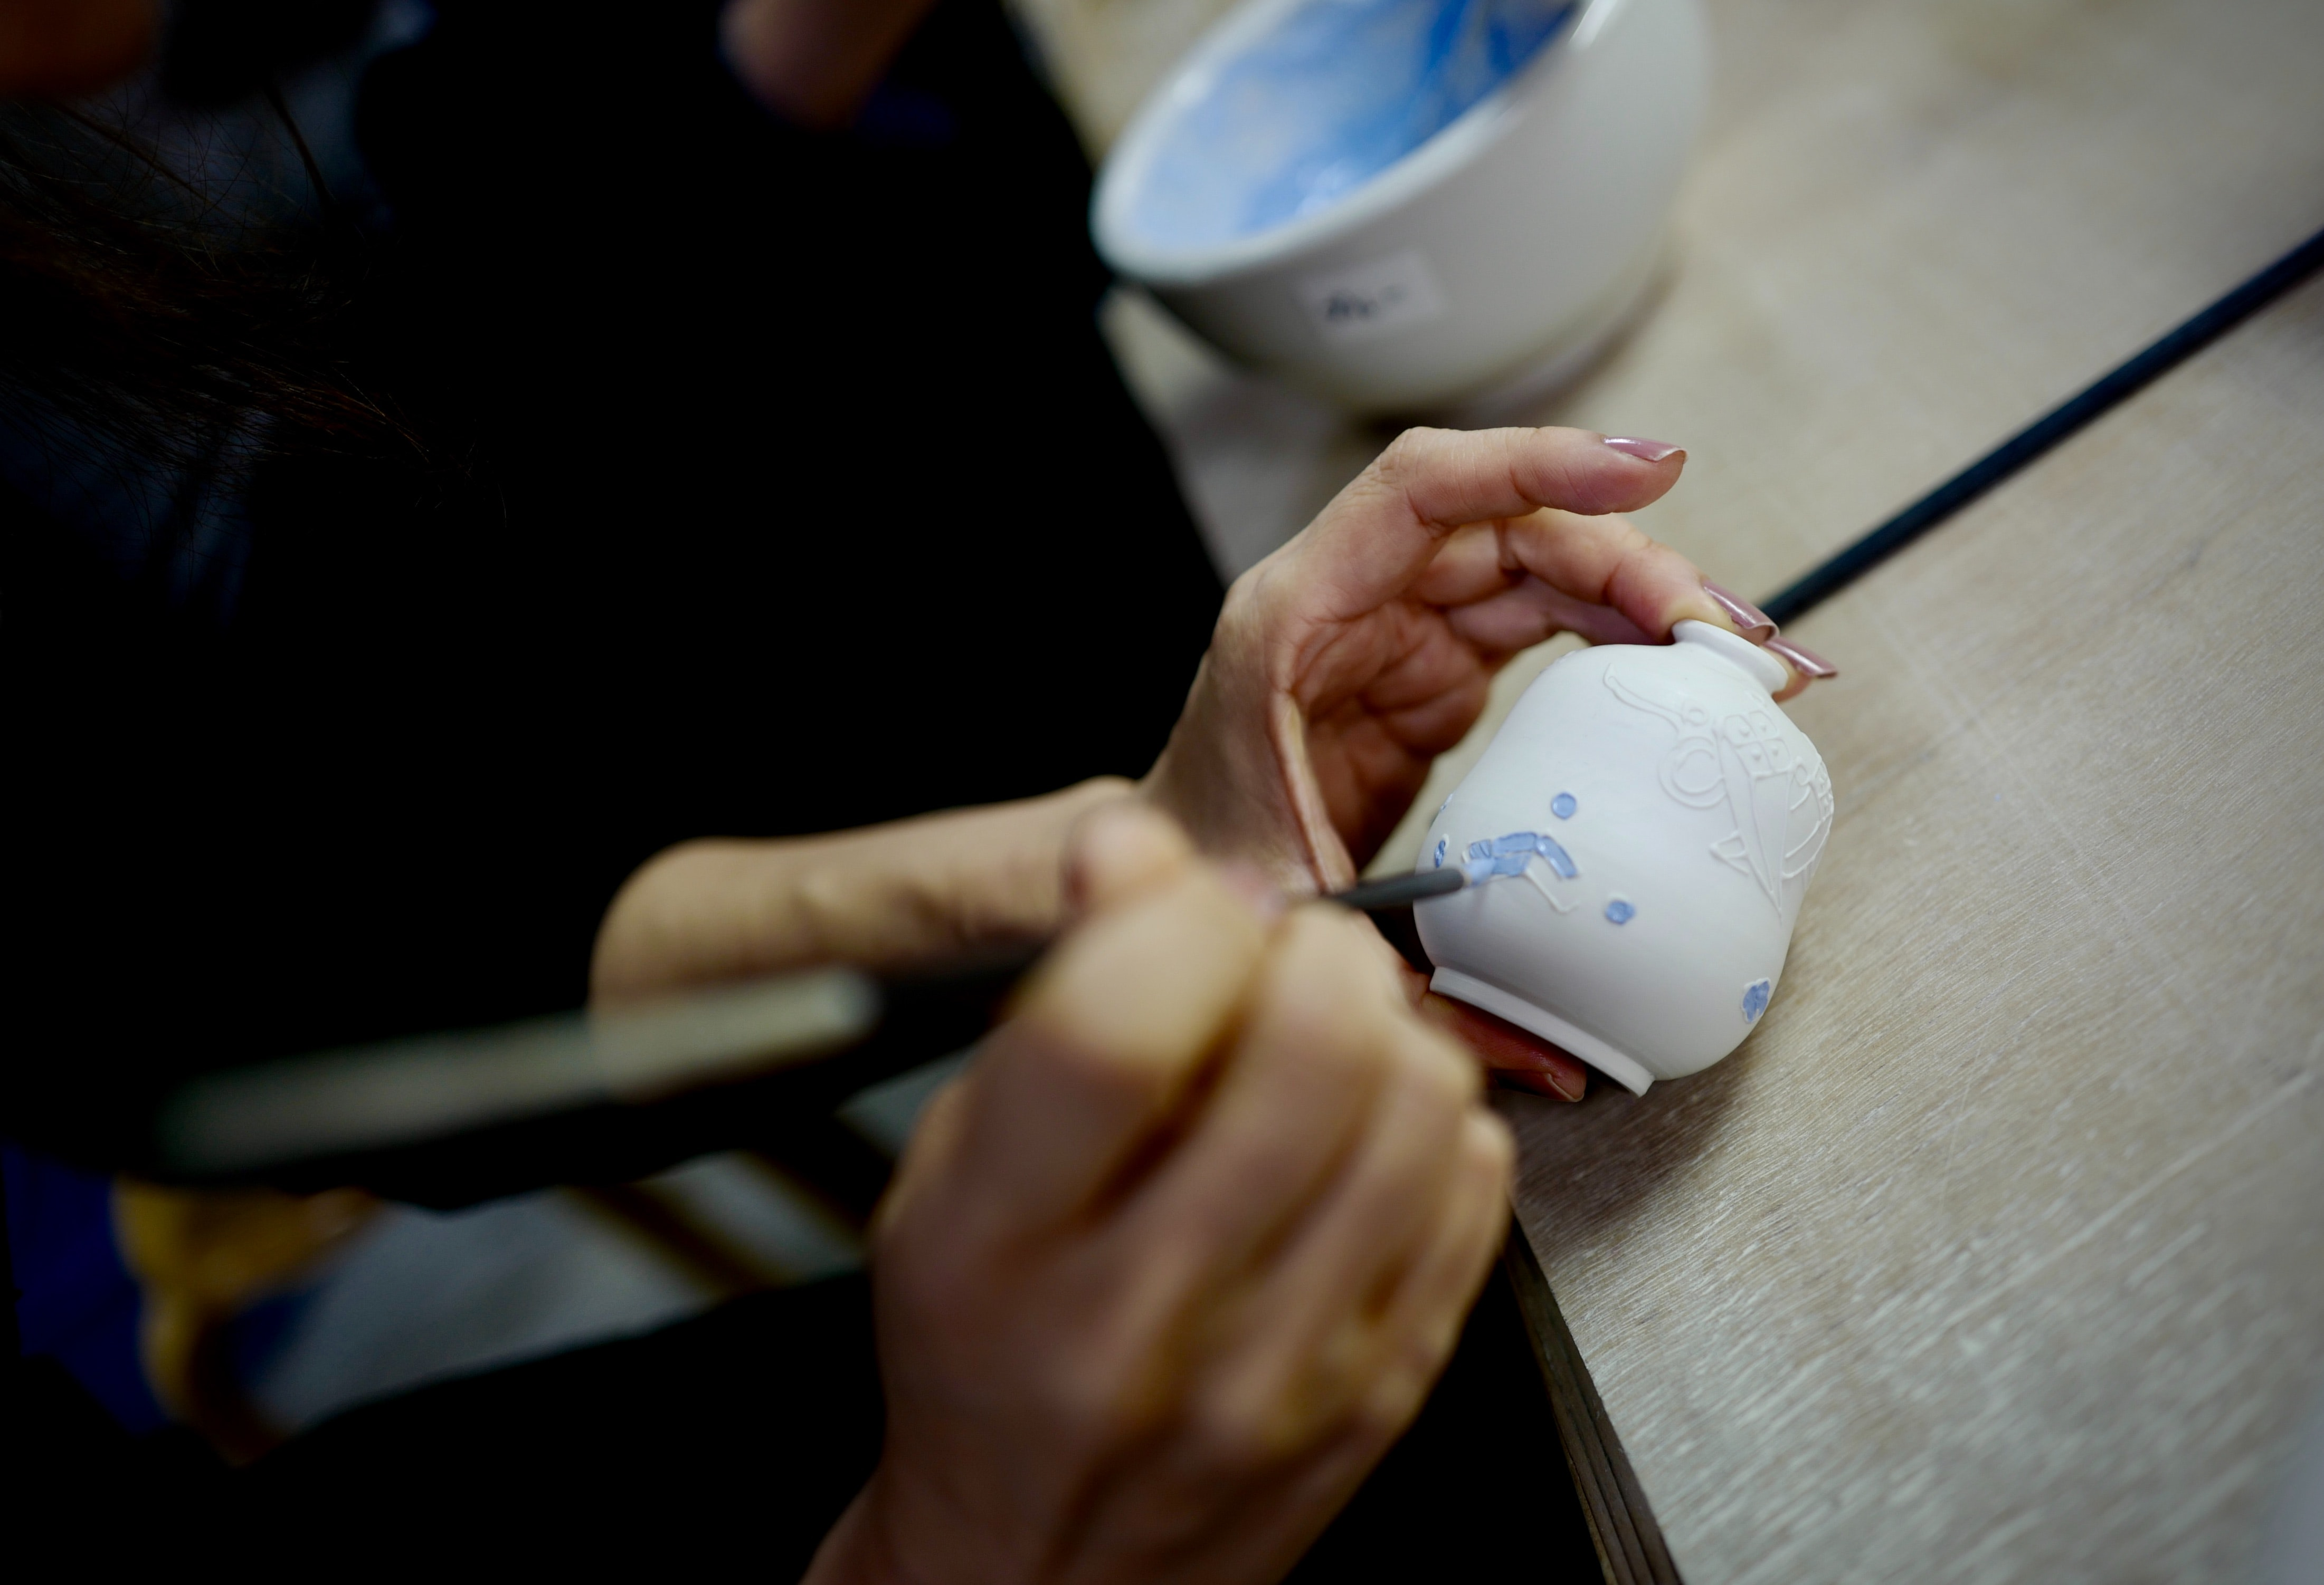
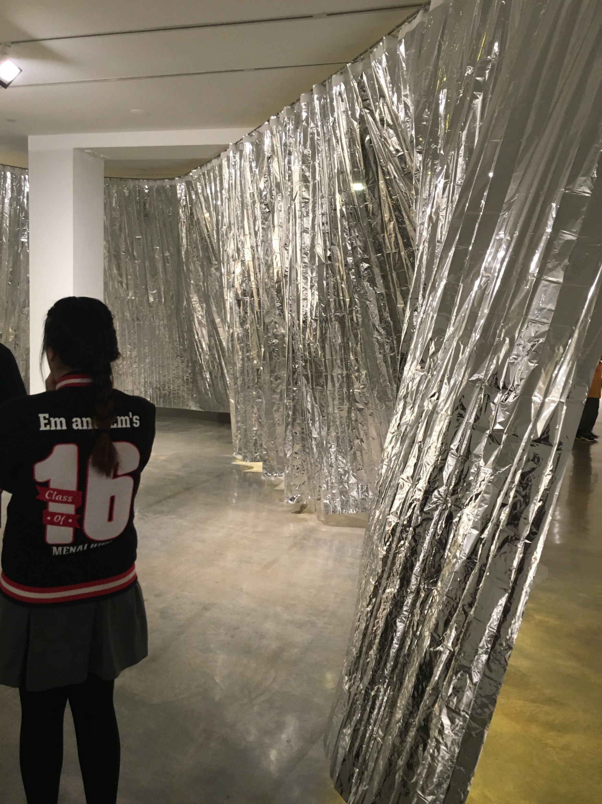
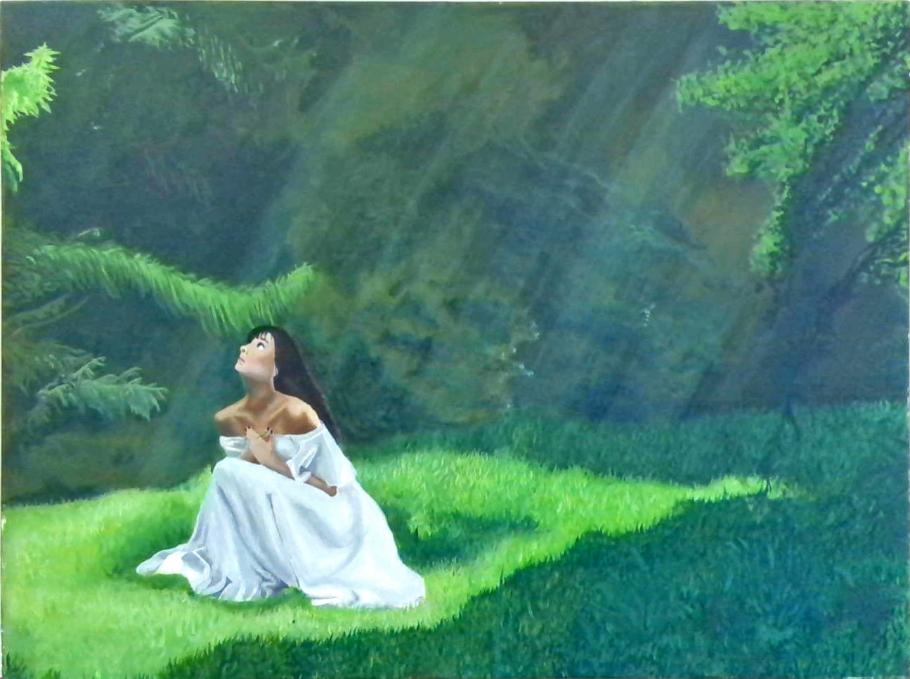
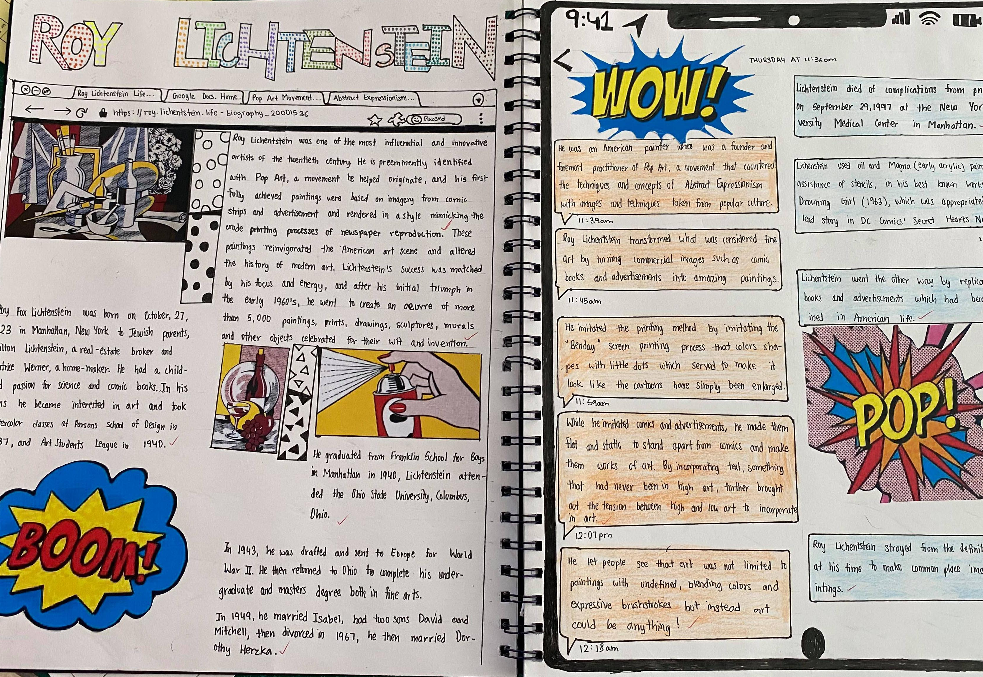

Slide 7
VISUAL ARTS ASSESSMENT SCHEDULE
YEAR 9 COURSE |  | YEAR 10 COURSE
Making Artworks | 30 % | Making Artworks | 30 %
Theory Responding to Artworks | 20 % | Theory Responding to Artworks | 20 %
Making Artworks | 30 % | Making Artworks | 30 %
Theory Responding to Artworks | 20 % | Written Exam | 20 %

Slide 8
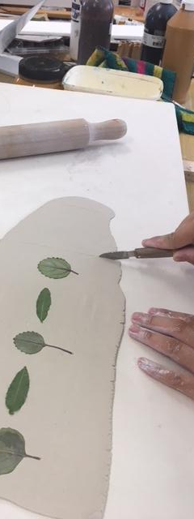
CERAMICS

Slide 9
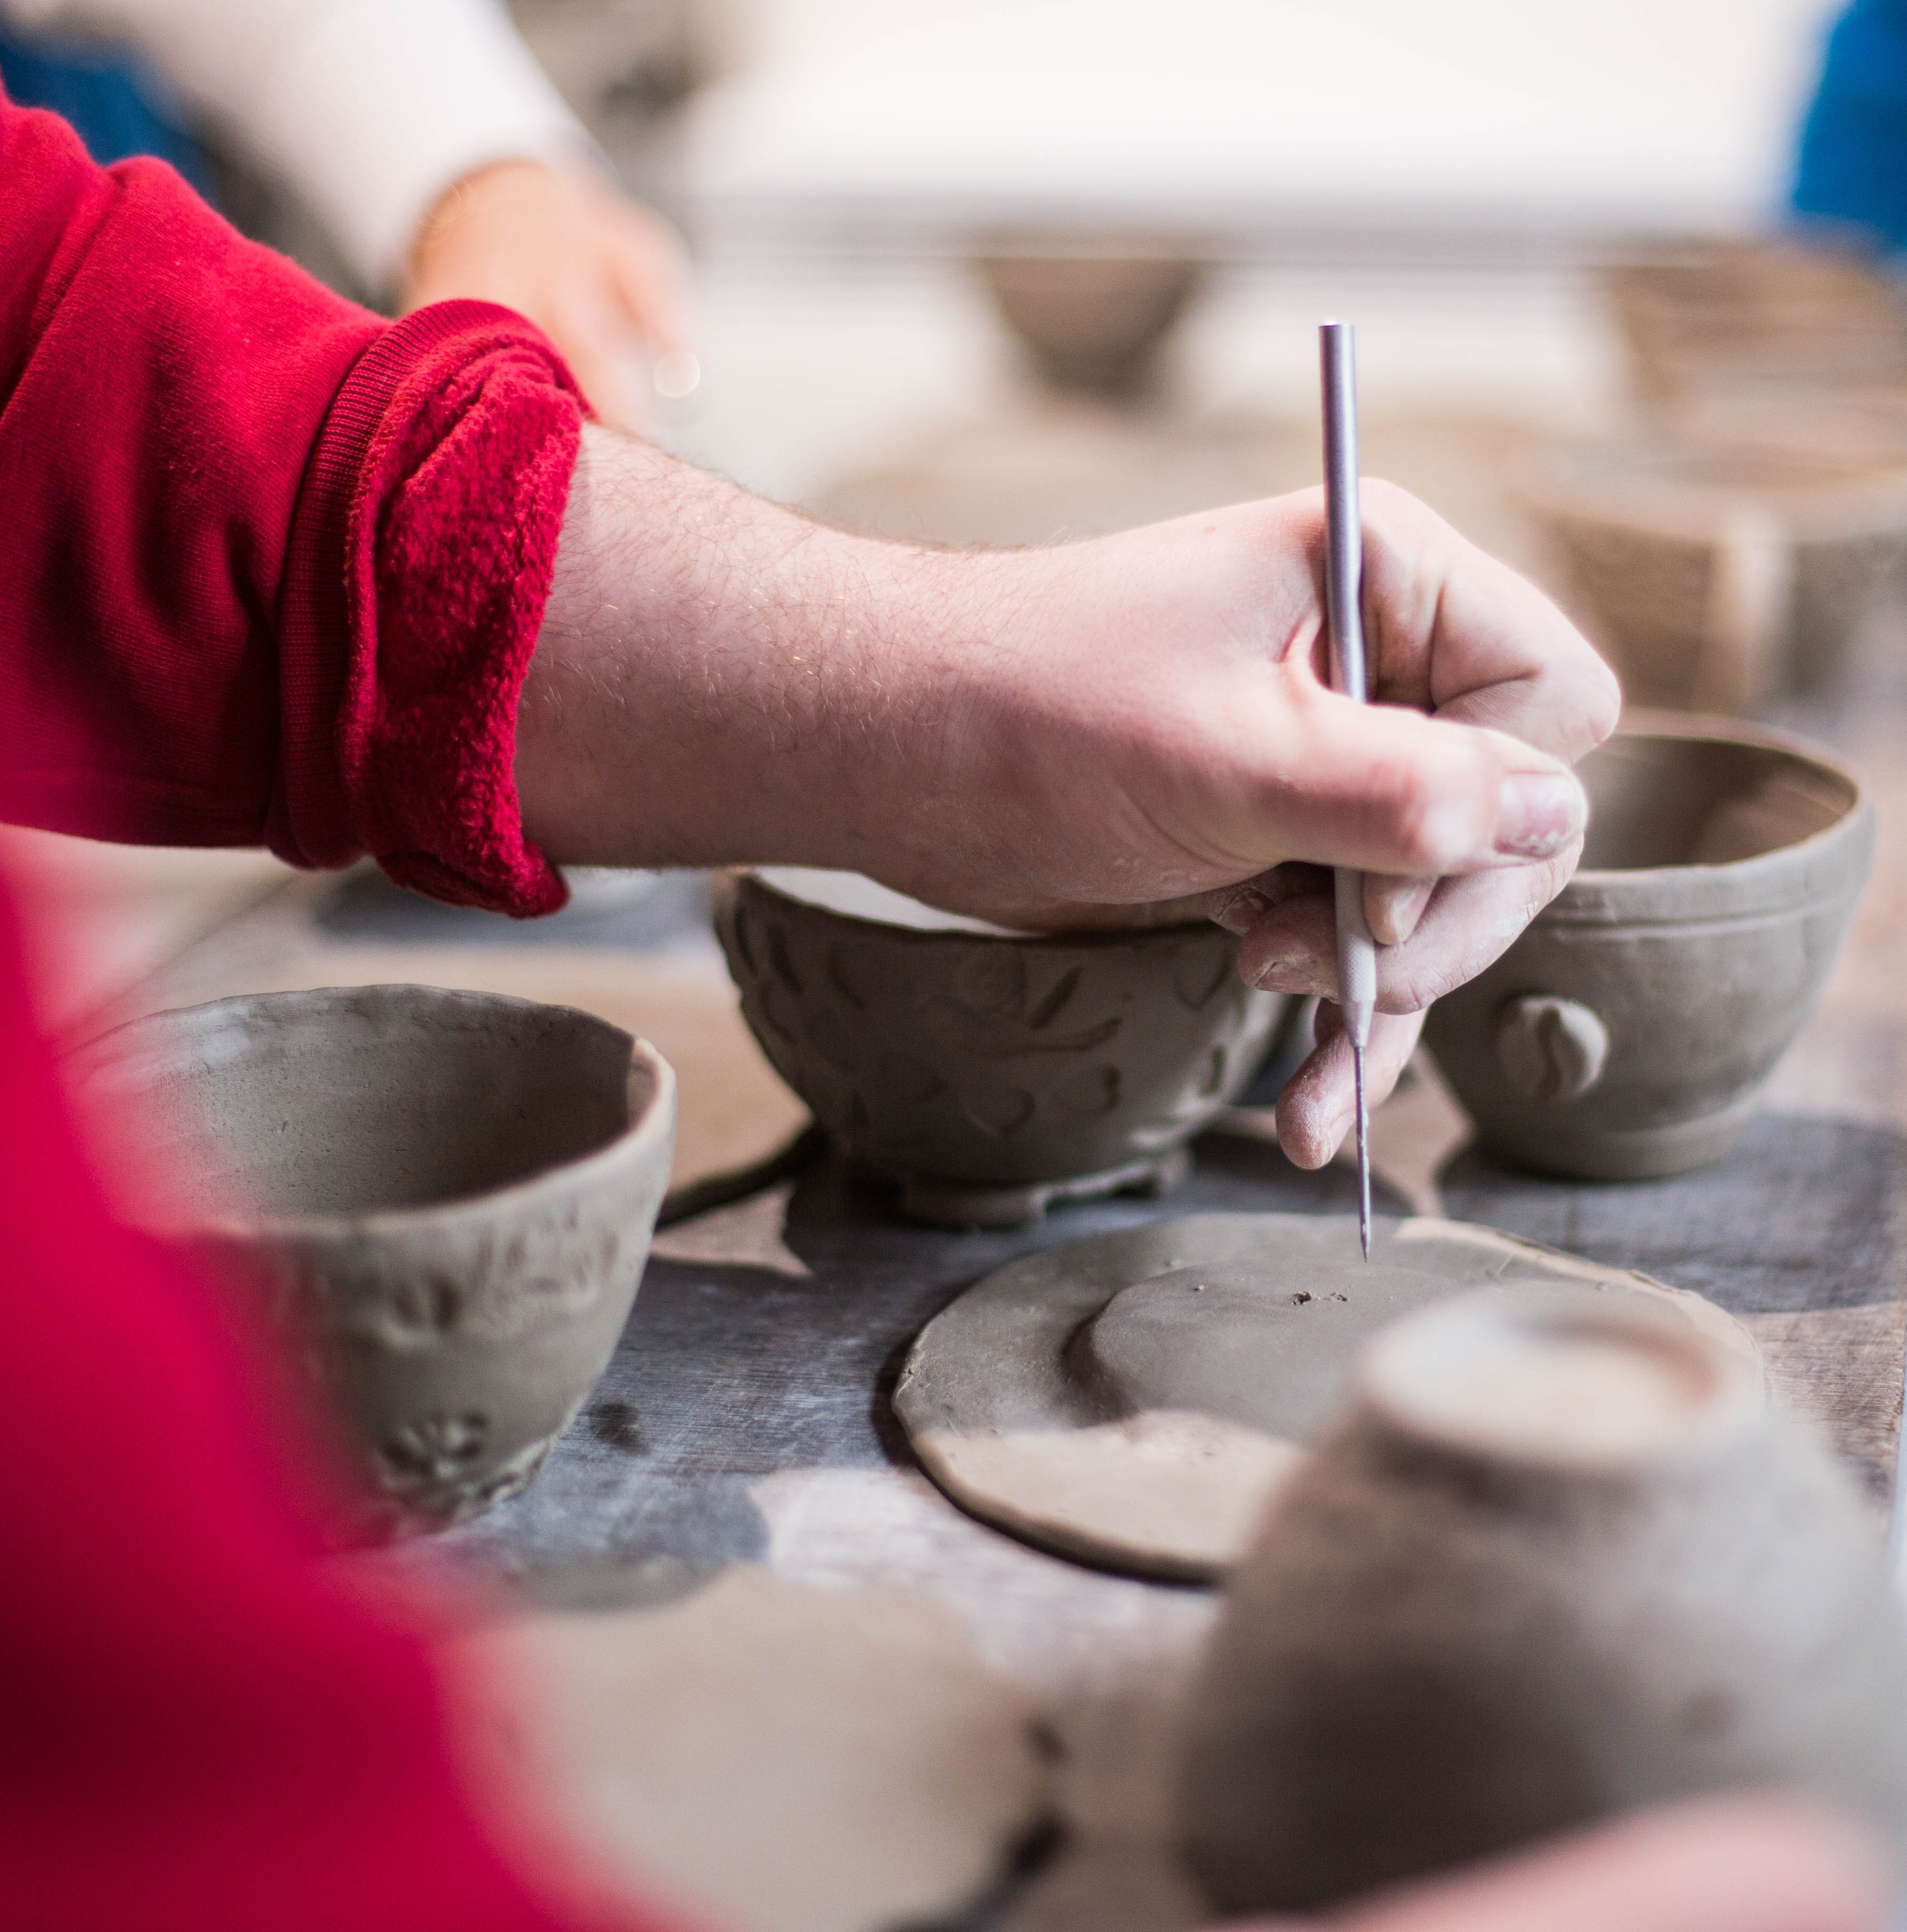
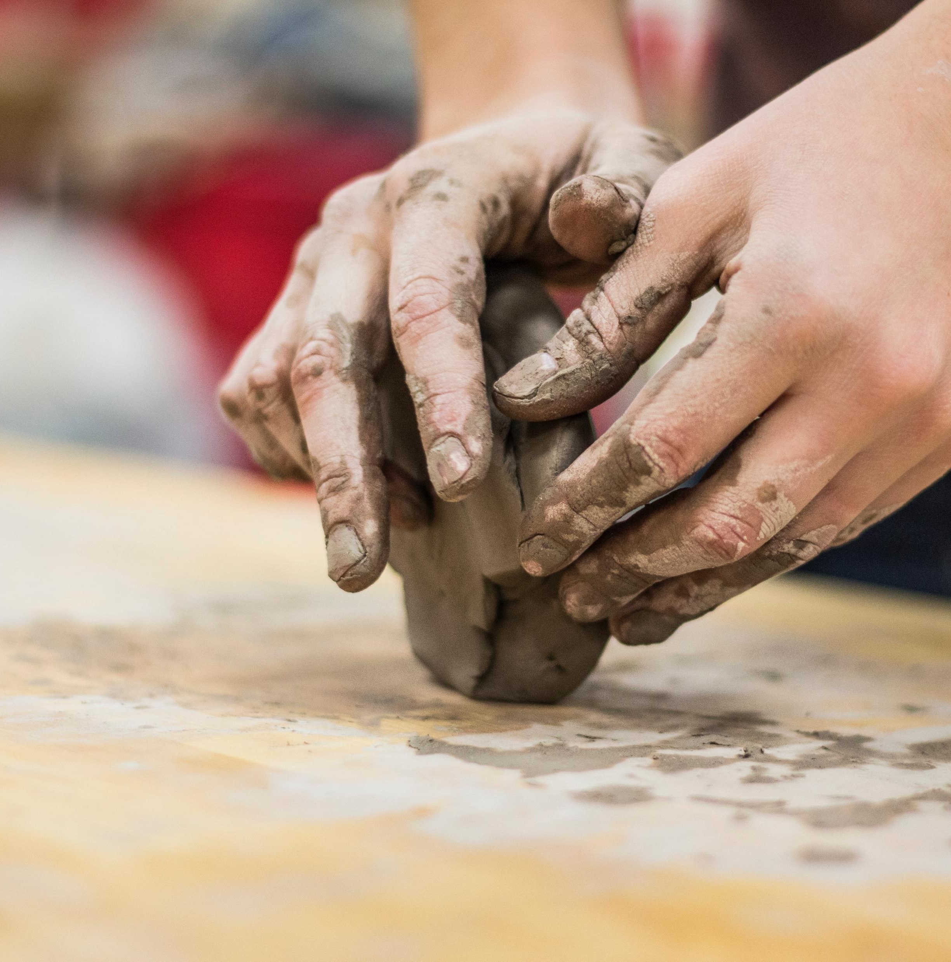

Slide 10
CERAMICS ASSESSMENT SCHEDULE
YEAR 9 COURSE |  | YEAR 10 COURSE
Making Artworks | 30 % | Making Artworks | 30 %
Theory Responding to Artworks | 20 % | Theory Responding to Artworks | 20 %
Making Artworks | 30 % | Making Artworks | 30 %
Theory Responding to Artworks | 20 % | Theory Responding to Artworks | 20 %

Slide 11
VISUAL DESIGN

Slide 12
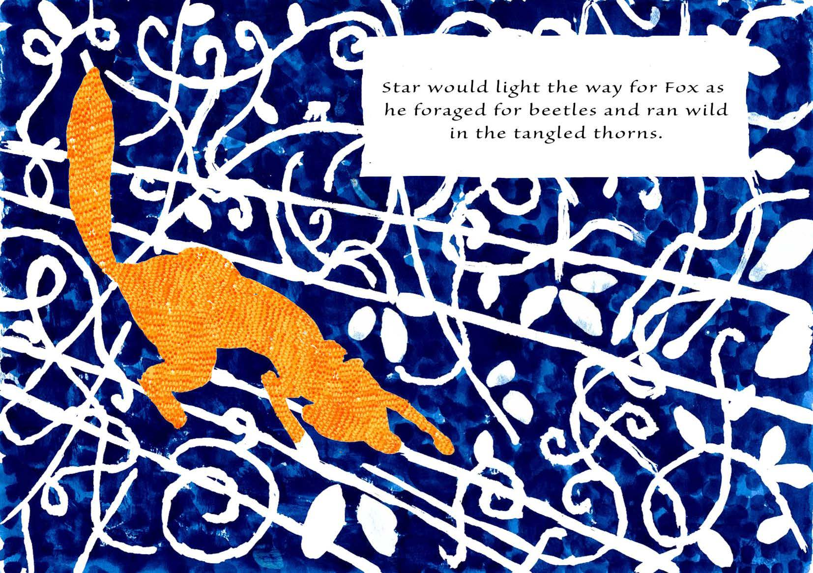
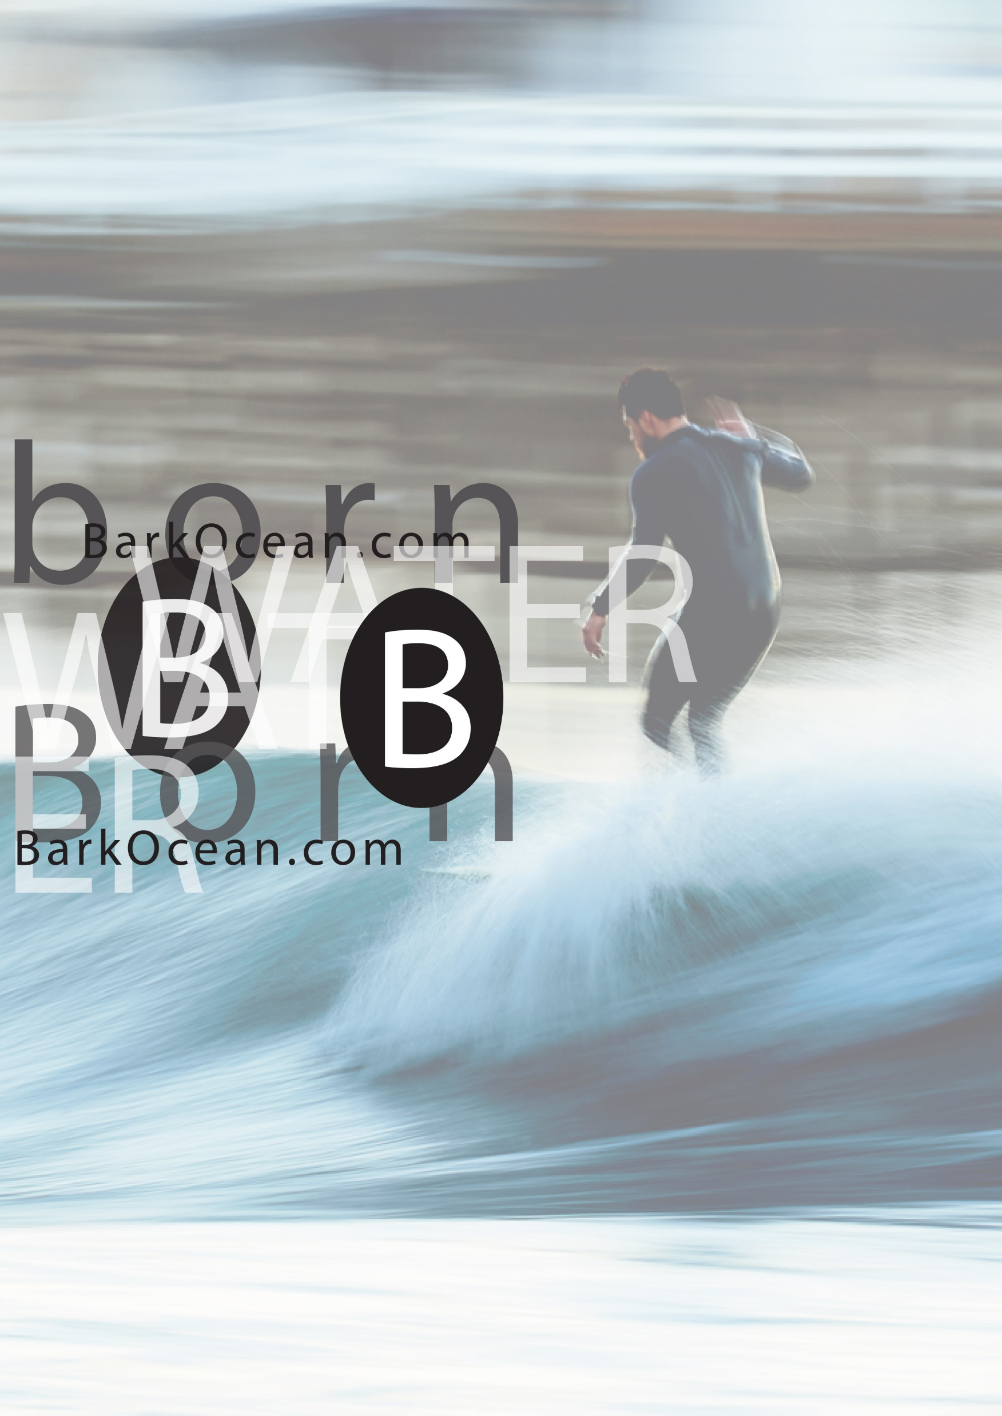
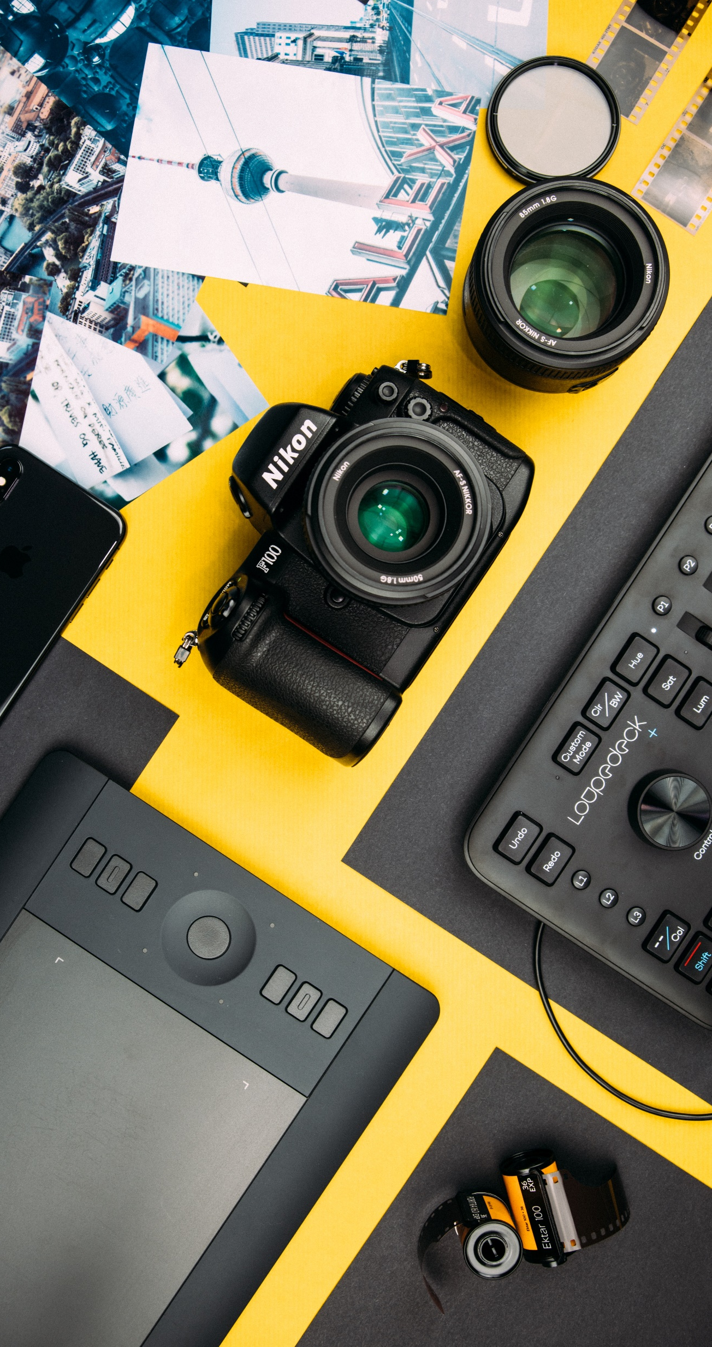

Slide 13
VISUAL DESIGN ASSESSMENT SCHEDULE
YEAR 9 COURSE |  | YEAR 10 COURSE
Making Artworks | 30 % | Making Artworks | 30 %
Theory Responding to Artworks | 20 % | Theory Responding to Artworks | 20 %
Making Artworks | 30 % | Making Artworks | 30 %
Theory Responding to Artworks | 20 % | Theory Responding to Artworks | 20 %

Slide 14
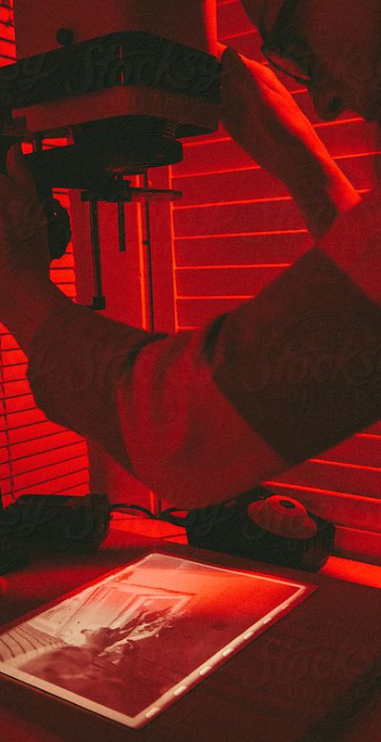
PHOTOGRAPHY, VIDEO and DIGITAL MEDIA

Slide 15
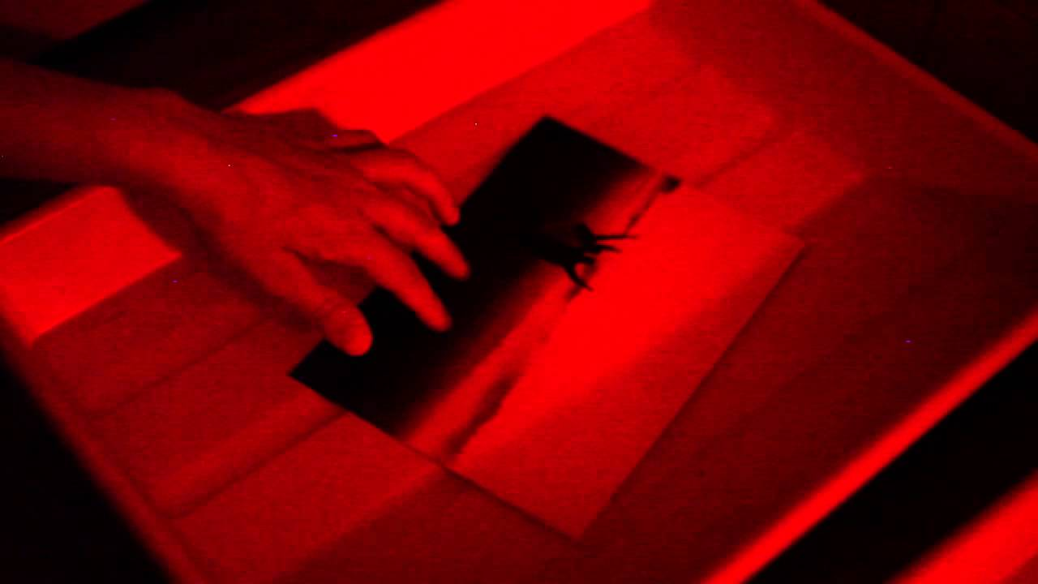
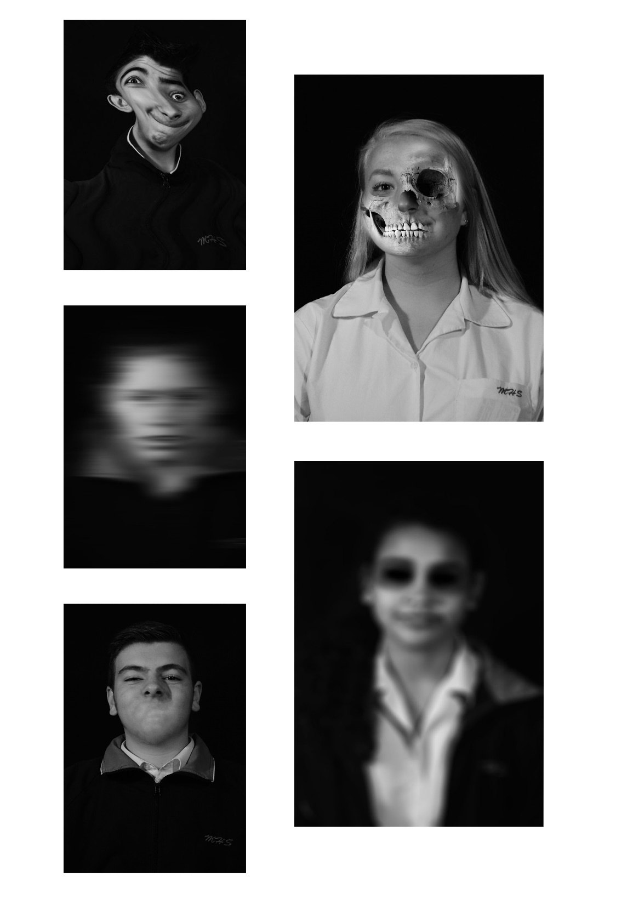
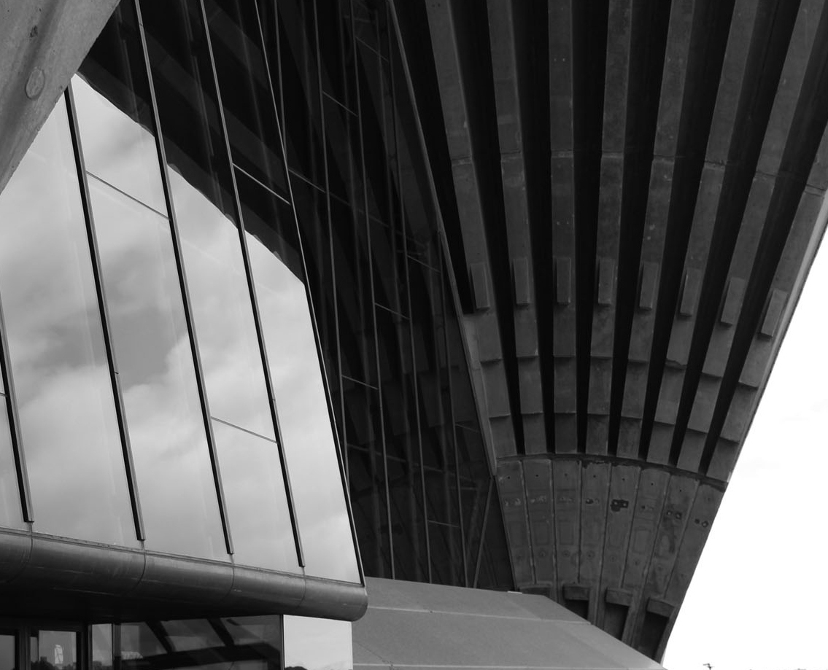
Darkroom (wet) and Digital Photography

Slide 16
PHOTOGRAPHY, VIDEO and DIGITAL MEDIA
ASSESSMENT SCHEDULE
YEAR 9 COURSE |  | YEAR 10 COURSE
Making Artworks | 30 % | Making Artworks | 30 %
Theory Responding to Artworks | 20 % | Theory Responding to Artworks | 20 %
Making Artworks | 30 % | Making Artworks | 30 %
Theory Responding to Artworks | 20 % | Written Exam | 20 %

Slide 17
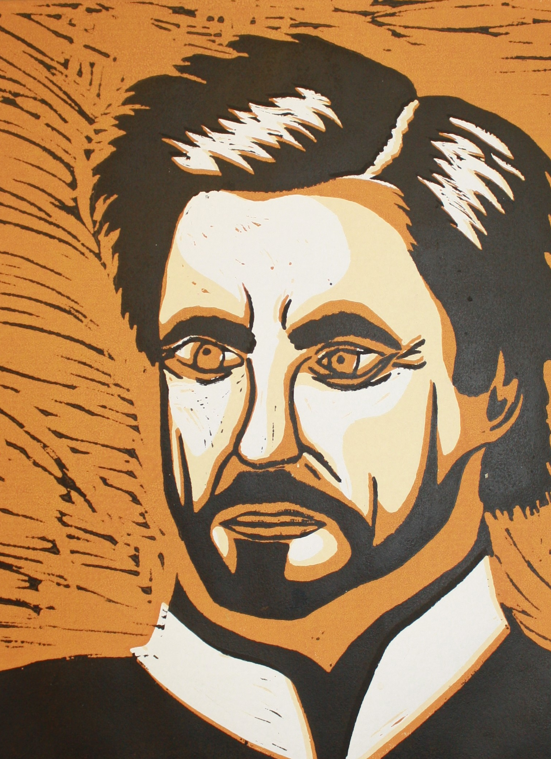
CAREERS
Artist
Art teacher
Teacher
Architecture
Media and Communications
Advertising
Graphic designer
Web design
Jewellery
Tech companies – Apple
Senior creative
Digital animator
Film and television
Social media
Anything on the web and media
Stage design

Slide 18
“It’s in Apple’s DNA that technology alone is not enough. It’s technology married with liberal arts, married with the humanities, that yields the
results that make our hearts sing.”
Steve Jobs – founder of Apple

