Slide 1
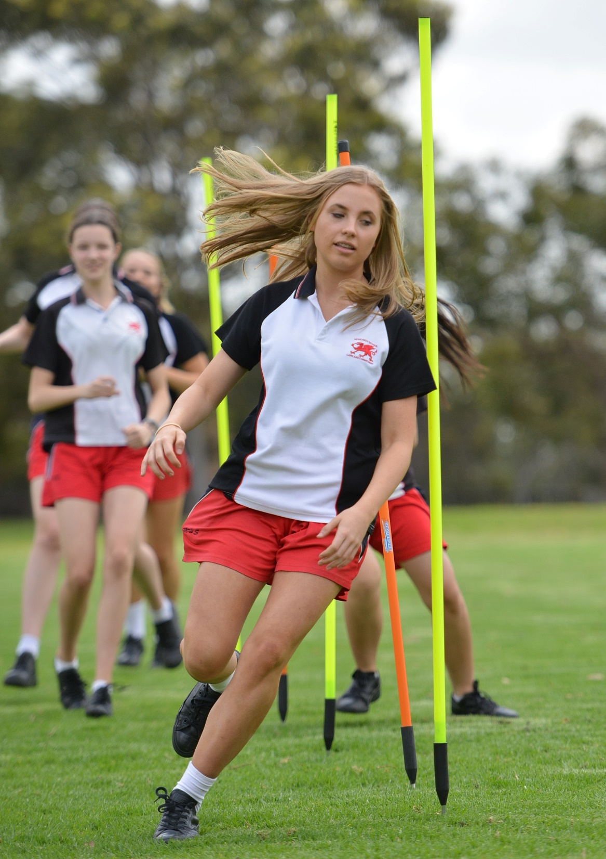
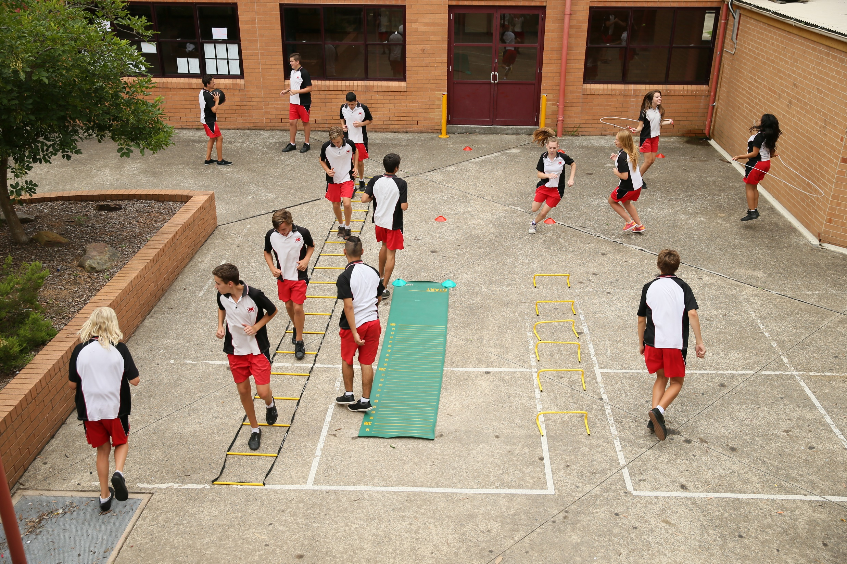
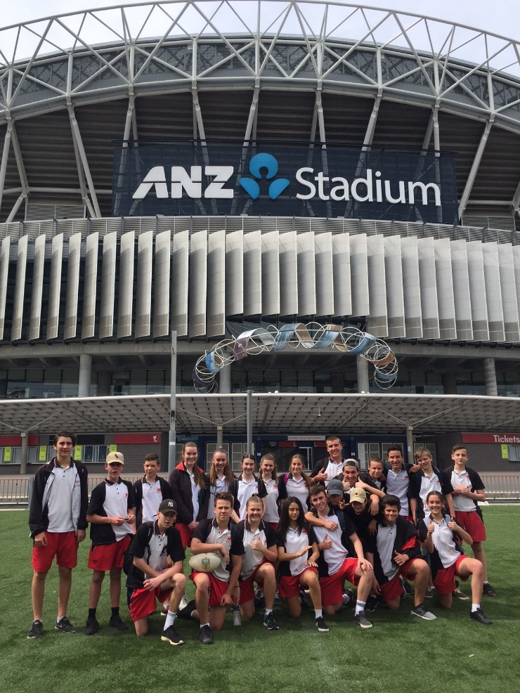
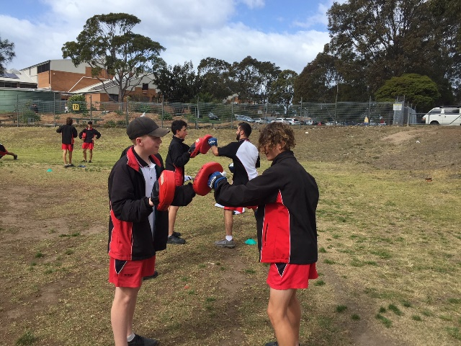
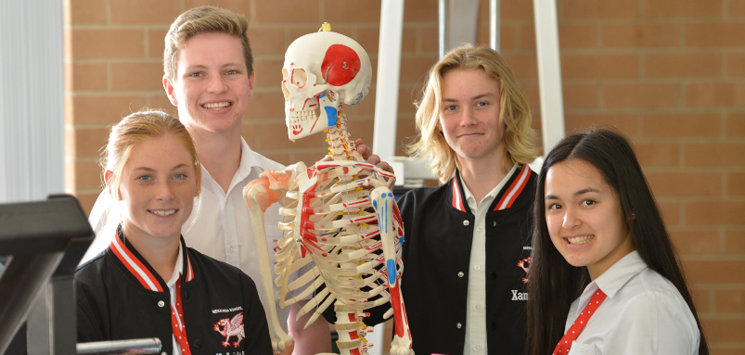
YEAR 9 ELECTIVE – PASS PHYSICAL ACTIVITY AND SPORTS STUDIES

Slide 2
Course Overview
Students who select PASS as an elective in Years 9 and 10 develop a foundation for participation and performance in a range of physical activity and sport movement contexts. They analyse the role of body systems, physical fitness, nutrition and safety, and apply their knowledge and understanding when participating and performing in various movement contexts.
Students demonstrate a knowledge and understanding of the factors that limit and enhance their capacity to move and perform efficiently and develop their ability to transfer movement skills in a variety of contexts.
Students establish a repertoire of strategies and techniques to develop movement skills and enhance their capacity to participate and perform. They analyse how effective and appropriate these strategies are in preparing themselves and others for particular physical activity and sport opportunities.

Slide 3
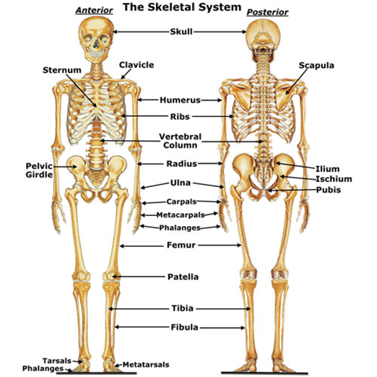
Area of Study 1 – Foundations of Physical Activity
In this area of study students are provided with the opportunity to explore and develop the foundations for participation and performance in physical activity and sport.
Overview of modules
Body systems and energy for physical activity – anatomy and physiology (skeletal, muscular, respiratory, circulatory, energy systems)
Physical activity for health
Physical fitness
Nutrition and physical activity
Participating with safety.

Slide 4
Area of Study 2 – Physical Activity and Sport in Society
In this area of study students explore physical activity and sport from national, community and individual perspectives. Students develop a broad understanding of the roles and effects of physical activity and sport, and the benefits and opportunities they can provide.
Overview of modules
Australia’s sporting identity – Australia at the Olympics
Opportunities and pathways in physical activity and sport
Issues in physical activity and sport

Slide 5
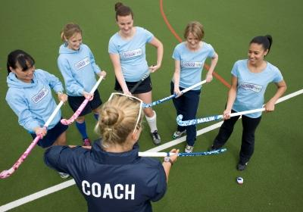
Area of Study 3 – Enhancing Participation and Performance
In this area of study students are provided with opportunities to enhance their participation and performance in physical activity and sport. Students explore strategies to promote active lifestyles and also develop skills in specific movement contexts.
Overview of modules
Coaching
Enhancing performance – strategies and techniques
Technology, participation and performance
Event management.

Slide 6
Additional Information and Enquiries:
The PASS course has a high volume of practical work and physical activity and requires students to have a MHS sports uniform for all practical lessons.
As a guide, students will attend six PASS lessons per fortnight (three lessons practical, three lessons theory based)
For more information or questions, please feel free to contact Matt Robinson (Head Teacher) via email (matthew.robinson@det.nsw.edu.au)

