Slide 1
CREATIVE AND PERFORMING ARTS
Year 11 and 12
Menai High School

Slide 2
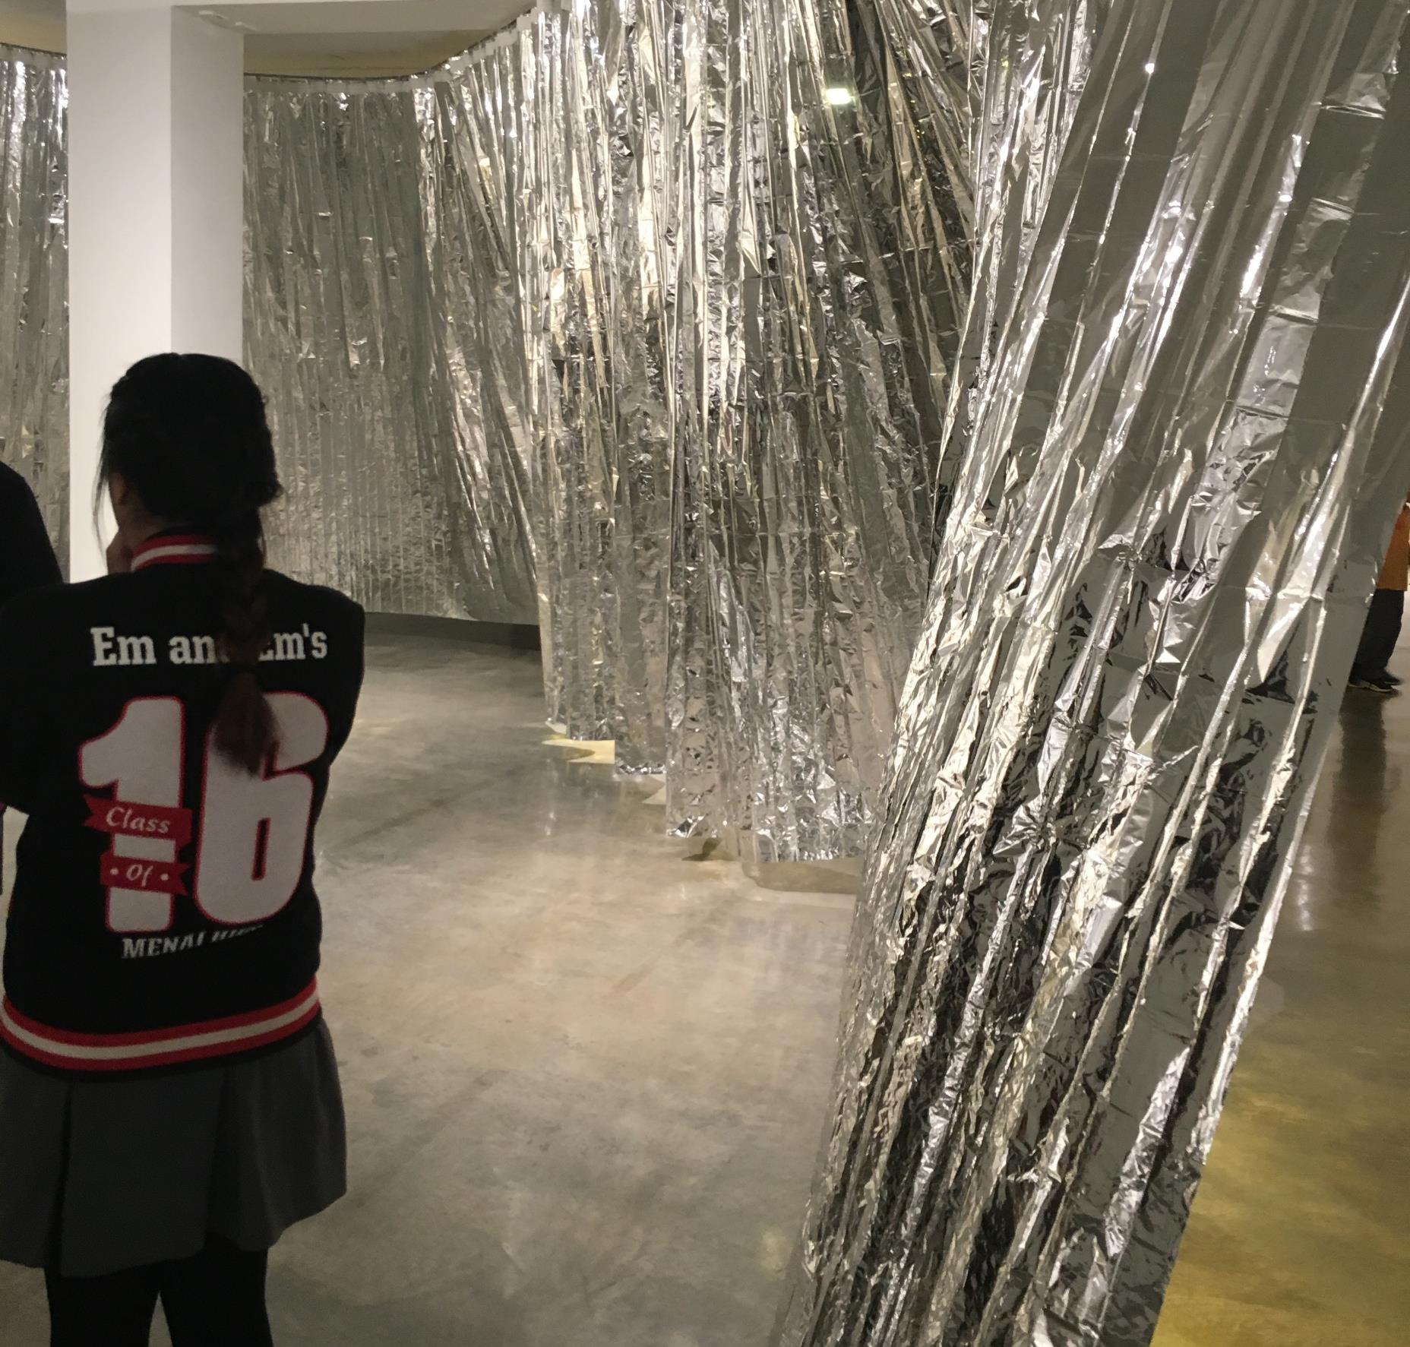
It’s about an ATAR
The ATAR is a number
Not vocational training
The higher the marks in each subject, the higher the ATAR

Slide 3
STRATEGY
Don’t do a subject because someone else is saying you should
DO THE SUBJECTS YOU LIKE AND ARE GOOD AT
IF YOU DO THE SUBJECTS YOU LIKE AND ARE GOOD AT, YOU’LL GET HIGH MARKS
=
HIGHER ATAR

Slide 4
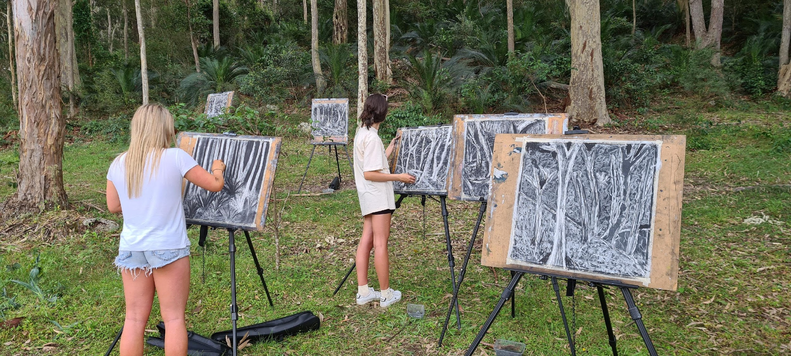
Dance
Drama
Music
Visual Arts
Visual Design
Photographic and Digital Media

Slide 5
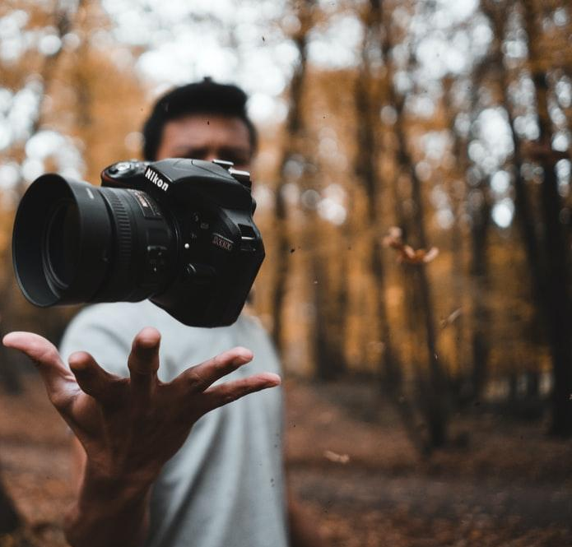
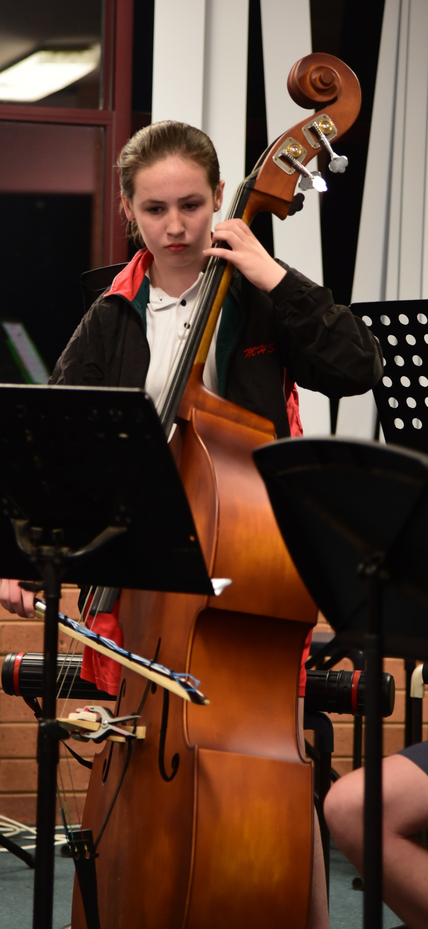
MYTHS
Scaling
Jobs
Difficulty
Talent

Slide 6
Scaling

Slide 7
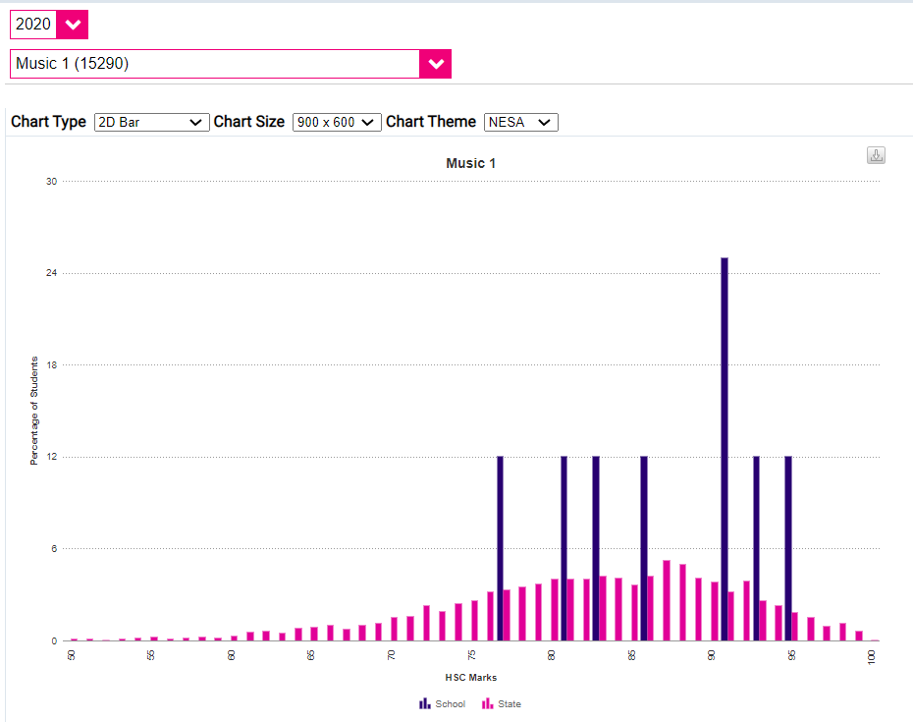
MUSIC
HSC Results
Menai is BLUE
The rest of the state is PINK

Slide 8
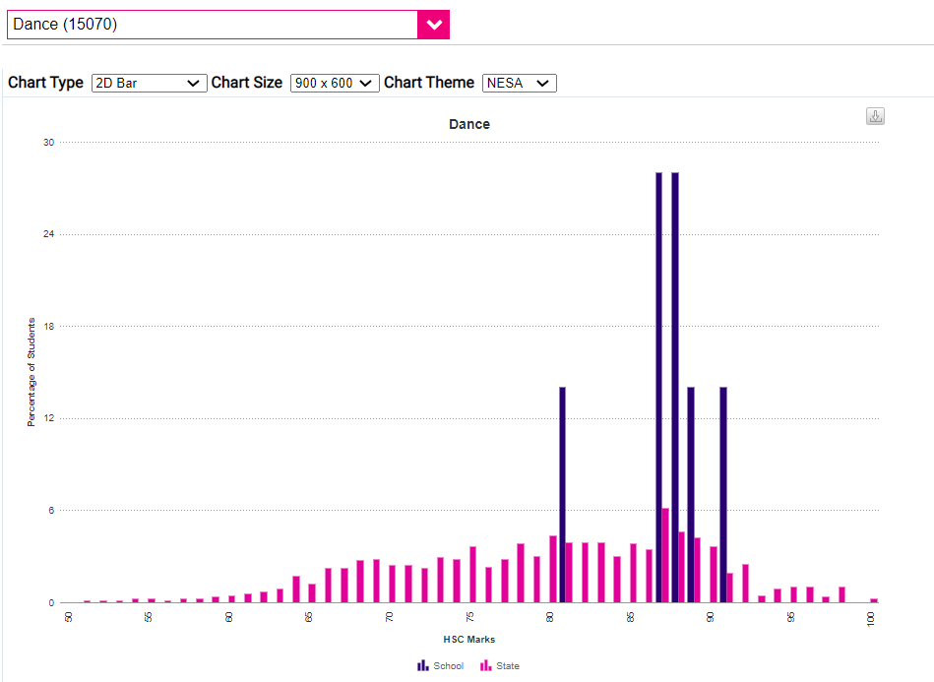
DANCE
HSC Results
Menai is BLUE
The rest of the state is PINK

Slide 9
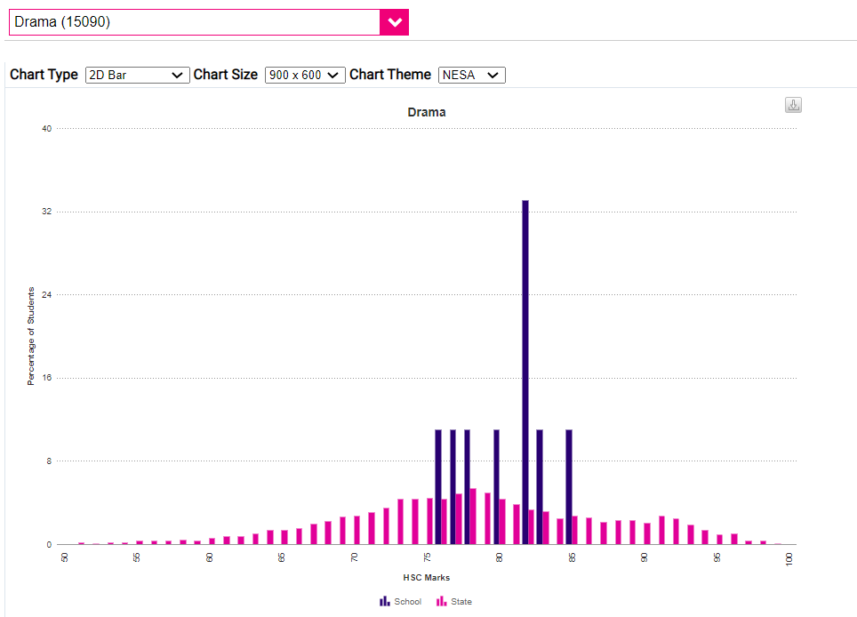
DRAMA
HSC Results
Menai is BLUE
The rest of the state is PINK

Slide 10
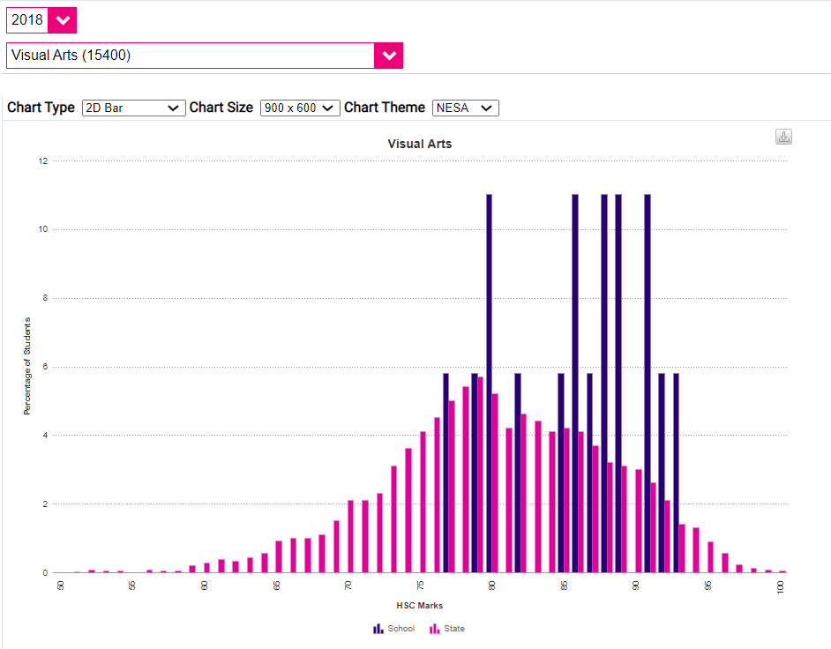
VISUAL ARTS
HSC Results
Menai is BLUE
The rest of the state is PINK

Slide 11
Jobs
it’s not a “hobby” - it’s and INDUSTRY

Slide 12
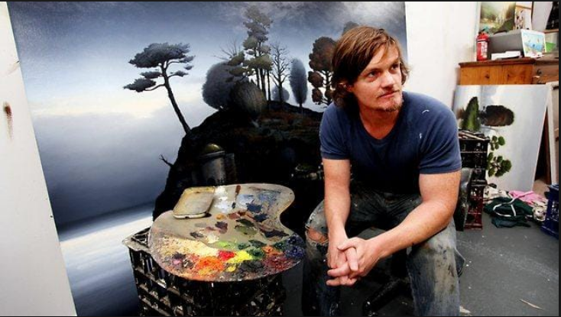
Alexander Mackenzie - Contemporary Australian Artist

Slide 13
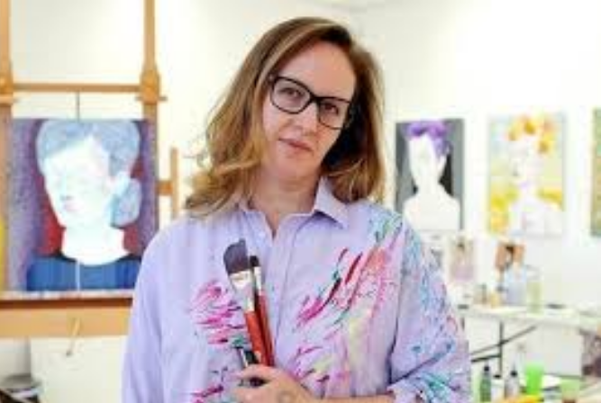
Del Kathryn Barton - Contemporary Australian Artist

Slide 14
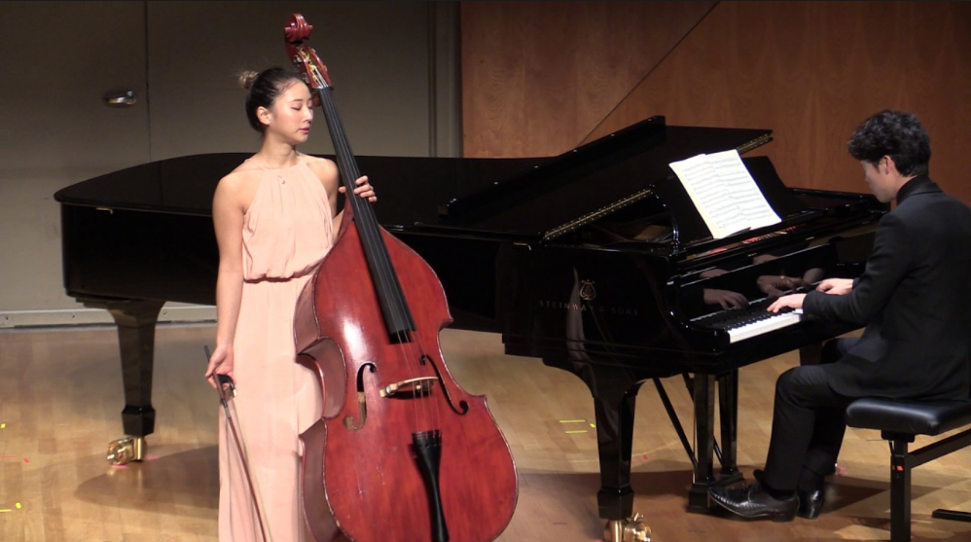
Mikyung Sung - Professional Musician

Slide 15
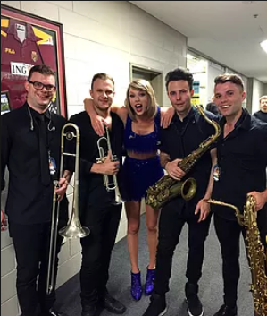
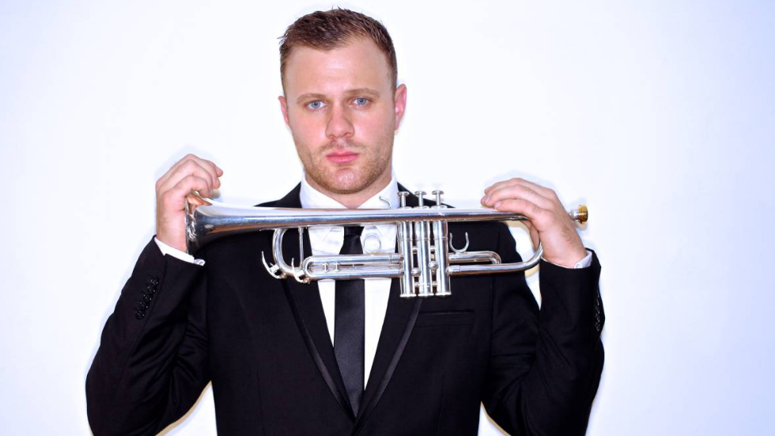
Dane Laboyrie - Professional Musician

Slide 16
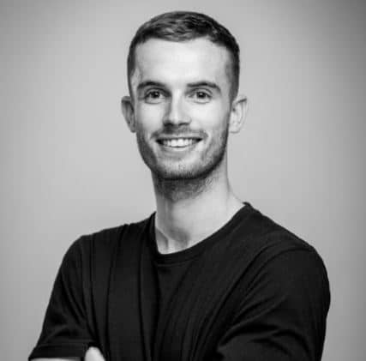
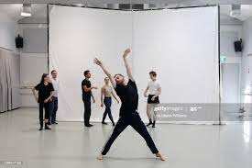
Dean Elliot - Professional Dancer - Sydney Dance Company

Slide 17
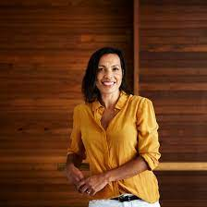
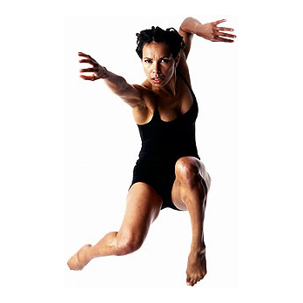
Francis Rings - Dancer / Choreographer - Bangara Dance Company

Slide 18
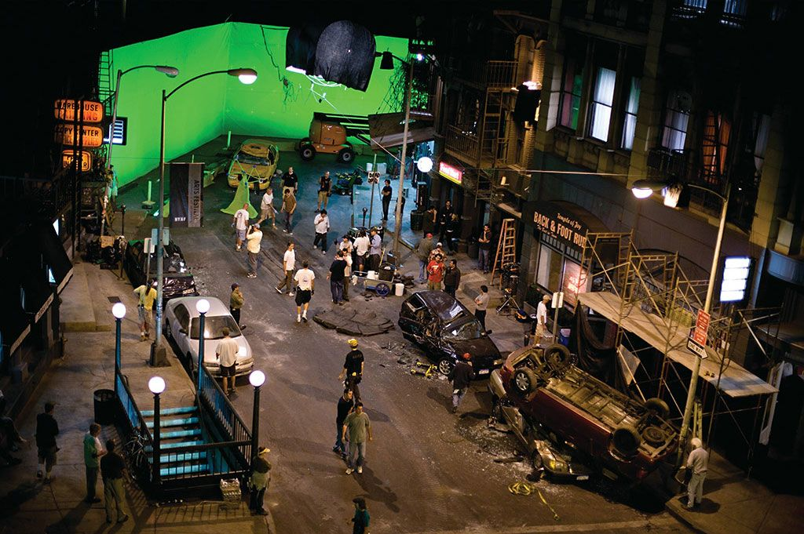

Slide 19
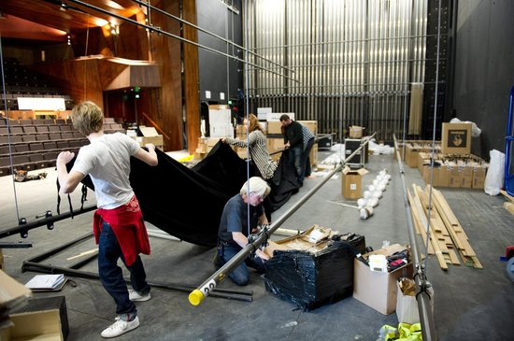

Slide 20
Difficulty
Talent

Slide 21
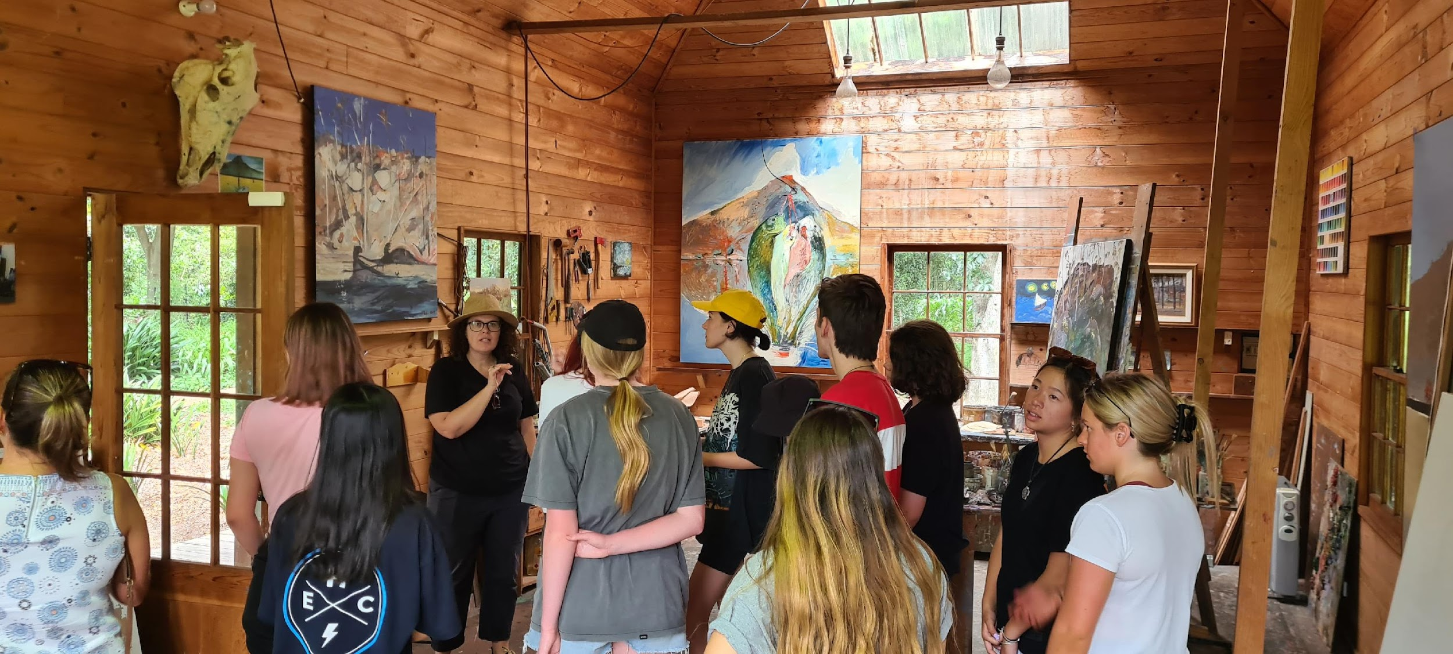
Majority of students
Visual Arts, Music, Dance, Drama was their highest mark
80%

Slide 22
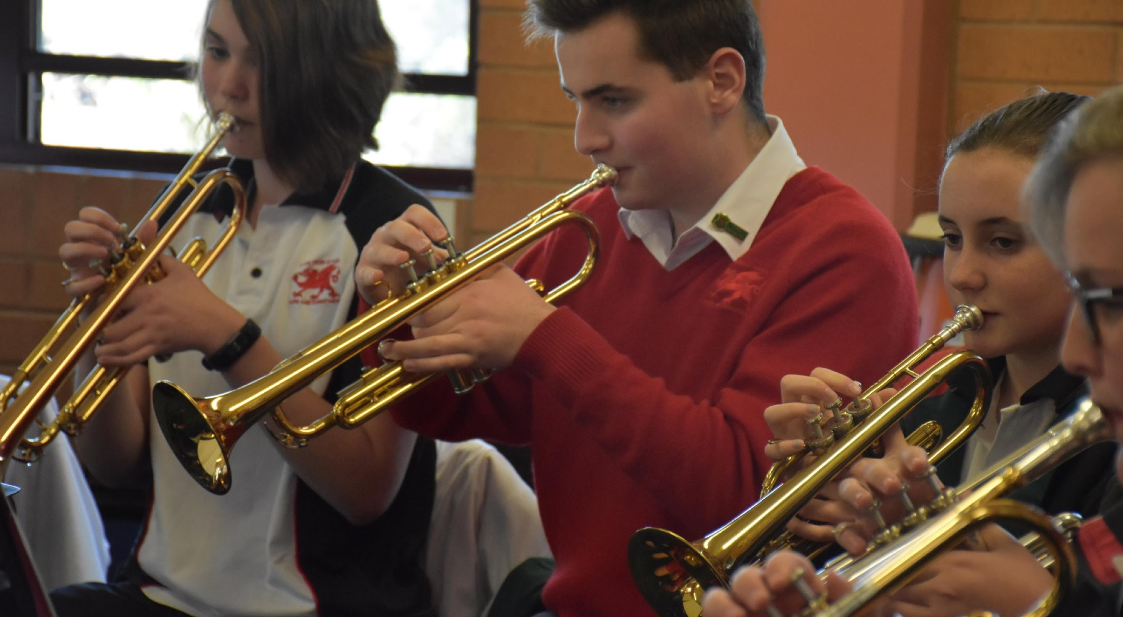
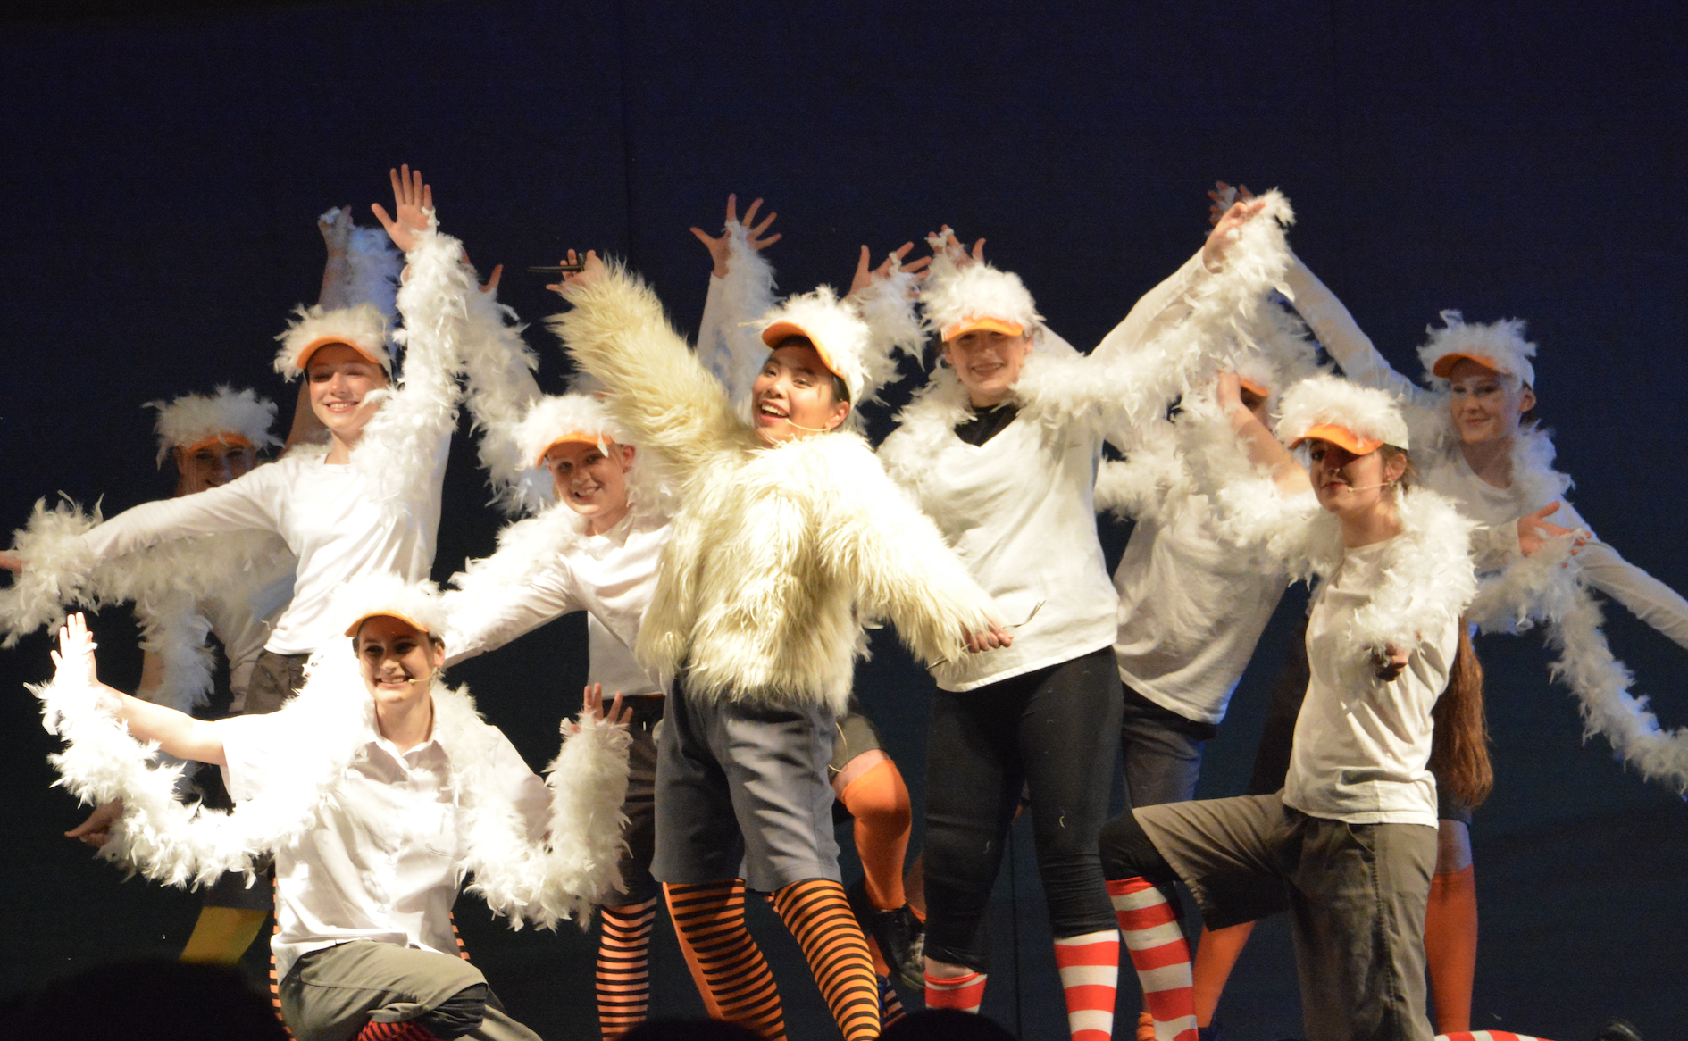
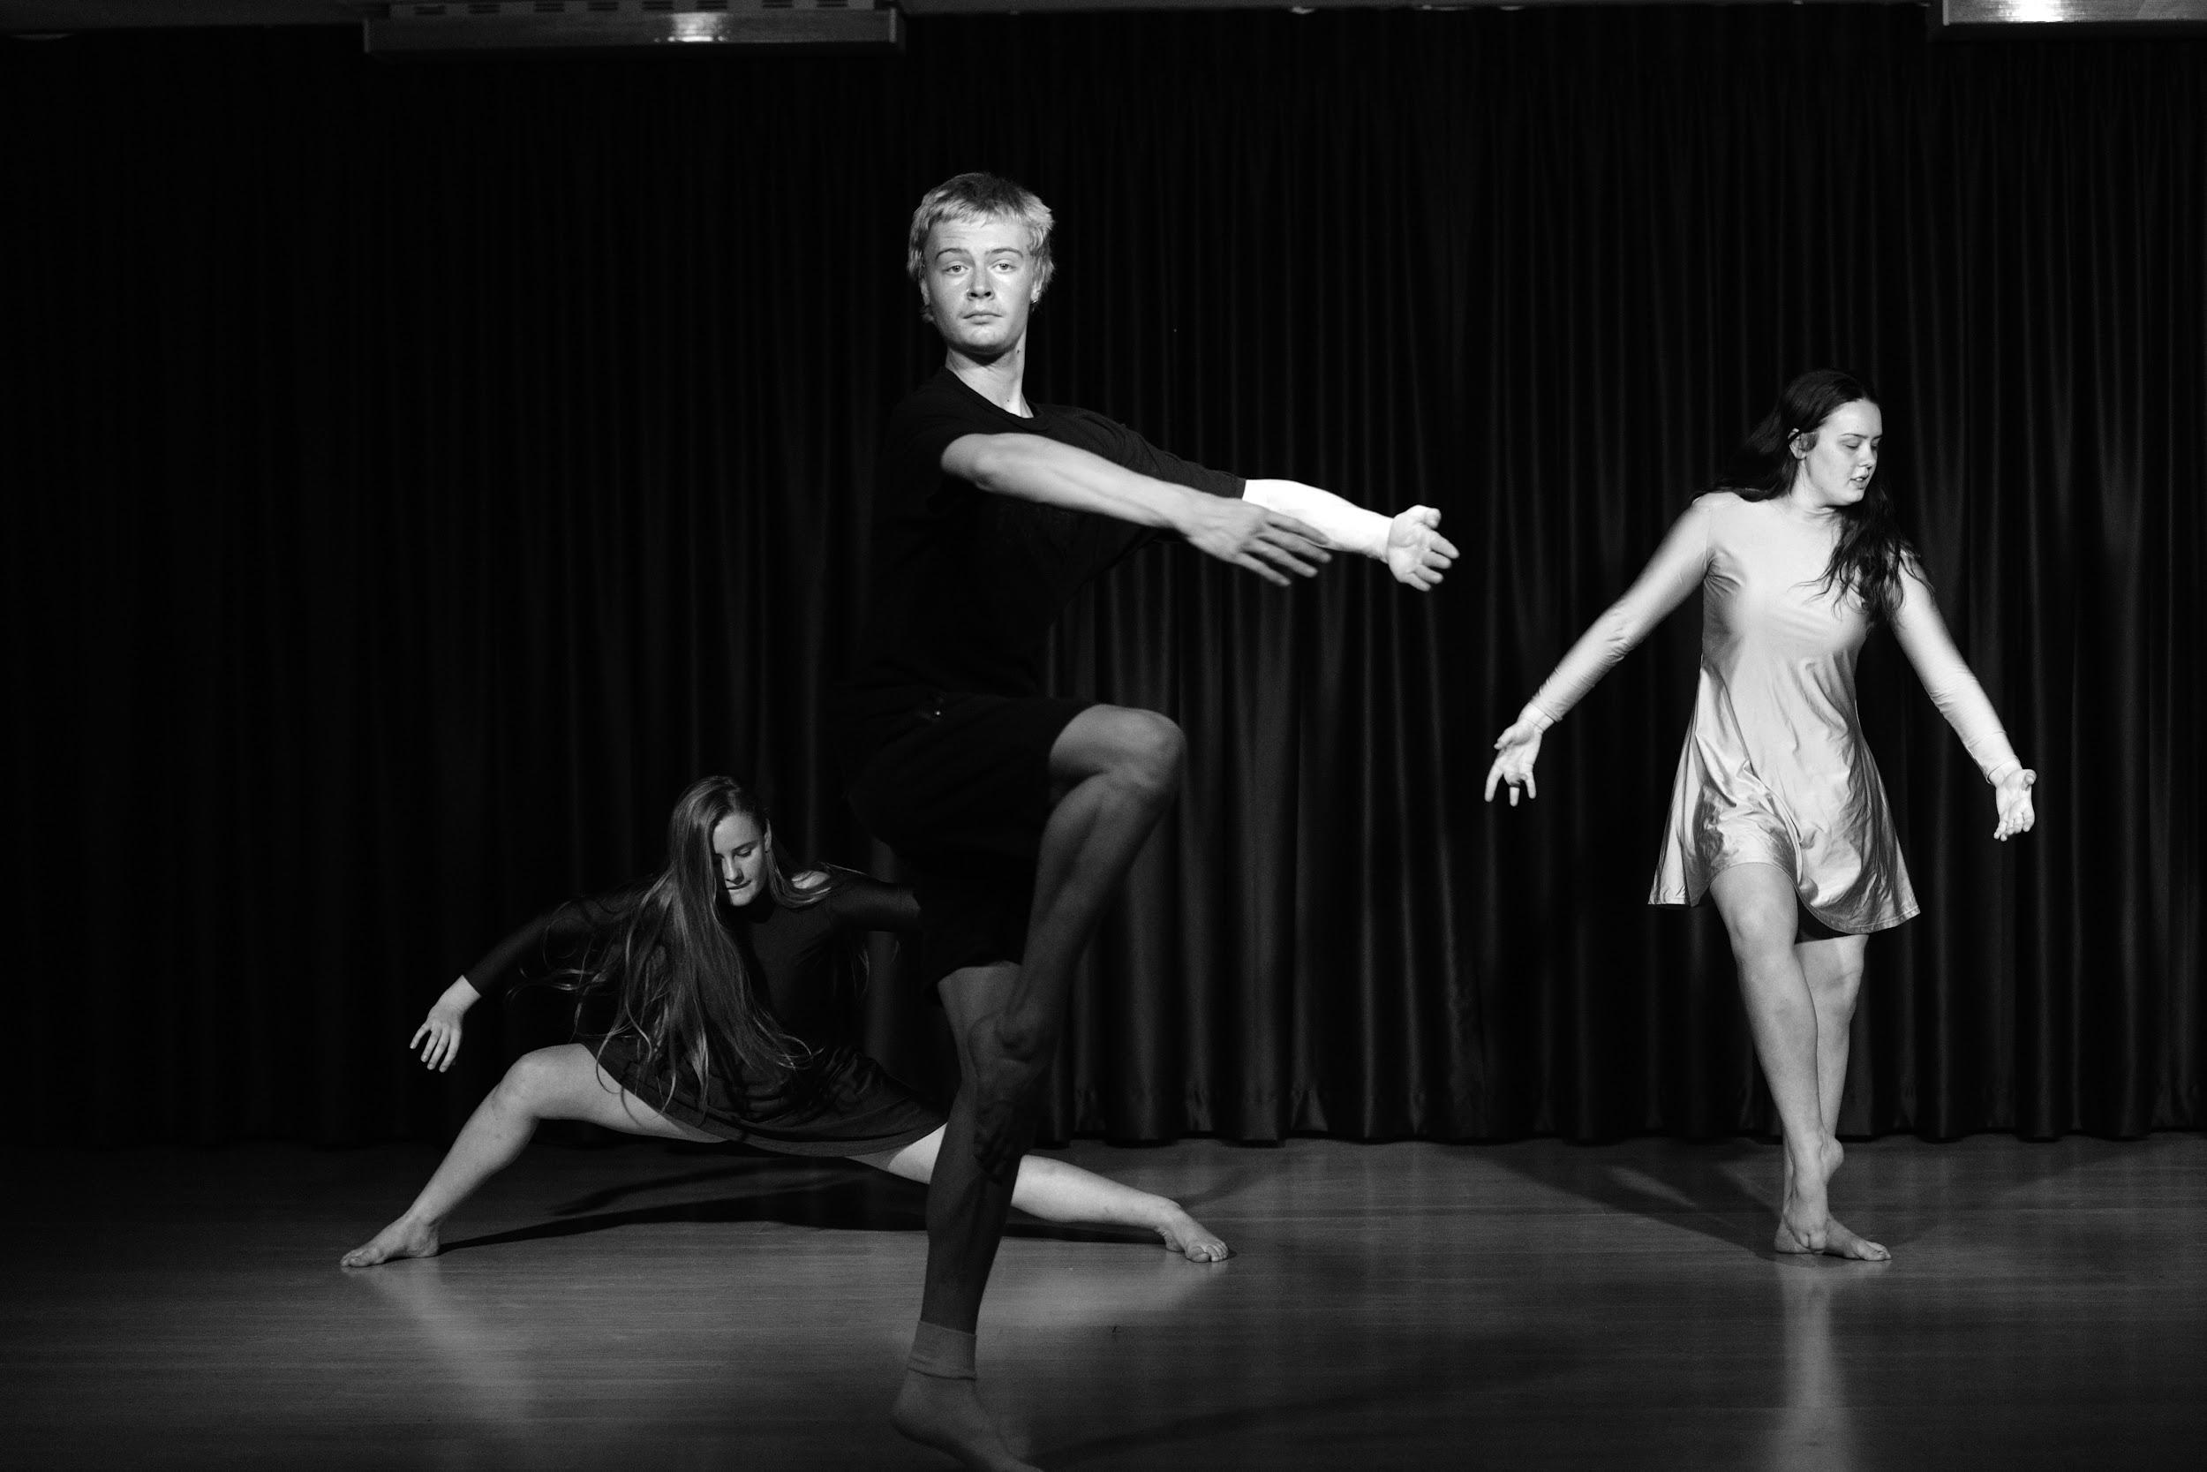
“Tell me and I forget…
teach me and I may remember….
involve me and I’ll learn”
Benjamin Franklin

Slide 23
Creativity and Problem Solving
Initiative and Enterprise
Self-learning and Project Based Learning
Communication
Collaboration
Planning and Organising
Time Management
Technology
Cross-Cultural Understanding

Slide 24
“It’s in Apple’s DNA that technology alone is not enough. It’s technology married with liberal arts, married with the humanities, that yields the results that make our hearts sing.”
Steve Jobs – founder of Apple

Slide 25
Questions??
Speak to your Dance, Drama, Music or Visual Arts Teacher via;
Email
Google Classroom
Sentral Portal messaging
Parents can email the school – attention to your teacher’s name
menai-h.school@det.nsw.edu.au
Mr Middleton, Head Teacher Creative and Performing Arts
neil.middleton@det.nsw.edu.au

