Slide 1
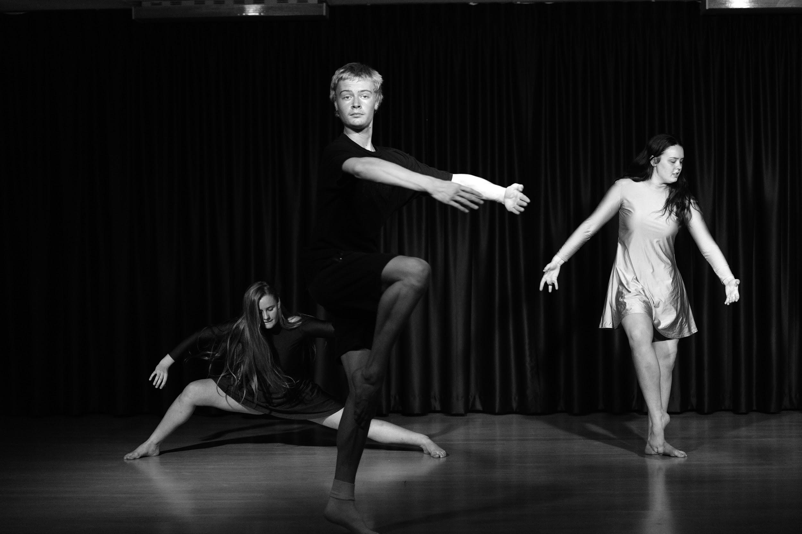
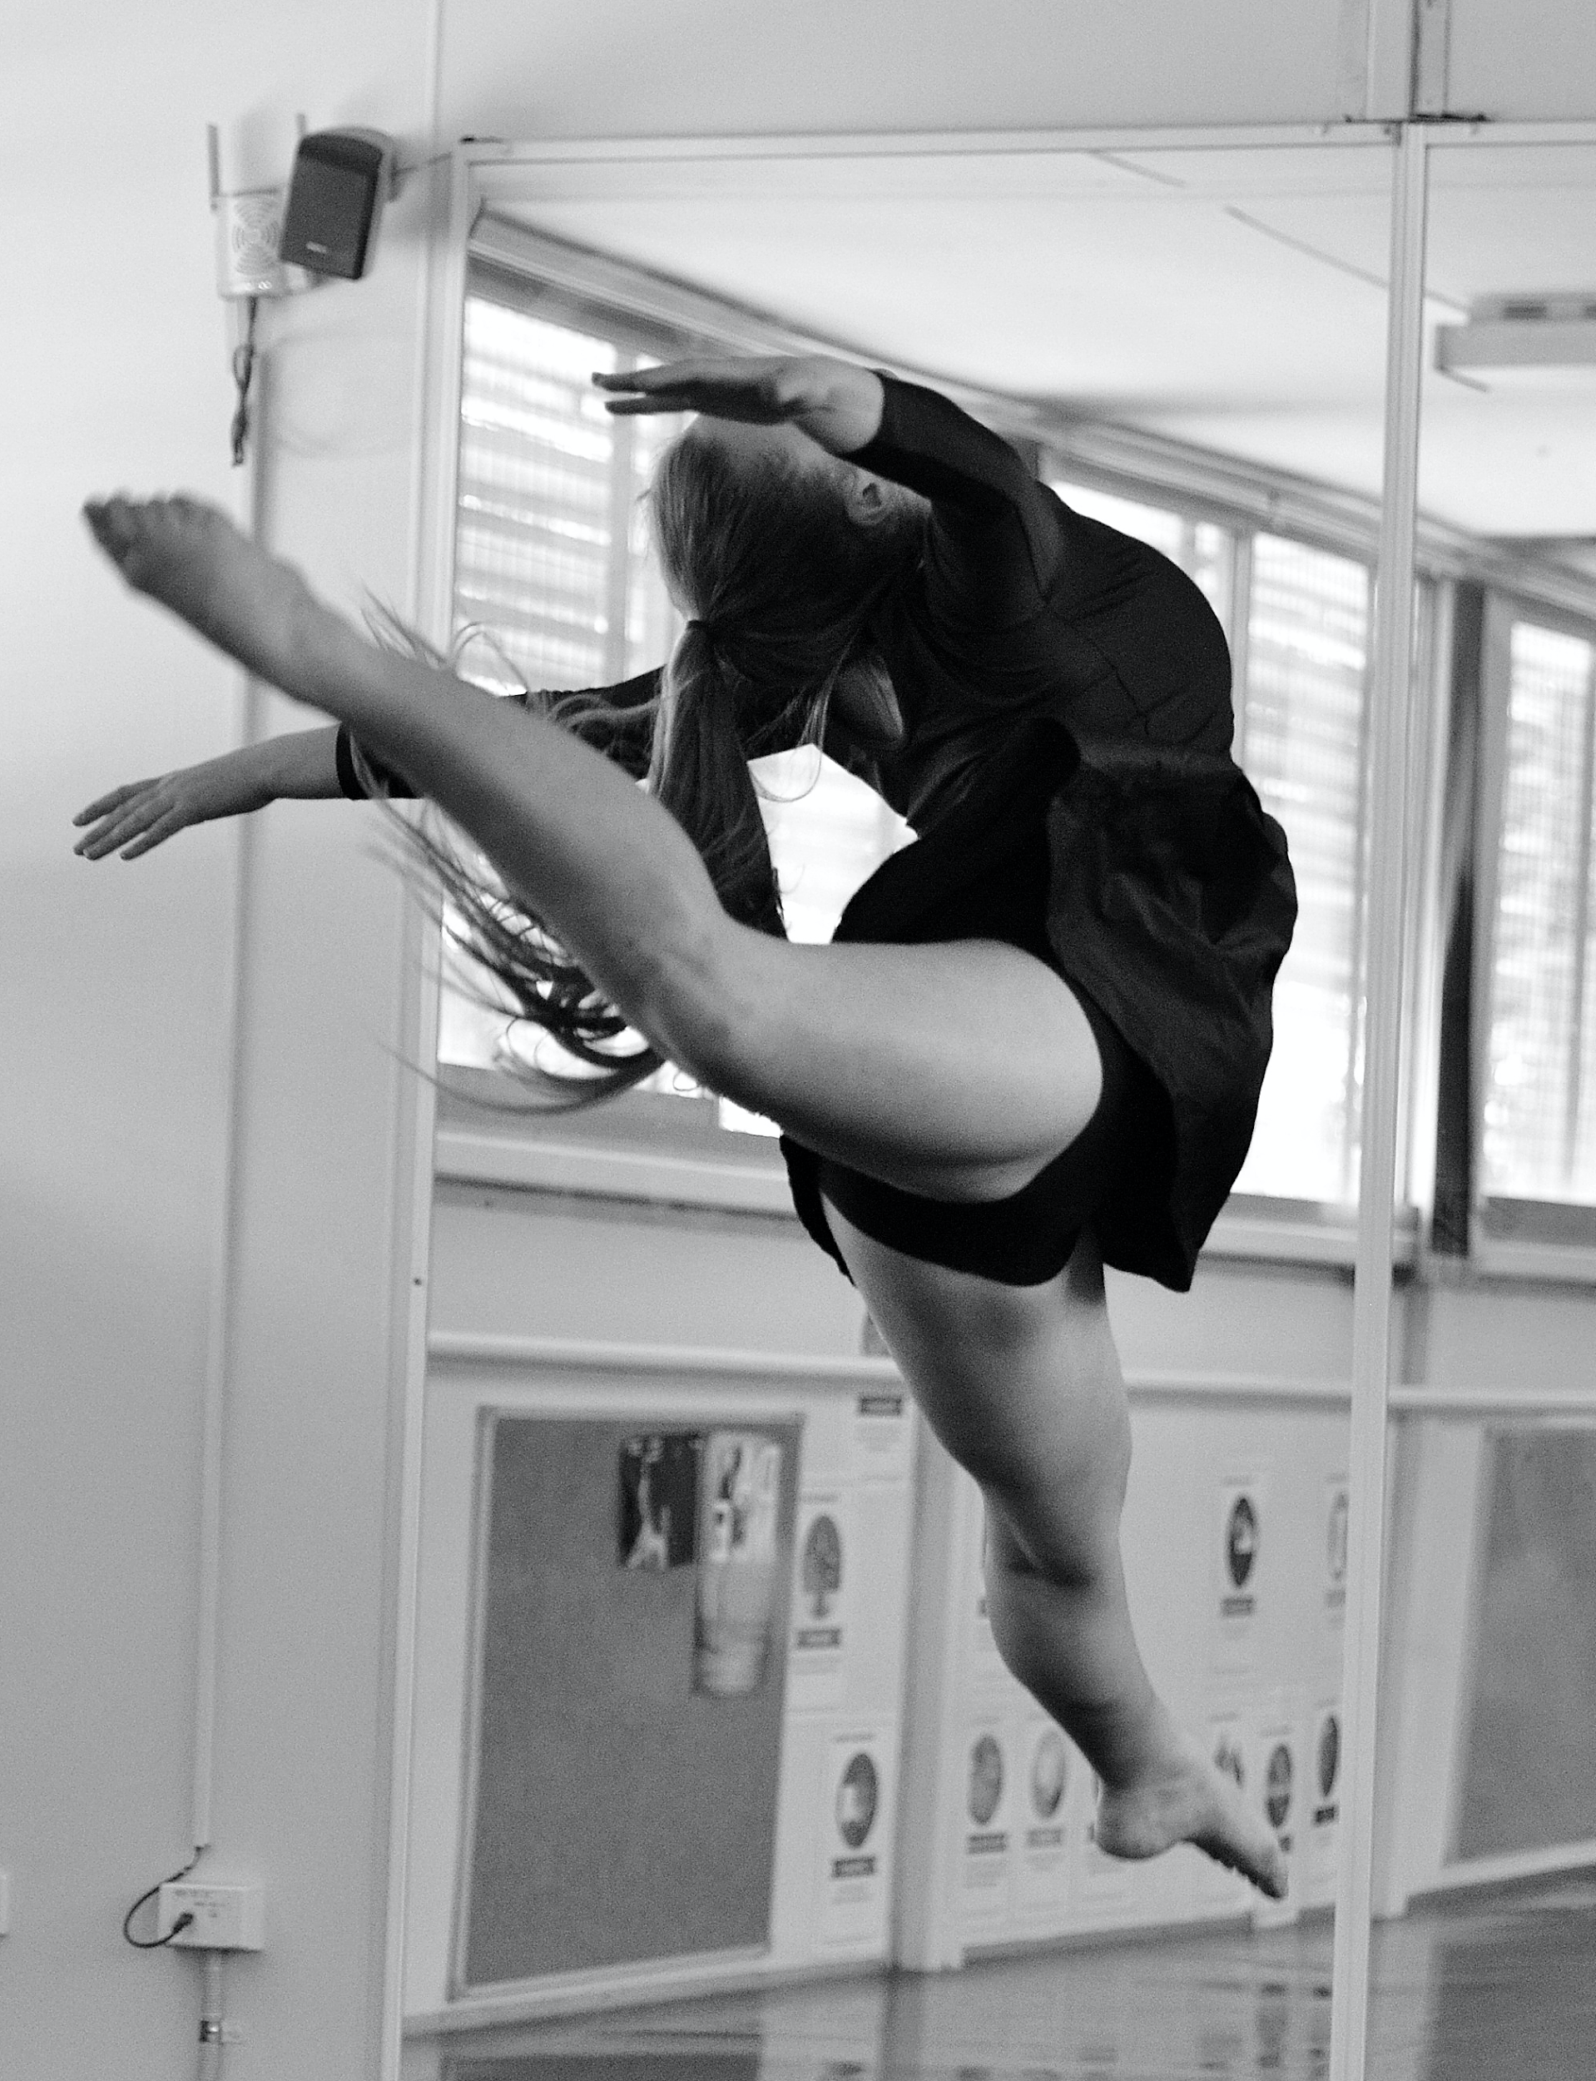
DANCE
2 UNIT – 2 YEARS - ATAR

Slide 2
Dance – HSC – 2 UNIT – ATAR
60% PERFORMANCE - Performing Dance
20% COMPOSITION - Creating Dance
20% APPRECIATION - Writing for Dance

Slide 3
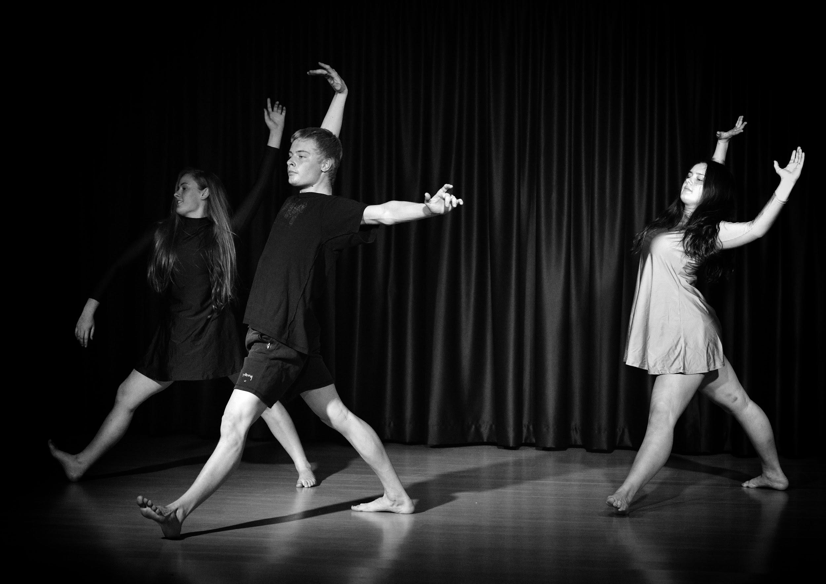
DANCE
Previous Dance training is not essential for HSC Dance, but can be beneficial.
Previous study of Dance in Years 9 and 10 is also not essential.
Menai High School has many Dance ensembles and companies that students can join to increase their technique and performance quality and take part in various performance opportunities.

Slide 4
The Course:
Dance in Stage 6 is designed for students to experience, understand and value dance as an artform through:
Dance Performance
Dance Composition
Dance Appreciation

Slide 5
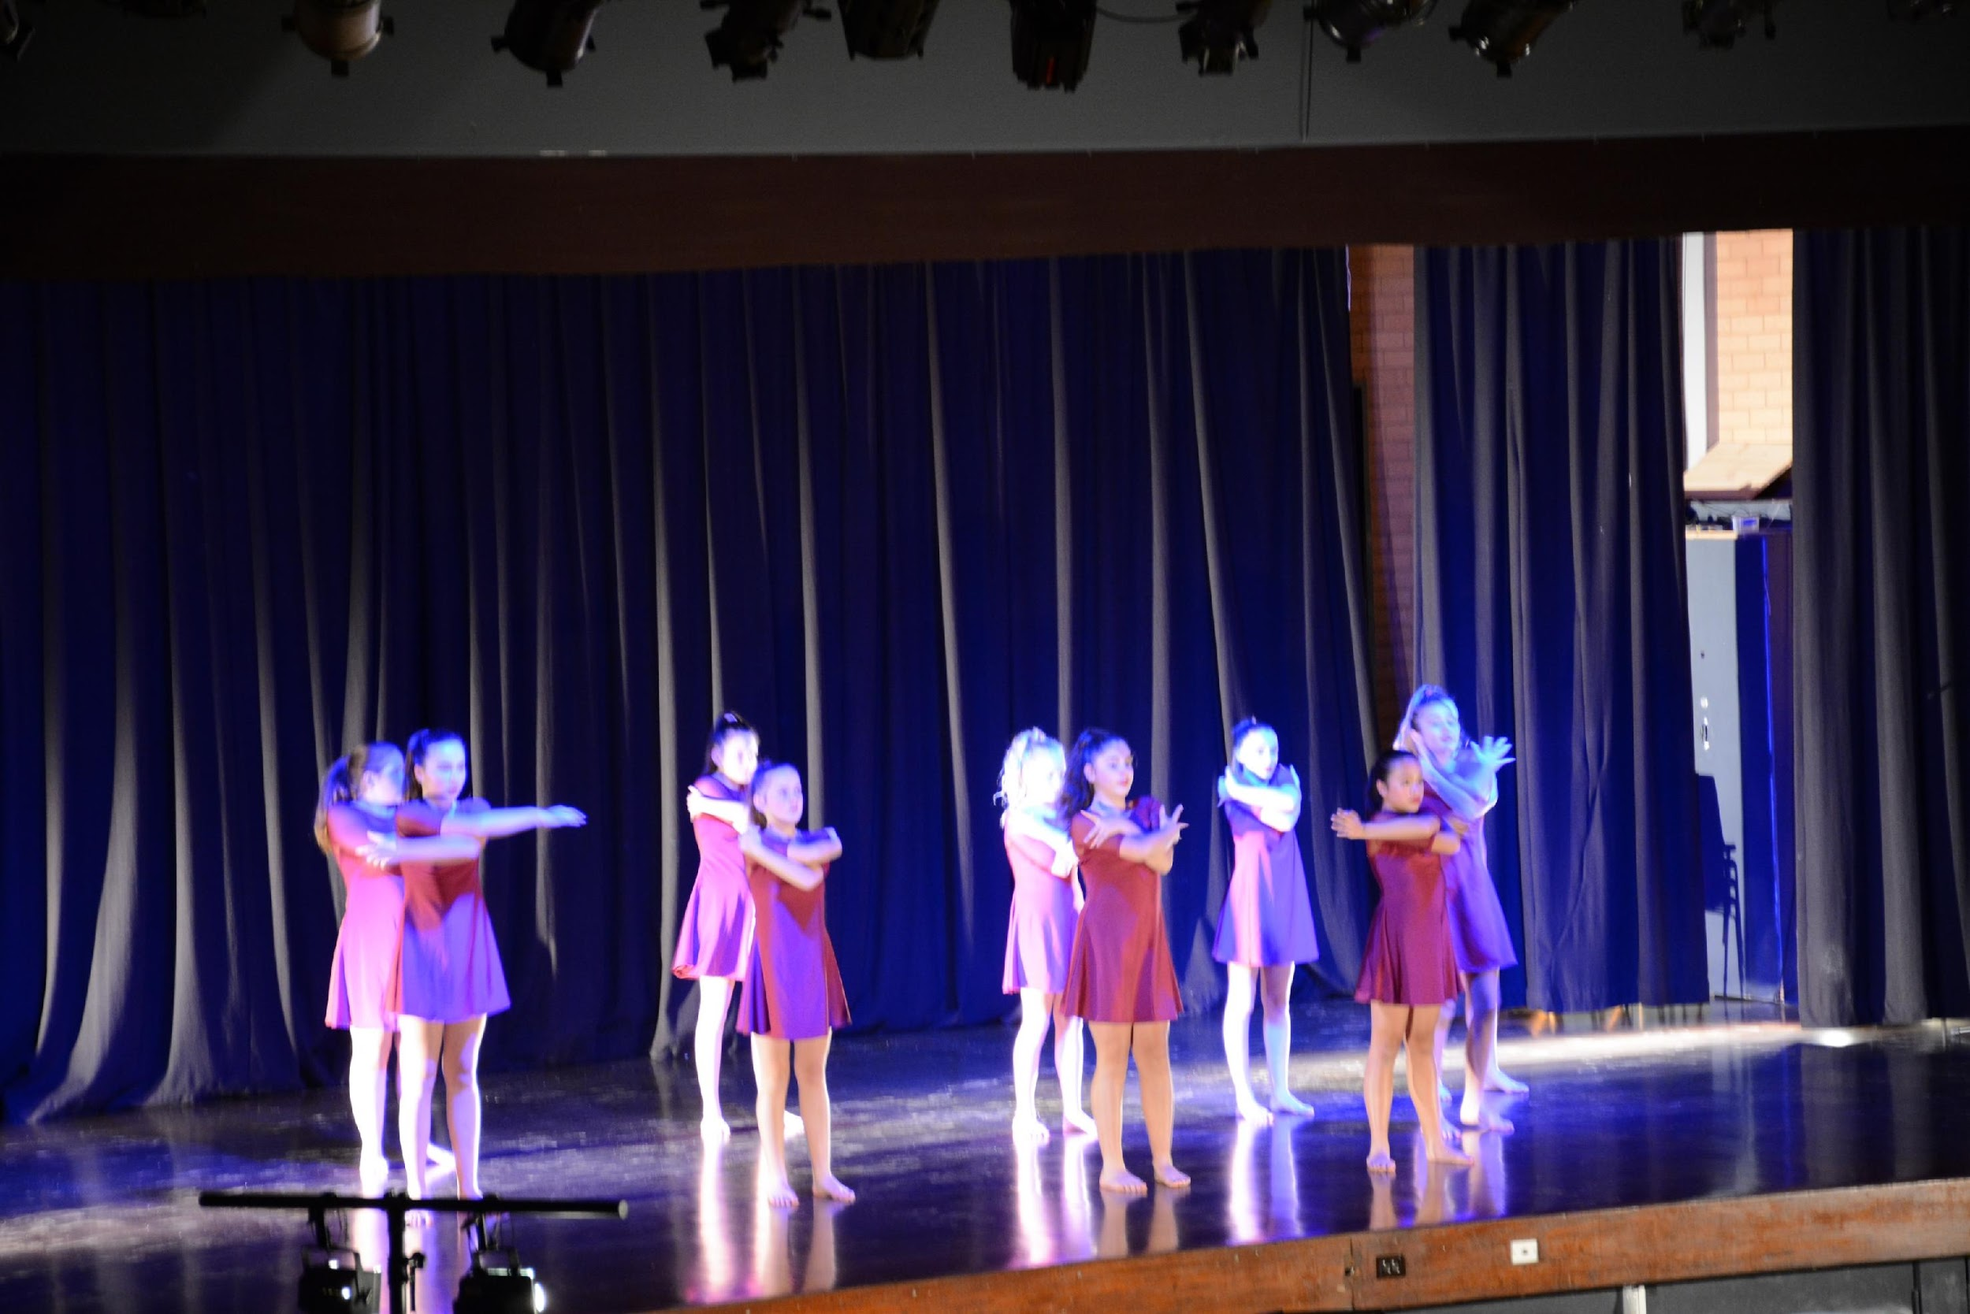
HSC EXAM REQUIREMENTS
MANDATORY:
Core Performance - 3 - 5 min dance - Teacher devised - Performed by the student
Core Composition - 3-5 min dance - Student devised - Performed by a younger student at the school
Core Appreciation - 2 written essays - covering both Australian and International Dance works
EACH STUDENT THEN CHOOSES ONE ADDITIONAL MAJOR IN EITHER:
Major Performance
Major Composition
Major Appreciation
Major Film and Video
Major Dance in Technology

Slide 6
ASSESSMENT SCHEDULE
YEAR 11 (Preliminary) Course |  | YEAR 12 (HSC) Course
Performance (Core and Major) | 60% | Core Performance | 20%
 |  | Core Composition | 20%
Composition | 20%
 |  | Core Appreciation | 20%
Appreciation | 20%
 |  | Major Study | 40%

Slide 7
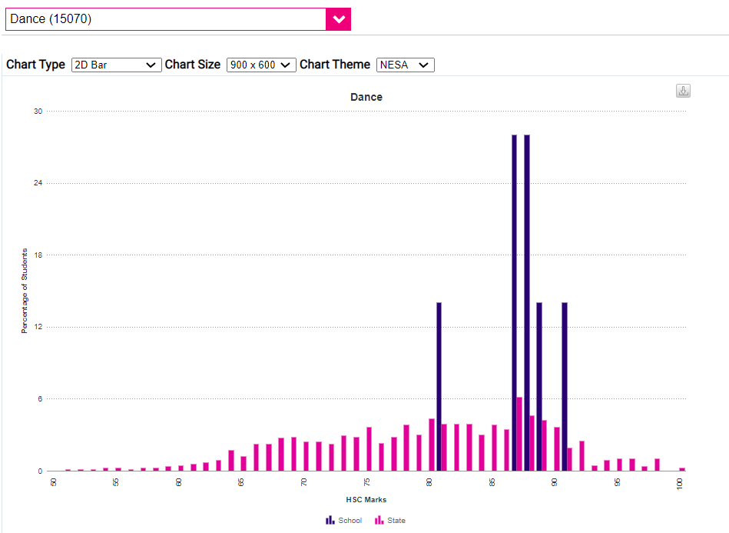
DANCE
HSC Results
Menai is BLUE
The rest of the state is PINK

Slide 8
