Slide 1
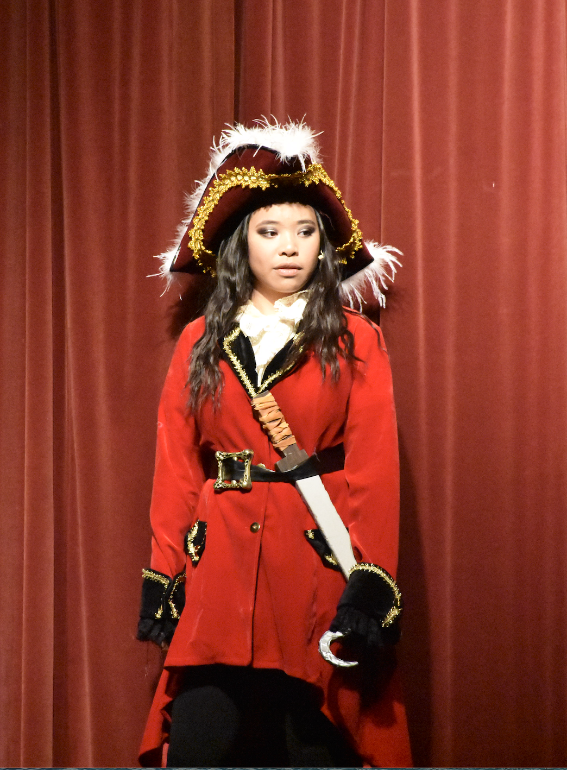
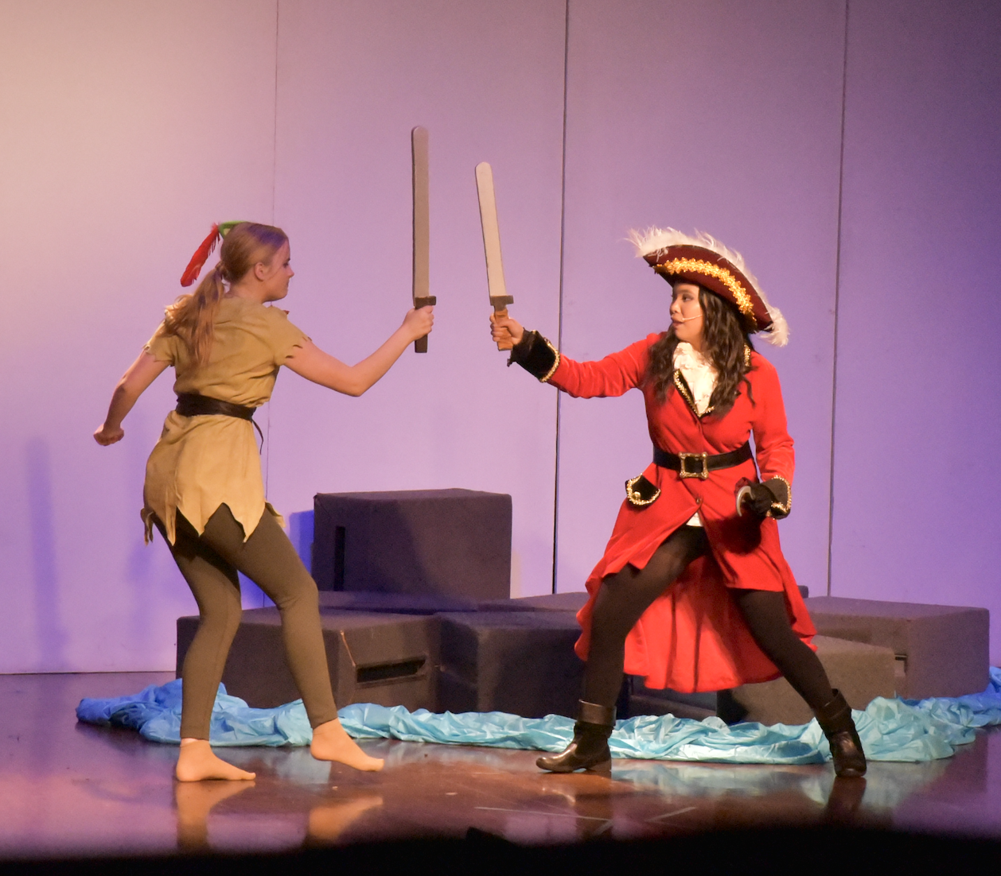
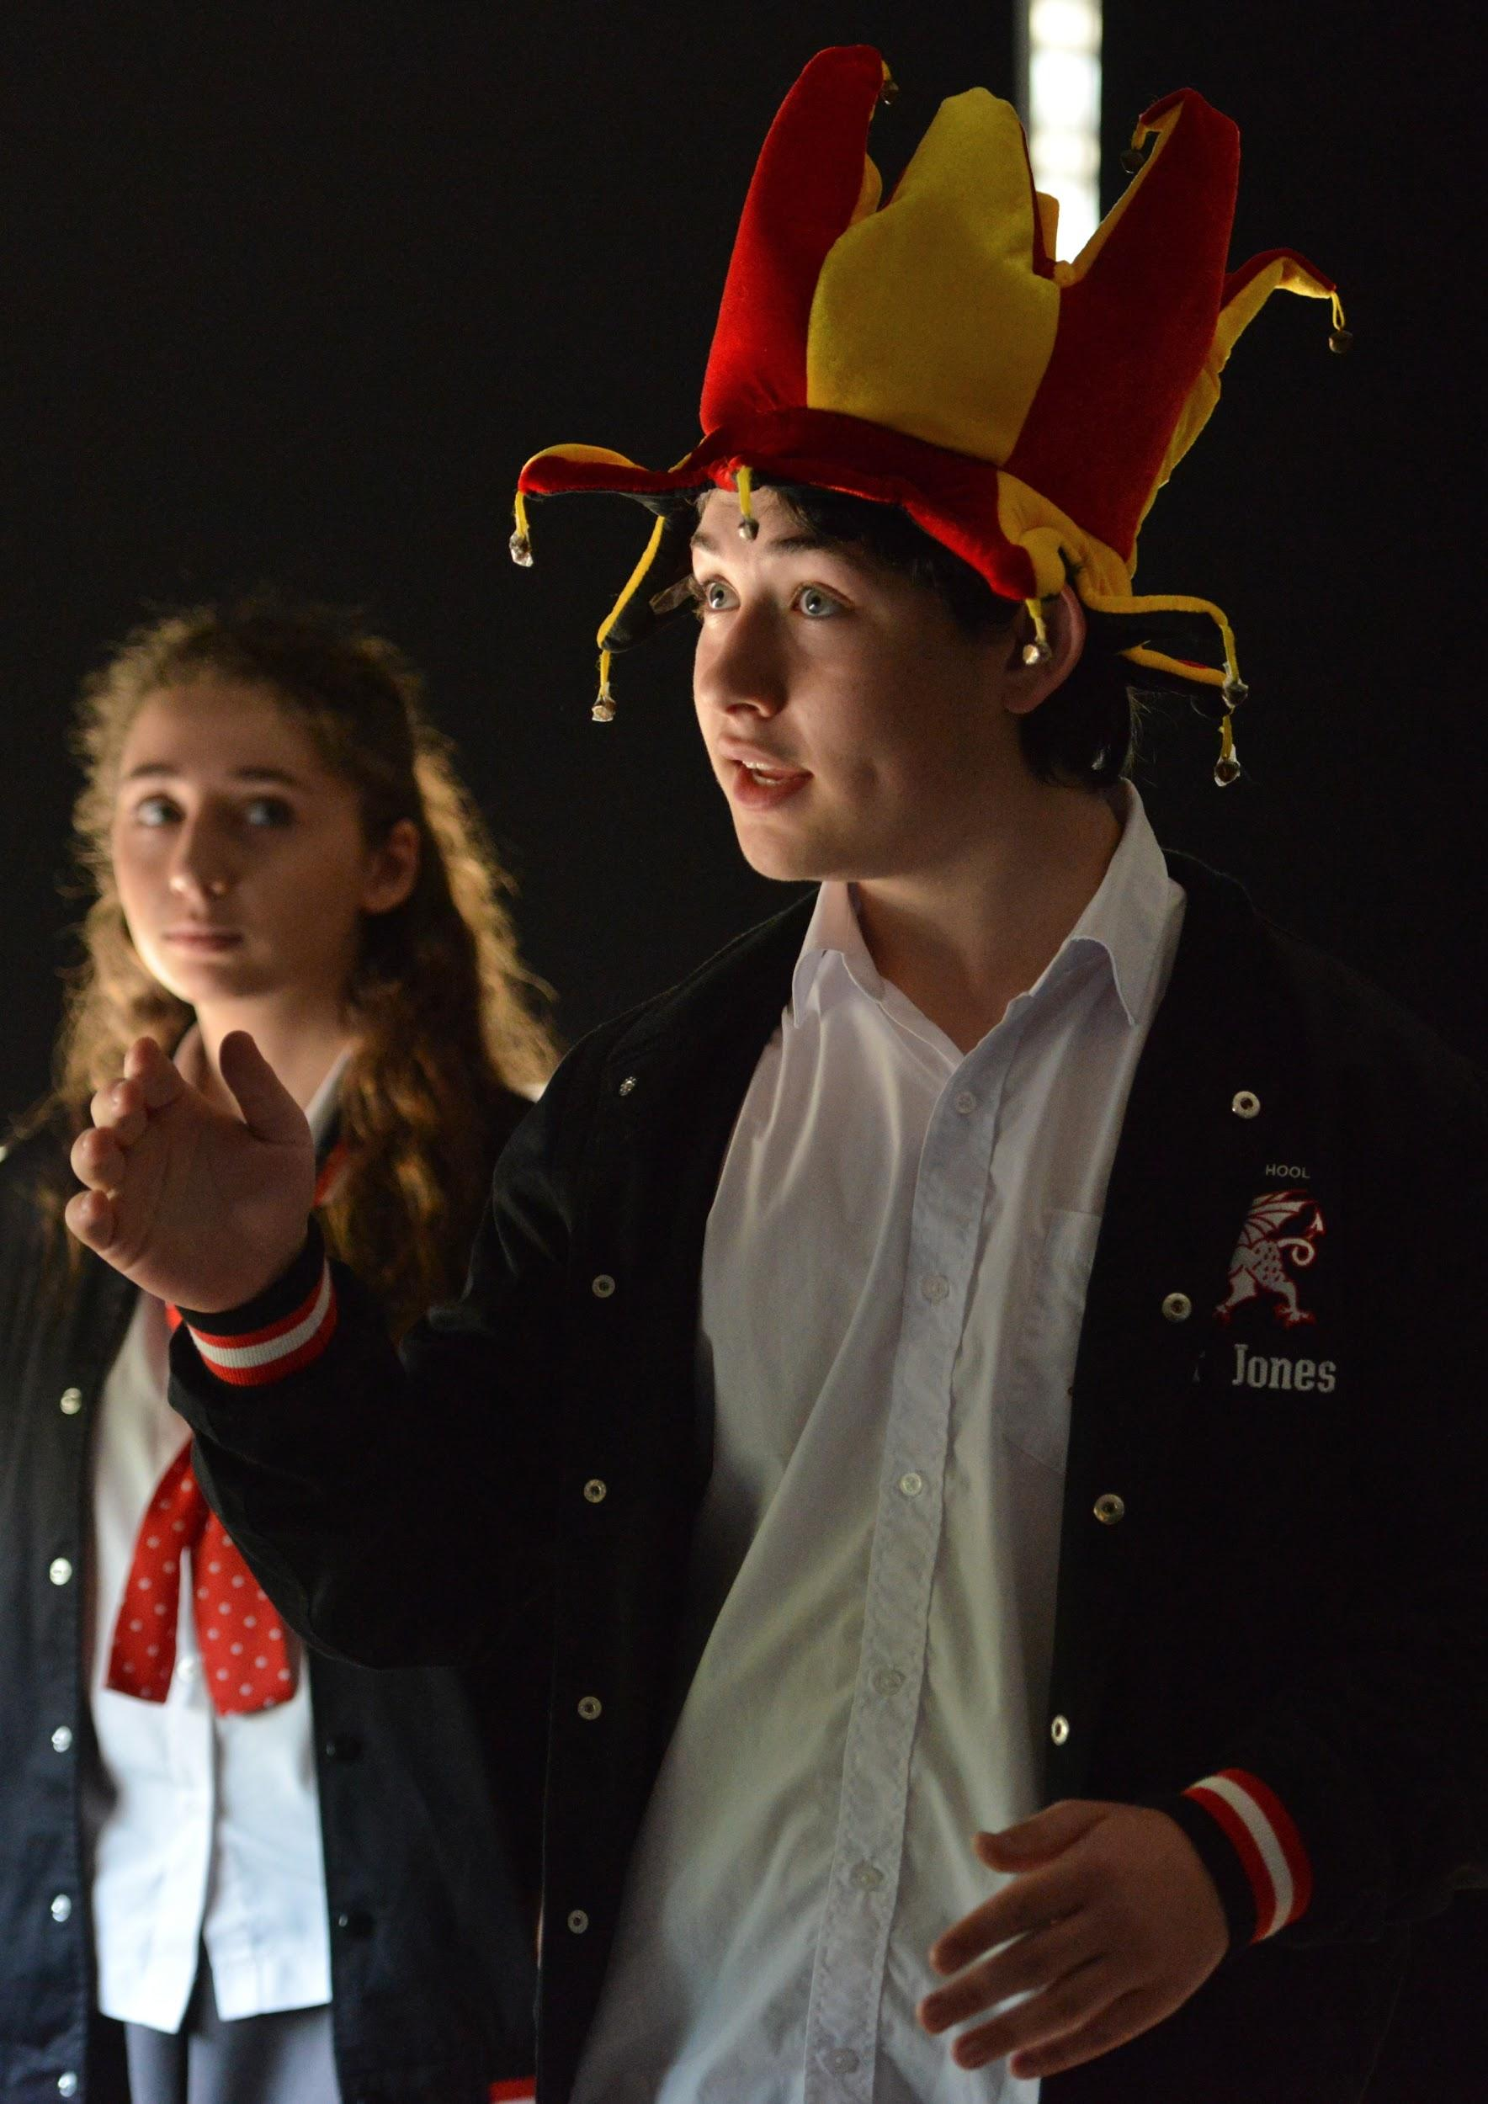
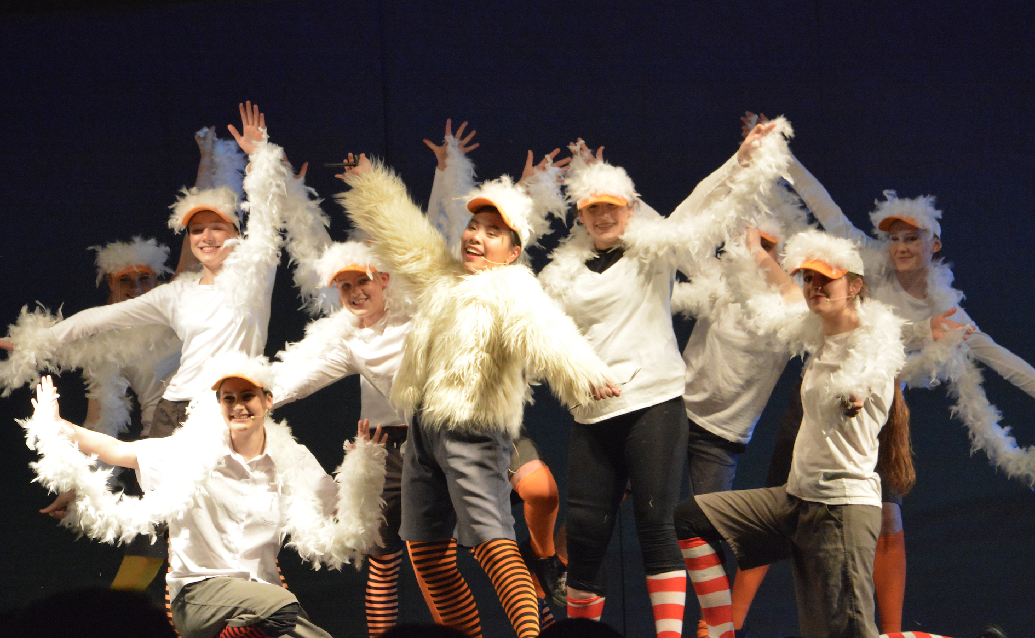
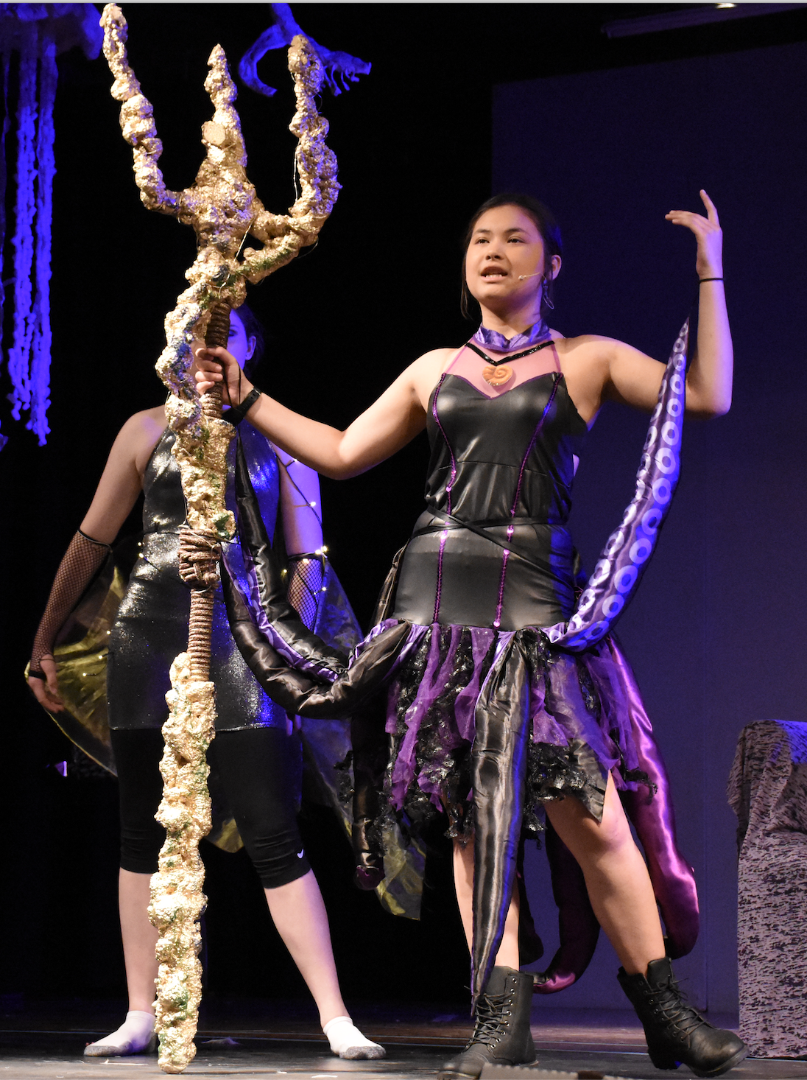
DRAMA
2 UNIT – 2 YEAR - ATAR

Slide 2
Drama– HSC – 2 UNIT – ATAR
60% PRACTICAL
40% THEORY

Slide 3
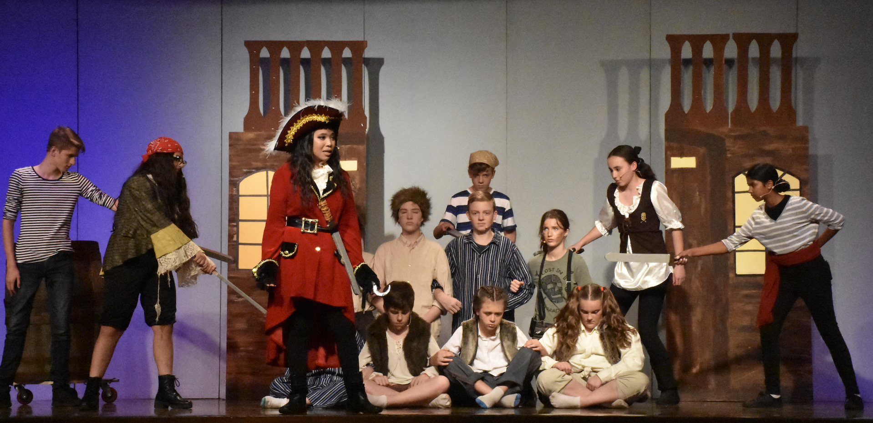
DRAMA
Drama is comprised of;
Making - 30%
Performing - 30%
Critically Studying - 40% 60% practical course! Putting the theoretical knowledge you learn in class into practice.

Slide 4
ASSESSMENT SCHEDULE
YEAR 11 (Preliminary) Course |  | YEAR 12 (HSC) Course
Group Play Building (Performance and Logbook) | 30% | Studies in Drama and Theatre Topic 6 - 'Black Comedy' - Performance of scene work and Essay | 20%
 |  | Australian Drama & Theatre: Topic 1 - 'Dramatic Traditions in Australia - Performance of scene work & Essay | 20%
Scripted Drama and Elements of Design (Workshops, Performance and Essay) | 30%
 |  | HSC Practical Trial Exam - Group Performance & Individual Project | 40%
Individual Project and Yearly Exam | 40%
 |  | HSC Written Trial Exam - Two Essays on the two topics for study | 20%

Slide 5
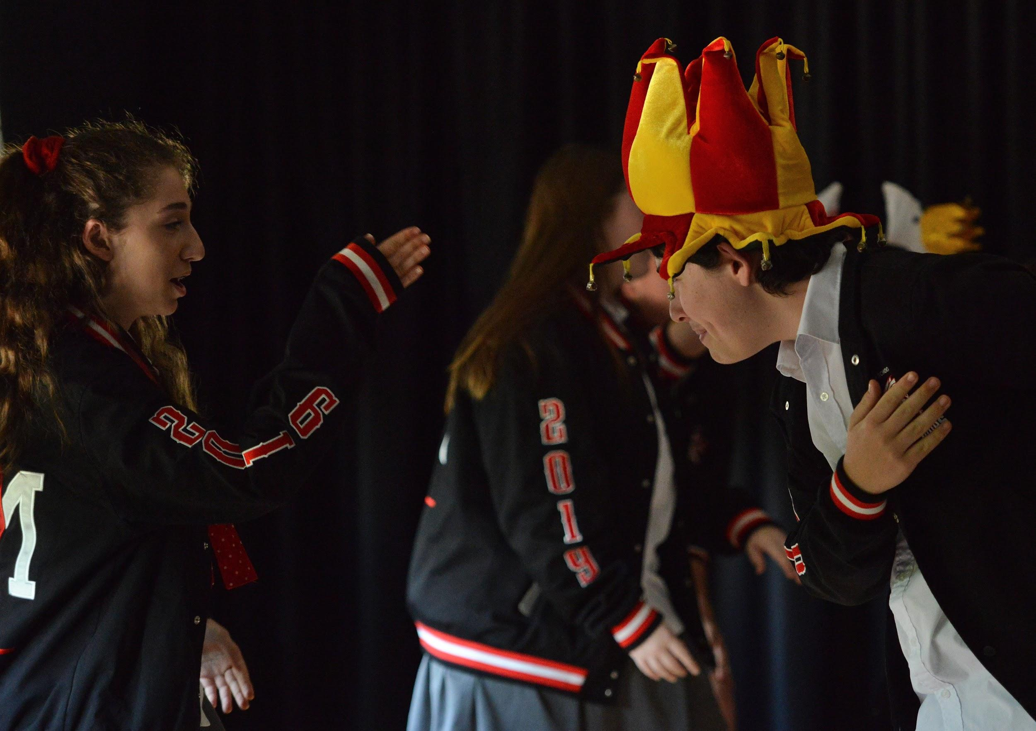
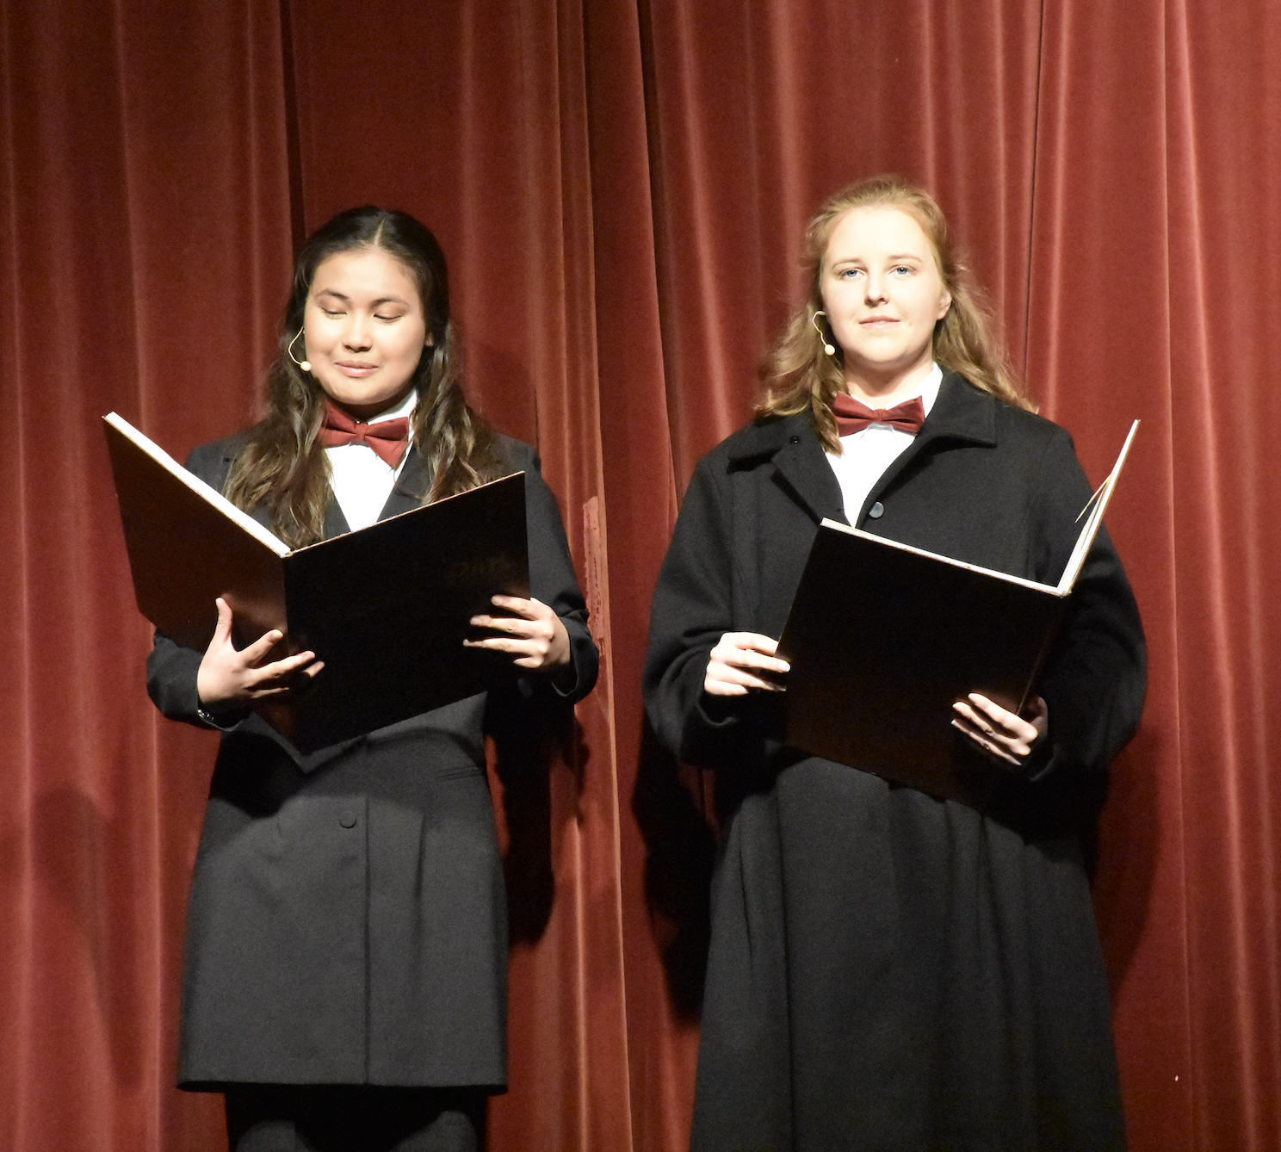
PRELIMINARY DRAMA
3 Core sections;
1) Improvisation Playbuilding and Acting
A combination of group playbuilt performances, scripted scene workshops and individual performances.
2) Elements of Production in performance
Including design concepts for set, costume and poster & program.
3) Theatrical Traditions and Performance Styles.
Putting theory into practice for key practitioners and dramatic performance styles.
The course allows for performance opportunities, collaboration and group work with peers, studies in Drama

Slide 6
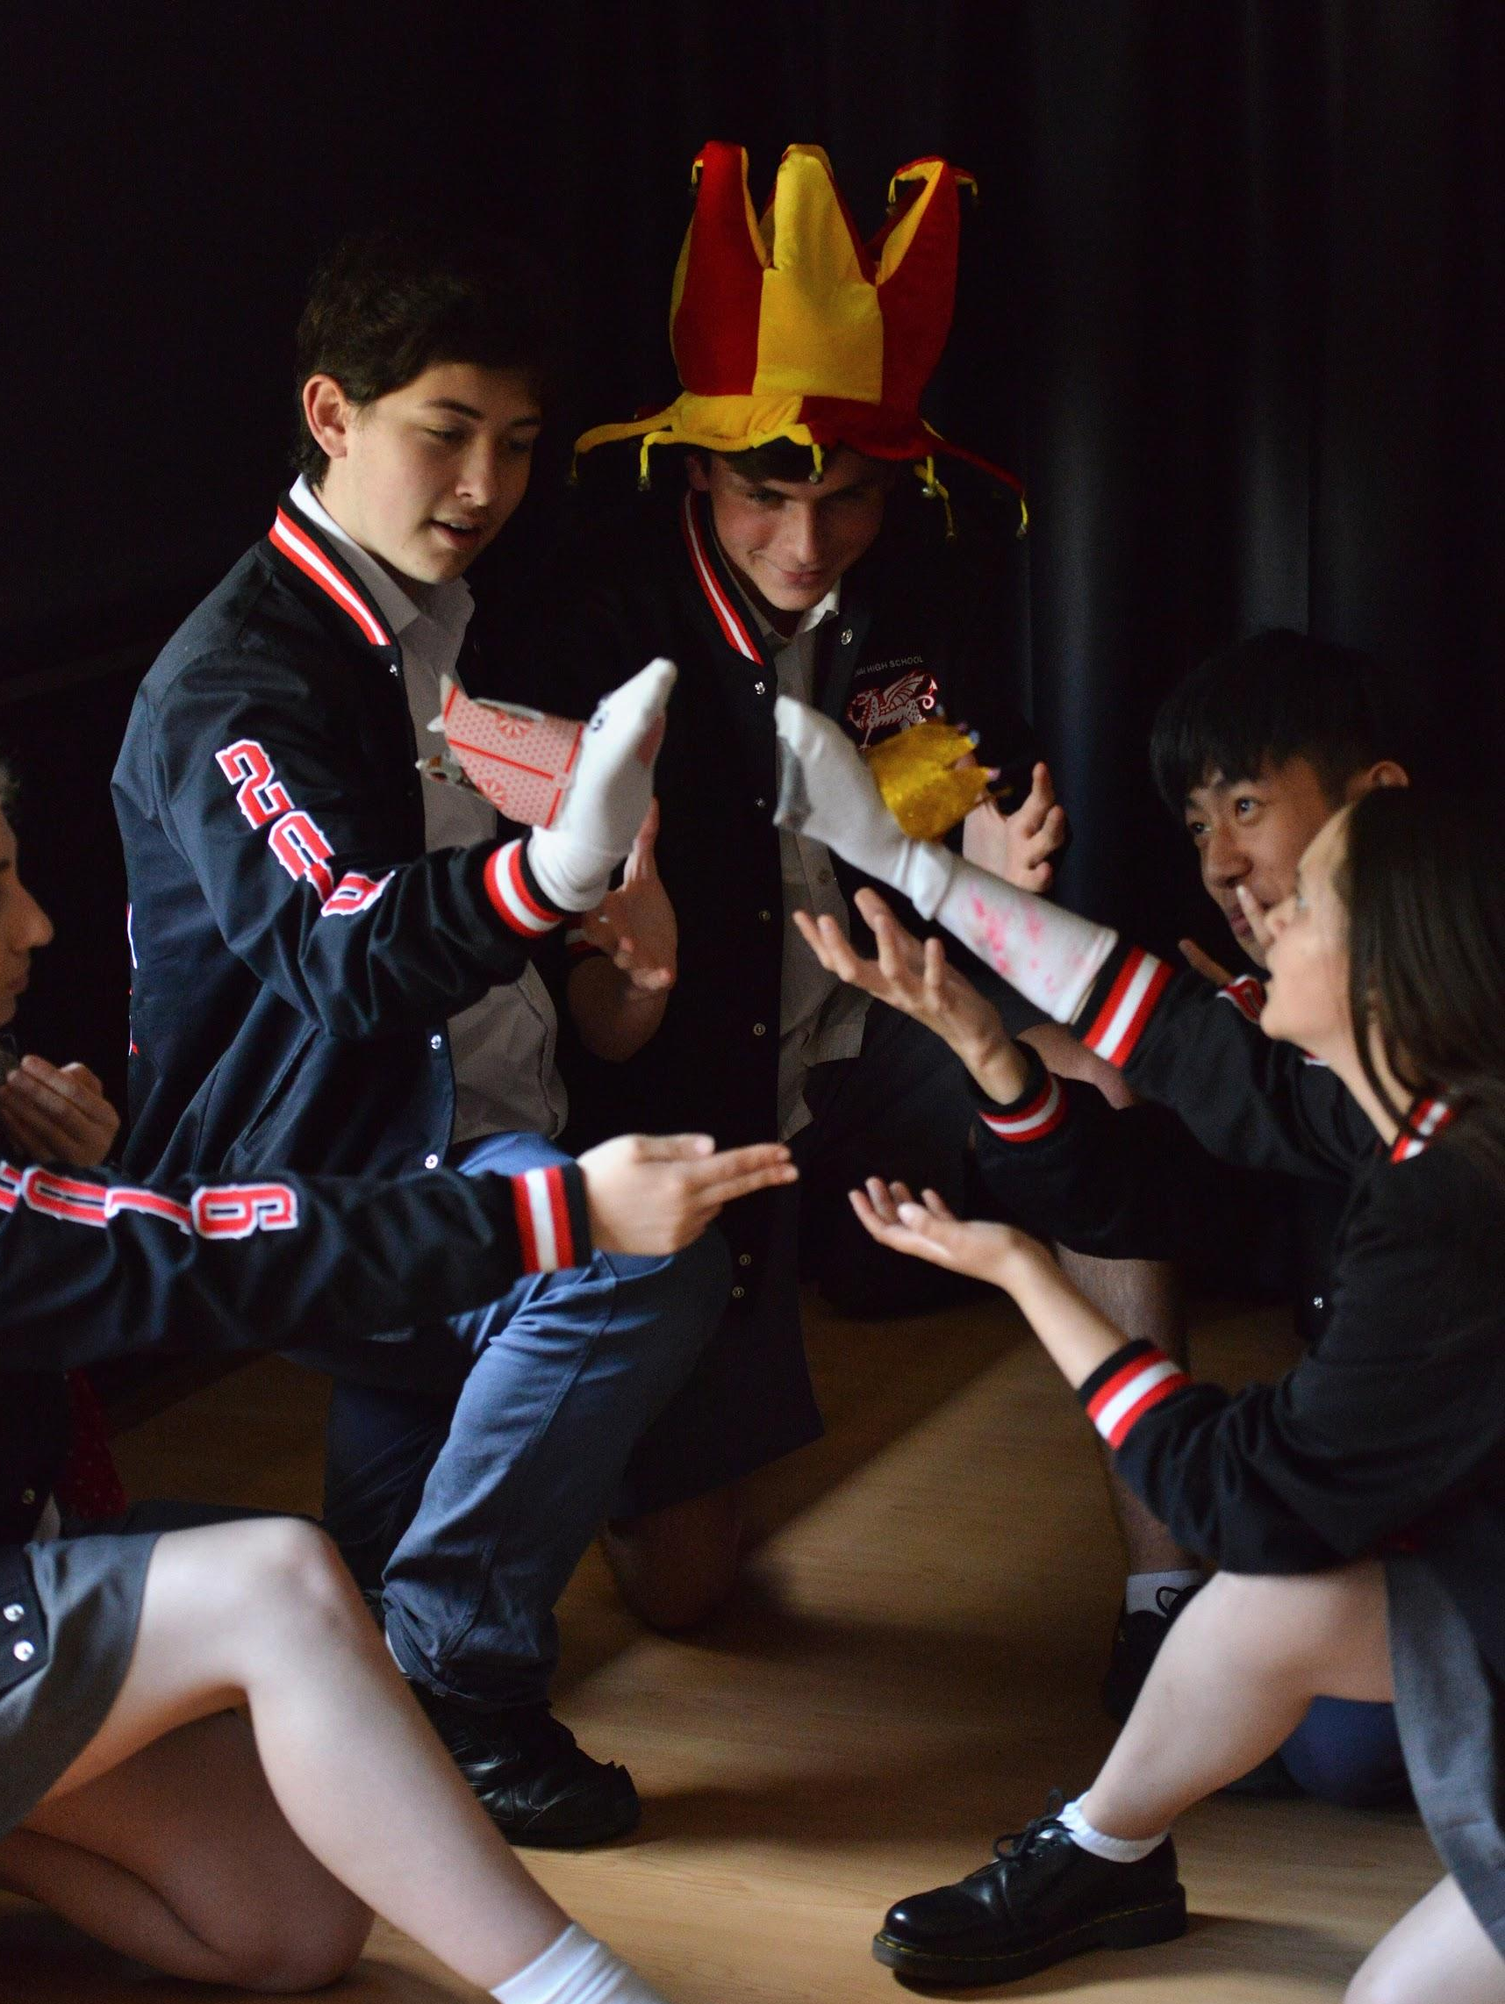
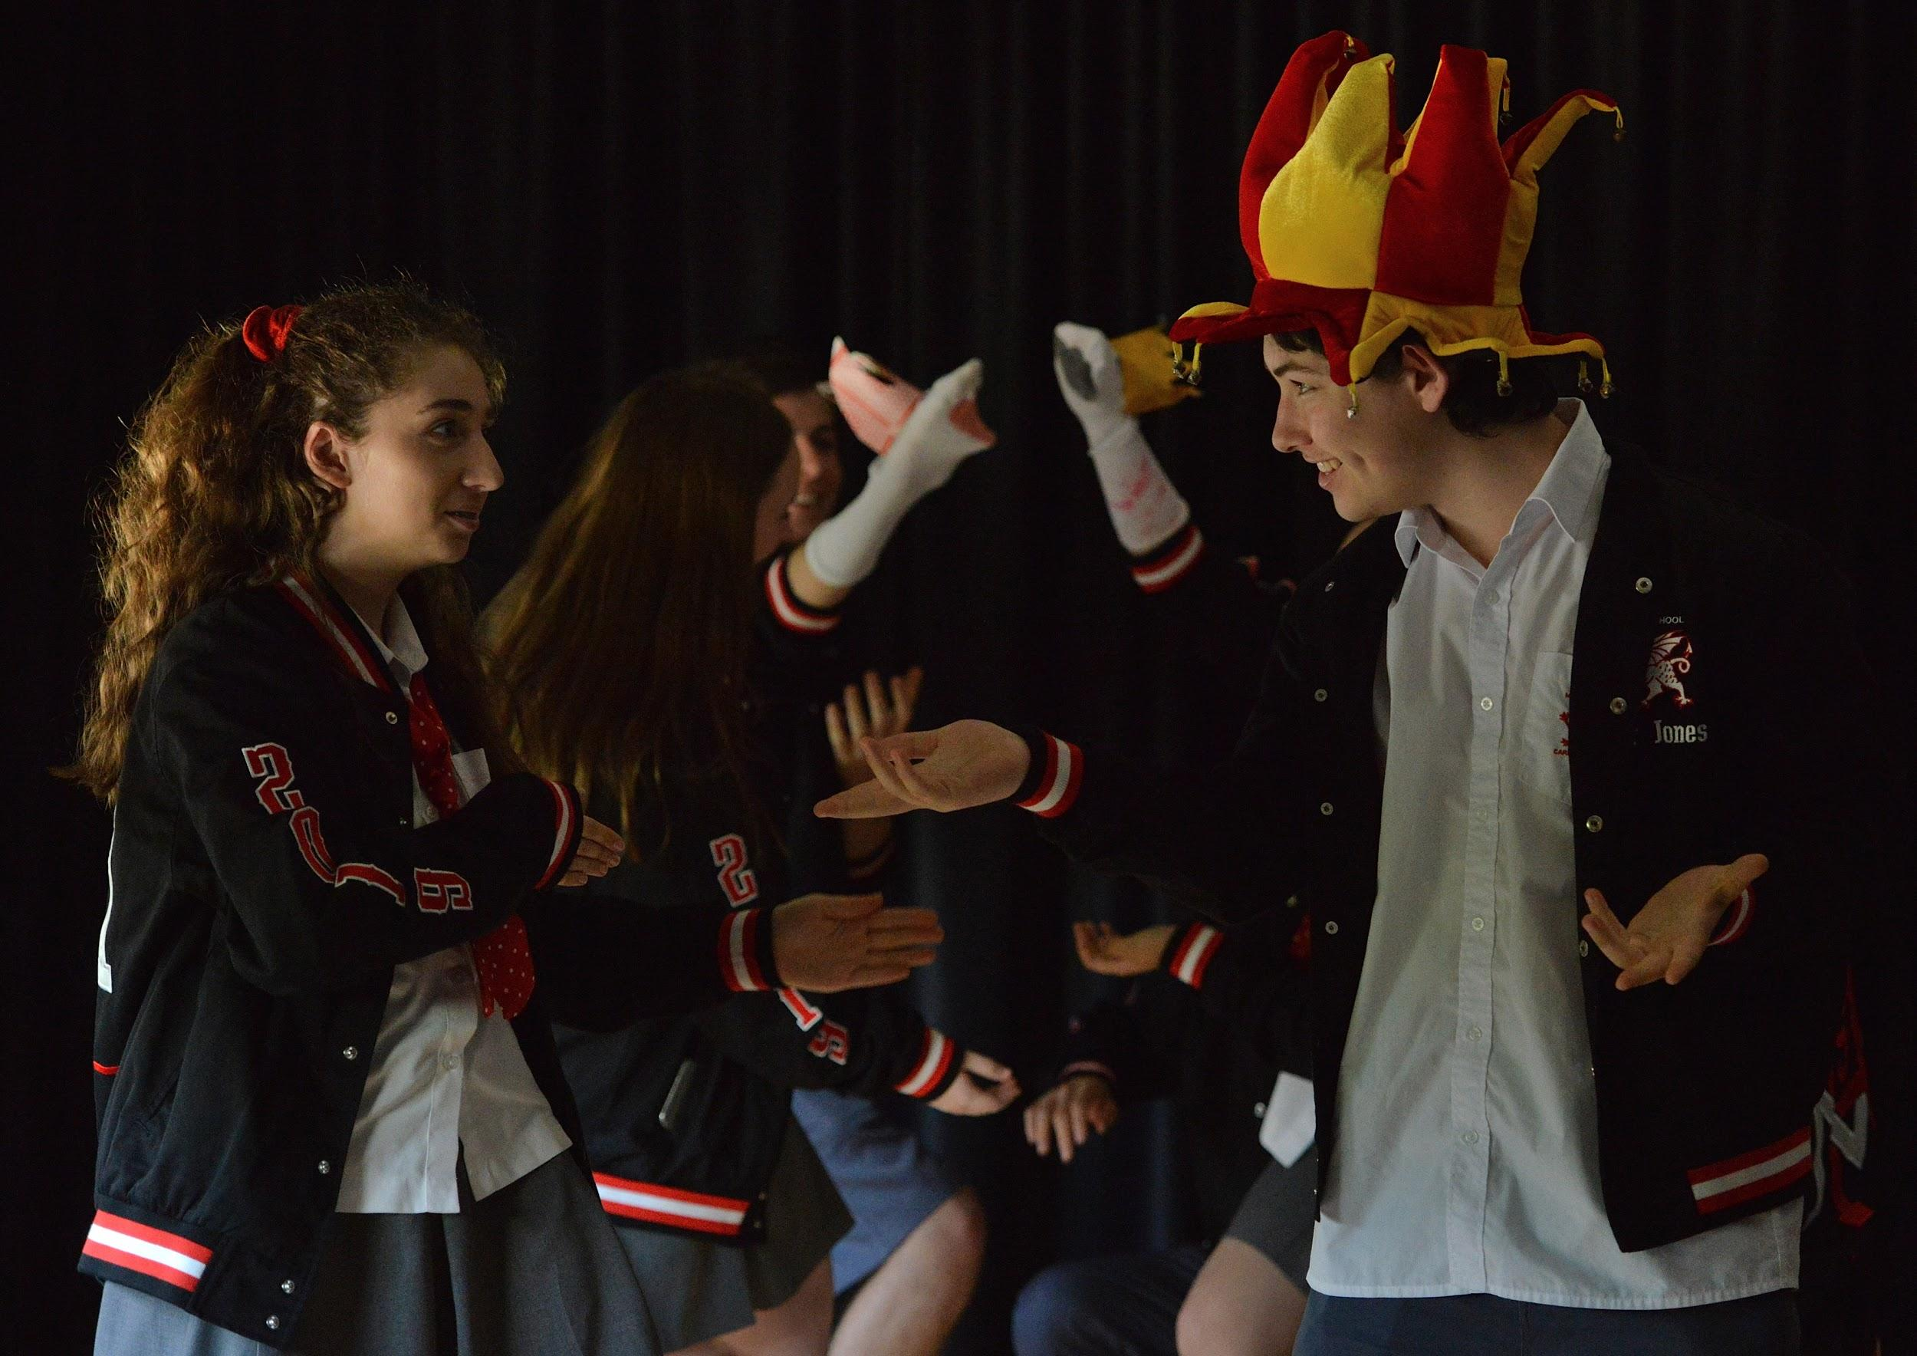
HSC DRAMA
HSC REQUIREMENTS
MANDATORY:
Group performance
Studies in Drama - Black Comedy
Australian Drama
CHOOSE ONE INDIVIDUAL PROJECT
Individual Performance (monologue)
Design; Set, Lighting, Costume, Promotion and Program
Script Writing
Critical Analysis; Directors Folio, Theatre Criticism, Applied Research Project
Video Drama

Slide 7
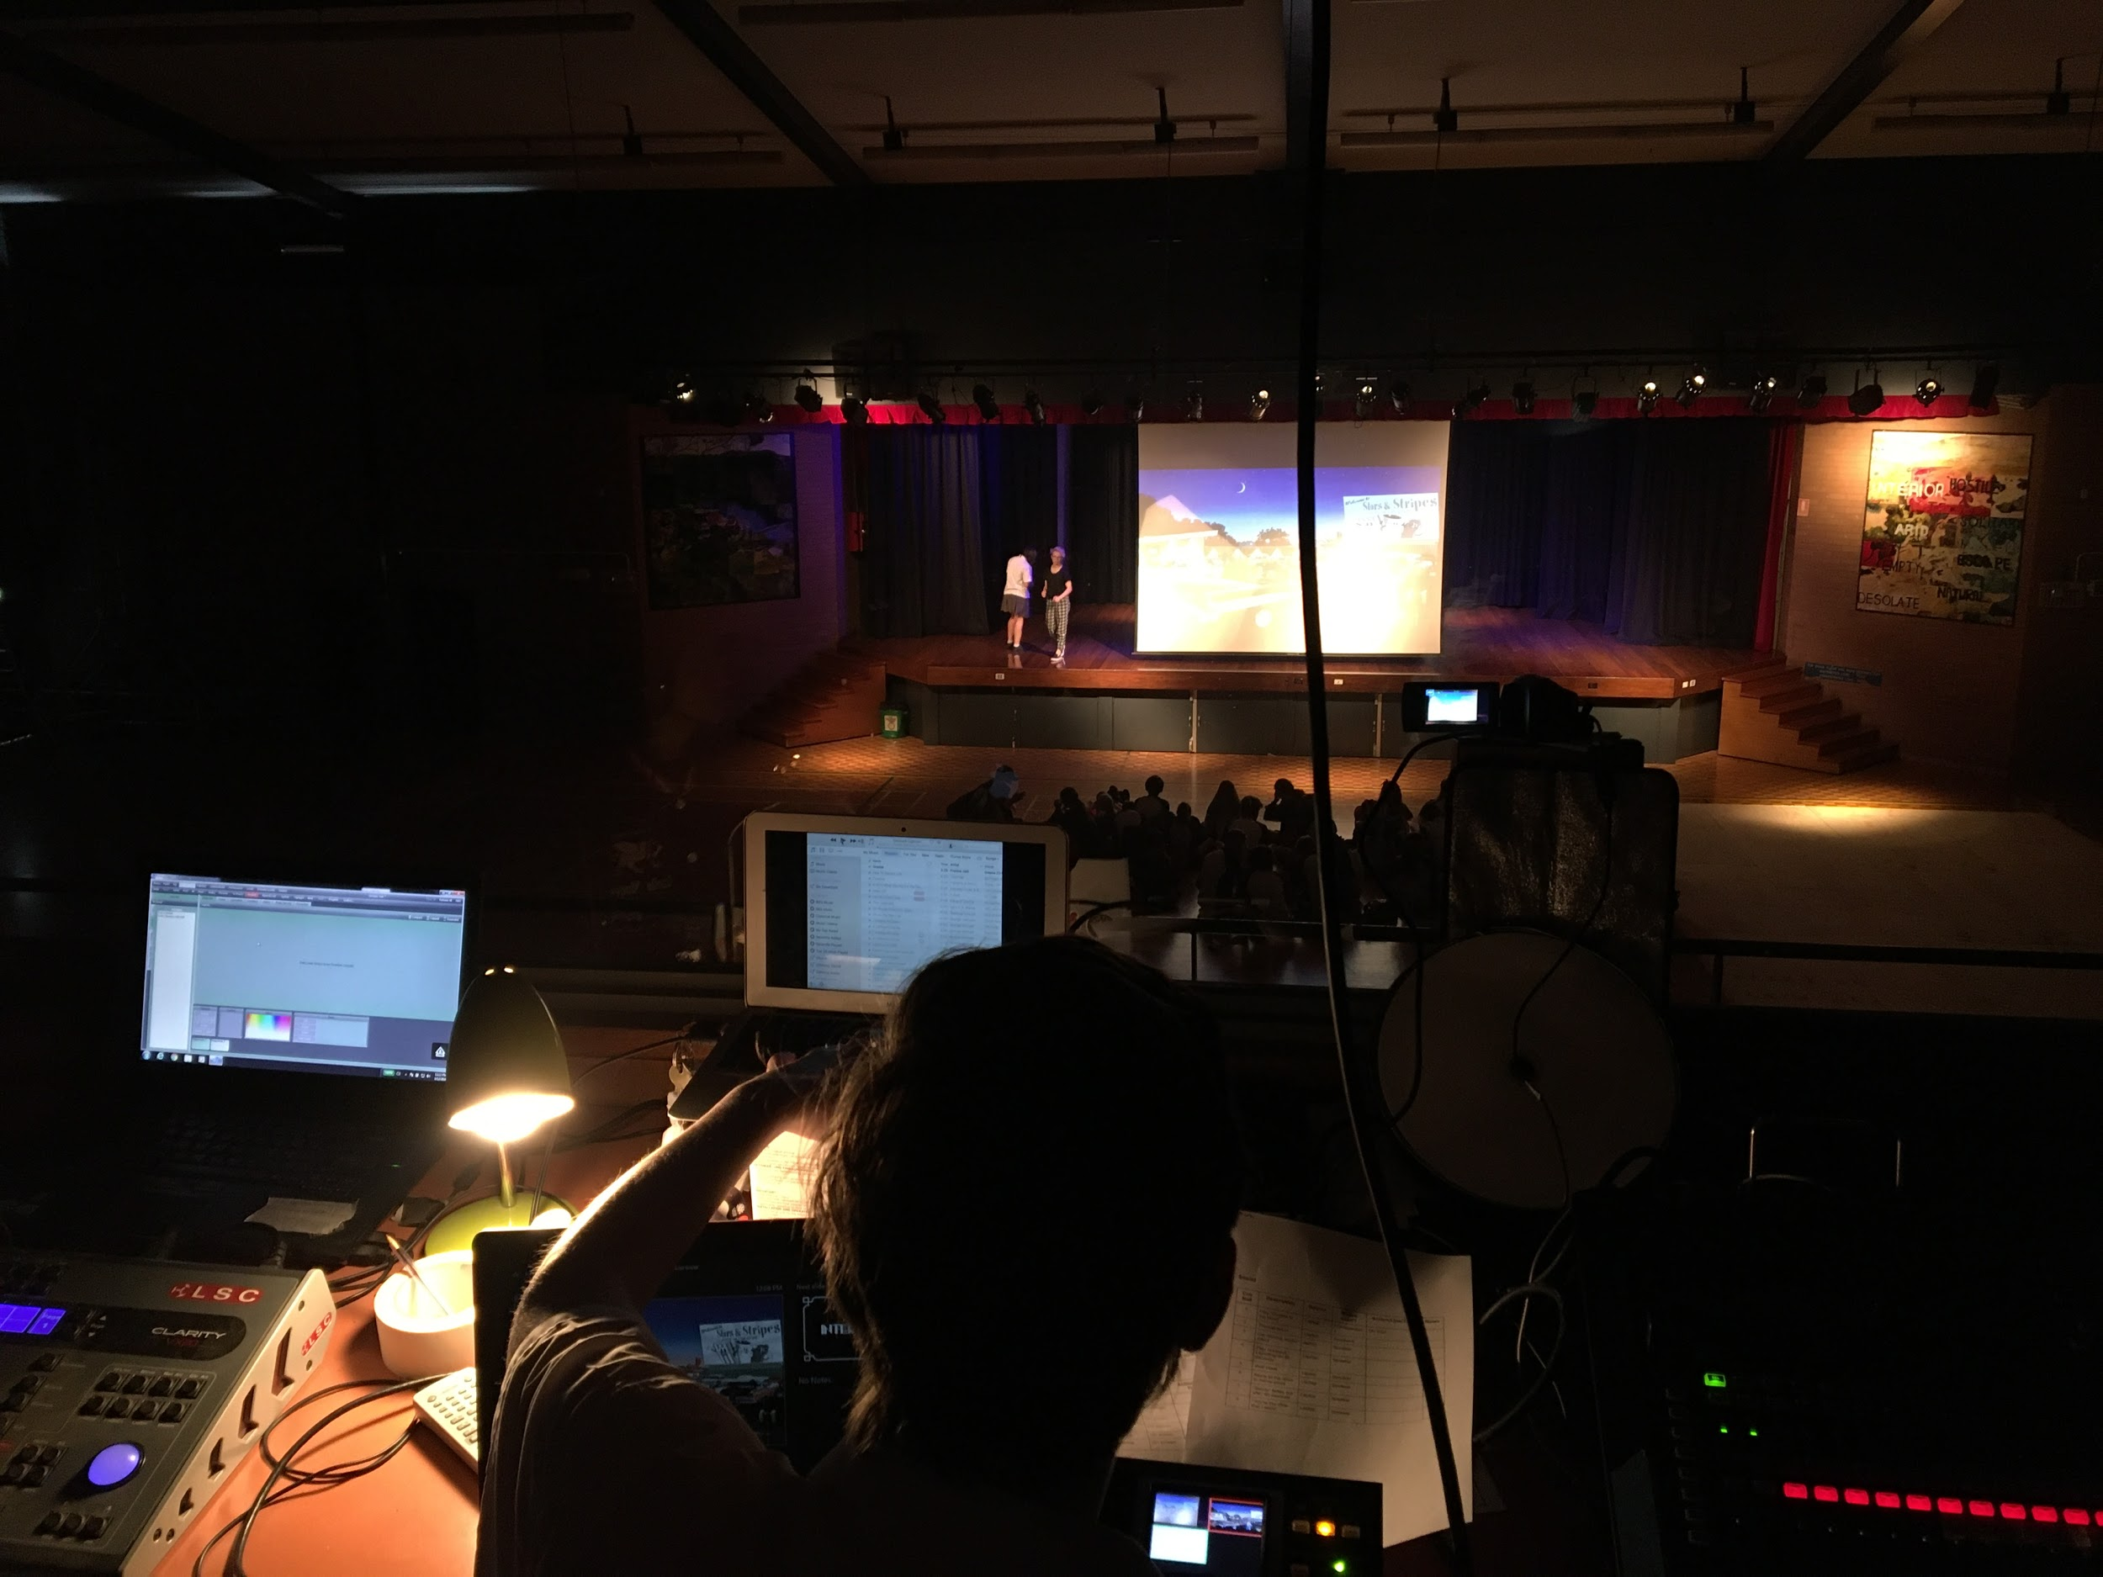
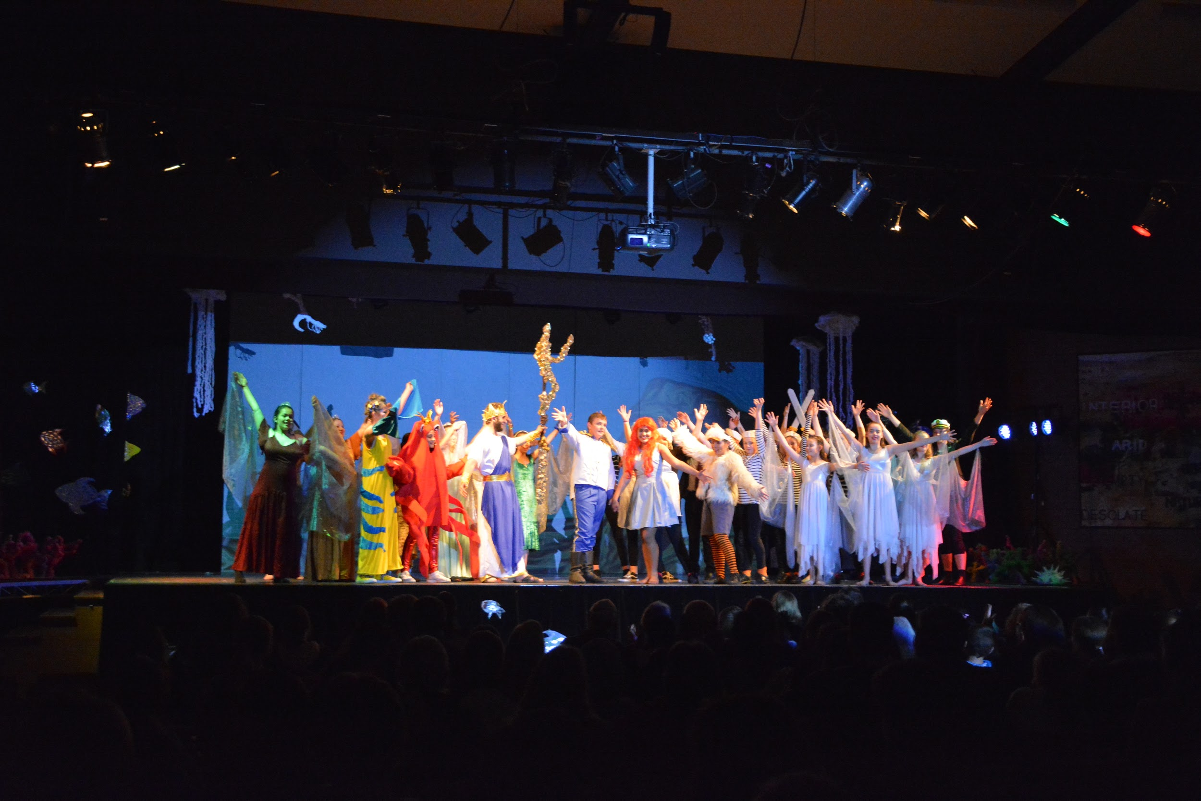
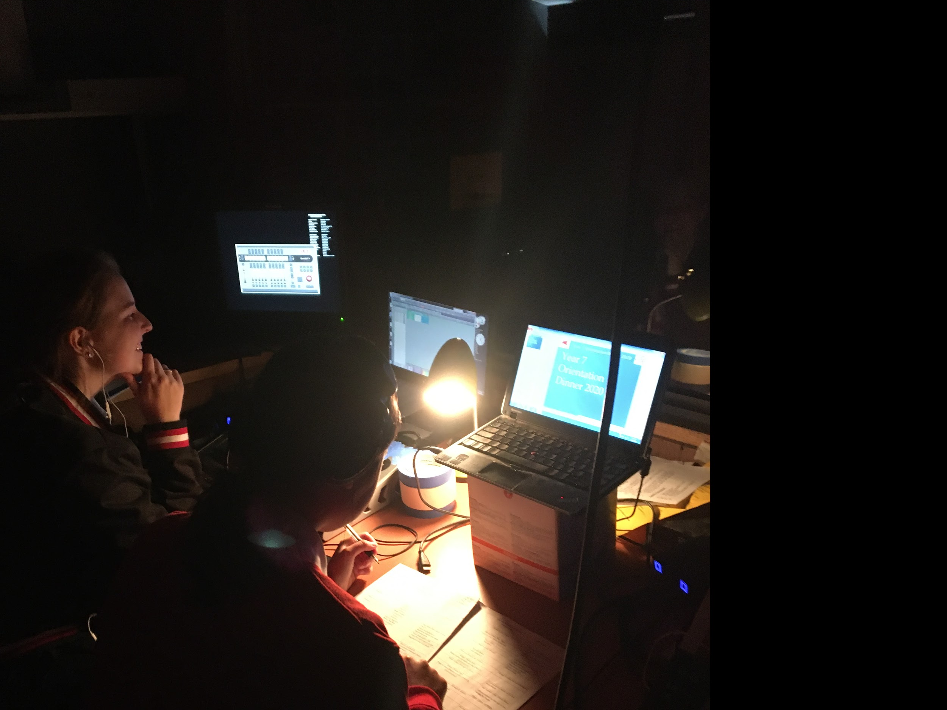
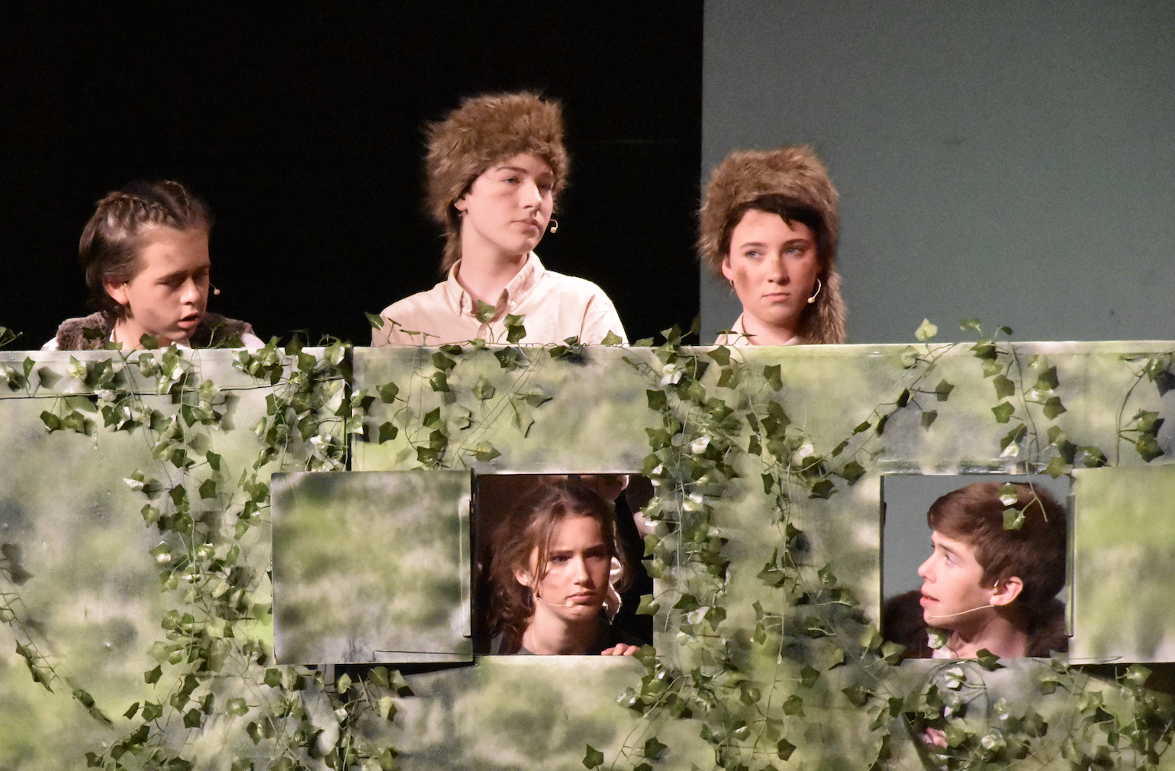
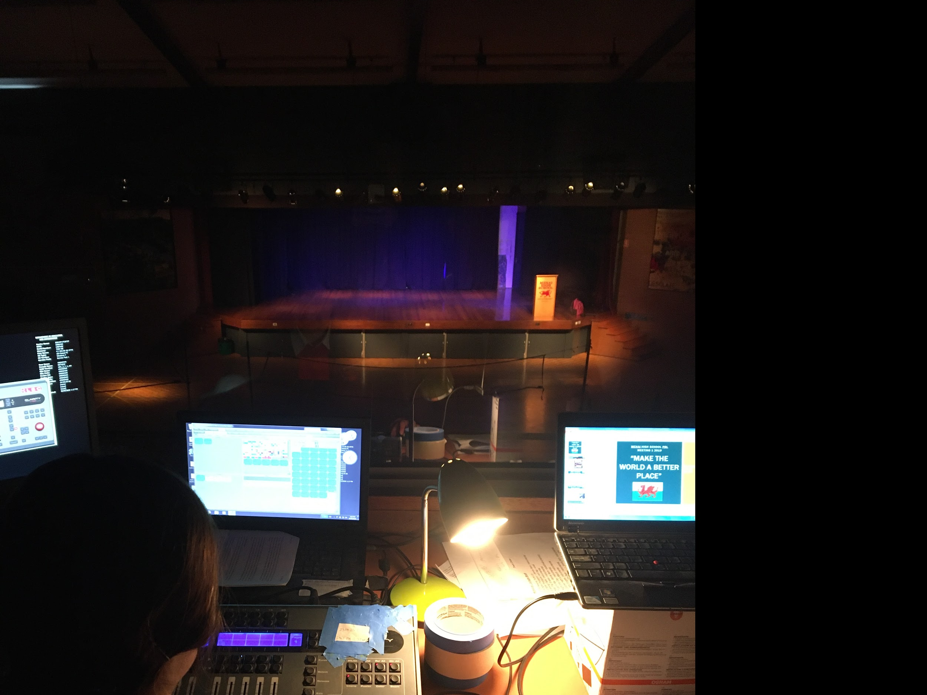
School Musical and Play
Annual School play or School Musical

Slide 8
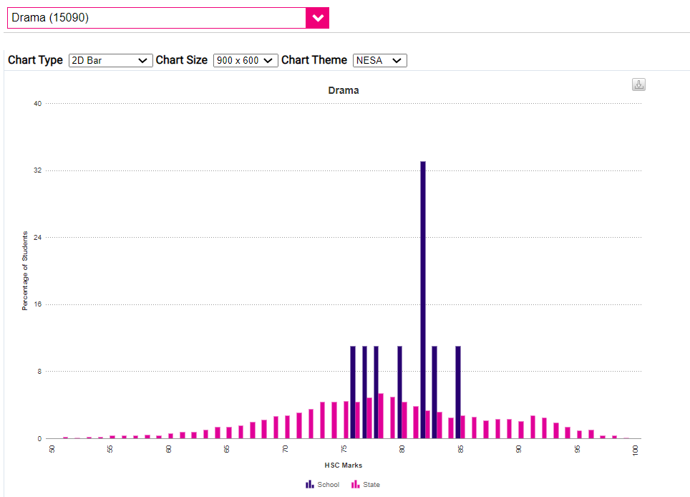
Drama
HSC Results
Menai is BLUE
The rest of the state is PINK

Slide 9
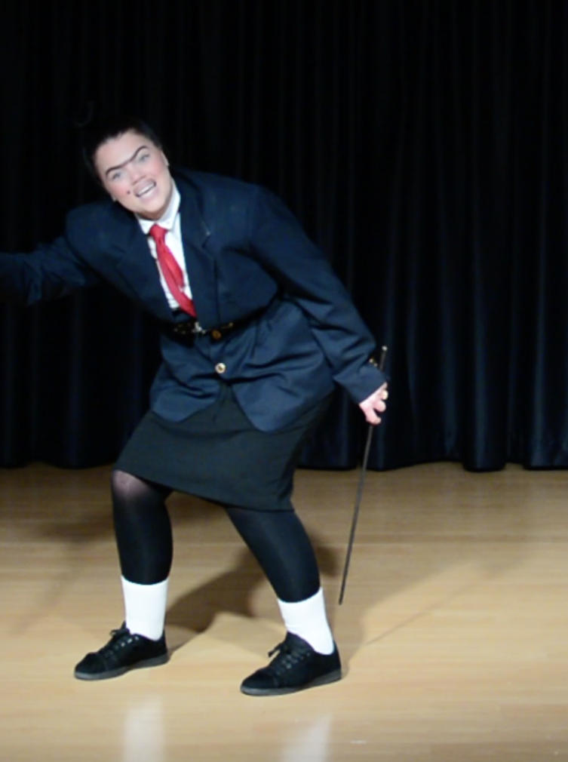
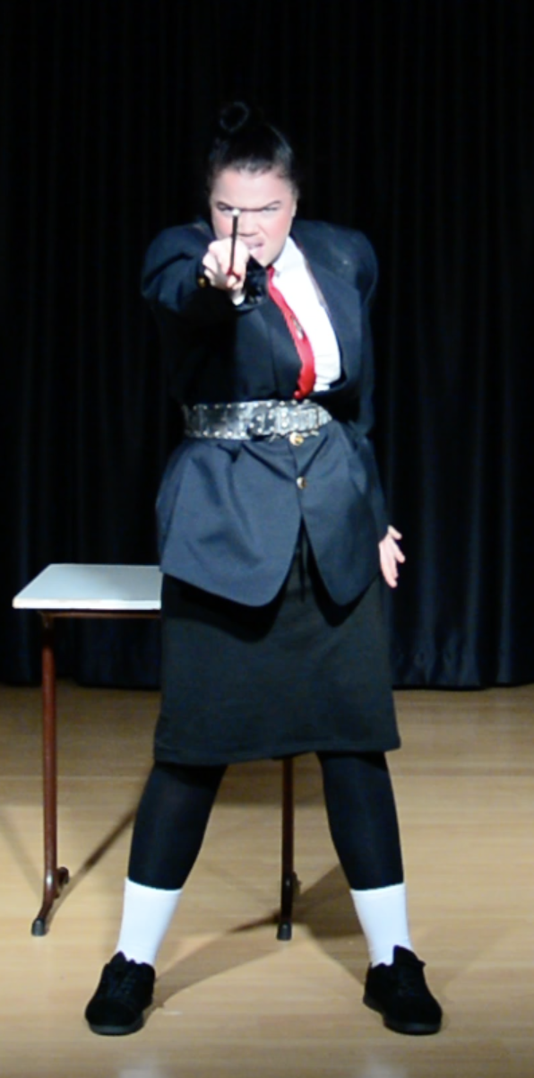
OnStage Nomination
Georgie Winchester
Class of 2020 HSC Drama

