Slide 1
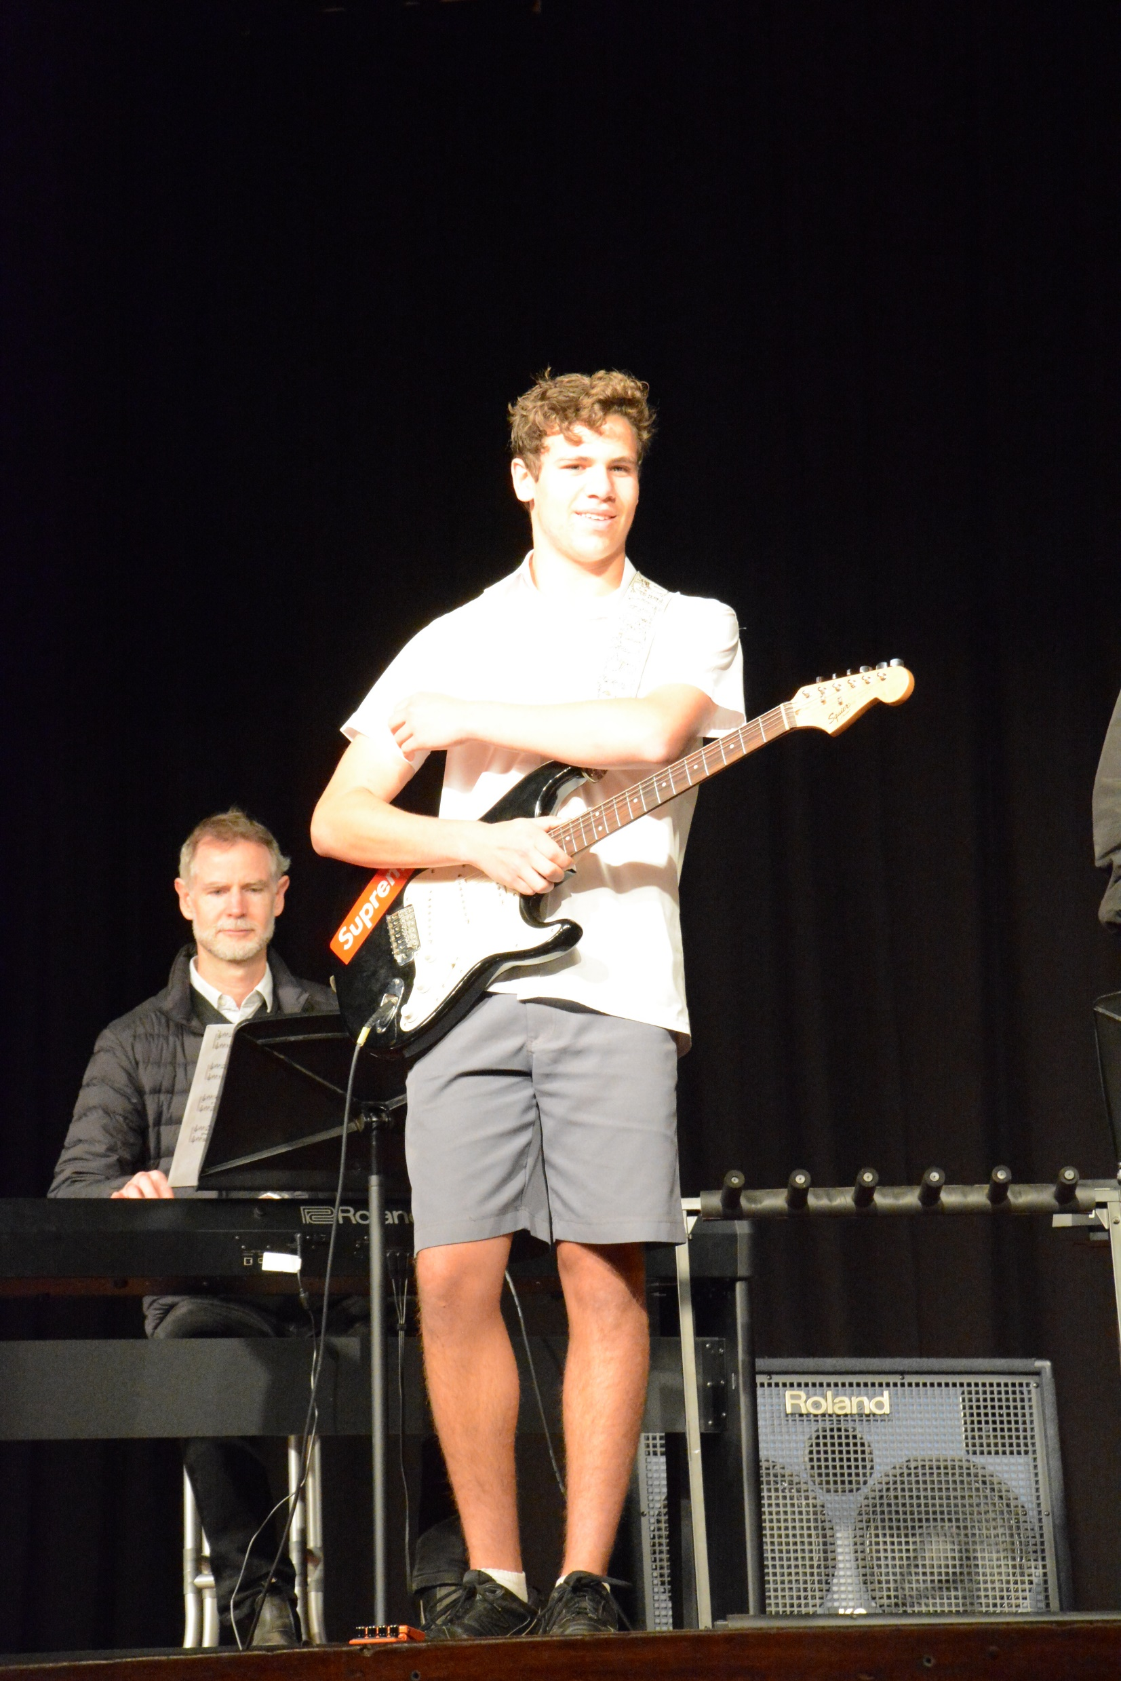
MUSIC
MUSIC 1
2 UNIT – 2 YEAR - ATAR

Slide 2
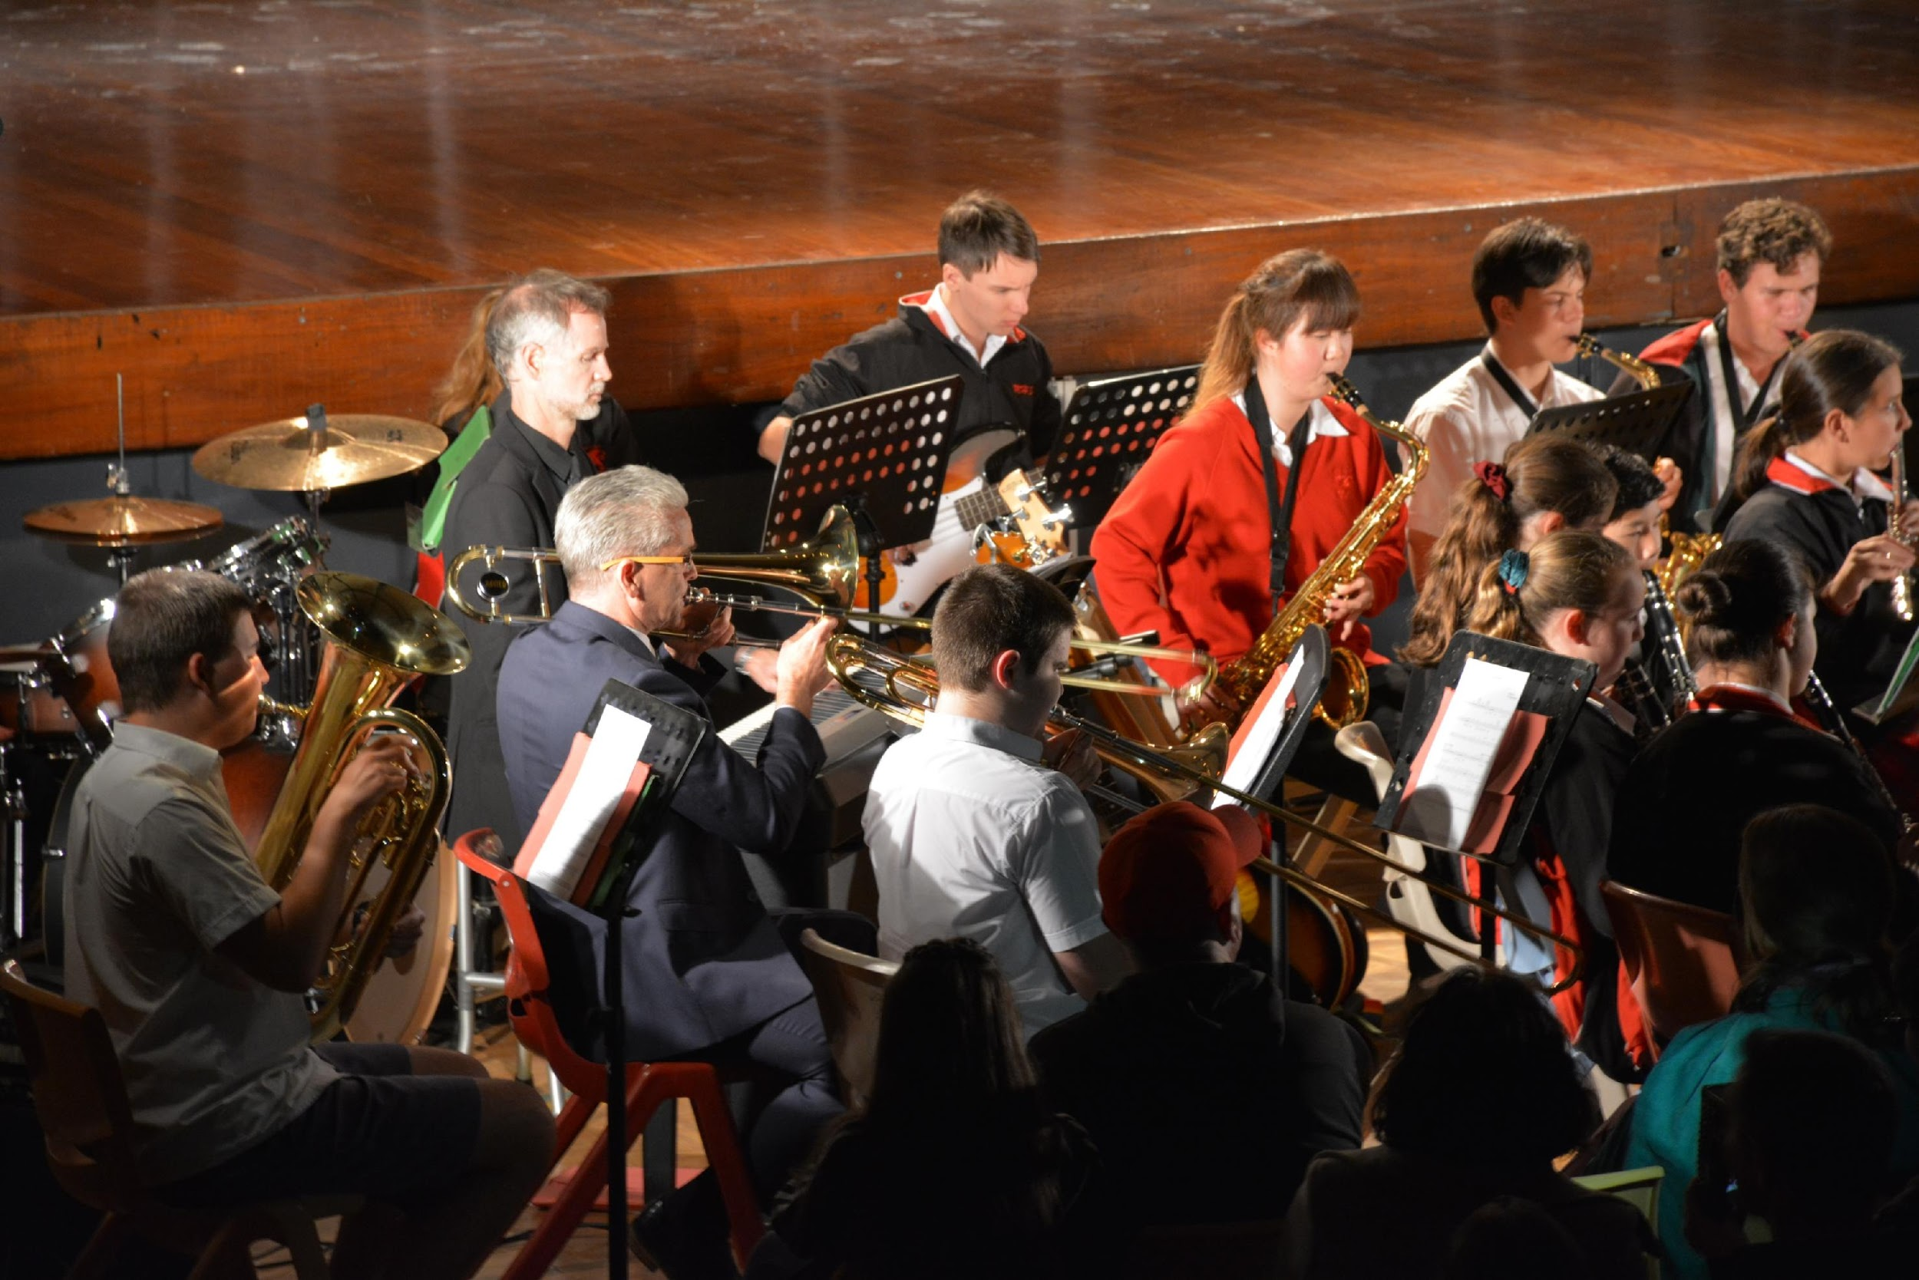
MUSIC 1
You may specialise in a particular instrument / voice - some students play more than one.
Private instrument tuition outside of school is helpful but not compulsory.
Learn to compose music in different styles
Learn to analyse music aurally through the musical concepts - pitch, duration, texture, tone colour, dynamics and expressive techniques and structure

Slide 3
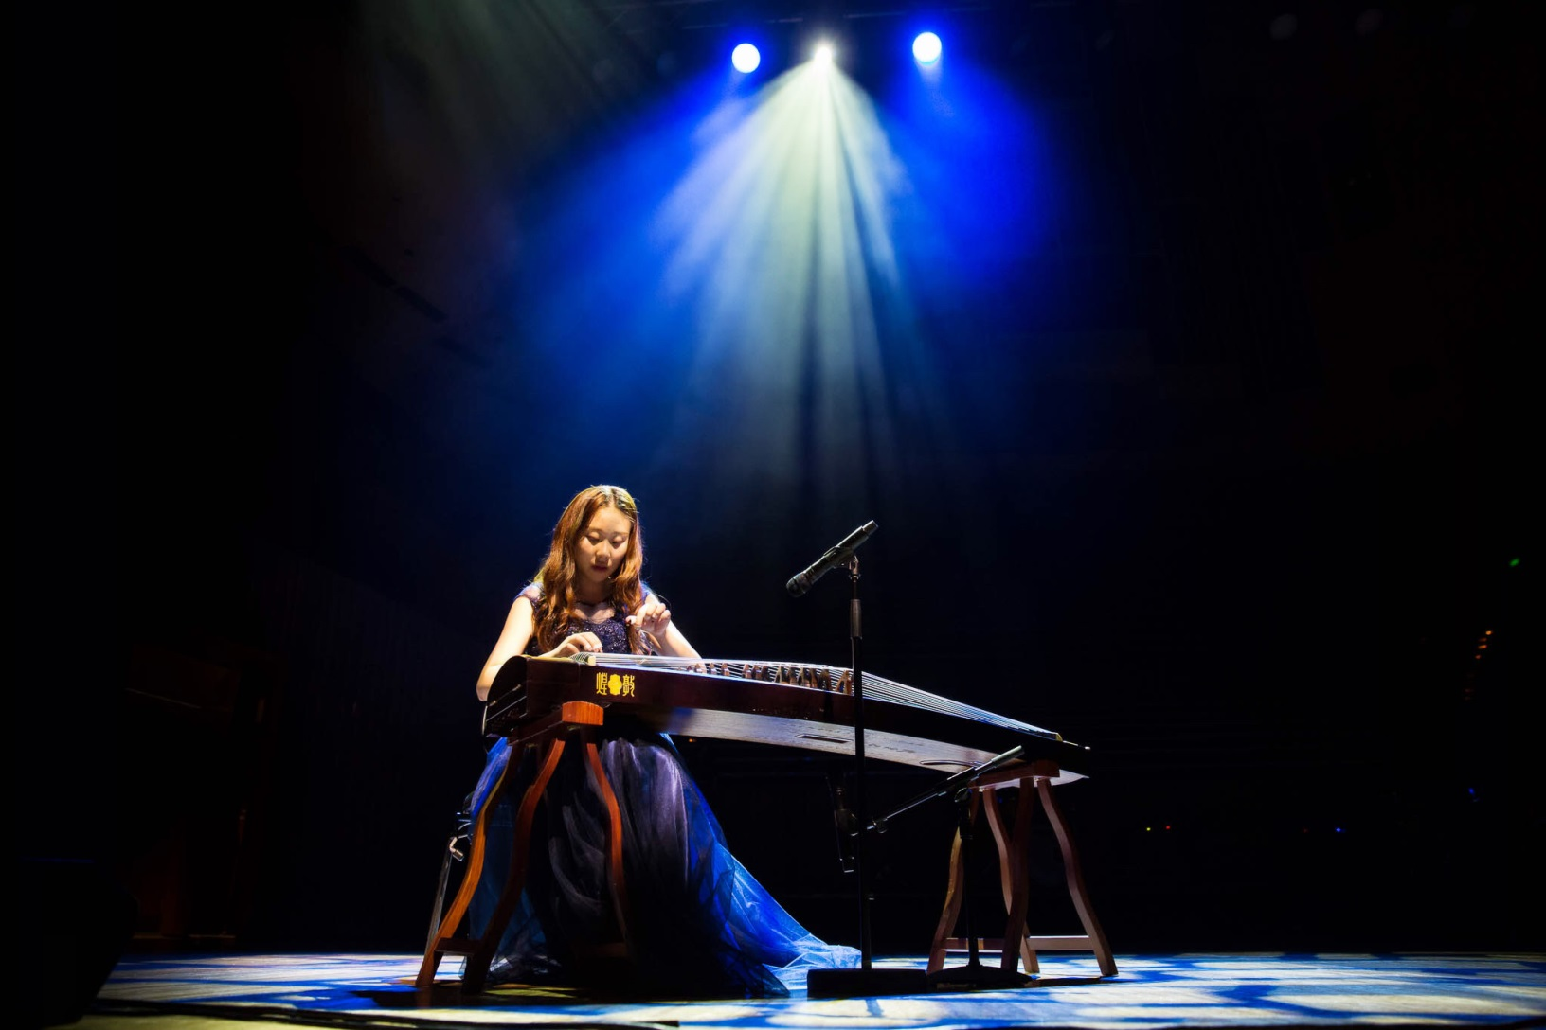
You don’t have to play a traditional Western style instrument.
A lot of students achieve excellent results playing a traditional instrument from their own or another culture.

Slide 4
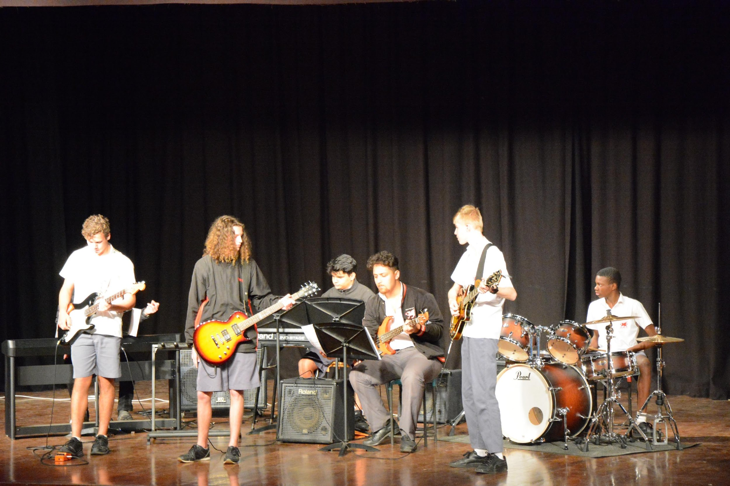
HSC REQUIREMENTS
MANDATORY:
One performance (max 5 min)
CHOOSE THREE ELECTIVES:
Performance (max 5 min) OR
Composition (max 4 min) OR
Musicology (10 min viva voce)

Slide 5
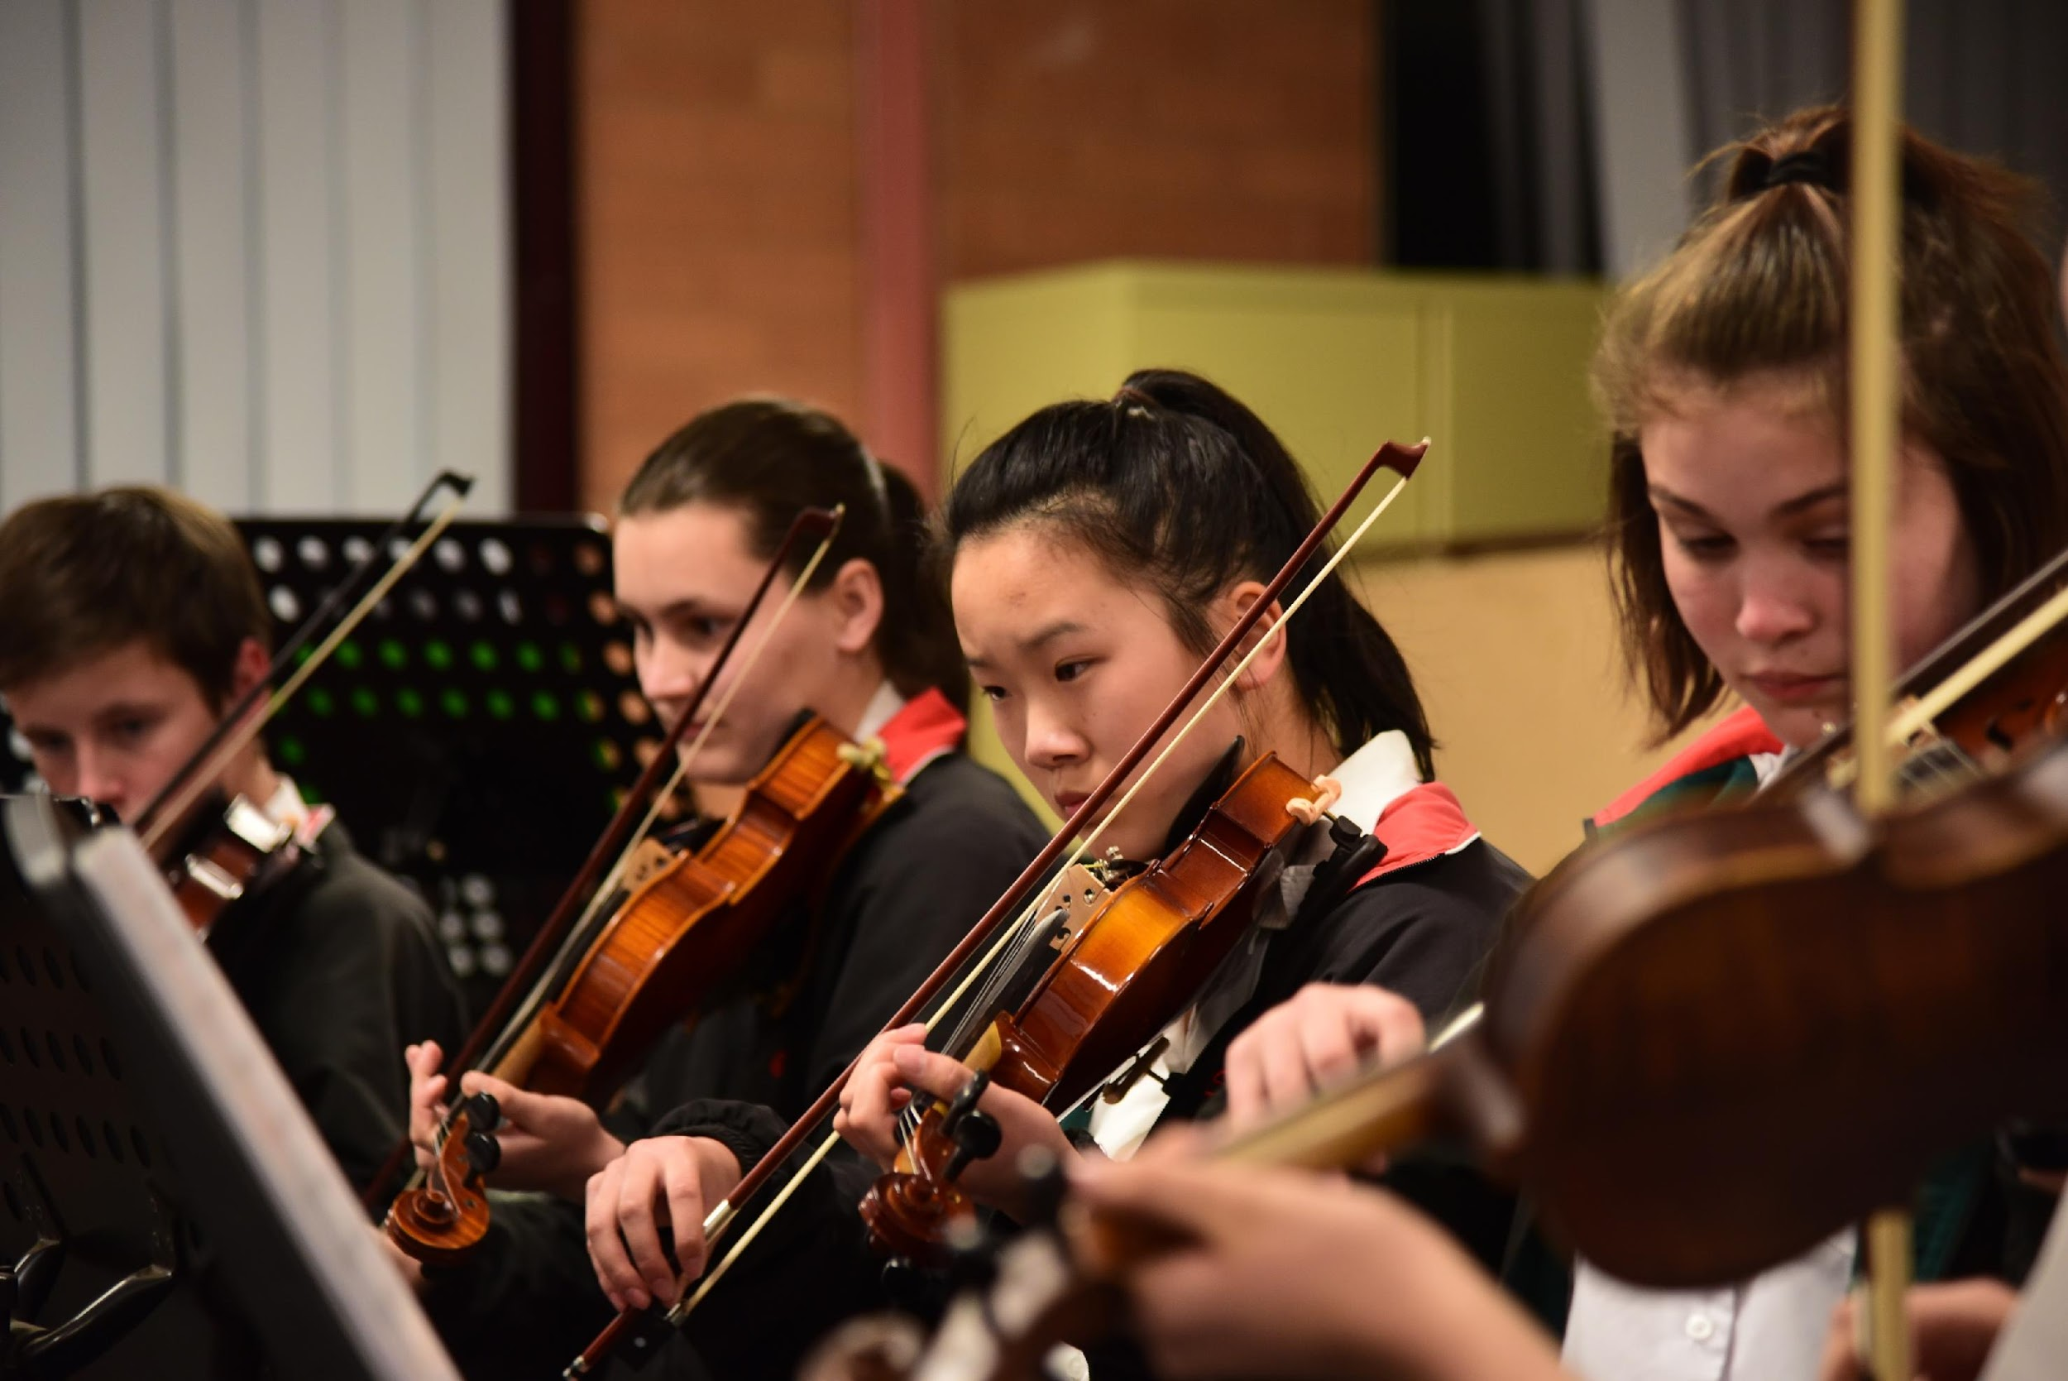
TOPICS
An instrument and its repertoire
Australian music
Baroque music
Jazz
Medieval music
Methods of notating music
Music and religion
Music and the related arts
Music for large ensembles
Music for radio, film, television and multimedia
Music for small ensembles
Music in education
Music of a culture
Music of the 18th century
Music of the 19th century
Music of the 20th and 21st centuries
Popular music
Renaissance music
Rock music
Technology and its influence on music
Theatre music

Slide 6
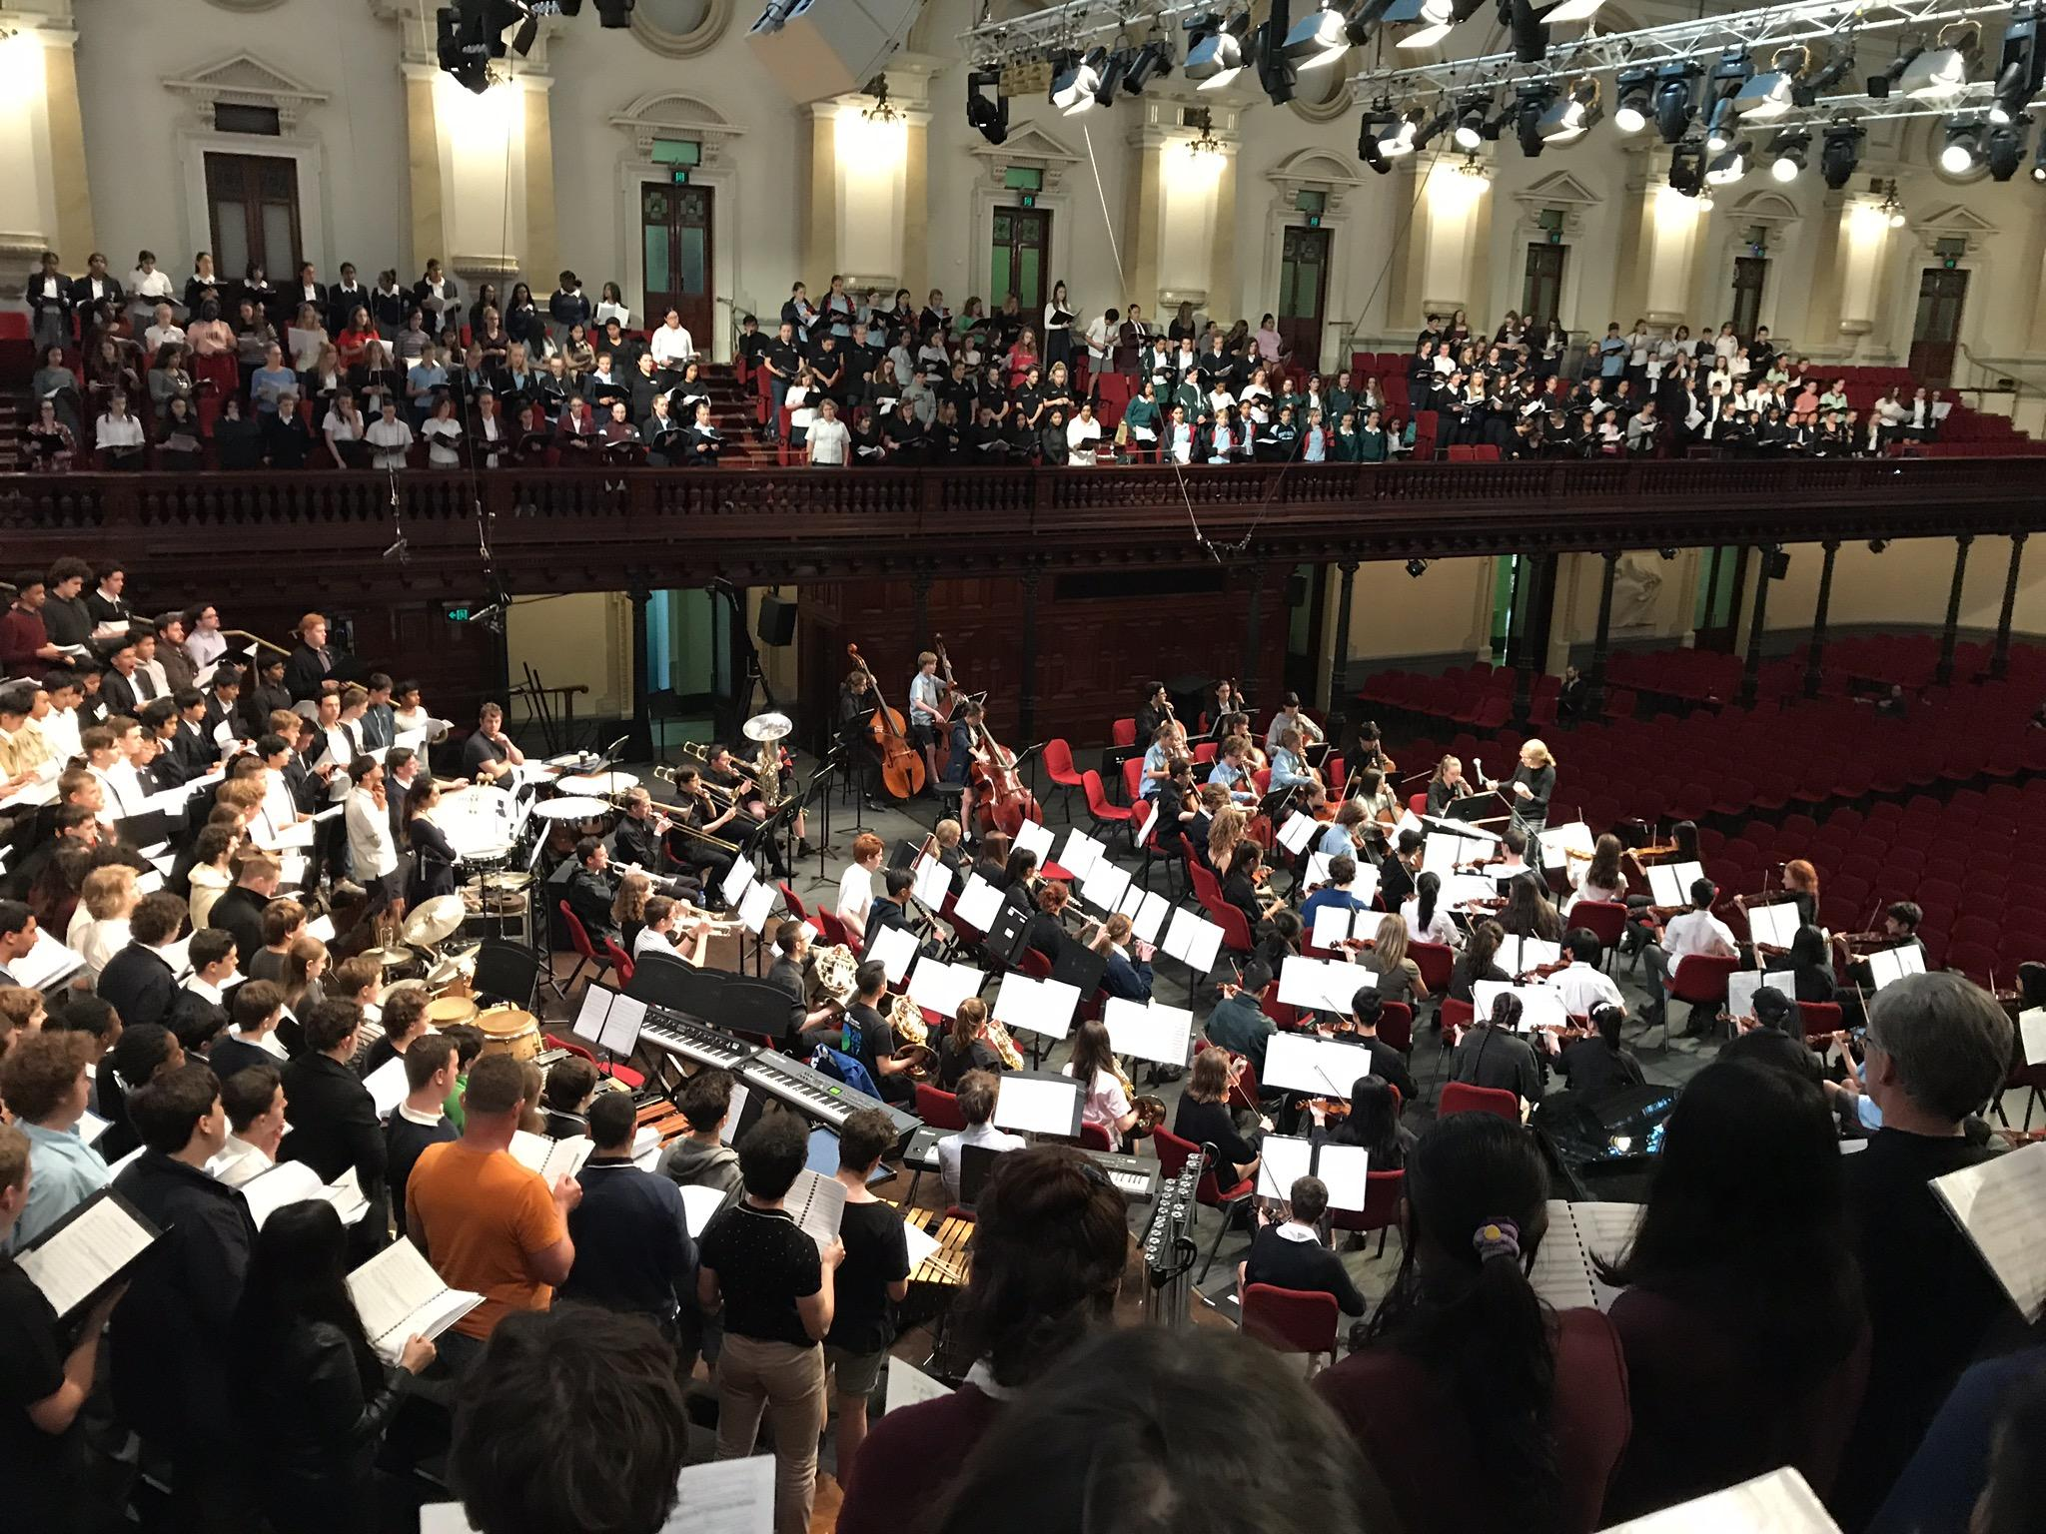
POSSIBLE MUSIC 1 HSC PROGRAM
PERFORMANCE
PERFORMANCE
PERFORMANCE
PERFORMANCE
PERFORMANCE
COMPOSITION
COMPOSITION
COMPOSITION
PERFORMANCE
PERFORMANCE
COMPOSITION
MUSICOLOGY
PERFORMANCE
COMPOSITION
MUSICOLOGY
MUSICOLOGY

Slide 7
ASSESSMENT SCHEDULE
YEAR 11 (Preliminary) Course |  | YEAR 12 (HSC) Course
Task 1- Arrangement and Analysis | 30% | Task 1- Composition portfolio and aural analysis | 20%
 |  | Task 2- Performance and Viva Voce | 20%
Task 2- Composition and Portfolio | 30%
 |  | Task 3- Presentation or Submission of Elective 1 and 2 | 30%
Task 3- Performance and Topic Investigation with Yearly Examination | 40%
 |  | Task 4- Trial HSC Examination and Presentation or Submission of Elective 3 | 30%

Slide 8
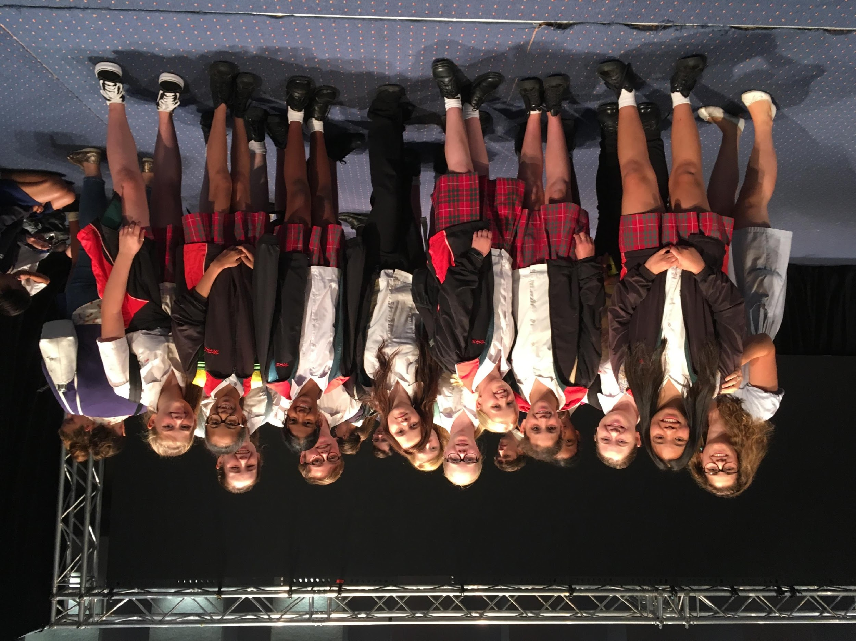
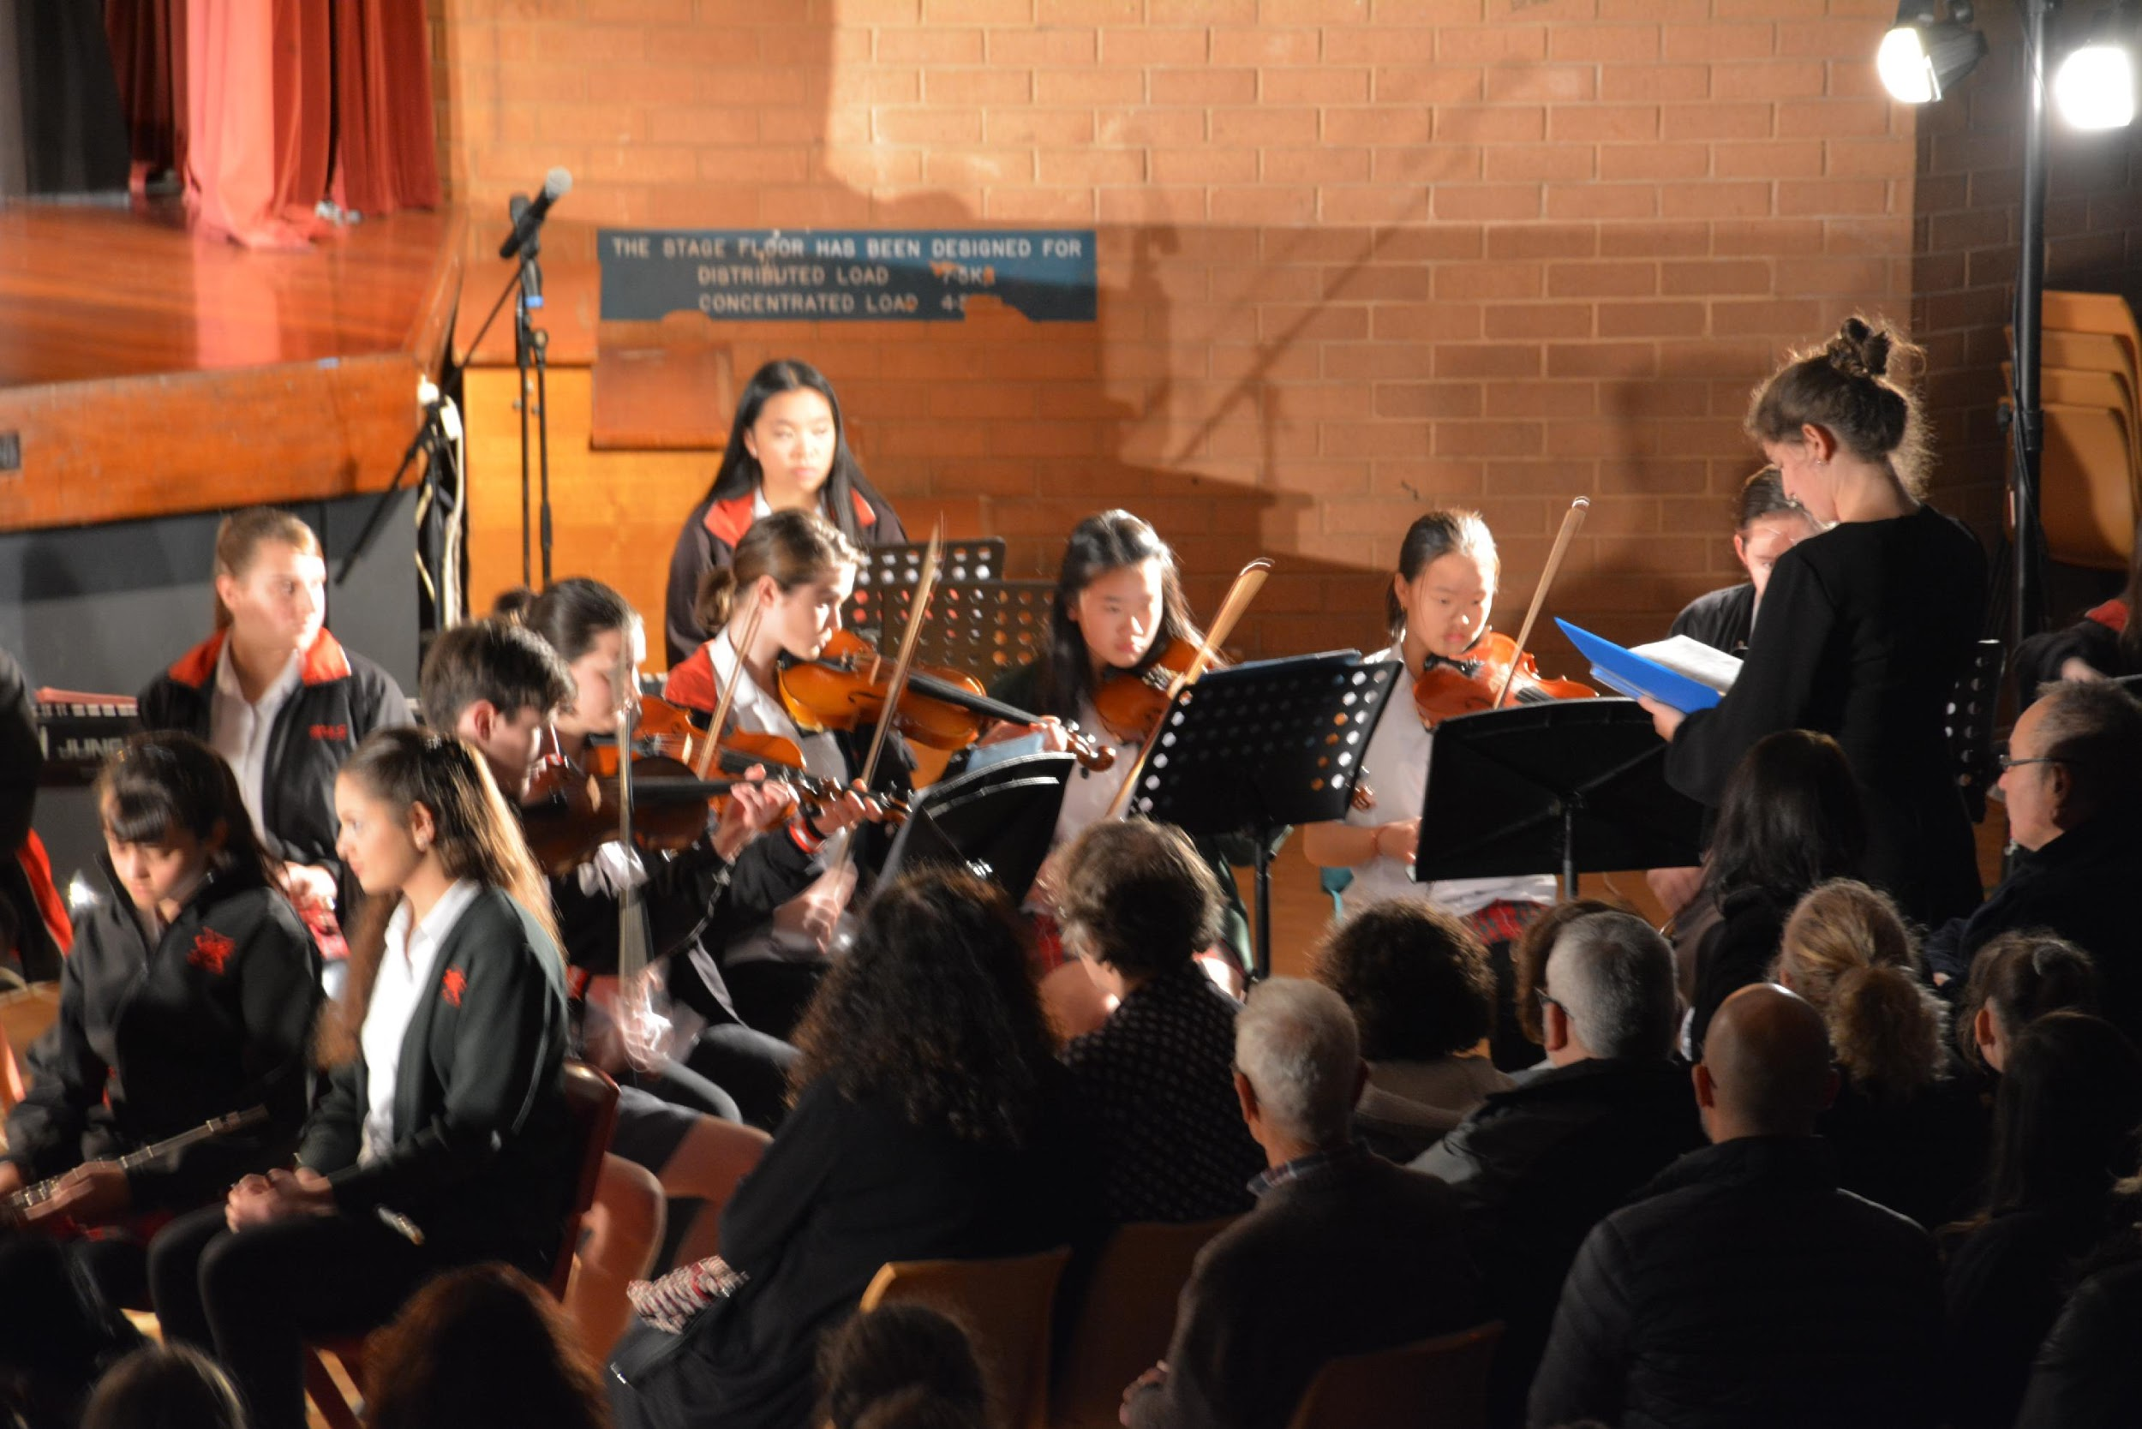
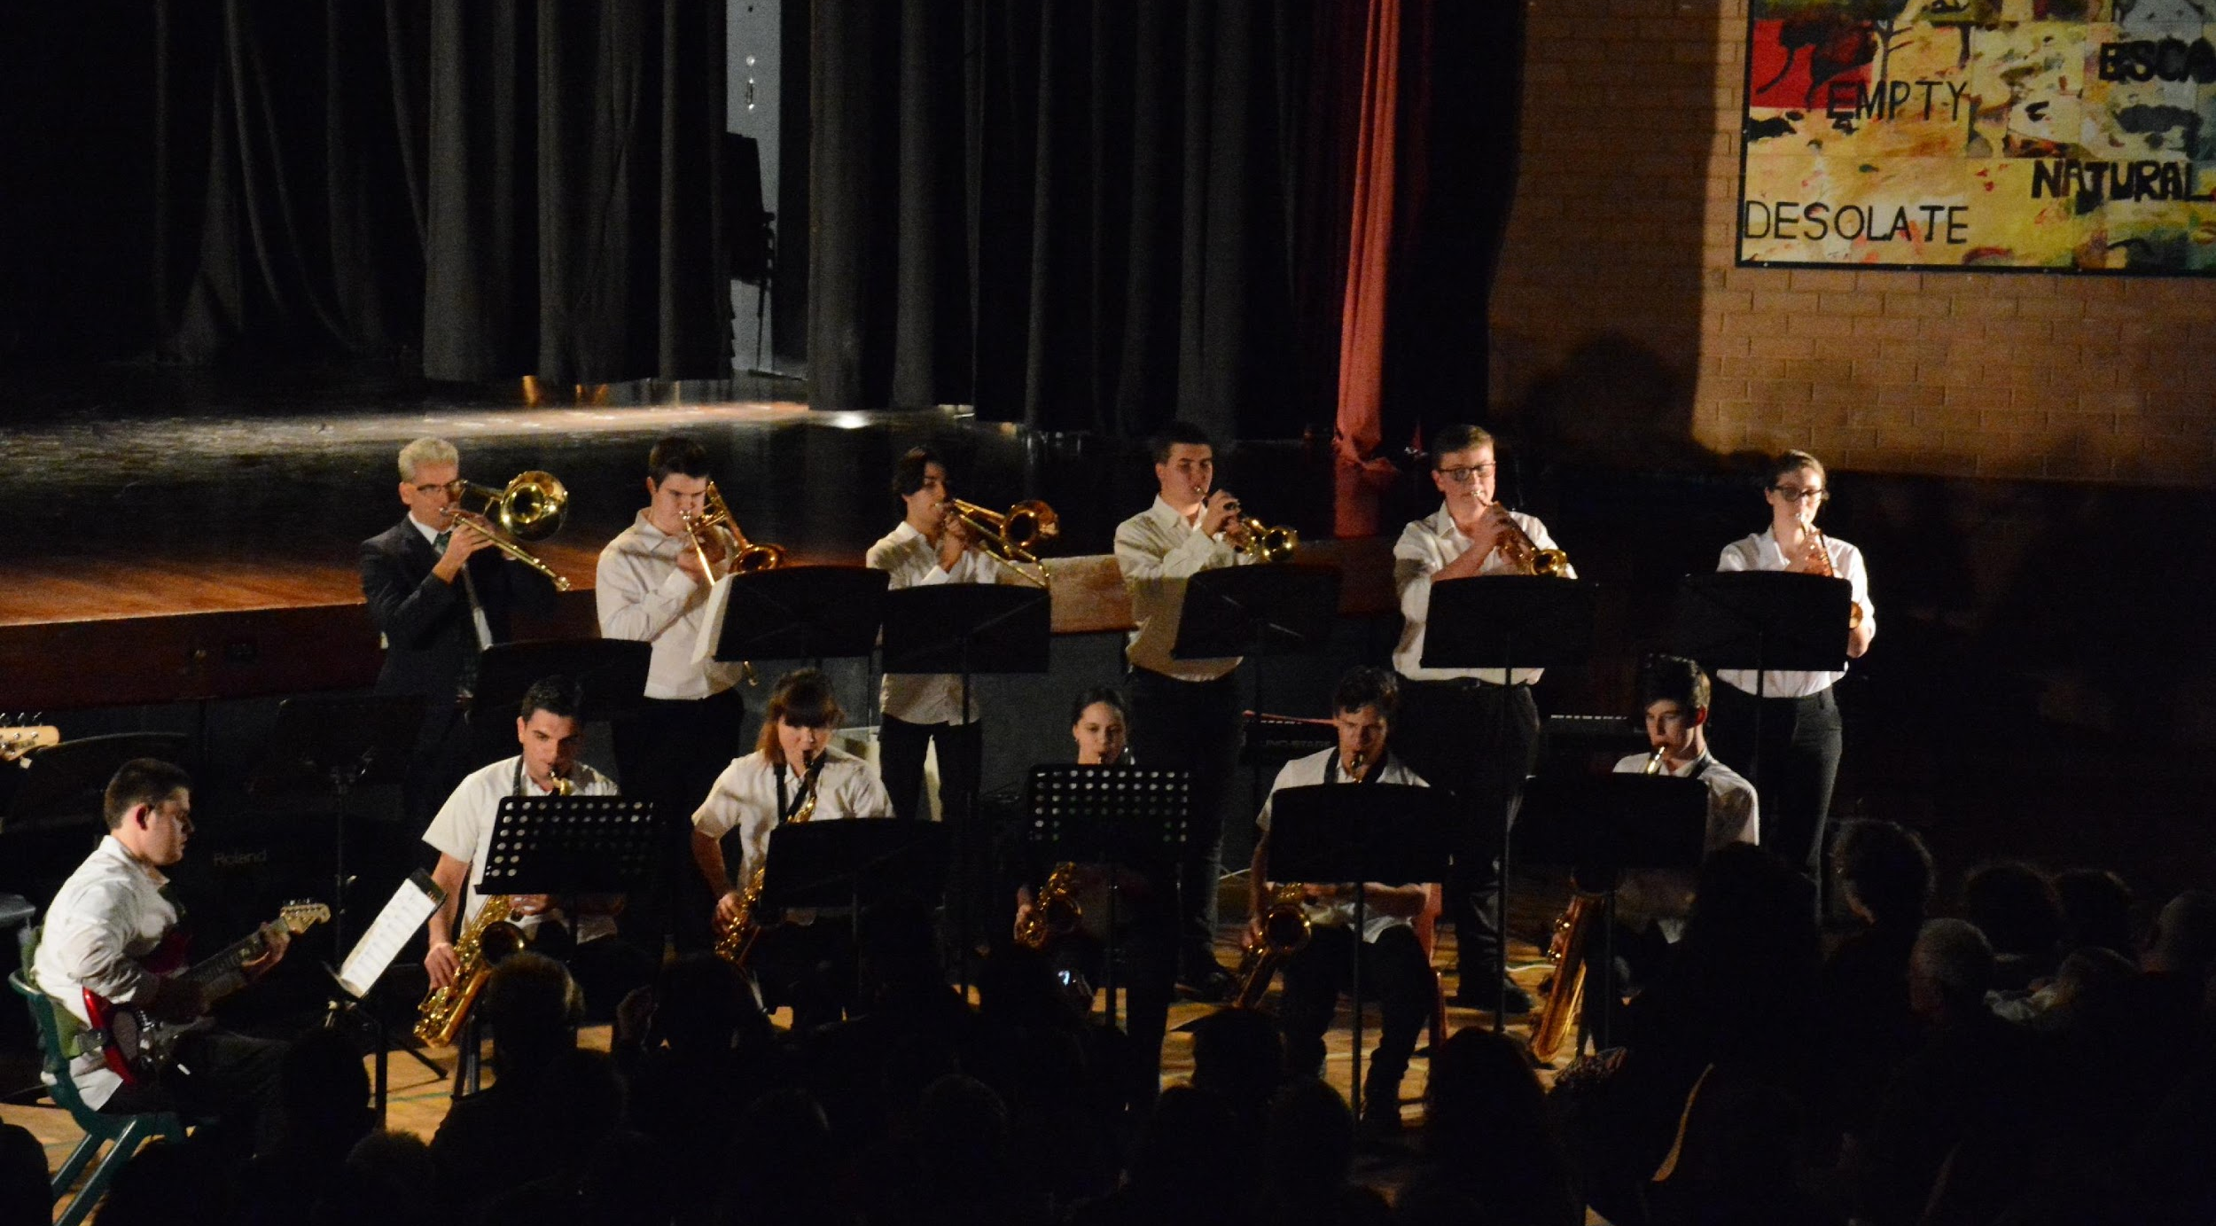
We would like you to be a part of our Ensembles
Concert Band
Vocal Ensemble
Stage Band
String Ensemble
Rock Band

Slide 9
CAREERS
Music teacher
Music tutor
Music therapist
Sound/Recording Engineer
Performer
Accompanist
Repetiteur
Composer/arranger
Sound Technician
Musicologist
Piano Tuner
DJ
Conductor
Band Manager
Speech pathologist
Stage Manager

Slide 10
HSC ENCORE
HSC Encore is an annual concert of the highest scoring HSC Performances.
Menai High School has had students represented in HSC Encore

Slide 11
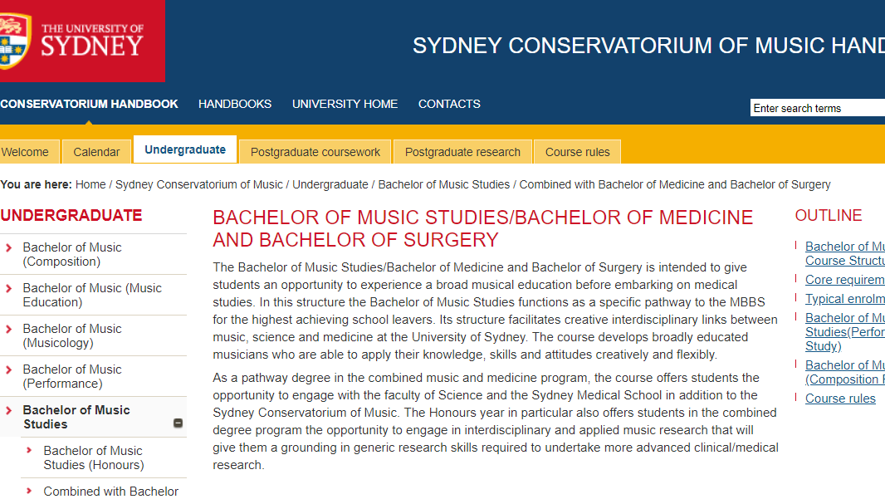

Slide 12
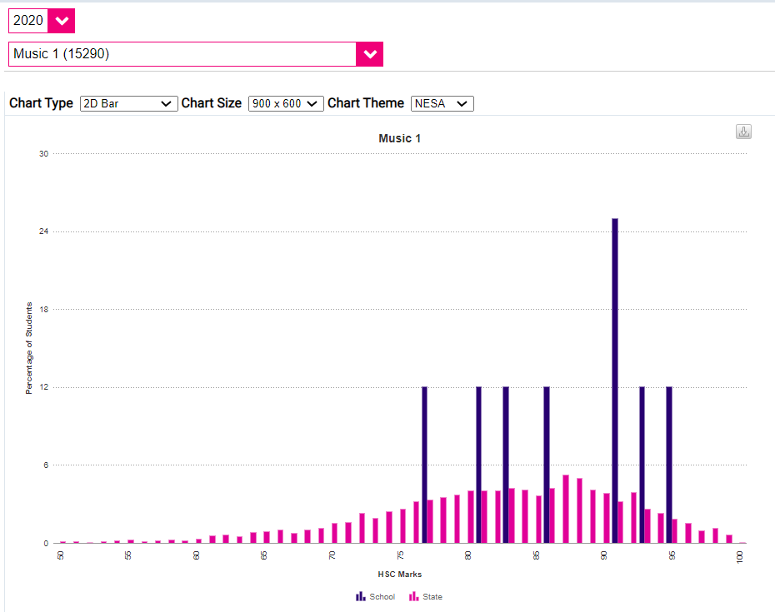
MUSIC
HSC Results
Menai is BLUE
The rest of the state is PINK

