Slide 1
Senior English
Subject Selection Information

Slide 2
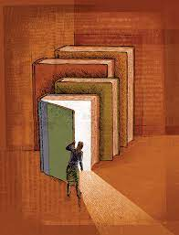
Which English Subject Should I choose?
English Advanced + English Extension
English Advanced
English Standard
English Studies

Slide 3
English Advanced
For advanced readers and writers
Students appropriate for this course:
Maintain an A - grade average
Historically rank in the top 48
Enjoy reading for pleasure
Enjoy the study of Shakespeare
Engage in independent critical and contextual analysis
Seek to continue to develop the sophistication of their imaginative, persuasive, discursive and analytical writing through a rigorous drafting and refinement process.

Slide 4
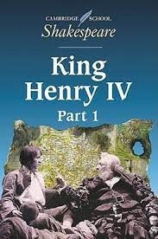
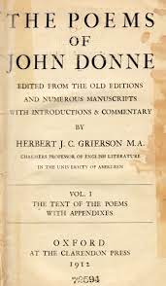
English Advanced
The texts studied are recognised as quality literature from the Western Literary Canon and, being written as far back as the 16th Century, the language and ideas of these texts are highly complex and can be challenging for young readers.

Slide 5
English Extension
Is undertaken alongside English Advanced as an additional unit
Classes occur “off the timetable” before and after school
Students must have passion for English literature and be:
-Perceptive readers, writers and critics
-Dedicated to developing their knowledge and understanding through independent research and critical analysis

Slide 6
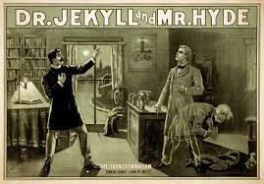
English Extension
Students who undertake this course have read numerous novels throughout their life.
They seek to study texts of the Western Literary Canon by researching the historical, social, political and philosophical paradigms that shape a text.

Slide 7
English Standard
English Standard is the Standard
The course most student undertake
Prerequisite for most university courses
Require compositions in a variety of forms; analytical writing, imaginative writing, discursive writing and reflections
Year 12 = 1 x 1.5 hour Paper (1 reading/short answer and 1 essay response) + 1 x 2 hour Paper (comprising of 2 essay responses and 1 extended composition either persuasive, discursive, imaginative and/or reflection).

Slide 8
English Standard
If you rely on your teacher to interpret the text, find the techniques, tell you what they mean, scaffold your essays, construct the paragraphs and the sentences, correct your grammar and expression... then English Standard is the course for you.
The texts are more modern and less challenging with “old language”
English Teachers still have high expectations of our Standard Students
Tasks are timed, examination style responses
The course offers more differentiation for students:
Those who wish to pursue Band 6
Students who just need 2 units of English to “get in” to university.

Slide 9
English Studies
For students who think they might not want to do the external HSC exams and don’t like to write essays...
Would like the opportunity to express their understanding of the texts and concepts without having to do too many timed examinations or essays.
Students entering this course historically have experienced difficulty/a lack of interest in English
Mostly C - D Range students in Years 9/10
Don't really like reading (and probably won’t read the set text on their own)
Don’t really like writing essays (and probably won’t hand in drafts)

Slide 10
English Studies
English studies is skills for real life...
Not a study of literature
Preparation of practical skills like how to write a resume and interview skills
English Teachers still have high expectations of our English Studies Students
Tasks are assignment based and involve multiple parts
Still study a “common module” in Year 12
Student can opt to undertake the External HSC Examination at the end of Year 12 if they wish (only 1 examination rather than 2).

Slide 11
Your English teachers know your work really well and have the experience to offer you advice to assist your choice.
We’d love to answer your questions.
Please ask.

