Slide 1
Menai High School Assessment Policy and Procedures
Welcome
Due to COVID restrictions the annual Year 10 ROSA Assessment information night 2022 has been replaced with this Parent Information Power point presentation.

Slide 2
Acknowledgement of Country
I would like to acknowledge the Cabrogal clan of the Darug nation who are the traditional custodians of this land. I would like to acknowledge the Dharawal and Gandangara nations who also accessed this land and pay my respect to all Elders – past, present and future. I would also like to extend that respect to both Aboriginal and non- Aboriginal people here today.

Slide 3
Welcome
What information will be discussed in this presentation?
Copies of the ROSA Assessment Policy and procedures.
Assessment Policy summary and main points
Why and what is assessment
Performance Descriptors
Requirements to be eligible for the award of a ROSA ?
Student Responsibilities/ School Responsibilities
Disability Provisions / Illness or Misadventure
Non submission of tasks
Process if absent for an assessment
Importance of completing all course work
Malpractice
N Determination ( Non Completion of a course)
Minimum Standards in Literacy and Numeracy for the HSC
NESA’s Students On Line
Helpful websites

Slide 4
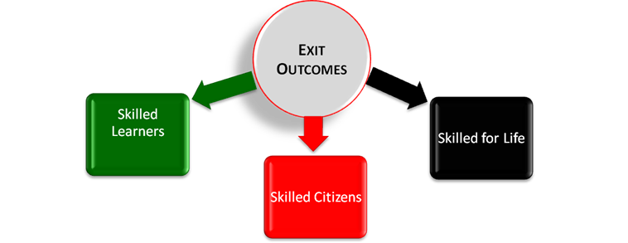
Menai High School Exit Outcomes

Slide 5
QUALIFICATIONS
Year 12 – HSC
Year 11 – ROSA transcript with grades from Preliminary courses and Year 10 Grades
NESA Minimum Standards test results
Year 10 – ROSA transcript with Year 10 grades
NESA Minimum Standards test results

Slide 6
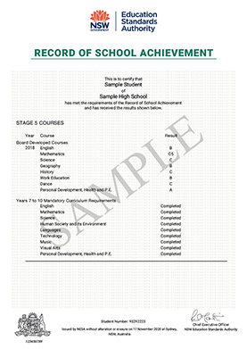

Slide 7
Menai High School Assessment Policy and Procedures

Slide 8
Record Of School Achievement (ROSA) ASSESSMENT TIMELINE
ROSA Term 1 to end Term 4

Slide 9
ASSESSMENT WHY IS ASSESSMENT NECESSARY?
The Assessment allows due weight to be given during the course to student achievement.
Course assessment schedule is used to
allocate grades for Year 10
complete school academic reports.

Slide 10
WHAT ARE ASSESSMENT TASKS?
These are the types of tasks used to assess students
formal examinations
class tests
practical work
performance
assignments
essays
oral presentations – etc

Slide 11
WHAT ARE PERFORMANCE DESCRIPTORS?
Performance descriptors are a series of statements which summarise the observable and measurable features of student achievement and assist in the awarding of grades to students based on levels of achievement.
Teachers will use performance descriptors to allocate ROSA grades.

Slide 12
WHAT ARE THE REQUIREMENTS TO
BE ELIGIBLE FOR THE AWARD OF A
ROSA ?

Slide 13
WHAT ARE THE REQUIREMENTS TO BE ELIGIBLE FOR THE AWARD OF A ROSA OR HIGHER SCHOOL CERTIFICATE?
Attend school for the required period of time (more than 85% of the available school days) and each course.
Study the pattern of courses required by NESA for the required time/hours. English , Mathematics, History, Geography, PDHPE and elective courses.
Have a satisfactory record of application in their studies;
Complete the requirements for a sufficient number of courses, including practical, oral or project works;
Complete assessment requirements for a sufficient number of courses;
Sport is a Department of Education requirement for completion of Year 10.
If the requirements for any of the core courses have not been met a student could be ineligible for the ROSA.
Example: a student has been N Determined in PDHPE. The student will not be eligible for their ROSA.

Slide 14
STUDENT RESPONSIBILITIES TO COMPLETE THE ROSA .
Work diligently and consistently concerning all course work.
Students must make a serious attempt at every course assessment task. If students do not this can result is a
mark of zero being awarded for that task.
Each student must complete the task by the time indicated on the task. If students do not this will result in a mark of zero being awarded for that task.

Slide 15
STUDENT RESPONSIBILITIES TO COMPLETE THE ROSA.
All work presented for assessment must be the student's own work.
If this is found out not to be the case, then a mark of zero will be awarded for that task.

Slide 16
SCHOOL RESPONSIBILITIES
At least two weeks' notice will be given for any task or any change of date for a task and it is the student's responsibility to report unduly onerous task loads immediately they occur.
An indication of when each of the assessment tasks will take place.
The mark value of each task in relation to the total number of marks for the course.
Each faculty will issue you with an Assessment policy for each of its courses you take.
The components and their weightings as specified.
The nature of each assessment task (eg. assignment)
Use the Performance Descriptors statements to assist in the awarding of grades to students based on levels of achievement.

Slide 17
DISABILITY PROVISIONS / ILLNESS OR MISADVENTURE
There are disability provisions for students with disabilities.
These need to be applied for with the NSW Education Standards Authority (NESA) .
Discuss with your Year Advisors, Head Teacher Administration - Mrs Ferraro or your Deputy Principal Mrs Sayed-Rich (Ms Ferraro relieving) .

Slide 18
DISABILITY PROVISIONS / ILLNESS OR MISADVENTURE
Illness or misadventure.
These matters can be discussed with the Head Teacher of the subject and/or your Deputy Principal . Application forms are to be collected from the front office.

Slide 19
ASSESSMENT TASKS NOT SUBMITTED
DO I HAVE TO DO THE ASSESSMENT TASKS?
Yes.
Students who fail to complete 50% of the available marks will be regarded as not having satisfactorily completed the course of study. In cases of NON-SATISFACTORY completion, a "N“ (non complication of the course will be submitted to the NESA).
Technology issues will not be an acceptable excuse. Students will need to ensure the work/task is saved in more than one place.
Student may need to enrol in Year 10 course again next year.

Slide 20
DO I ONLY HAVE TO COMPLETE ASSESSMENT TASKS?
No
You are expected to complete coursework for all subjects.
Students who do not complete course work may be issued with an “N” determination (i.e non-completion ) in that subject.

Slide 21
WHAT HAPPENS IF I AM ABSENT THROUGH ILLNESS OR INJURY?
Inform the Head Teacher of that subject on the due date of the task. On the first day of return to school the student is to;
Complete an illness / misadventure form and return it to the Head Teacher/Deputy Principal with appropriate documentation as evidence signed by parents
Be prepared to do the exam or assessment task or hand in the task on the first day of return to school.

Slide 22
DURING EXAMINATIONS/ FORMAL EXAMS
It is not an automatic response that the exam will be rescheduled. This will be at the discretion of the Principal or Principal’s representative.
The missed exams can only be re scheduled during the exam period and the first day of return back to normal lessons.
Failure to comply with the requirements in the section above will result in a mark of zero for that task and the issuing of an `N' warning letter.

Slide 23
ATTENDANCE ON ASSESSMENT DAYS.
On the day of Assessable tasks, students MUST attend all timetabled lessons, otherwise they will be considered absent and require a medical certificate - no student should gain an unfair advantage over other students.

Slide 24
MALPRACTICE IN ASSESSMENT TASKS
All work presented in Assessment Tasks must be your own work.
All Year 11 students must complete an ‘All My Own Work’ course to be eligible for the HSC.
This course will completed at the end of Year 10 2022 ready for the start of Year 11 2023.

Slide 25
NON COMPLETION OR N DETERMINATION
If a student has not followed the requirements for a ROSA teachers will;
Send a “N” Warning letter explaining the requirements that have not been met by the student.
The letter will indicate the action the student must follow to redeem the “N” Warning and the due date of the action/ completion of the task. The student will still be awarded zero for the task. But the teacher needs to see the abilities of the student
What is the minimum number of N waring letters in a subject are needed before the student can be N Determined.
Two N warning letters is the minimum number of letters needed to be sent to the parents.
What action/s does the student need to do to redeem?
Complete the task or resubmit the task by the new date indicated on the letter.

Slide 26
NOT ELIGIBLE FOR A ROSA OR HSC
Students who are not eligible for the ROSA but leave school will receive a Transcript of Study. TOSA
Year 12 students who are not eligible for a HSC will receive their ROSA with the Year 10 grades and Year 11 grades.

Slide 27
MINIMUM STANDARDS IN LITERACY AND NUMERACY
Each student needs to meet the requirements of the minimum standards tests. There will be numerous opportunities to complete these tests at school in Yr 10, 11 and 12.

Slide 28
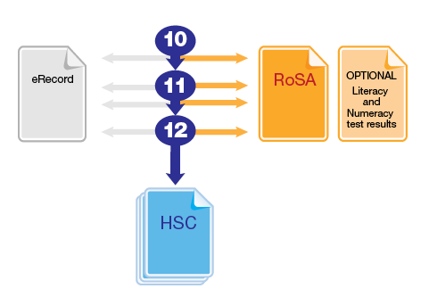
Leaving without your HSC
If you decide to leave school before completing your HSC, you have three other options to show your achievements and credentials:
eRecord: You can retrieve a record of your grades from Students Online at any time.
Record of School Achievement (RoSA): You may be eligible for a RoSA if you meet certain criteria. The RoSA shows your courses and grades for Years 10 and 11, and any HSC courses you have taken.
Literacy and numeracy test results: You can take optional online literacy and numeracy tests and show the results to potential employers.
Talk to your teachers about the RoSA and the literacy and numeracy tests if you are thinking about leaving before you complete the HSC.

Slide 29
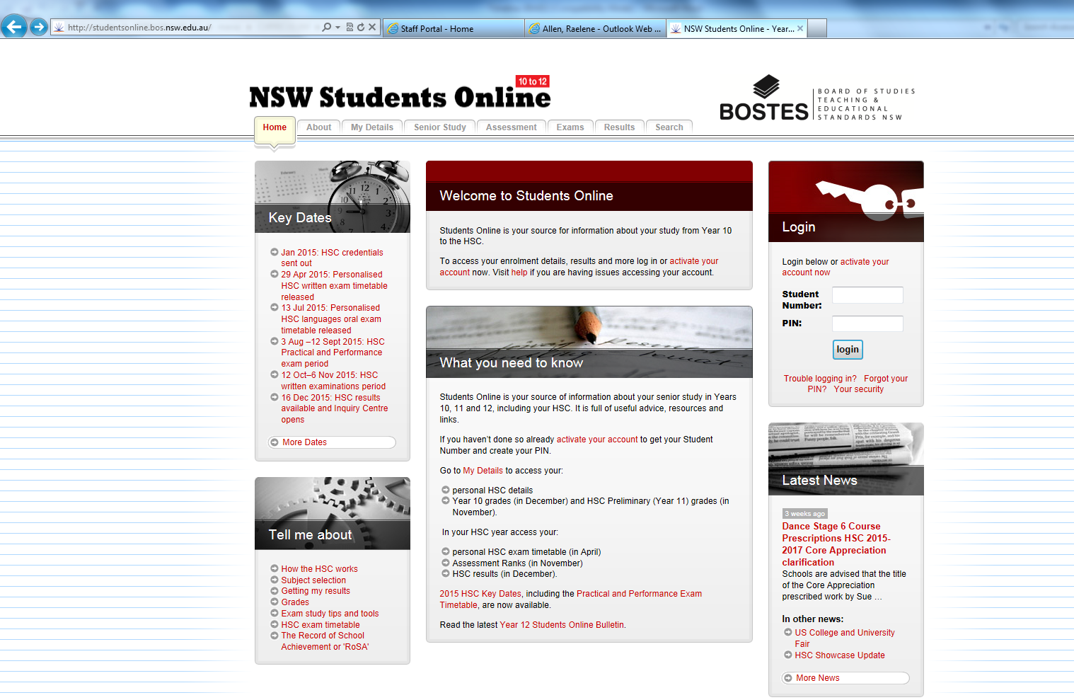
Students on line https://studentsonline.nesa.nsw.edu.au/
This is a very important site that students will need register themselves as
This is the method of communication by NESA to students. Students in Year 10 will be shown how to register later in term 1.

Slide 30
Helpful Web Sites
NESA
https://educationstandards.nsw.edu.au/wps/portal/nesa/home
NESA Students On Line
Students on line https://studentsonline.nesa.nsw.edu.au/
Menai High School
http://www.menai-h.schools.nsw.edu.au
University Admissions Centre
www.uac.edu.au

Slide 31
IF SUPPORT IS NEEDED
Year Advisors, Head Teacher Welfare – Ms Stone & School Counsellor - Mrs Brooker
Learning Support Team – Mrs Cooper
Menai High Careers Website- Mr McCartney
Year Advisors Mr Staines and Ms LaRosa
Head Teachers of each Faculty

Slide 32
Parent Communication
The school will use the following methods to communicate to parents;
Parent portal on Sentral
This could be a message or email.
Letters sent home from teachers or Head Teachers
School Newsletter
School Website- Assessment policy booklet/ Welfare Discipline booklet placed on the website.
General announcements via Facebook

Slide 33
THANK YOU
Thank you Year 10 Parents/caregivers for the support you provide your child.
Your child has been given a copy and emailed a copy of the 2022 ROSA Assessment policy and assessment schedules
If you have any questions please contact Mrs Ferraro.

