Slide 1
HSIE Stage 5 Electives
Human Society and its Environment

Slide 3
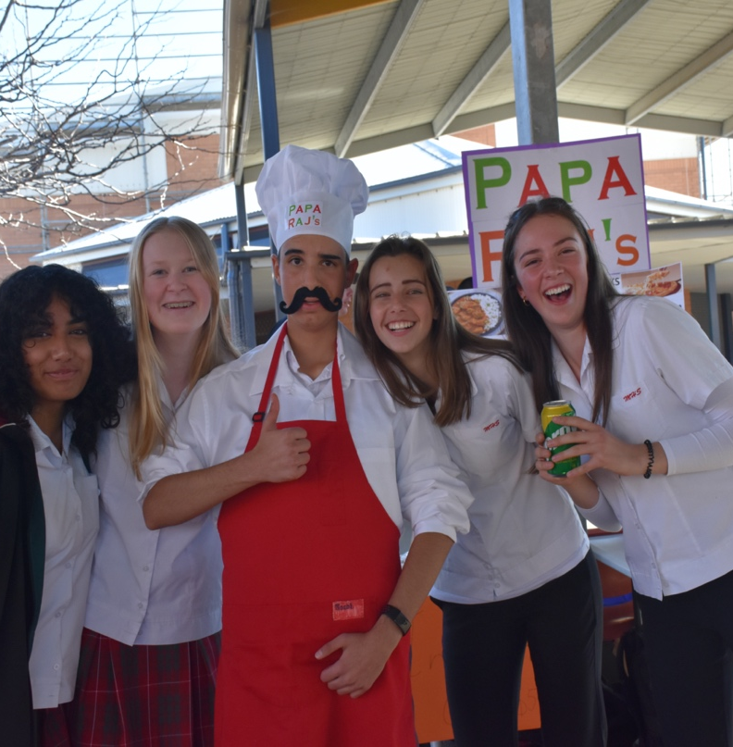
Overview of the course
The Commerce course at Menai High School has been developed to reflect the interests and needs of all students. It is a dynamic and contemporary subject which provides for a range of learning styles.
Central to all themes is the study of current issues and events.
Commerce utilises a practical approach to learning that allows students to apply theory to real life situations. Students develop critical thinking, reflective learning and the opportunity to participate in the community.
Students have the opportunity to develop values and attitudes that promote real behaviour and social responsibility and a commitment to contribute to a more just and equitable society. The Commerce course is a very useful introduction for the HSC subjects of Business Studies, Legal Studies and Economics.

Slide 4
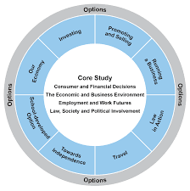
Commerce Topics
The Year 9 course has students study travel and plan their own dream holiday in an overseas country where they learn about all aspects involved in travel. The students attack this venture with great enthusiasm. Students also develop a clearer understanding of the world of finance whilst enjoying the competitive nature of their involvement in the Australian Securities Exchange share trading game.
The Year 10 course provides students with the opportunity to plan and run their own business. In this hands-on activity students will participate in ‘Business Day’ where they sell their own products to the school making a profit that will support a charity of their choice. Through this they learn concepts of budgeting, marketing and planning. Students also explore the ‘Law and Society’ topic where they examine the rights and responsibilities that affect them in society. The content deals with current real-world issues including young people and the law.

Slide 6
Subject Overview
From podcasts to fieldwork and debates, the study of Elective Geography will provide students with the opportunity to express their own ideas and arguments, evaluate the opinions of others, and engage in additional content and skills that provide them with a broader understanding of the discipline of Geography.
Students will learn to pose geographical questions, plan and process an inquiry, evaluate their findings and respond, through action, to what they have learnt, both through technological tools and fieldwork.
They will learn more about the rich and complex nature of Geography in its integration of natural science, social science, and humanities to build a holistic understanding of the world – and make a change for a sustainable and just future

Slide 7
Geography Topics
Through a series of inquiry-based units, Elective Geography encourages students to question why the world is the way it is, understand their relationship with the world and propose actions designed to shape a socially just and sustainable future.
Learn about the processes that shape the physical geography of our world, from tectonic plates to wild weather systems; dive deep into the Mariana Trench and investigate the exploitation of our oceans; understand what it means to be a citizen of the globe and make your argument against climate change.
Try your hand at turning the tides of the US Election and learn how nations are used as pawns in political battles; or track the terrifying spread of disease at local, national and international scales.

Slide 9
SAM Overview
The Elective History subject, S.A.M, provides students with the opportunity to develop a keen interest in and enjoyment of exploring the past. S.A.M stands for Studies of the Ancient and Modern World and allows students to develop knowledge and understanding of an array of past societies and historical periods.
Topics will be studied through archaeology, oral history, biographies, film studies and media, and students will explore the nature of history and the methods historians use to construct history through a range of thematic and historical studies.
Students undertake processes of historical inquiry, including analysing sources and sequencing major historical events, to show an understanding of continuity, change and causation.
Students also learn important historical concepts such as empathetic understanding, significance and contestability.

Slide 10
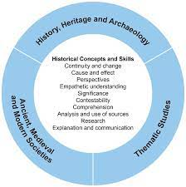
SAM Topics
Students will venture back in time to understand the Myths and Legends of ancient and medieval civilisations, learn the battle tactics of Alexander the Great, study the Aztec culture and become witch hunters during the Salem Witch trials
Solve Crime Mysteries and Conspiracy Theories, listen to Music Through History, behold the 7 Ancient Wonders, learn the dangerous ways of Pirates and study the American Civil Rights Movement and Slavery
Students will develop a lifelong interest in and enthusiasm for History!​

Slide 11
Want More Information?
Speak to any teacher from the HSIE staffroom.
Speak to your current Geography teacher

