Slide 1
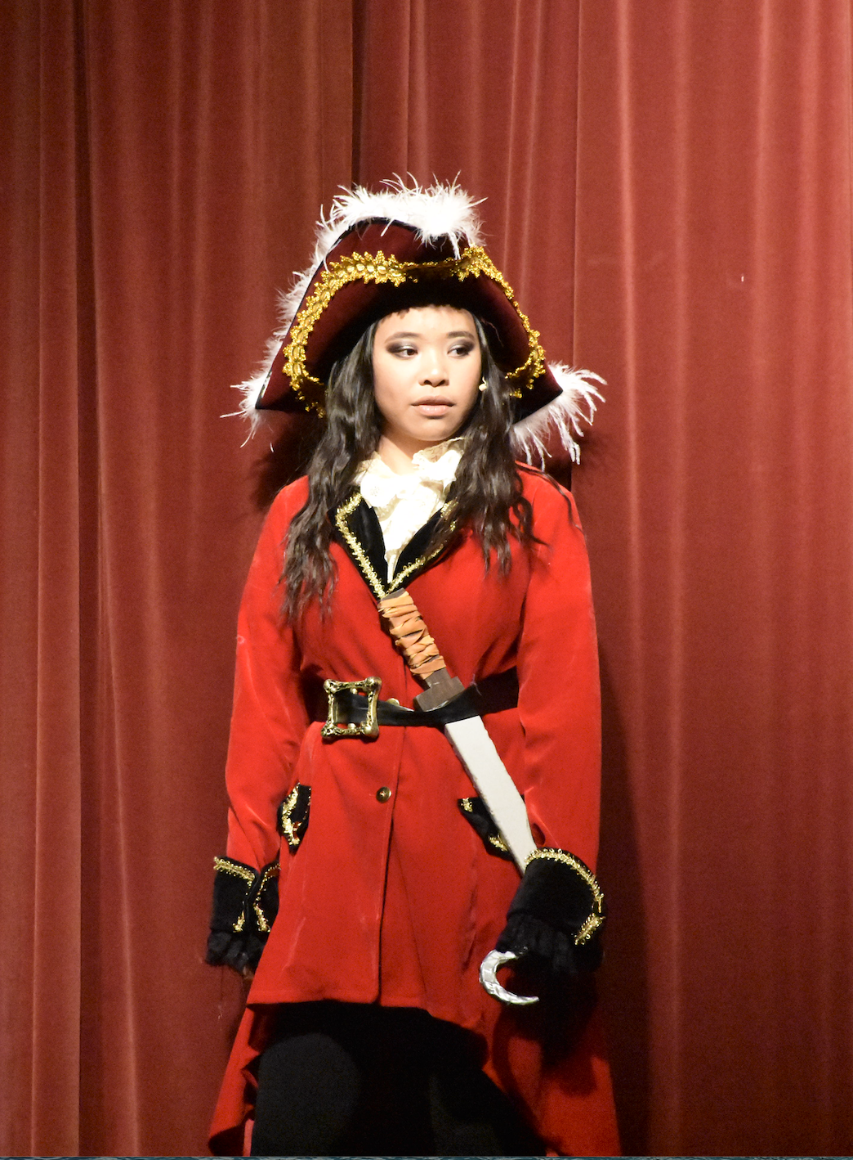
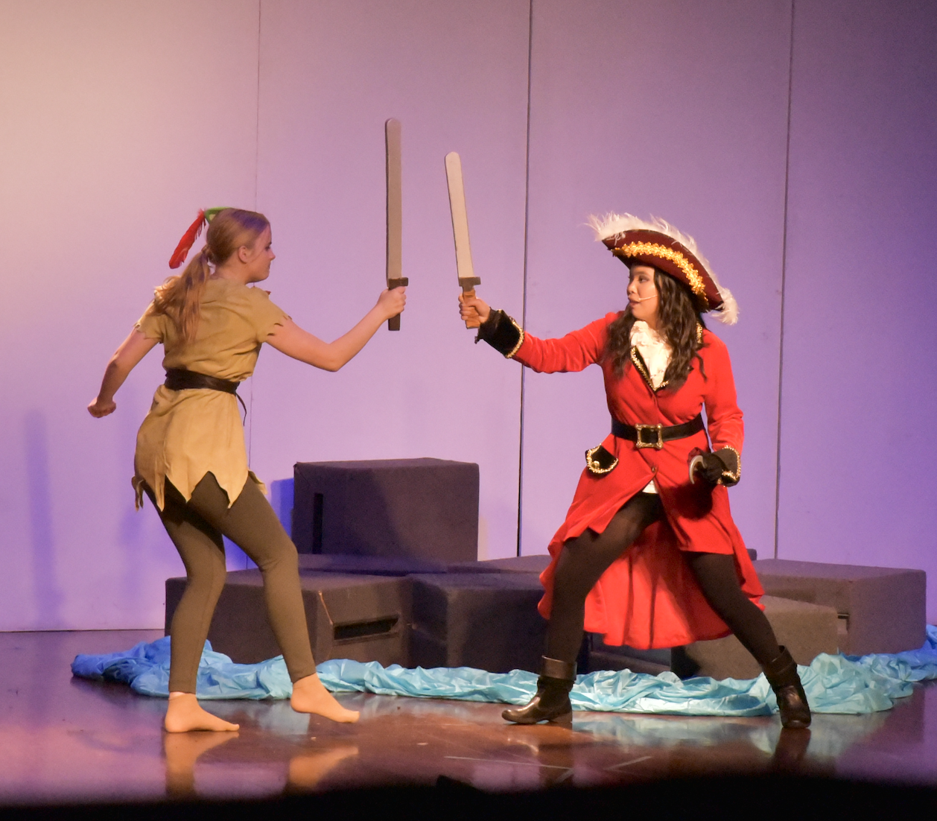
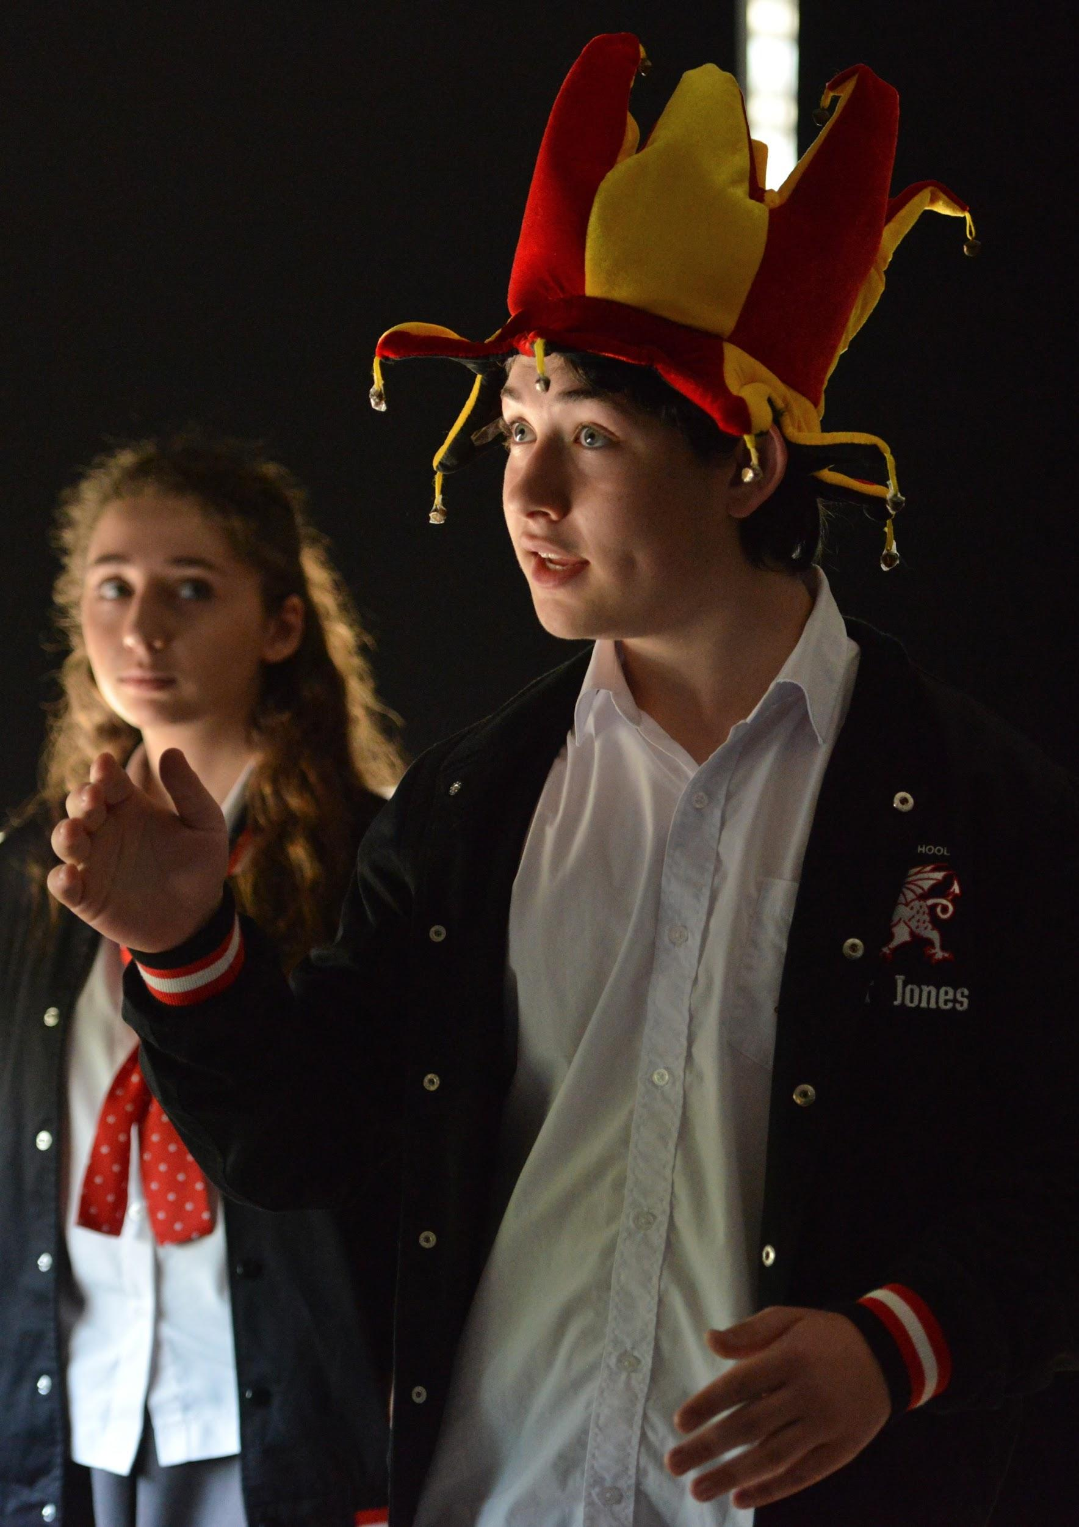
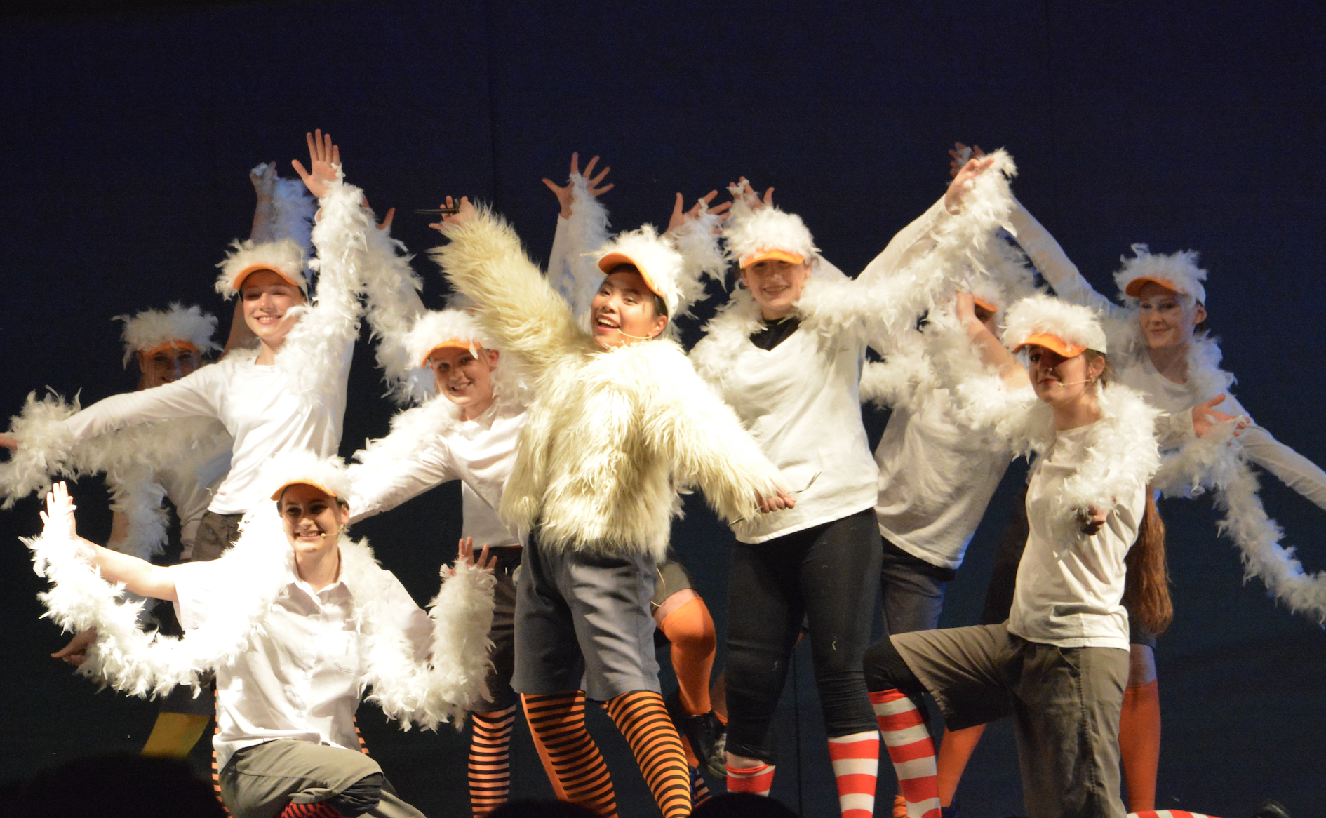
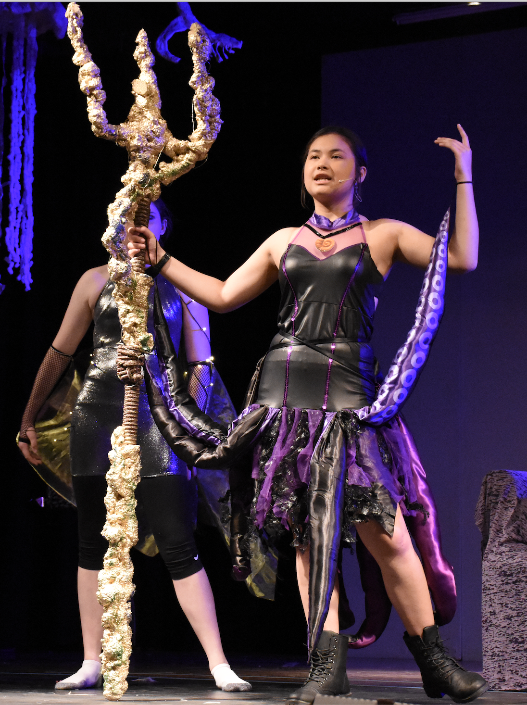
DRAMA
Year 9 and 10

Slide 2
Year 9 and 10 program of study
60% PRACTICAL
40% THEORY

Slide 3
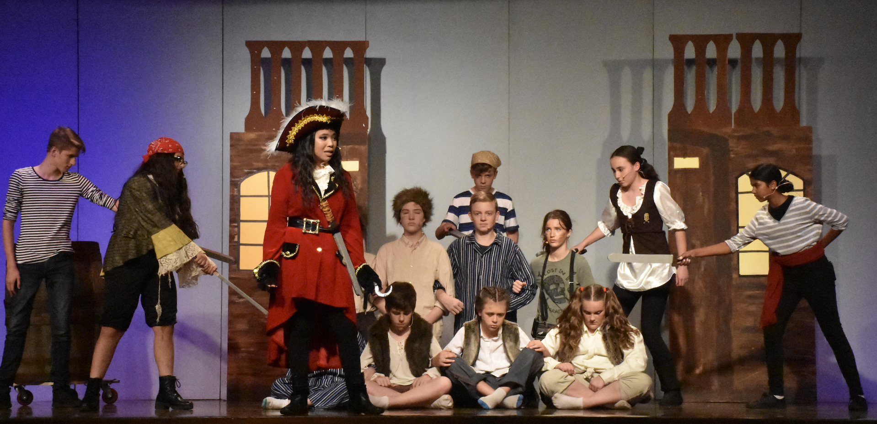
DRAMA
Drama is comprised of;
Making - 30%
Performing - 30%
Critically Studying - 40% 60% practical course! Putting the theoretical knowledge you learn in class into practice.

Slide 4
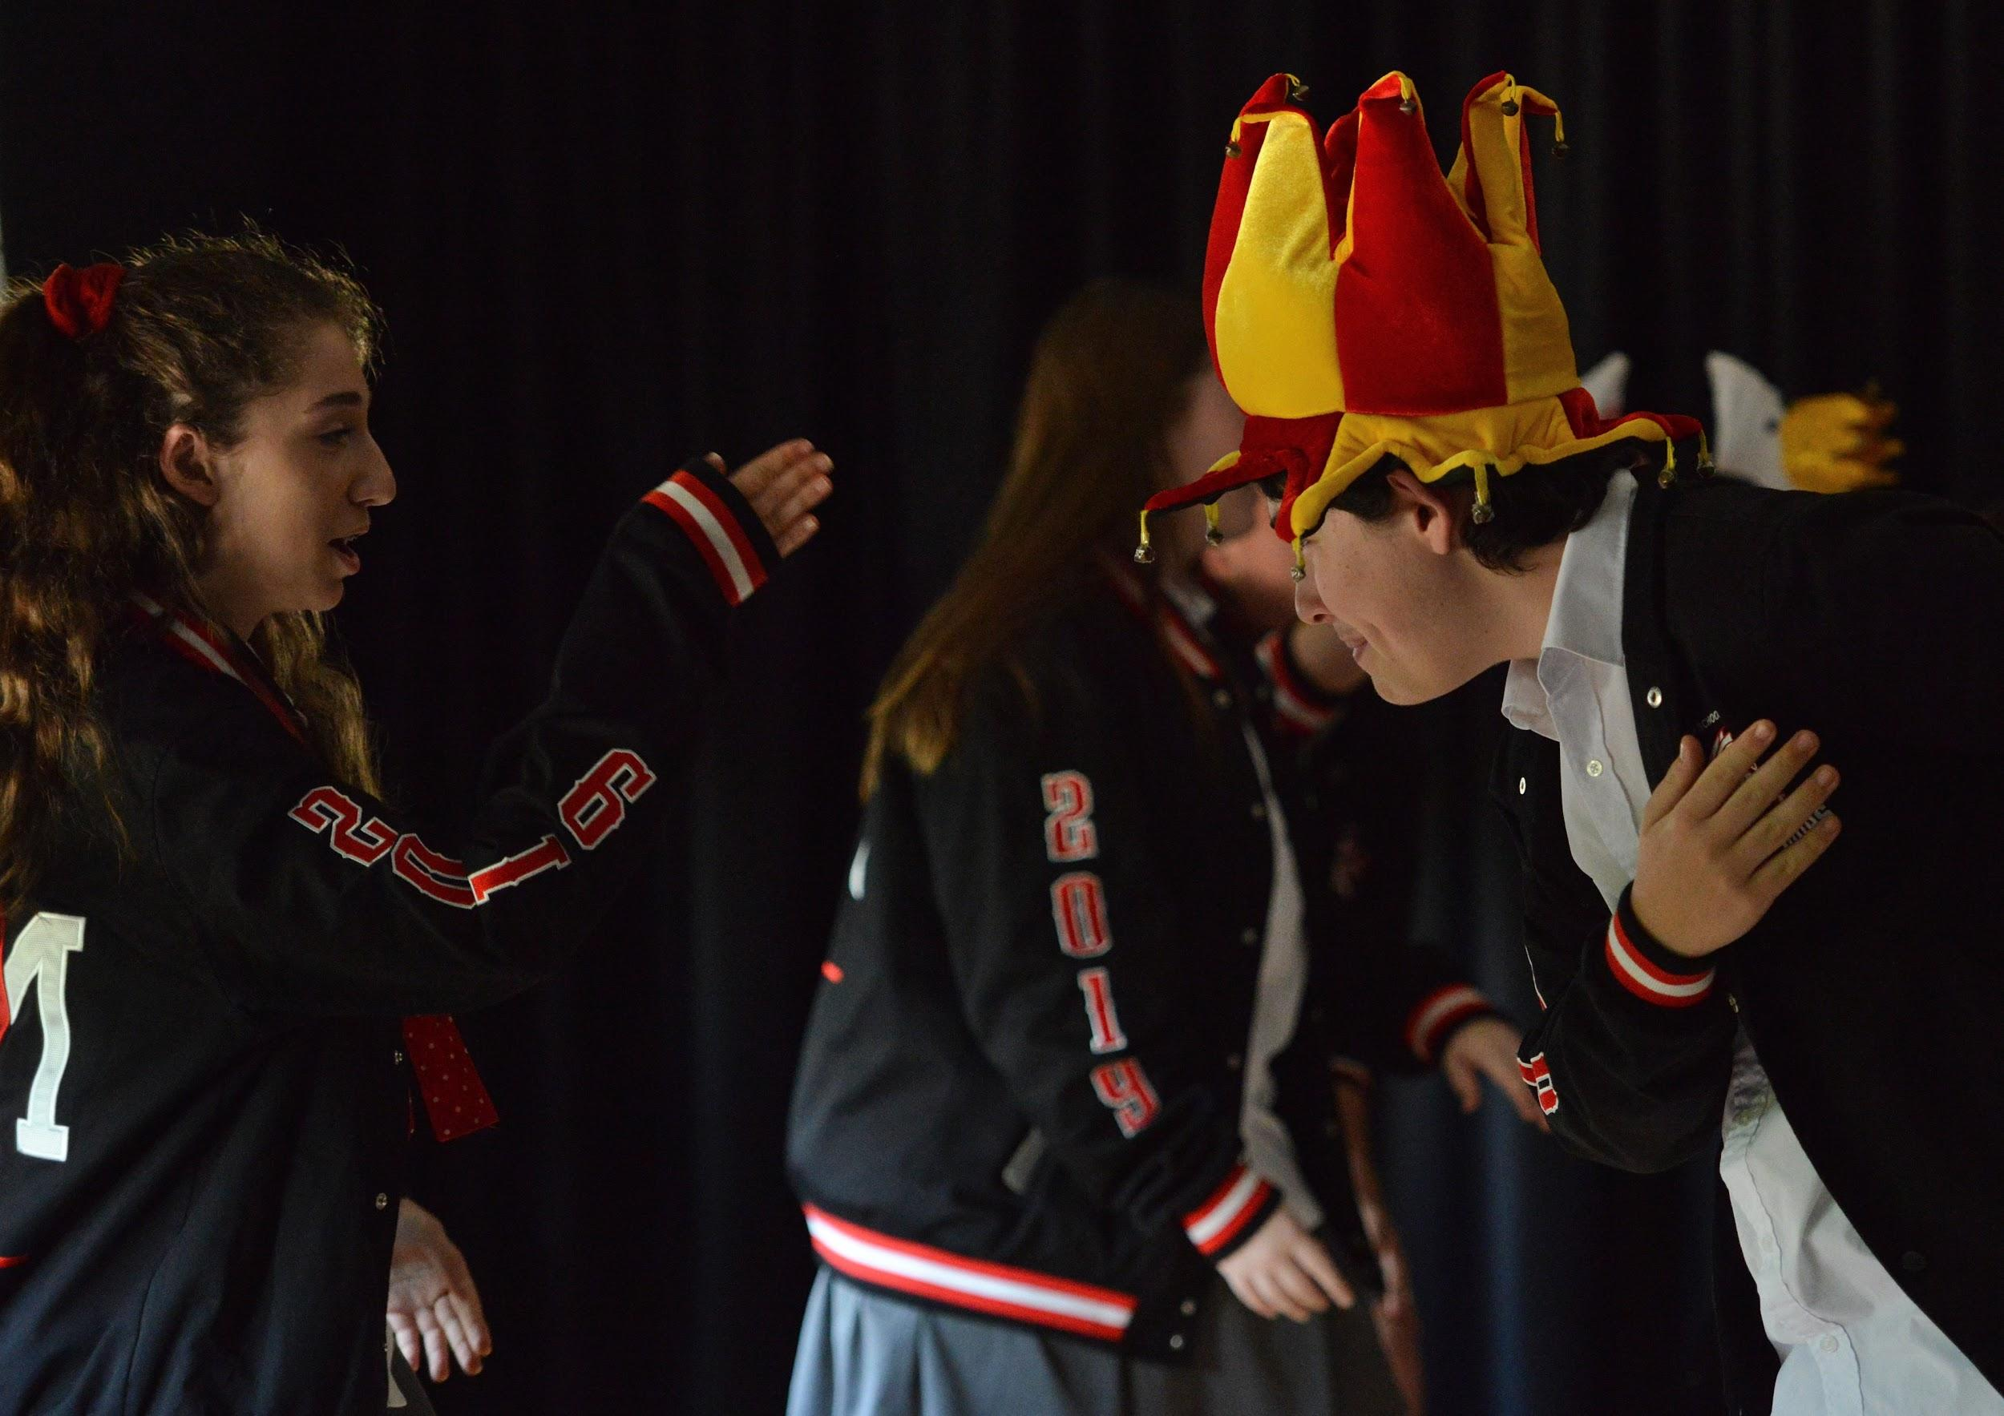
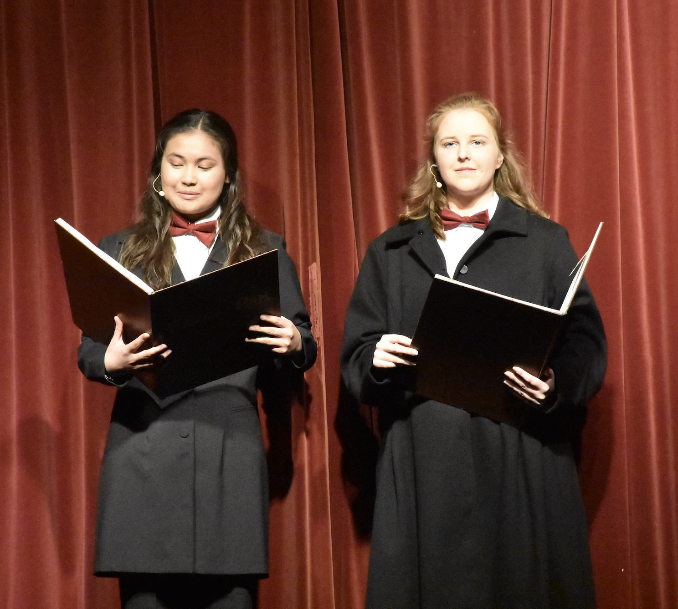
Years 9 and 10
3 Core sections;
In Stage Five students will develop knowledge, understanding and skills through;
• Making drama that explores a range of imagined and created situations in a collaborative drama and theatre environment
• Performing devised and scripted drama using a variety of performance techniques, dramatic forms and theatrical conventions to engage an audience
• Appreciating the meaning and function of drama and theatre in society

Slide 5
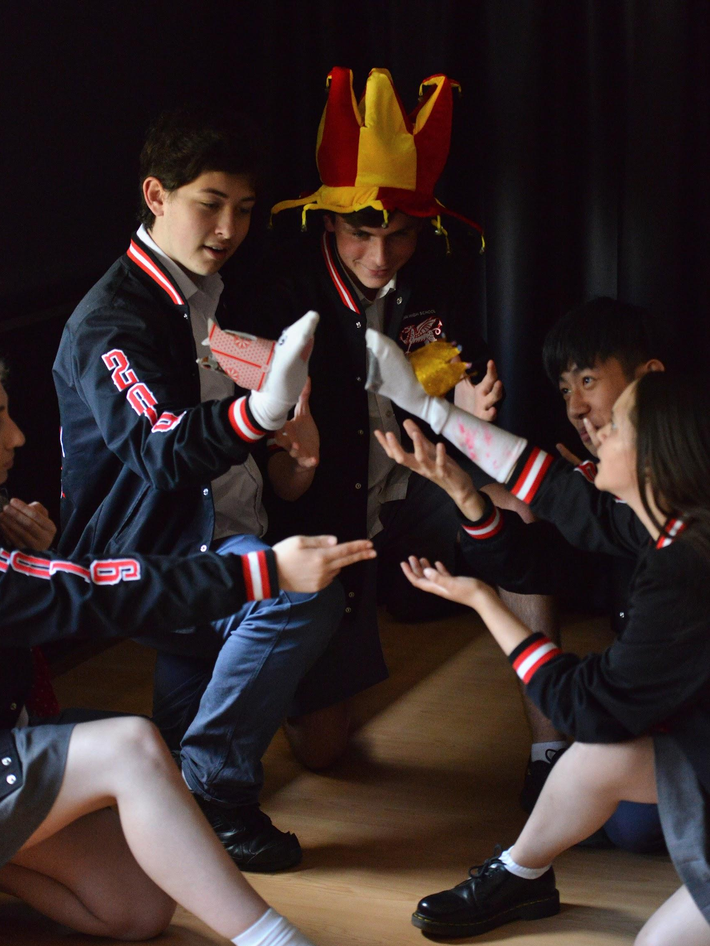
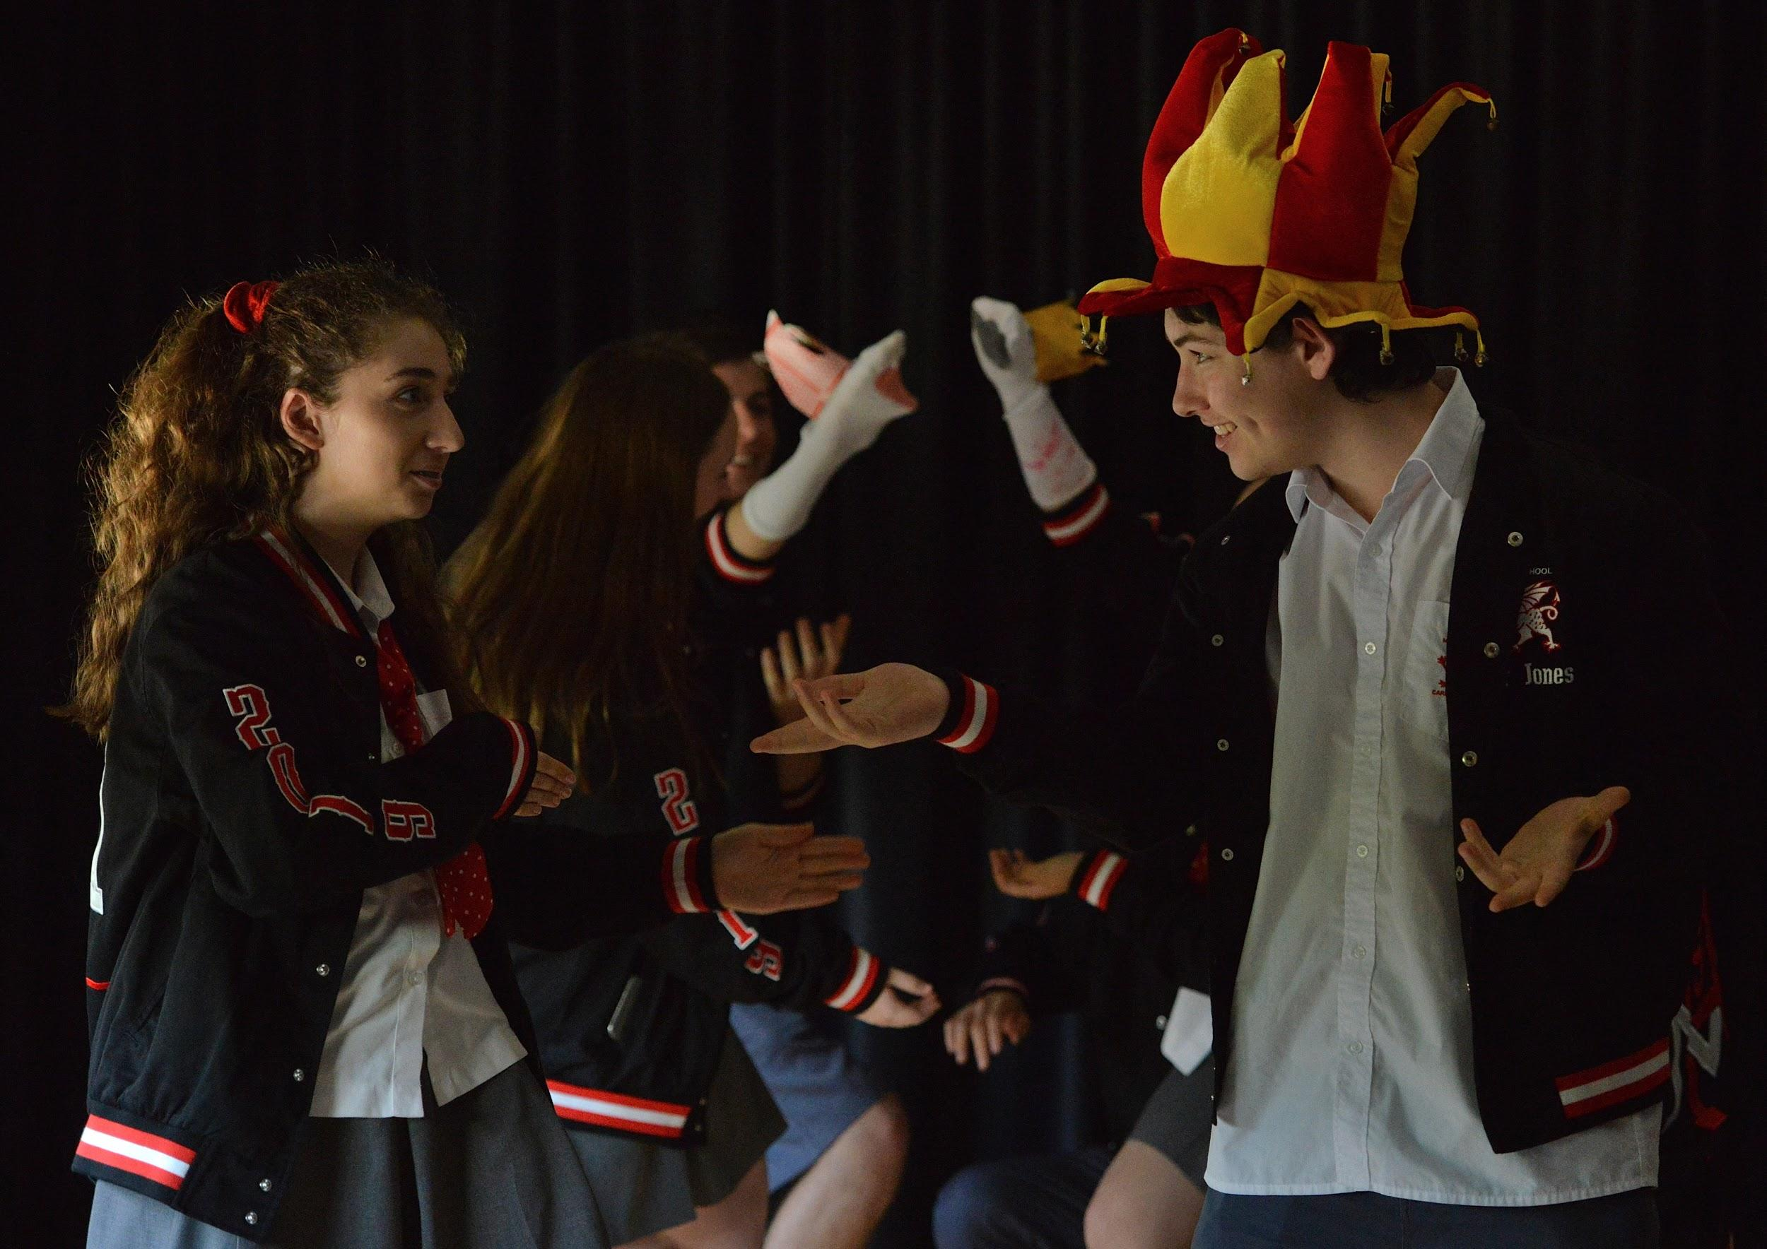
HSC REQUIREMENTS
Year 9:
Term 1: Introduction to the Elements of Drama and Playbuilding
Term 2: Commedia Del ‘Arte
Term 3: Shakespearean Theatre
Term 4: Short-Film/Video Drama
Year 10:
Term 1: Playbuilding
Term 2: Dramatic Text Study and Design
Term 3: Political Theatre
Term 4: Realism and monologue Performance

Slide 6
ASSESSMENT SCHEDULE
YEAR 9 Assessments |  | YEAR 10 Assessments
The Elements of Drama and Playbuilding | 25% | Playbuilding and Logbook | 25%
 |  | Text Study and Analysis | 20%
Informal Elements of Drama Exam | 0%
Commedia Del ‘Arte | 20%
 |  | Dramatic Form Performance | 25%
Shakespearean Drama | 25%
 |  | Monologue | 15%
Short Film | 15% | Yearly Exam | 15%
Yearly Exam | 15%

Slide 7
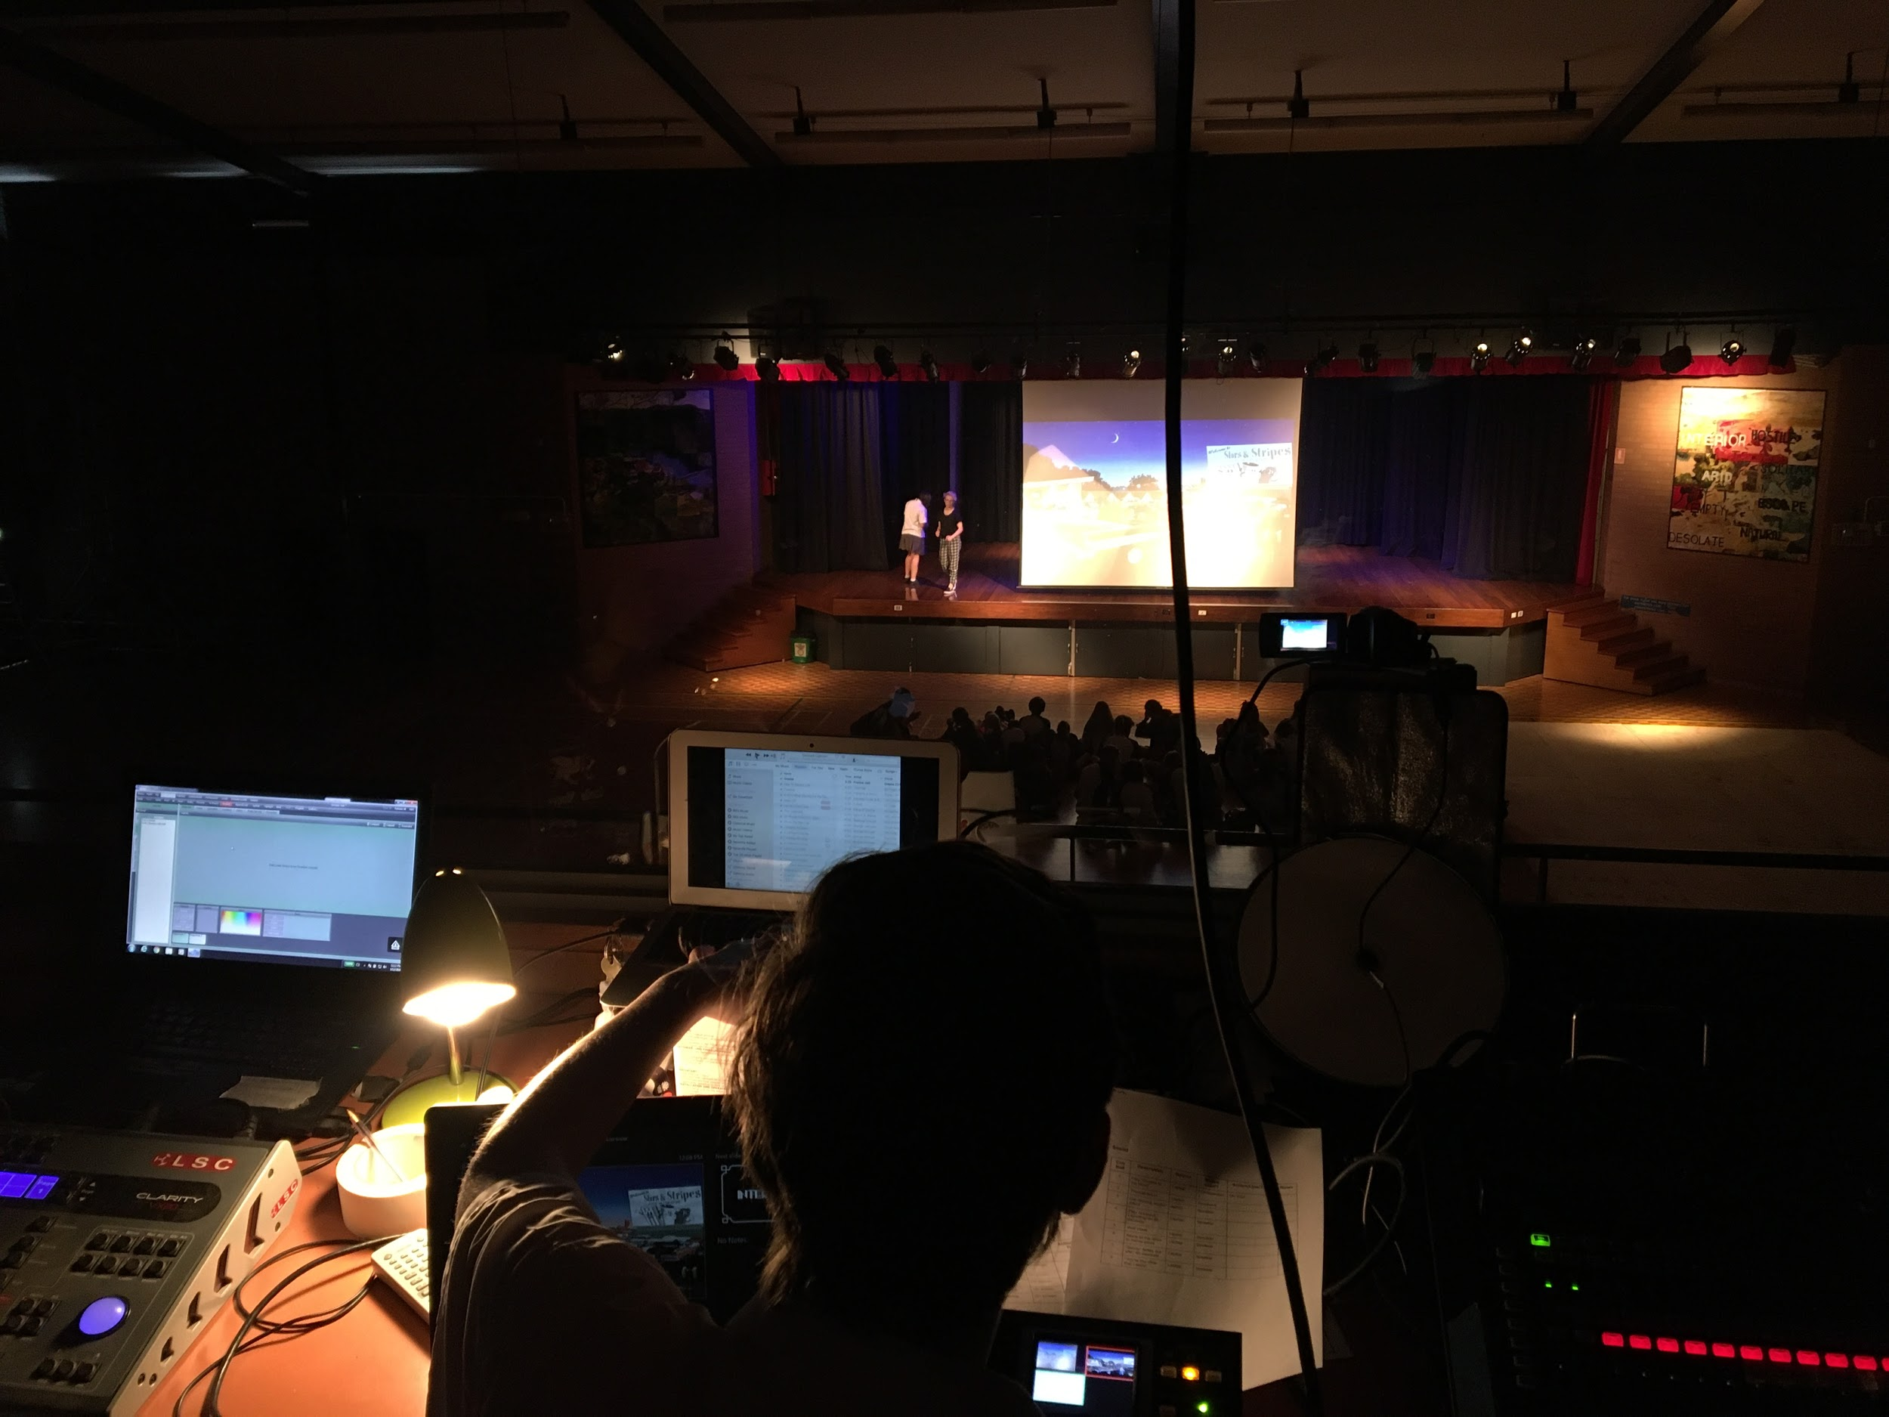
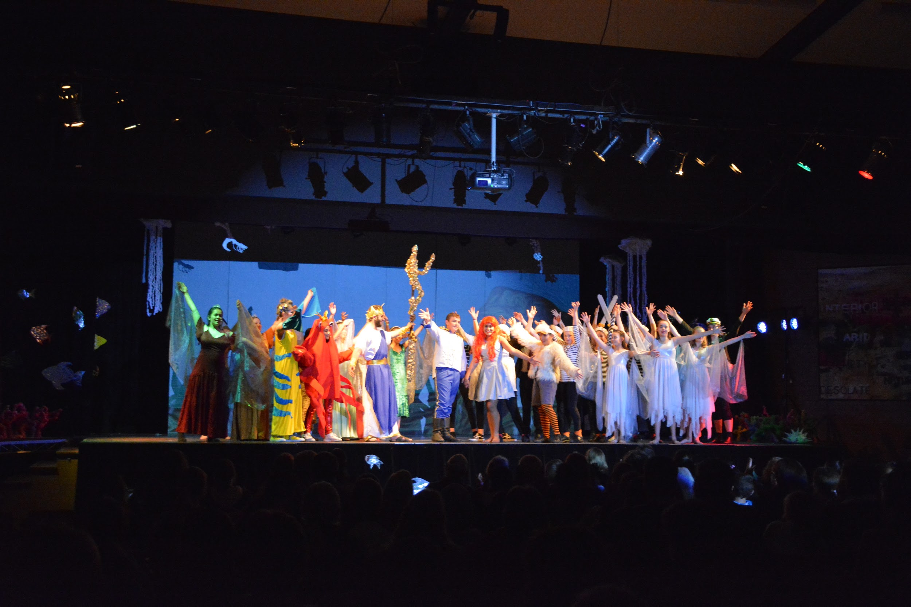
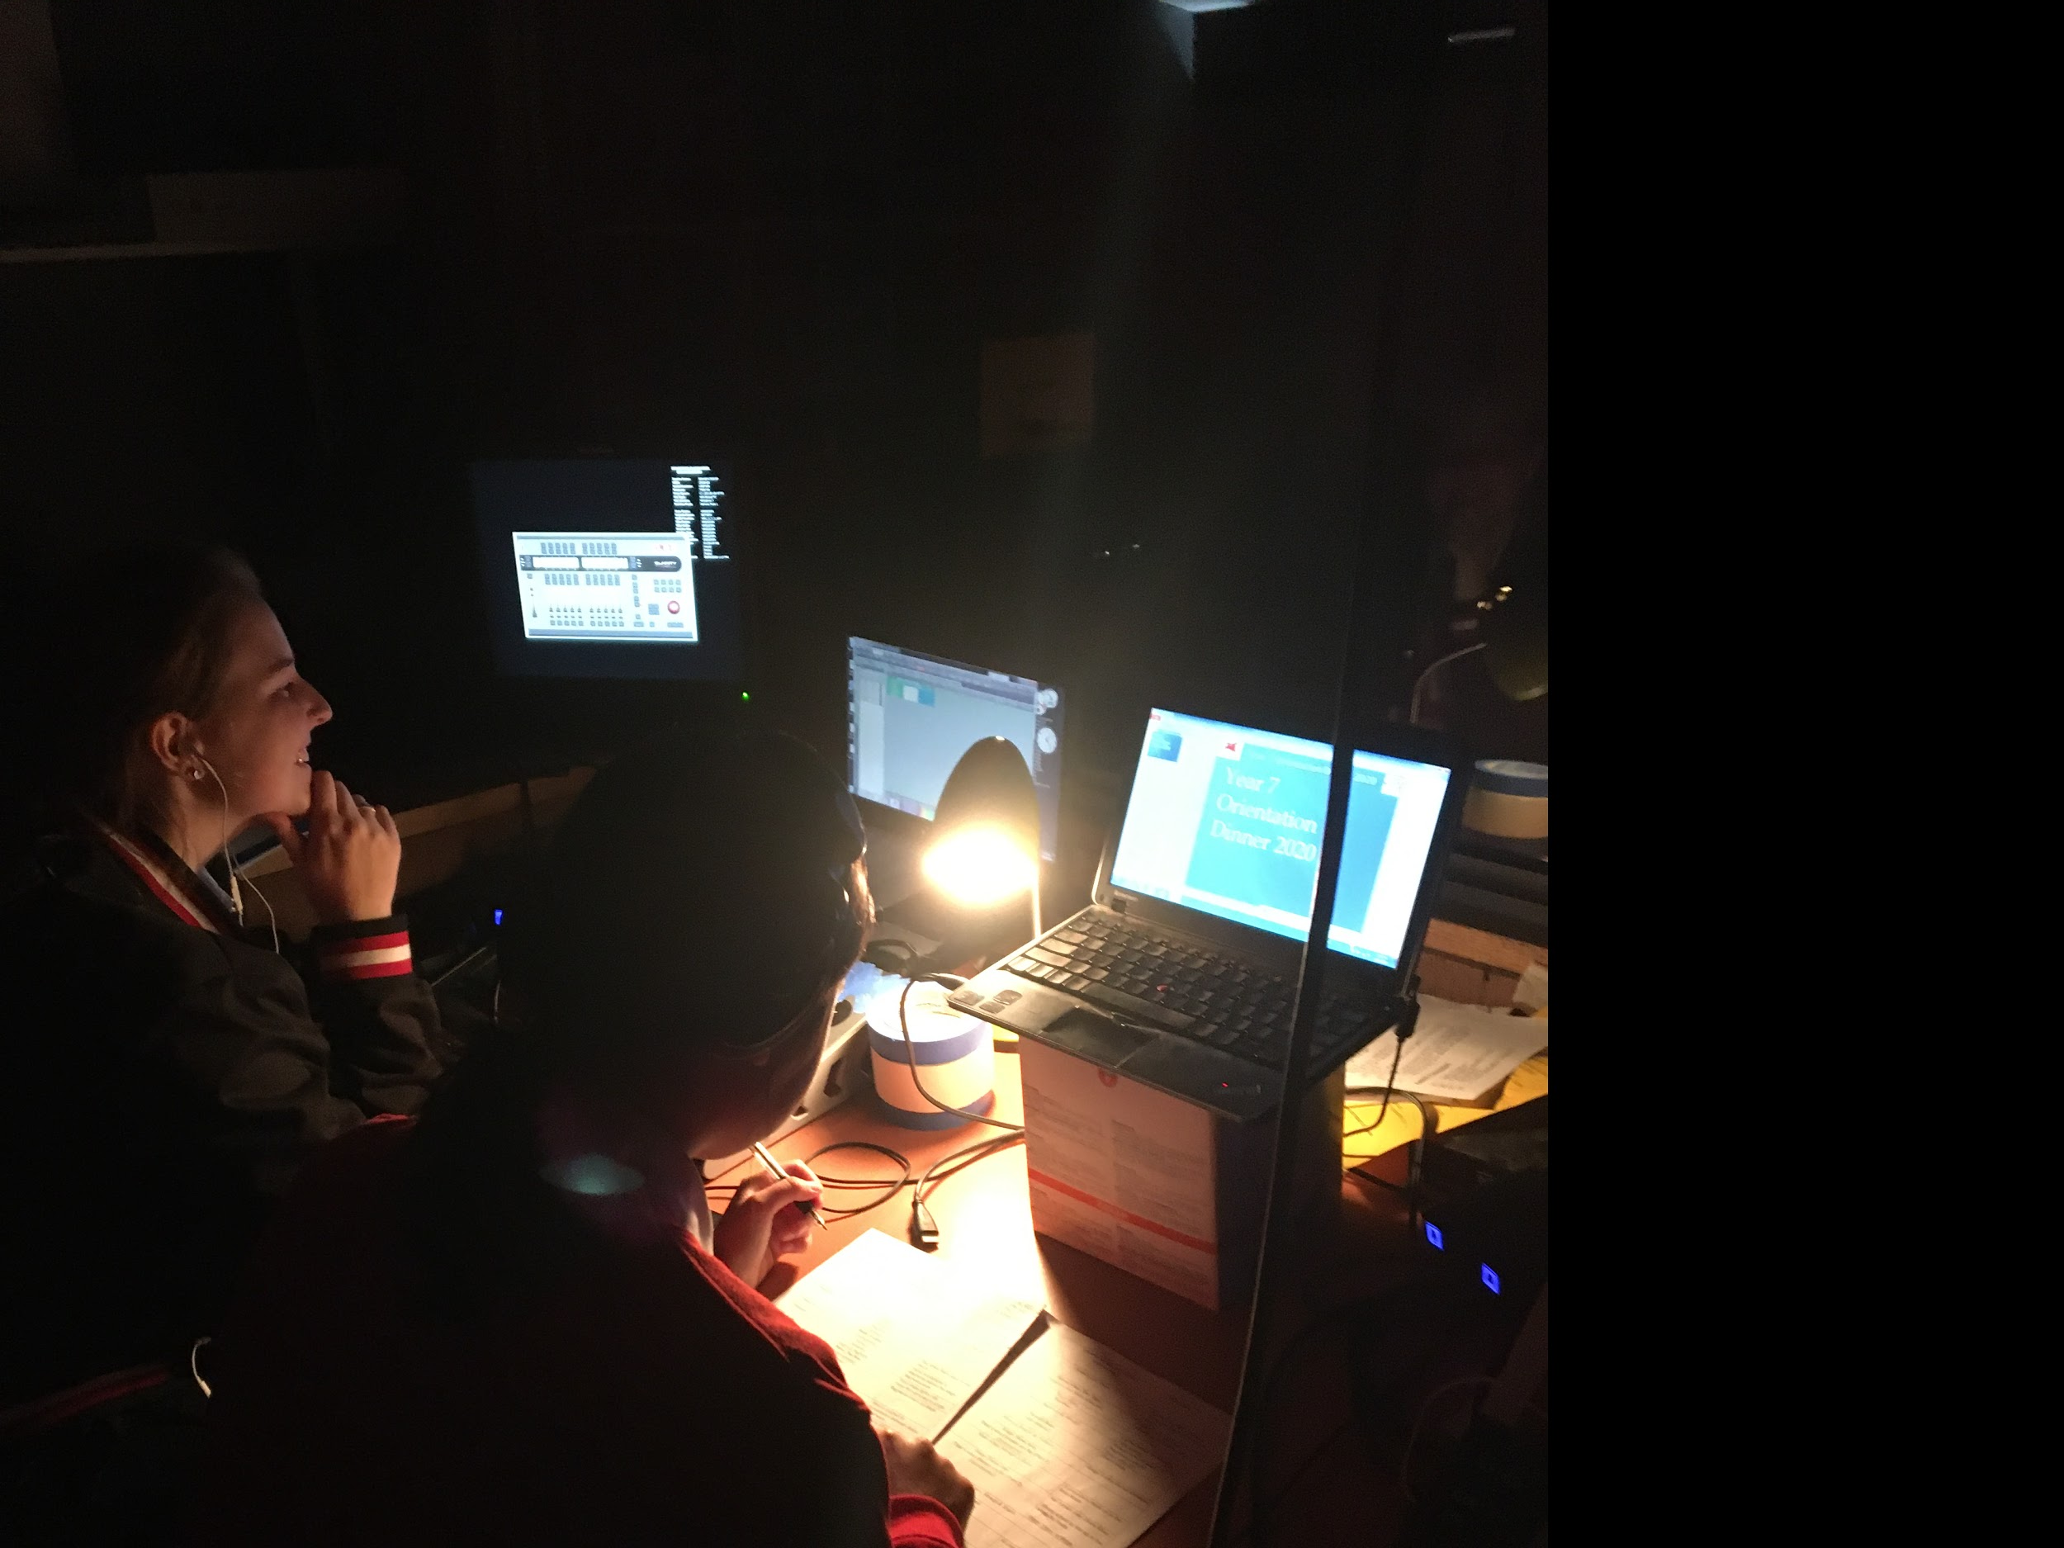
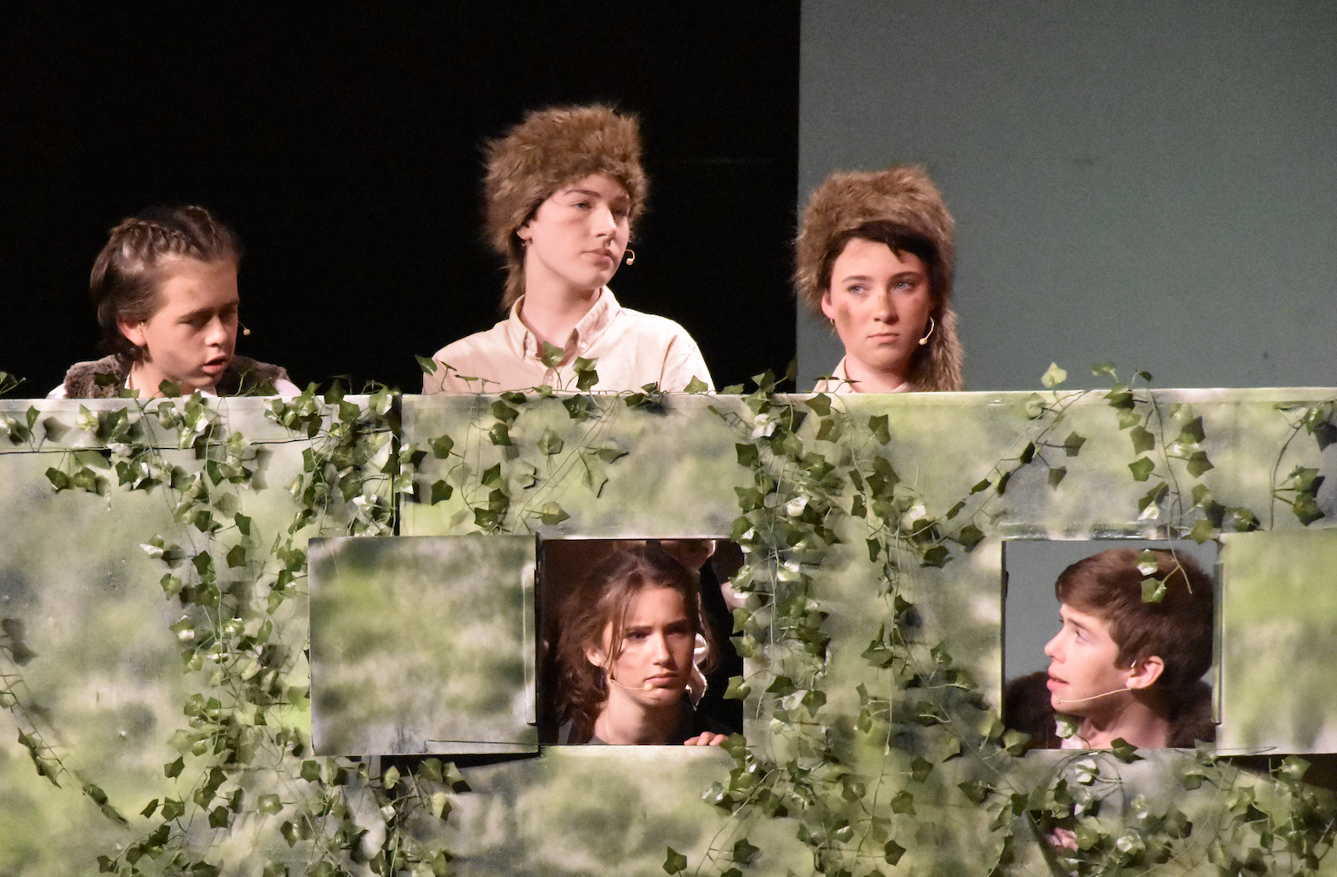
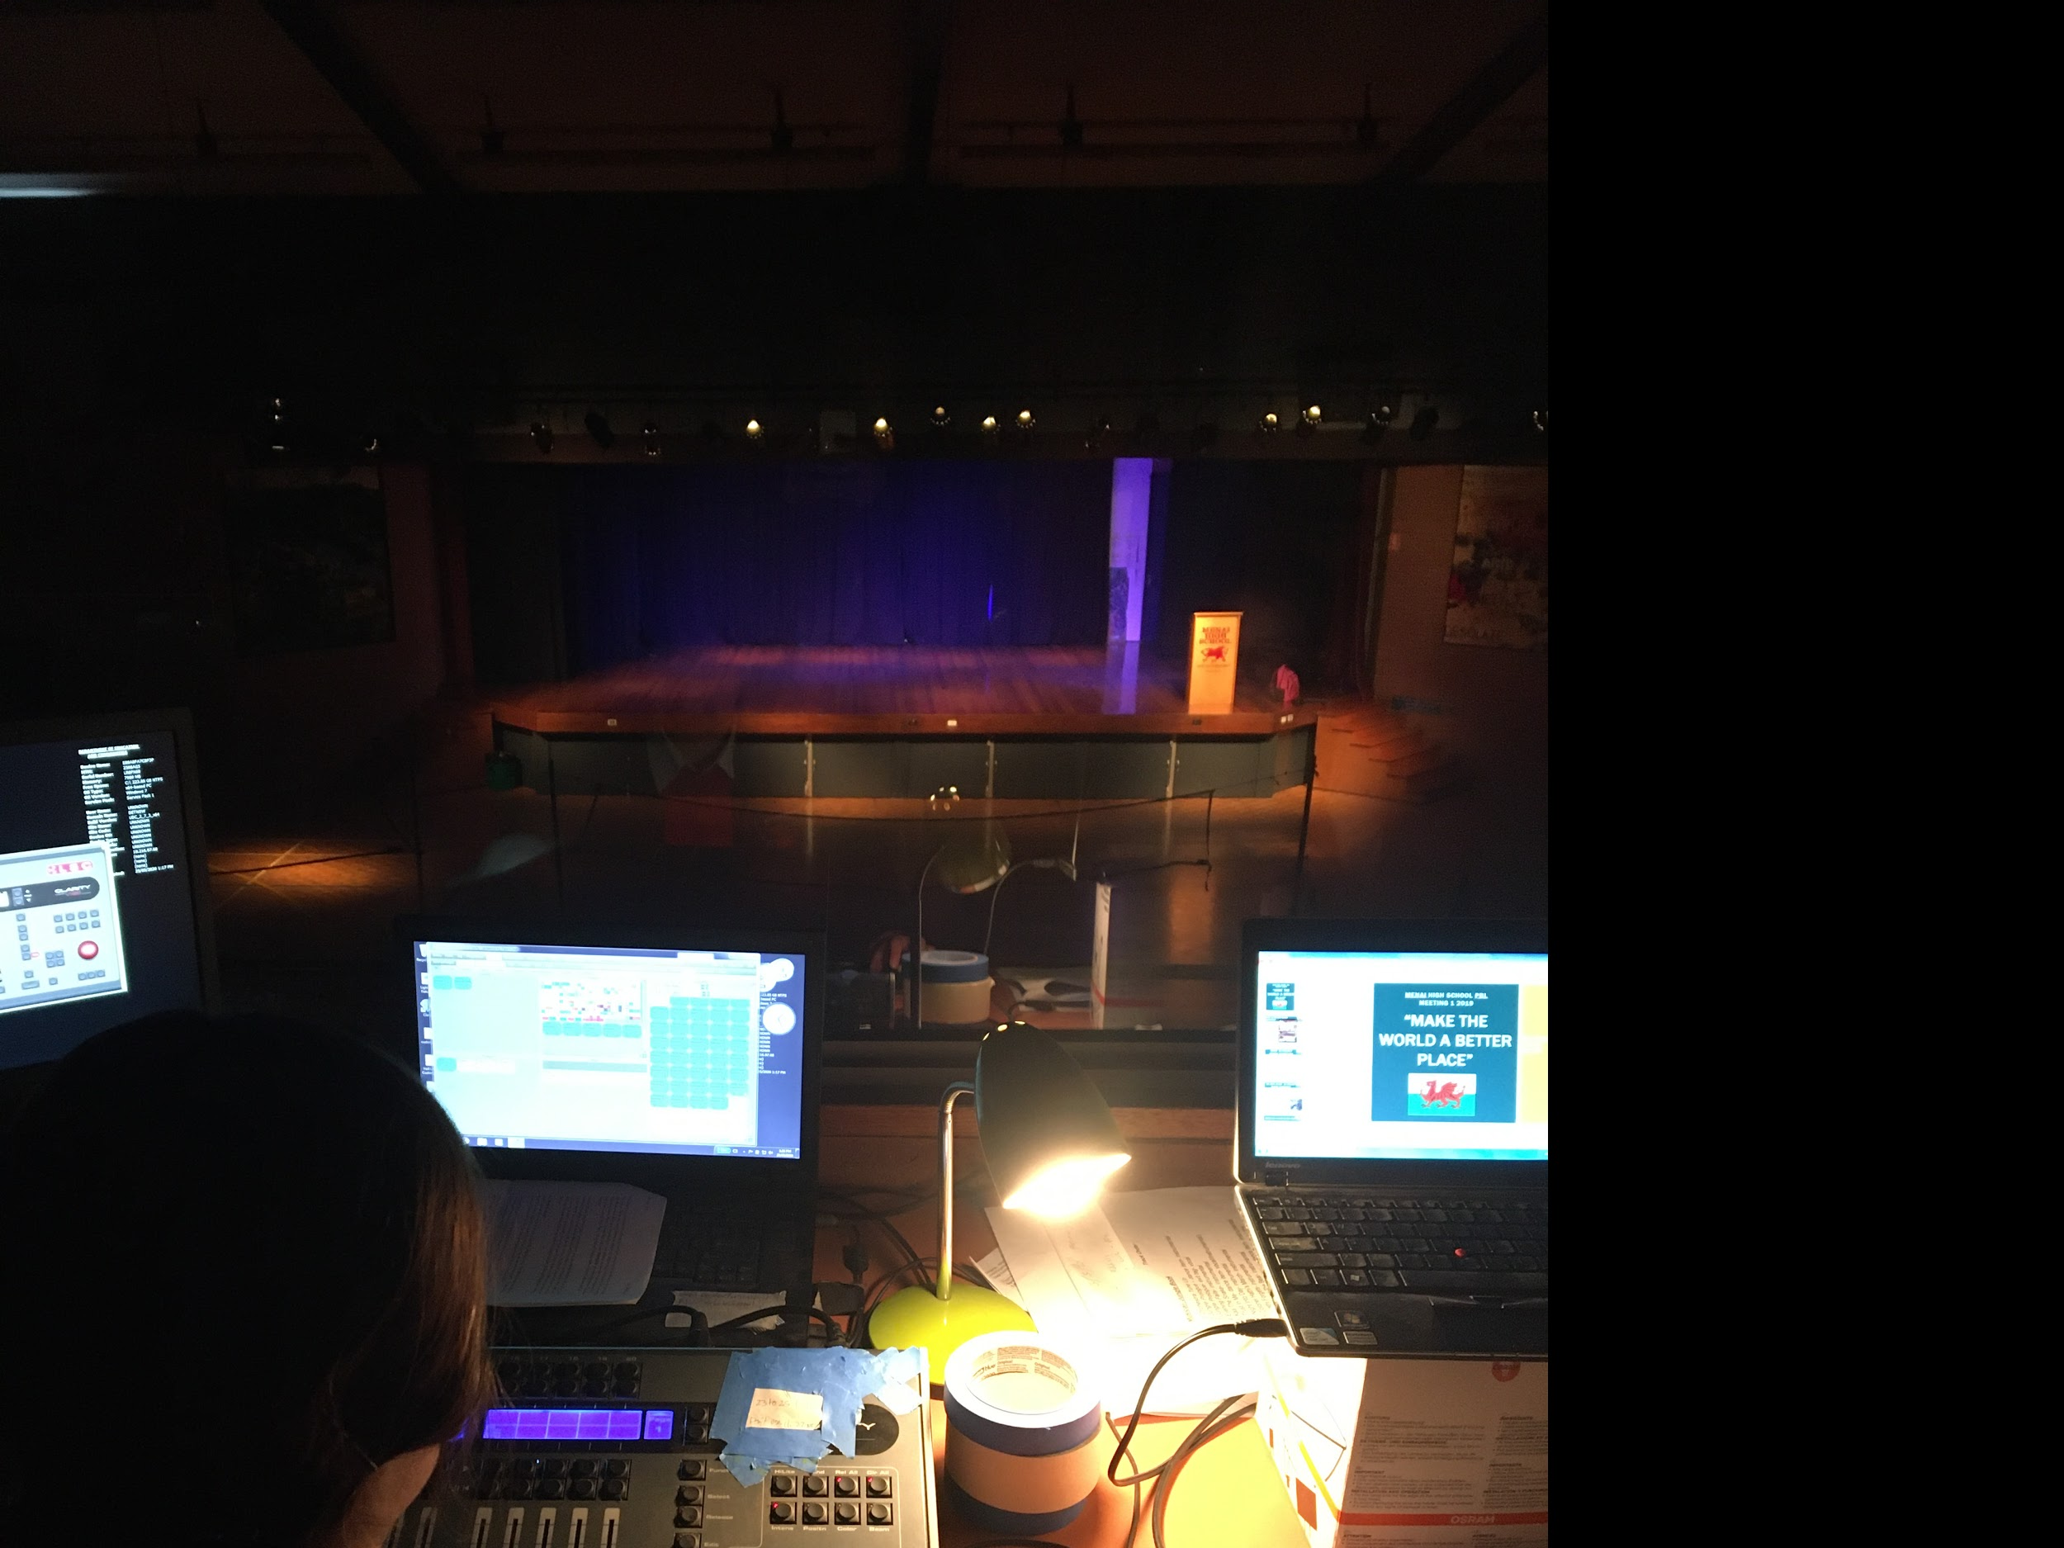
School Musical and Play
Annual School play or School Musical

Slide 8
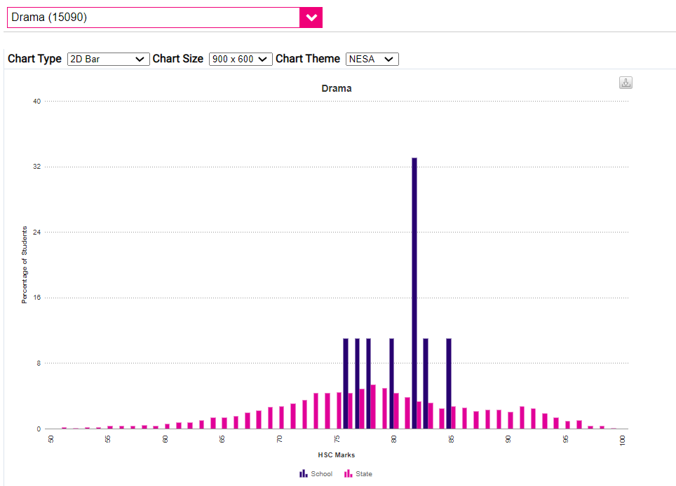
Drama
HSC Results
Menai is BLUE
The rest of the state is PINK

Slide 9
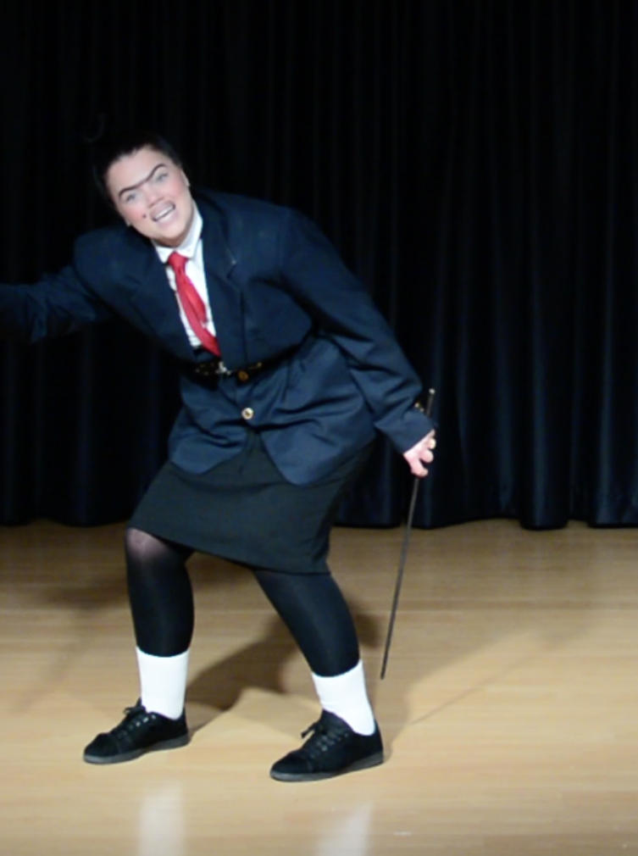
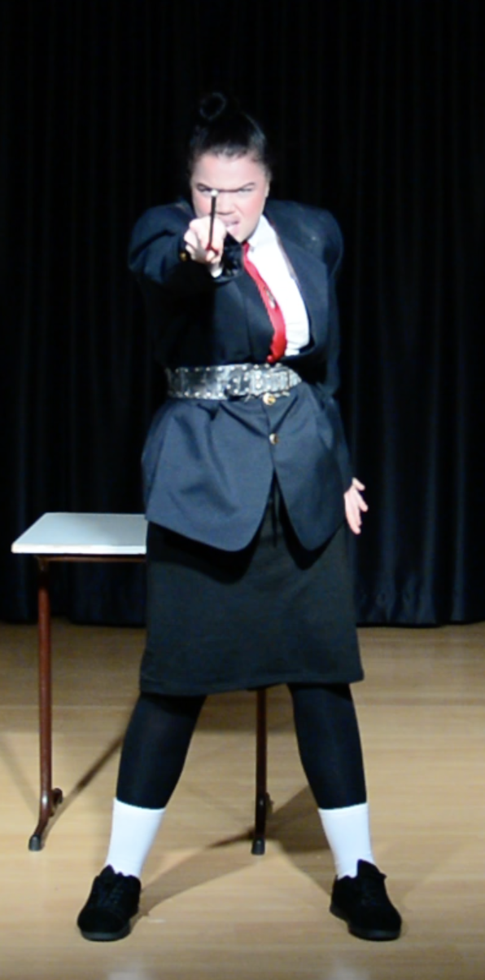
OnStage Nomination
Georgie Winchester
Class of 2020 HSC Drama

