Slide 1
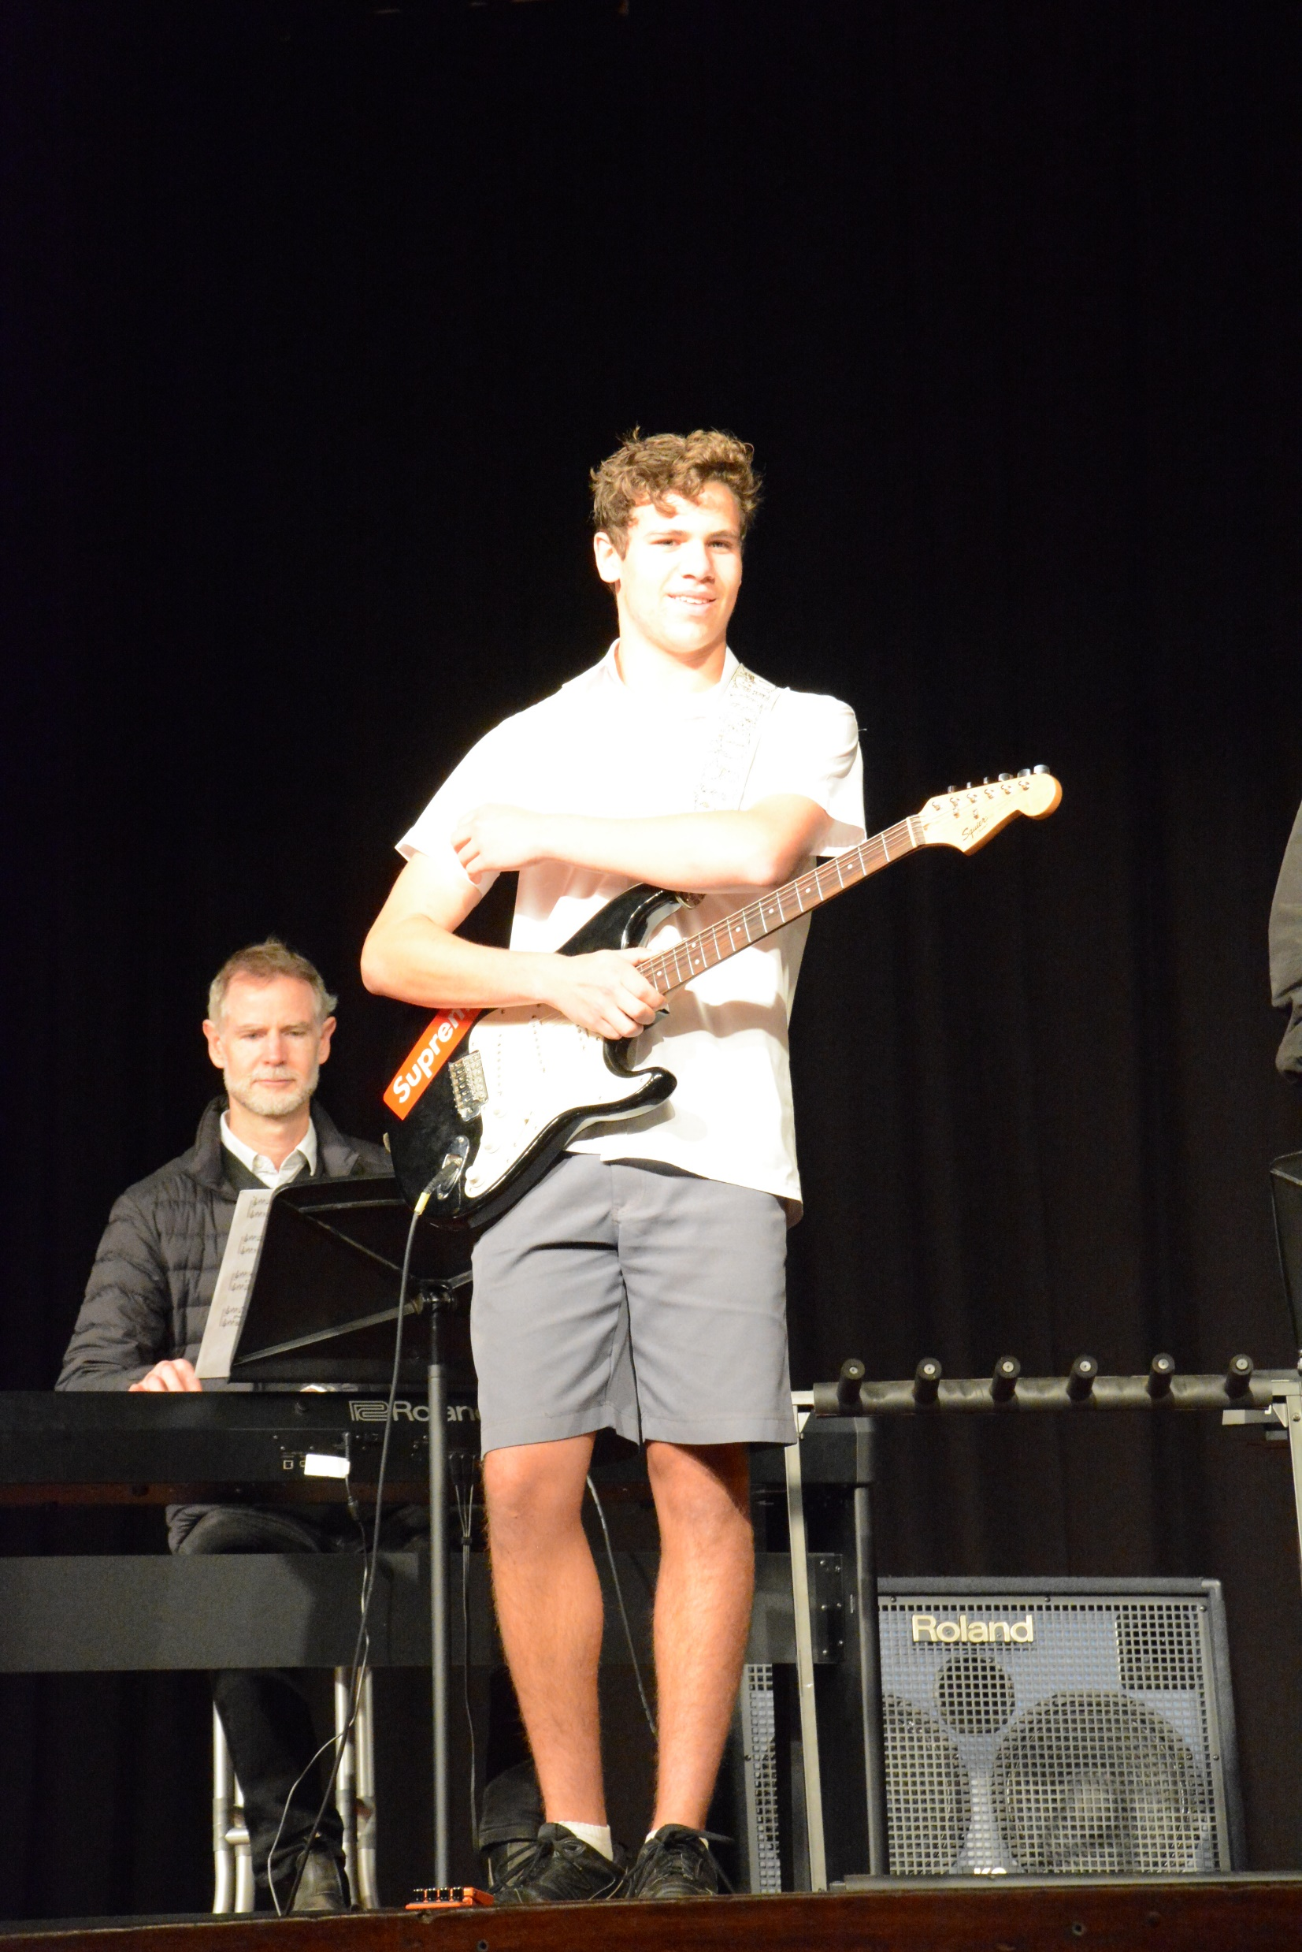
MUSIC ELECTIVE
YEAR 9-10
STAGE 5

Slide 2
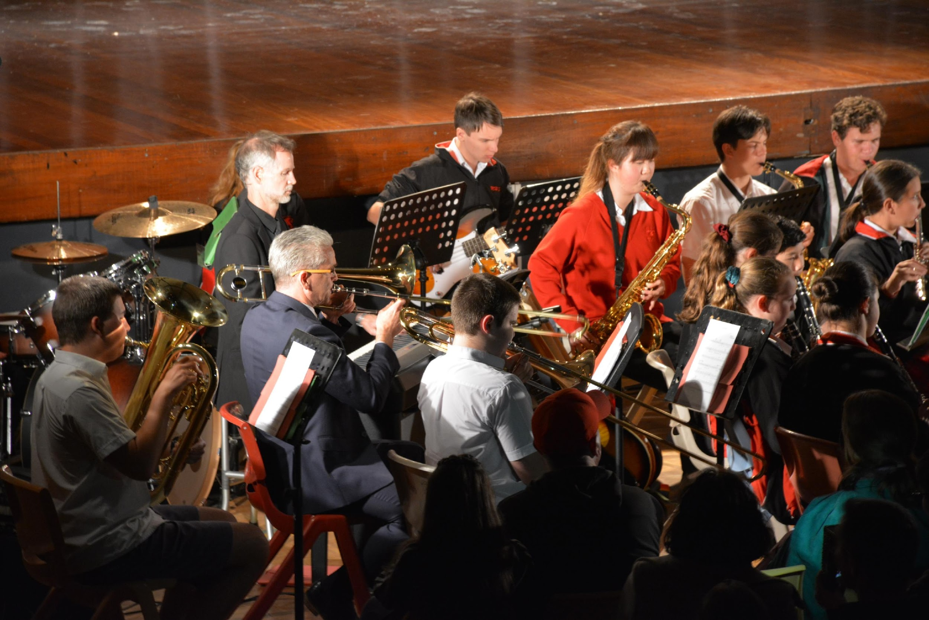
MUSIC
You may specialise in a particular instrument / voice - some students play more than one.
Private instrument tuition outside of school is helpful but not compulsory.
Learn to compose music in different styles
Learn to analyse music aurally through the musical concepts - pitch, duration, texture, tone colour, dynamics and expressive techniques and structure

Slide 3
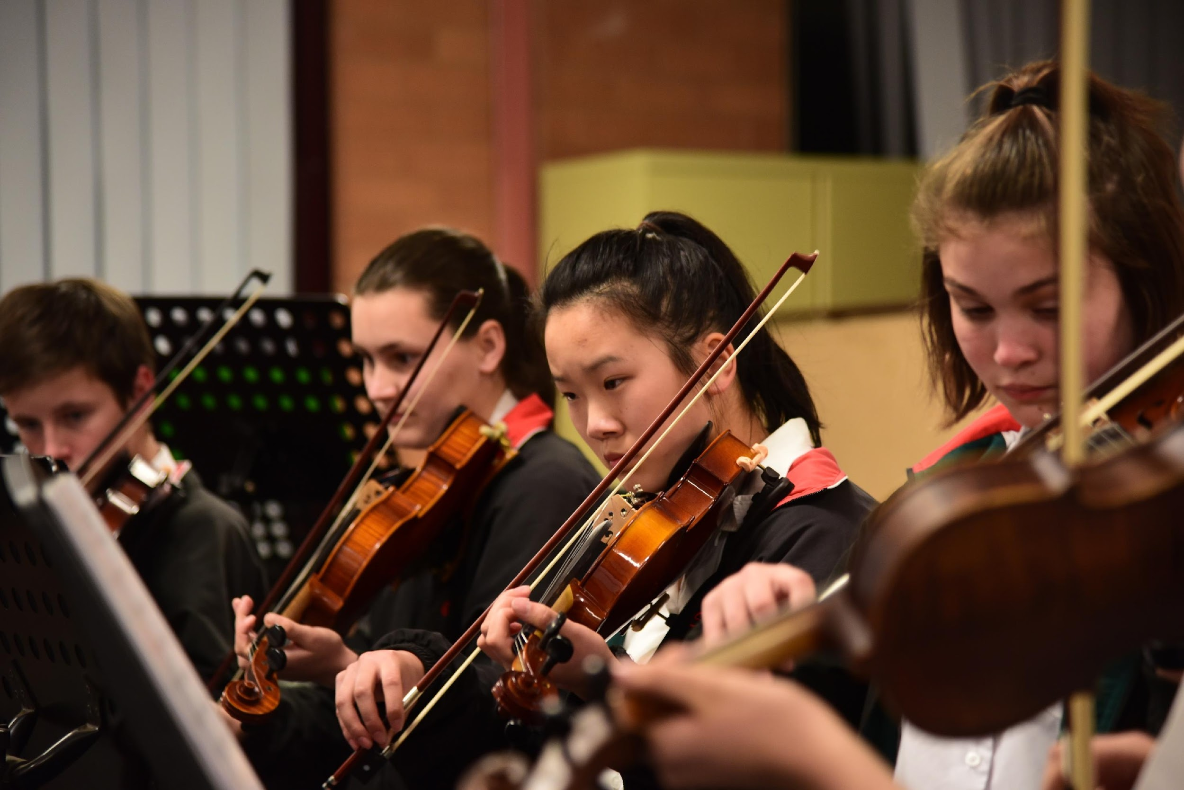
Objectives of Music Elective Course
The aim of the course is to build your knowledge, understanding and skills in music through:
Performing
Composing
Listening
Understanding and experiencing different musical styles
Value and appreciate music by engaging in all of these

Slide 4
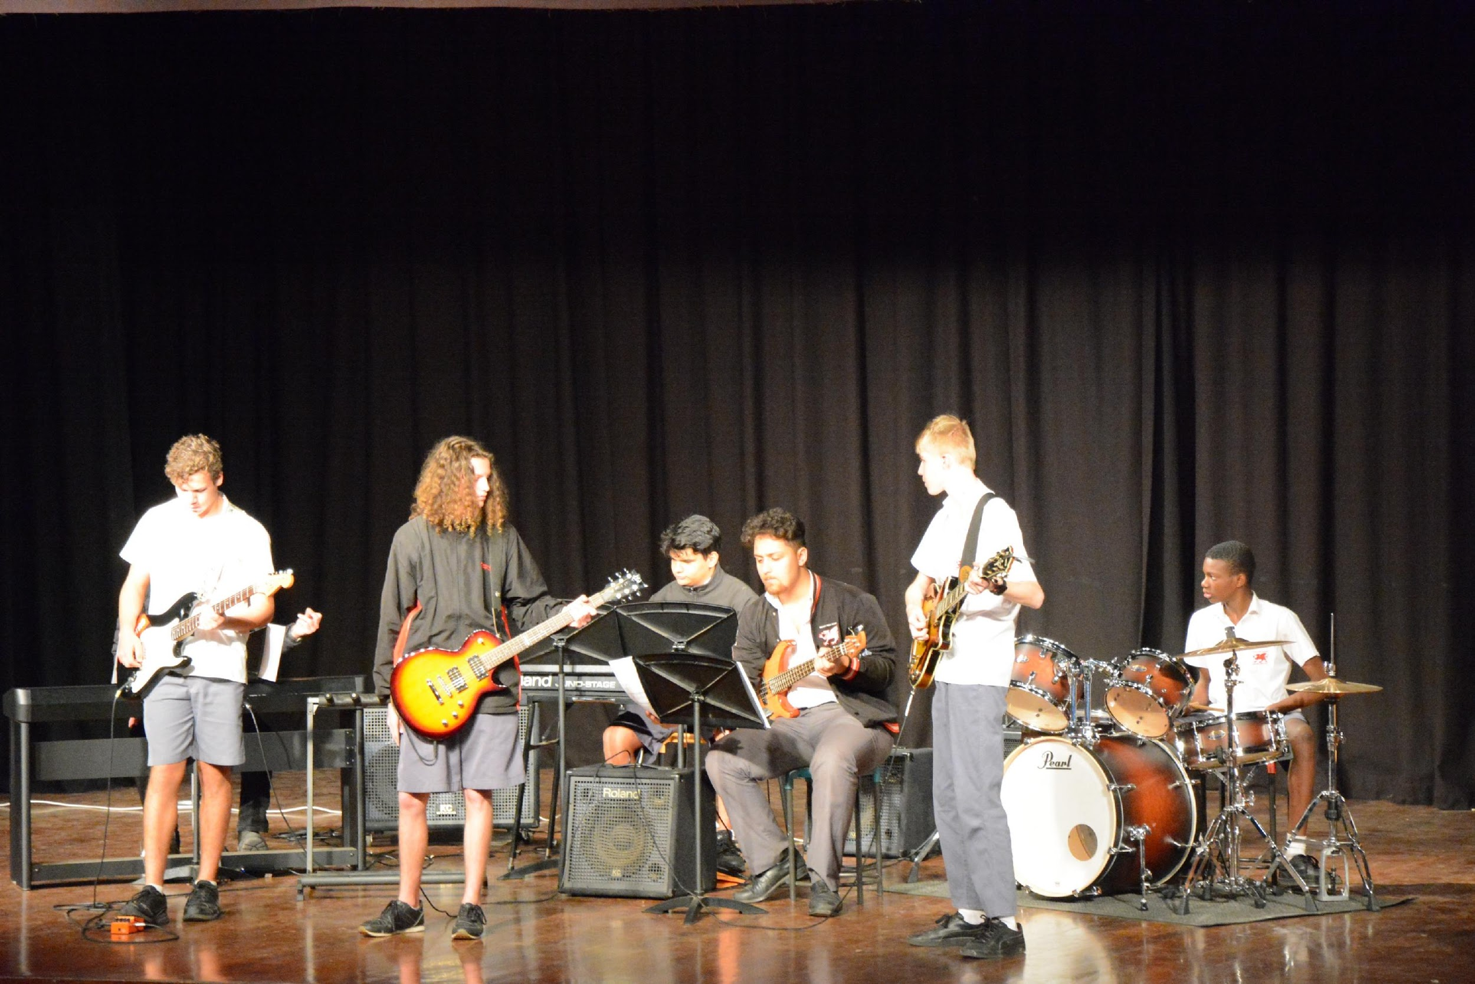
TOPICS & ELECTIVES
YEAR 9:
Introductory Unit- Popular Music
Classical Music
Film Music
YEAR 10:
Jazz and Blues
Own Choice Elective
Baroque Music

Slide 5
ASSESSMENT SCHEDULE
YEAR 9 Course |  | YEAR 10 Course
Performance 1 | 10% | Performance 1 | 10%
Composition 1 | 10% | Composition 1 | 10%
Half Yearly Examination | 20% | Half Yearly Examination | 20%
Performance 2 | 15% | Performance 2 | 15%
Composition 2 | 15% | Composition 2 | 15%
Yearly Examination | 30% | Yearly Examination | 30%

Slide 6
CAREERS
Music teacher
Music tutor
Music therapist
Sound/Recording Engineer
Performer
Accompanist
Repetiteur
Composer/arranger
Sound Technician
Musicologist
Piano Tuner
DJ
Conductor
Band Manager
Speech pathologist
Stage Manager

Slide 7
You don’t have to play a traditional Western style instrument.
A lot of students achieve excellent results playing a traditional instrument from their own or another culture.

Slide 8
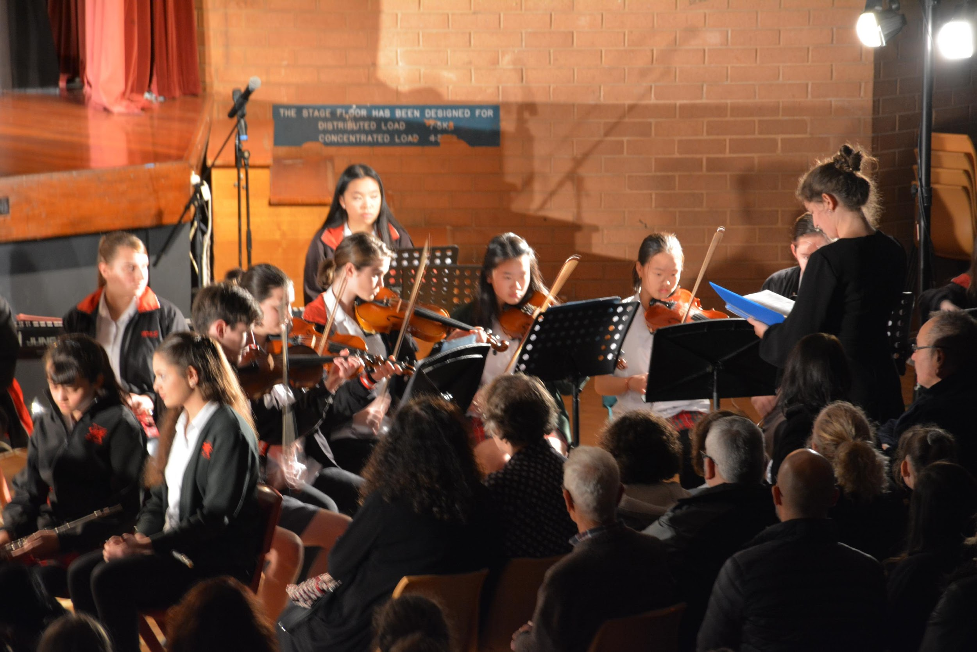
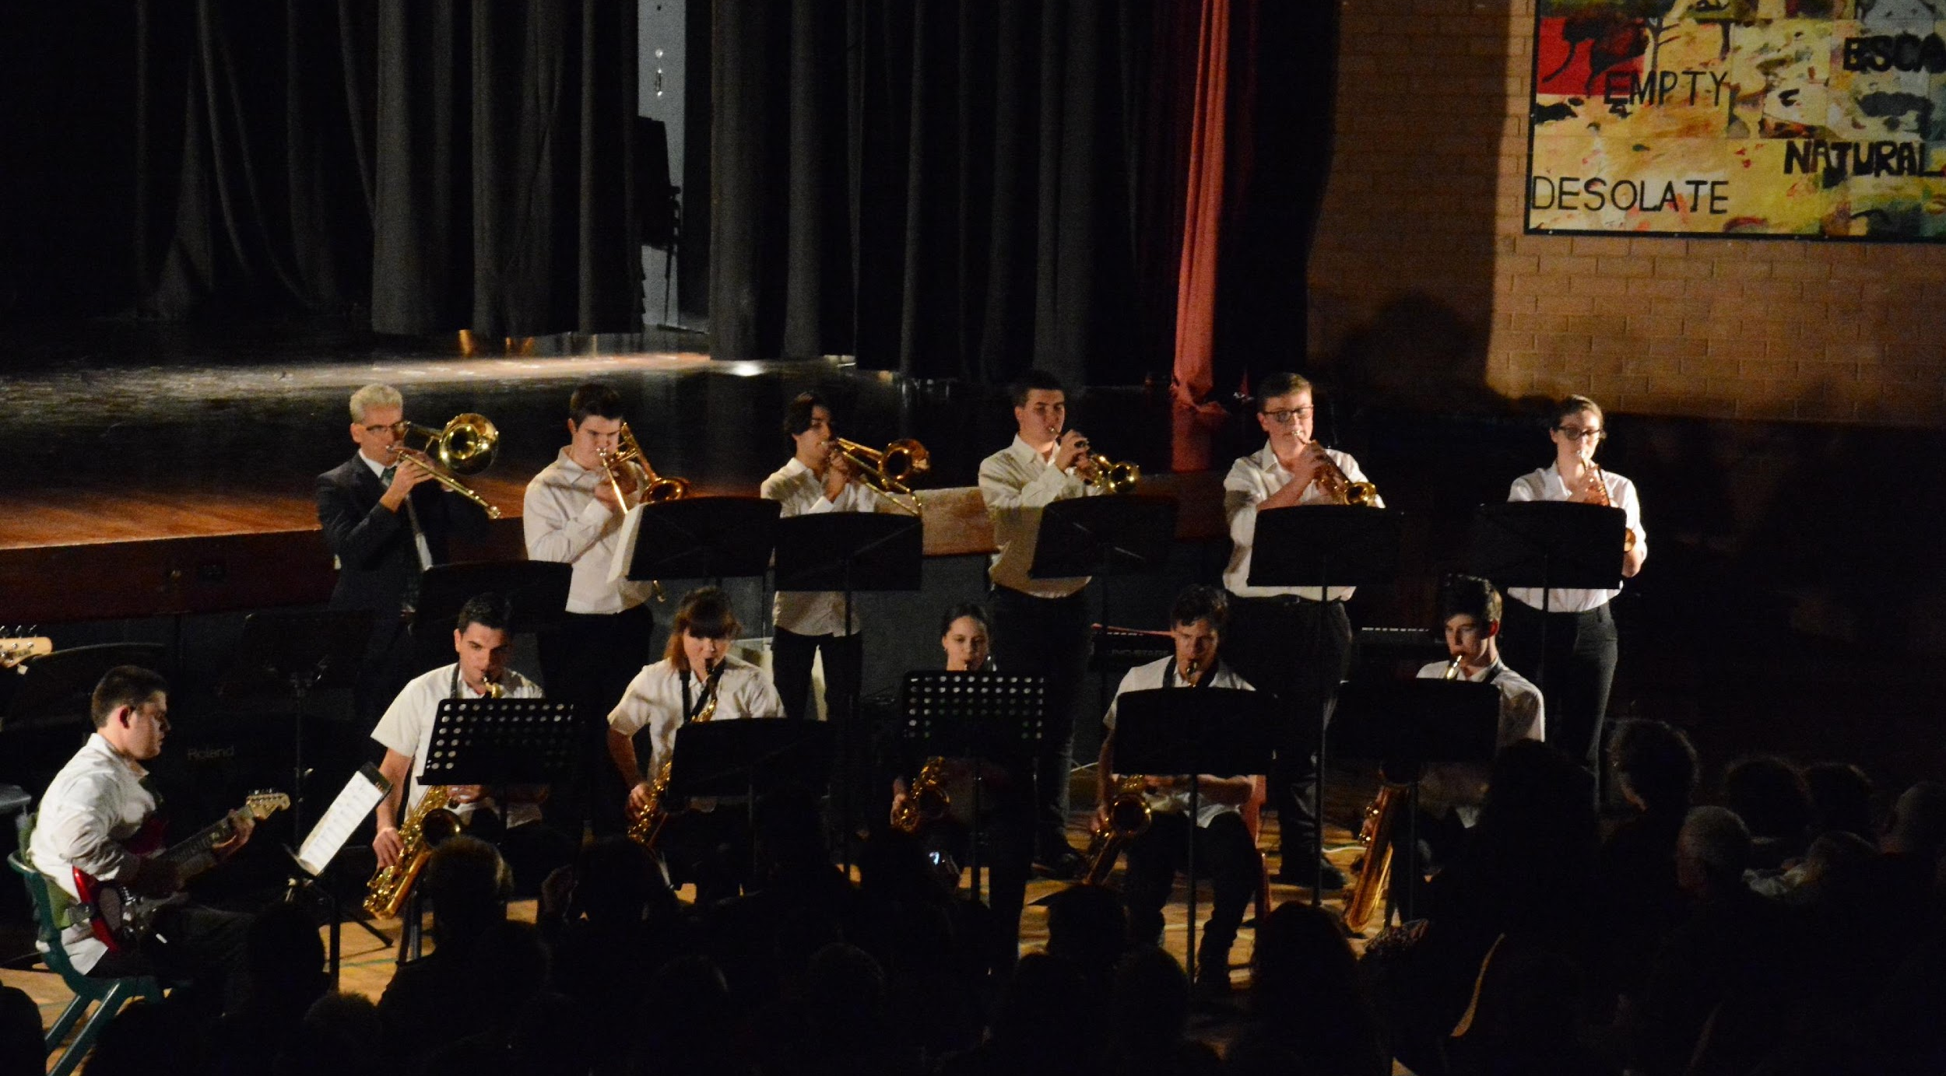
We would like you to be a part of our Ensembles
Concert Band
Vocal Ensemble
Stage Band
String Ensemble
Rock Band

