Slide 1
SUBJECT INFORMATION: YEAR 11 and 12 PDHPE AND SLR

Slide 2
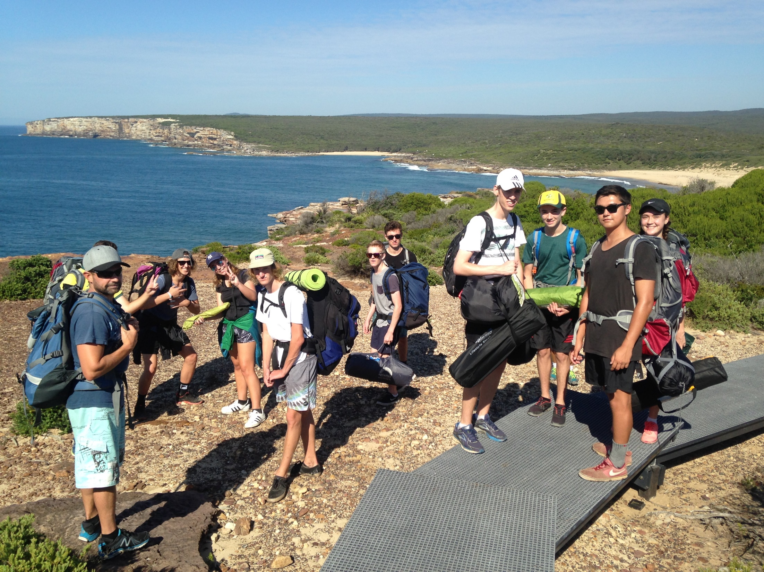
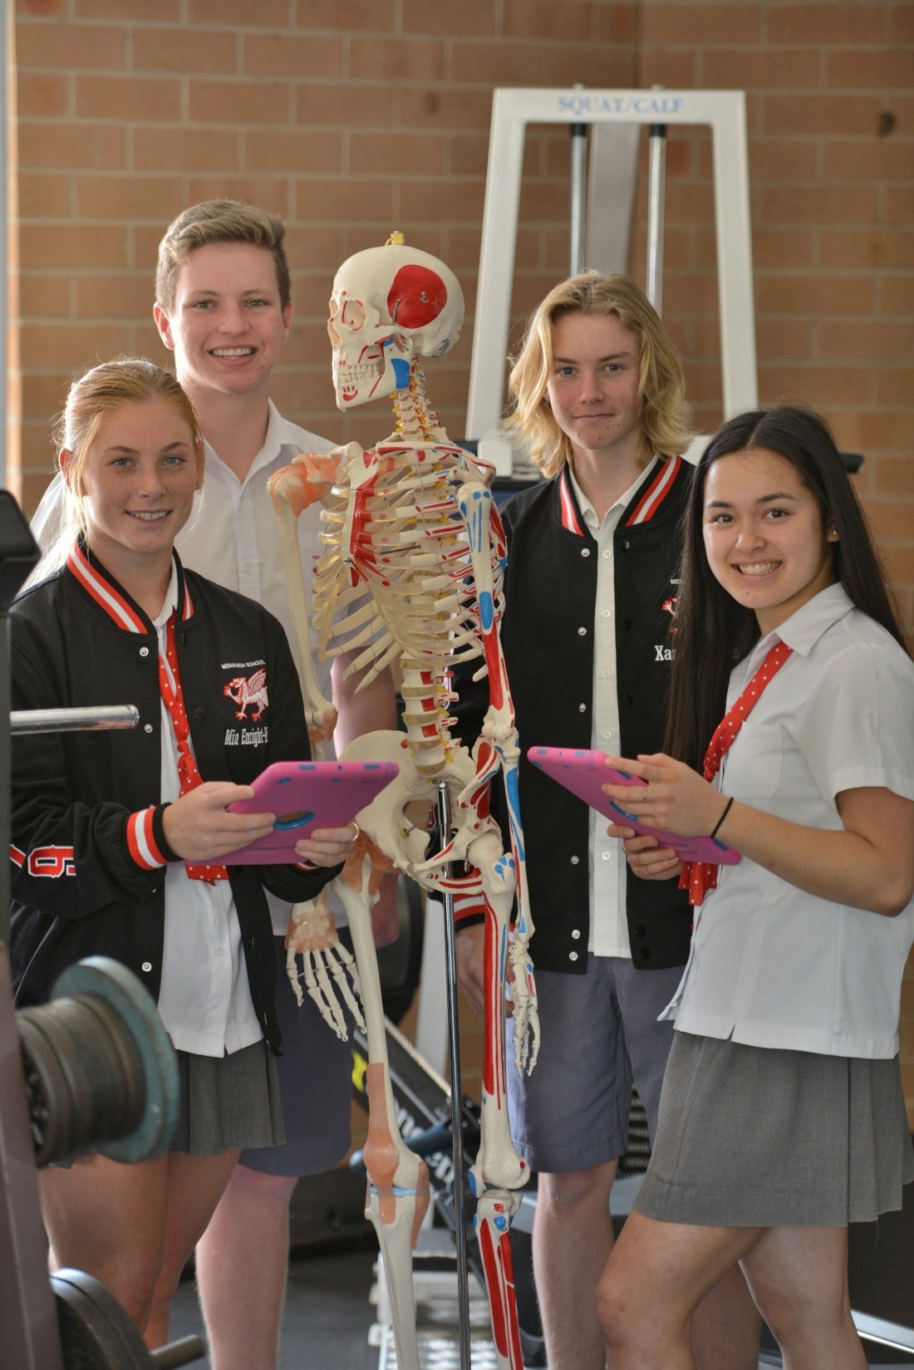
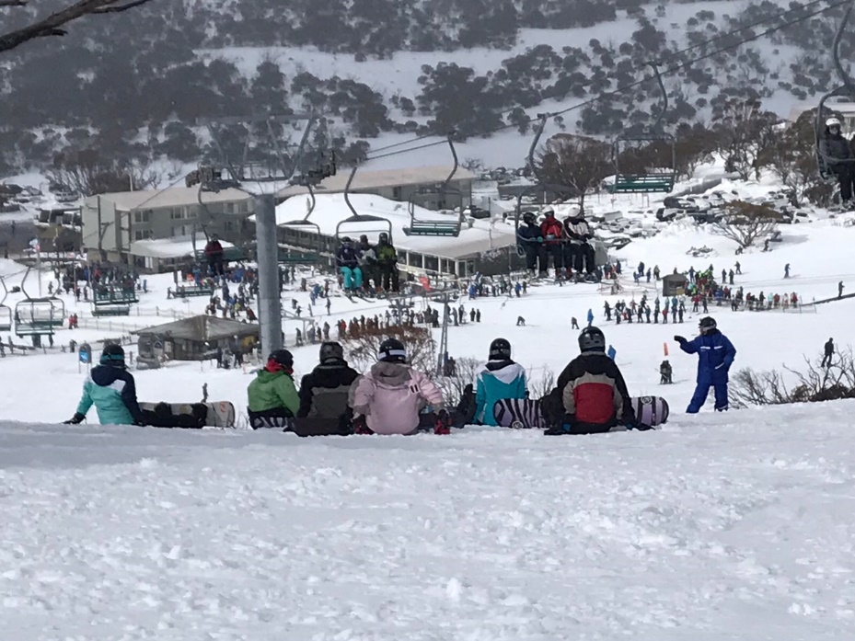
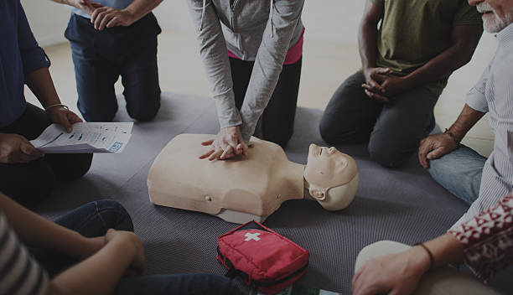
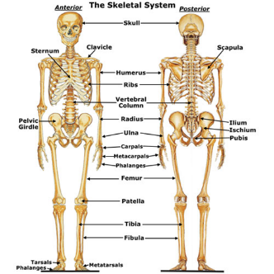
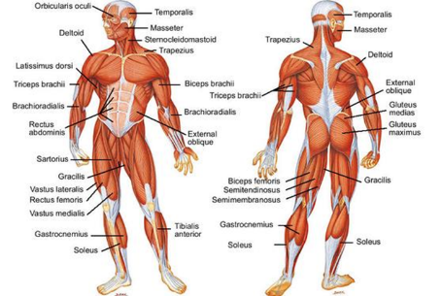
PDHPE in Years 11 and 12

Slide 3
Overview of Course

Slide 4
Some of the topics covered in Core 1 for PDHPE include:
Health Component
Meanings of health and the health behaviours of young people
The determinants of health
What is health promotion
The Ottawa Charter as an effective health promotion framework
Measuring health status, epidemiology
Groups experiencing health inequities
Health care in Australia

Slide 5
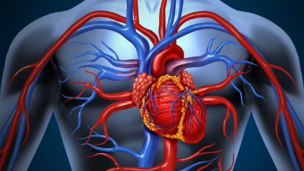
Some of the topics covered in Core 2 for PDHPE include:
Sports Science Component
Skeletal system, muscular system, respiratory system, circulatory system
Health-related and skill-related components of physical fitness
Sports physiology
Biomechanics
Energy systems
Types of training and training methods and principles of training
Psychological strategies to enhance motivation and manage anxiety
Sports nutrition
Stages of skill acquisition

Slide 6
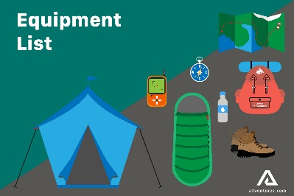
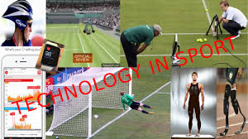
Some of the topics covered in the Options for PDHPE include:
First aid - assessment and management
Outdoor recreation – planning skills, optional excursions for overnight hike / ski trip
Sports Medicine – classifying, assessing and managing sports injuries, injury prevention and injury rehabilitation
Improving performance in athletes – training for improved performance, planning a training year, ethical considerations such as drugs in sport, technology in sport

Slide 7
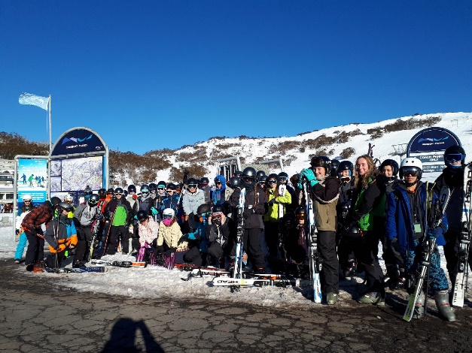
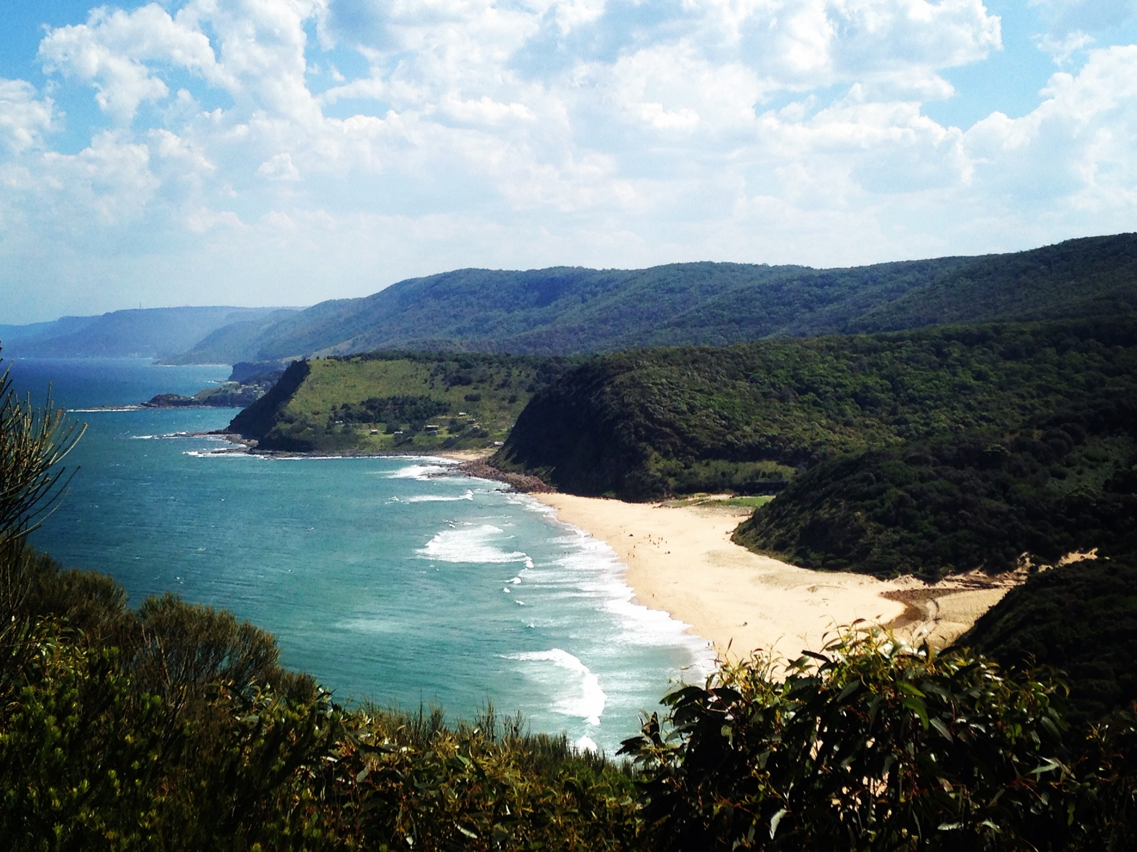
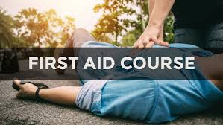
Additional Information:
THE 2 UNIT PDHPE COURSE IS A THEORY BASED COURSE AND COUNTS TOWARDS A STUDENT’S ATAR.
In 2020, 9 students received a Band 6 in PDHPE at MHS. Two students scored 96% in their HSC Exam.
Yr 11 PDHPE students are provided with the opportunity to: - participate in an overnight hike walking the Coastal Track - attend the three day ski trip - obtain their Royal Lifesaving First Aid Accreditation

Slide 8
Additional Information and Enquiries:
PDHPE Stage 6 Syllabus link:
https://educationstandards.nsw.edu.au/wps/portal/nesa/11-12/stage-6-learning-areas/pdhpe/pdhpe-syllabus
Other useful Websites:
https://www.pdhpe.net/pdhpe-net/preliminary-pdhpe/
For more information or questions, please feel free to contact Matt Robinson (Head Teacher) via email (matthew.robinson@det.nsw.edu.au)

Slide 9
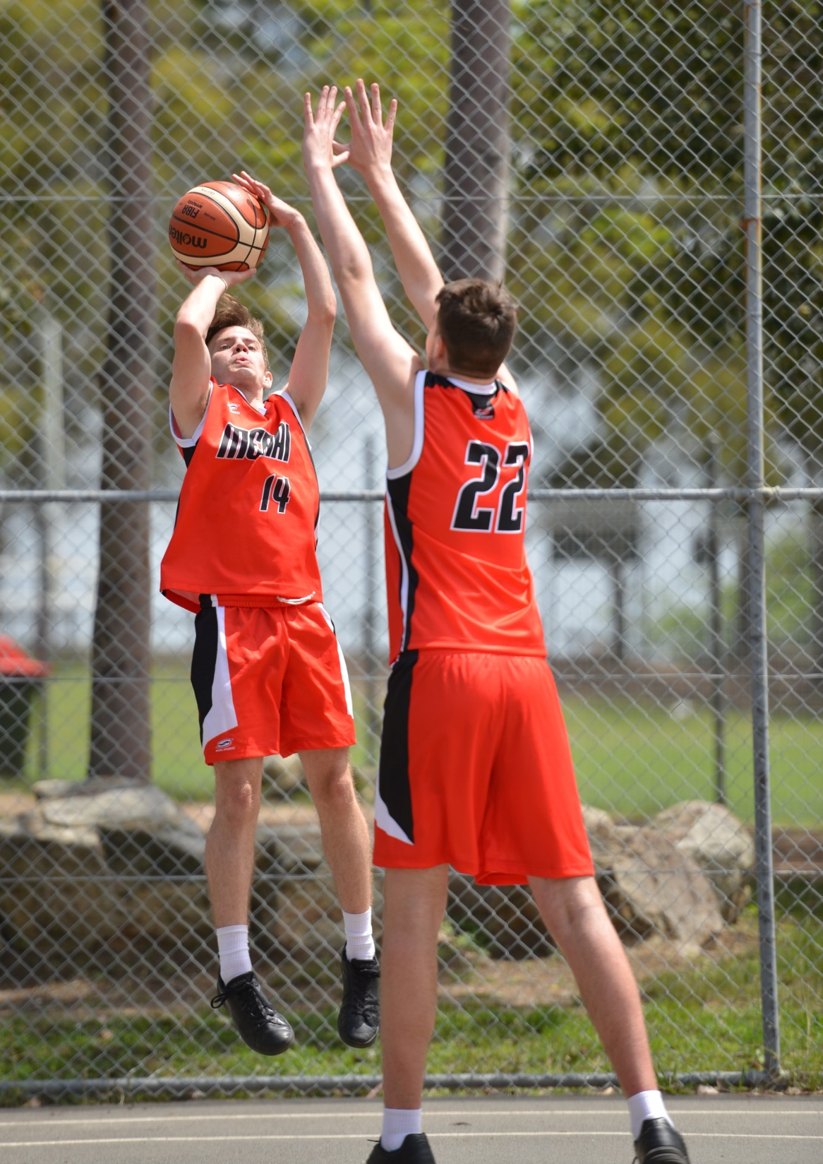
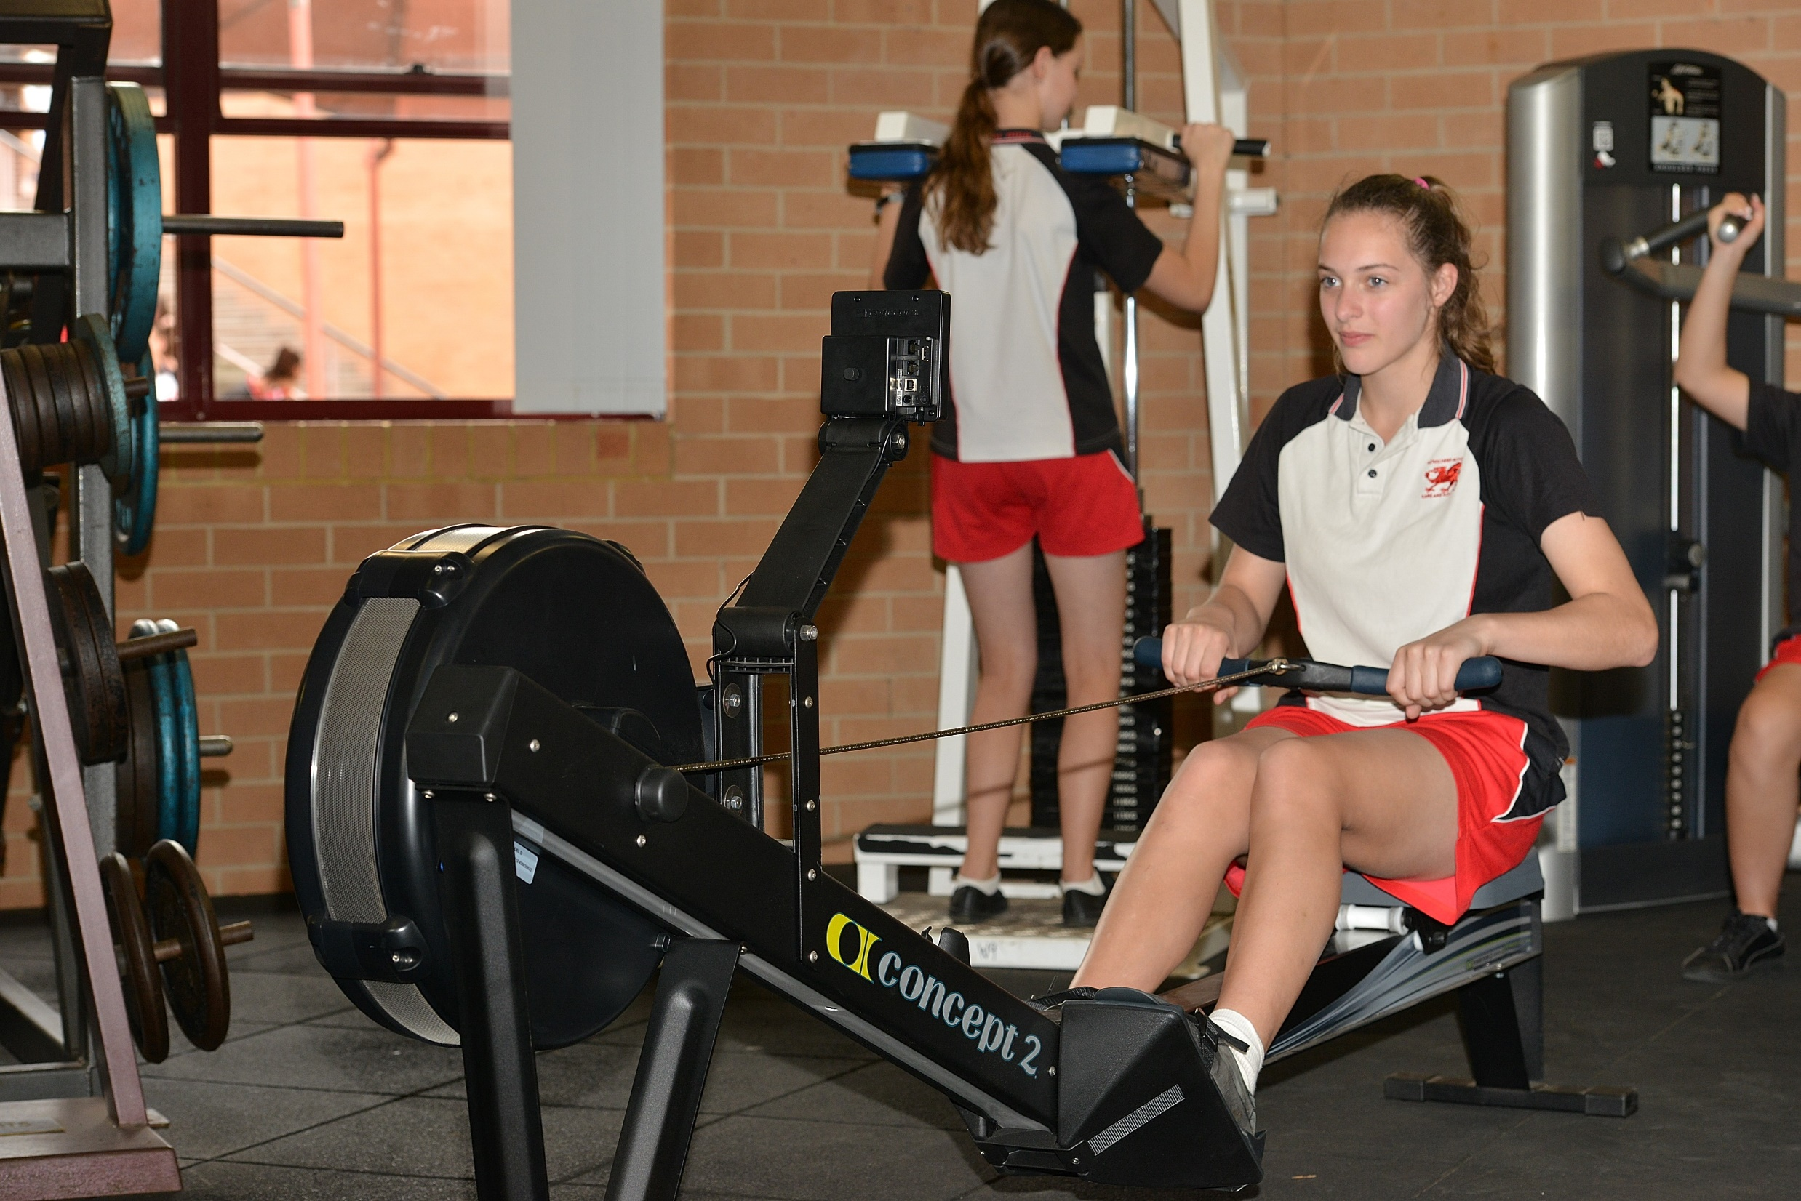
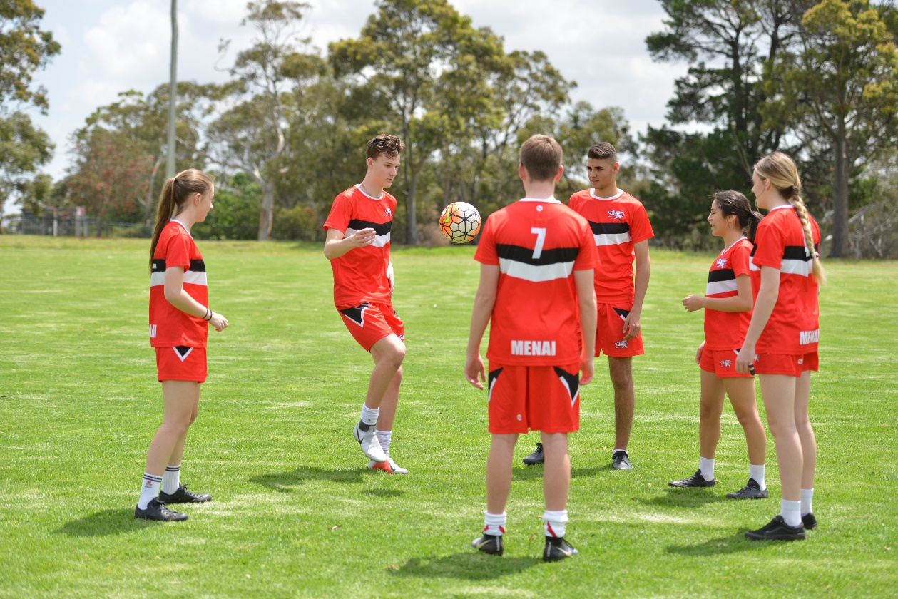
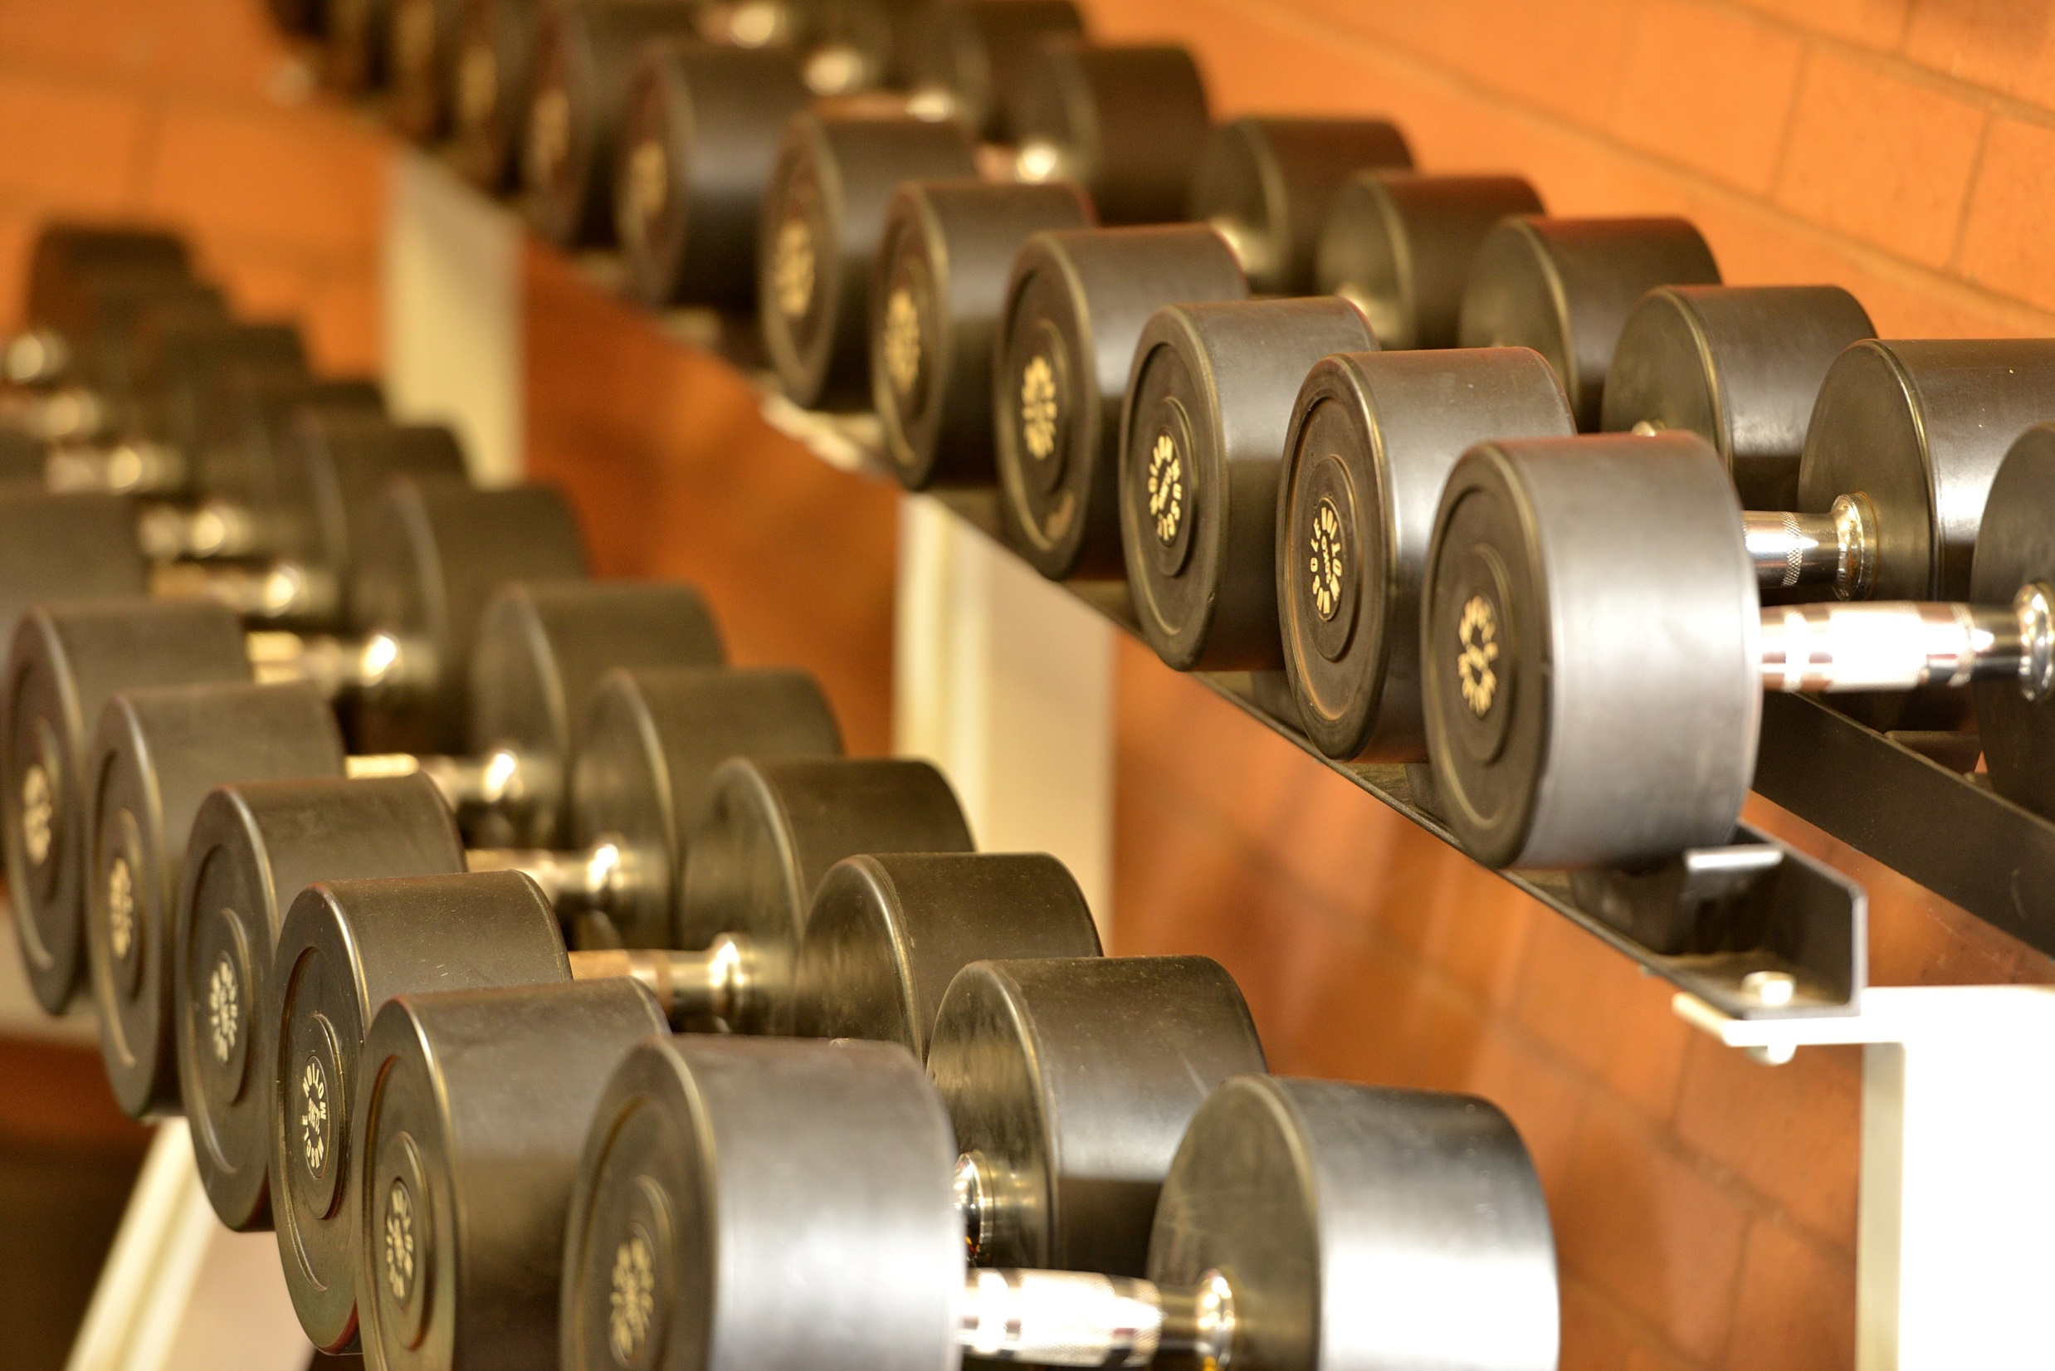
SLR – SPORT LIFESTYLE AND RECREATION IN YRS 11 AND 12

Slide 10
Overview
The SLR course at Menai HS caters for a wide range of student needs. It can assist students in developing:
the qualities of a discerning consumer and an intelligent critic of physical activity and sport
high levels of performance skill in particular sports
the capacity to adopt administrative roles in community sport and recreation
the skills of coach, trainer, first aid officer, referee and fitness leader. In the context of this course it may be possible for students to acquire recognised qualifications in these areas.
The course features a highly practical focus: physical activity being both an area of study and a medium for learning.

Slide 11
The modules in Sport, Lifestyle and Recreation studied at Menai HS are:
Aquatics
Athletics
First Aid and Sports Injuries
Fitness
Games and Sports Applications I
Games and Sports Applications II
Healthy Lifestyle
Individual Games and Sports Applications
Outdoor Recreation
Resistance Training
Sports Administration
Sports Coaching and Training

Slide 12
Additional Information and Enquiries:
The SLR course counts towards the Higher School Certificate and appears on the student's Record of Achievement.
However, the SLR course does not count in the calculation of the Australian Tertiary Admission Rank (ATAR).
The SLR course has a high volume of practical work and physical activity and requires students to have a MHS sports uniform for practical lessons.
The SLR course provides students with the opportunity to obtain their Royal Lifesaving First Aid Accreditation.
You can choose both PDHPE and SLR in Yr 11 and Yr 12
For more information or questions, please feel free to contact Matt Robinson (Head Teacher) via email (matthew.robinson@det.nsw.edu.au)

Slide 13
PDHPE / SLR in Yr 11, Yr12

